Slide 1
Digital Image Processing - Elementary Methods
Assignment: Image Enhancement Techniques using Python
Digital Image Processing Assignment - Elementary Methods
Student: ________________ ID: ________________ Date: ________________

Slide 2

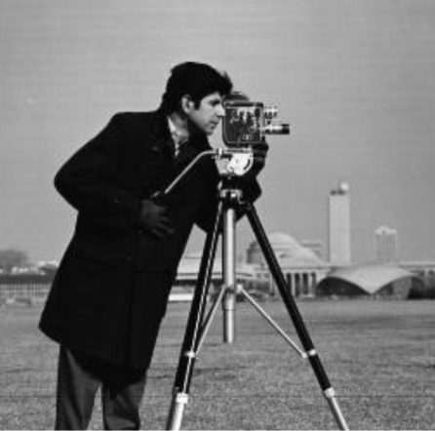
Slide 2 of 15: Introduction to Digital Image Processing
Digital image processing involves performing operations on an image to enhance it or extract useful information.
Key concepts include:
• Image acquisition and digitization
• Spatial domain processing (point, local, and global operations)
• Frequency domain processing using Fourier transforms
• Image enhancement, restoration, and compression
• Edge detection, segmentation, and feature extraction
This assignment covers seven fundamental transformation techniques that form the foundation of more advanced processing pipelines.
Color Flower image (626×936 pixels)
Grayscale Cameraman image (442×446 pixels)

Slide 3
Slide 3 of 15: Objectives and Tools Used
LEARNING OBJECTIVES:
1. Implement and analyze elementary image transformation techniques
2. Understand the mathematical foundations of each method
3. Compare effectiveness of different enhancement approaches
4. Handle both grayscale and RGB color images
TOOLS & TECHNOLOGIES:
• Python 3.x programming language
• NumPy for vectorized array operations
• Matplotlib for image visualization
• Pillow (PIL) for image I/O
• OpenCV (cv2) for color space conversions
METHODS IMPLEMENTED:
1. Image Negative • s = L - 1 - r (inverts pixel values)
2. Gamma Correction • s = c · (r/255)^γ (power-law transformation)
3. Logarithmic Transform • s = c · log(1 + r) (expands dark details)
4. Contrast Stretching • Linear mapping to full 0-255 range
5. Histogram Equalization • CDF-based intensity redistribution
6. Intensity Slicing • Isolate/highlight specific intensity ranges
7. Bit Plane Slicing • Decompose image into 8 bit planes (0-7)
Grayscale test image
RGB color test image

Slide 4
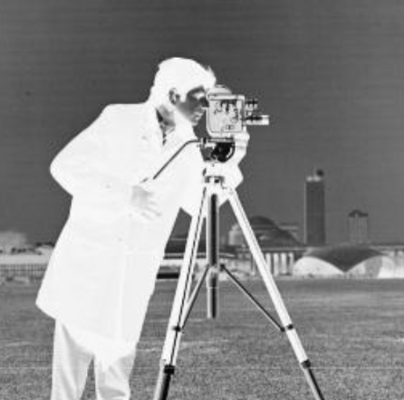
Slide 4 of 15: 4. Image Negative
Input Image
Output Image
Original grayscale Cameraman image with intensity values ranging from dark (0) to bright (255)
Negative transformed image where s = 255 - r - bright areas become dark and vice versa
Minimum (0) becomes maximum (255) and vice versa

Slide 5

Slide 5 of 15: 5. Gamma Encoding / Correction
Input Image
Output Image
RGB Flower test image with varying color channels
Gamma correction adjusts luminance per channel
γ = 0.5: Moderate brightening - expands dark details
Power-law transformation s = 255·(r/255)^γ
γ < 1 brightens, γ > 1 darkens
Tested values: 0.3, 0.5, 1.0, 2.0, 3.0

Slide 6
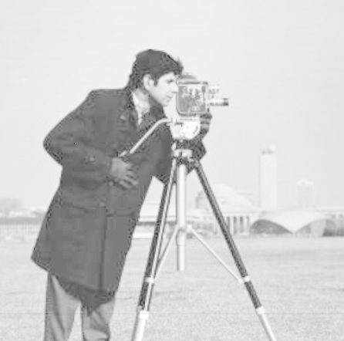
Slide 6 of 15: 6. Logarithmic Transformation
Input Image
Output Image
Grayscale Cameraman image before transformation
Intensity values distributed across the full range
Logarithmic transform s = c·log(1+r) expands dark regions and compresses bright regions
Enhances visibility of faint details
Mimics human visual response to light

Slide 7
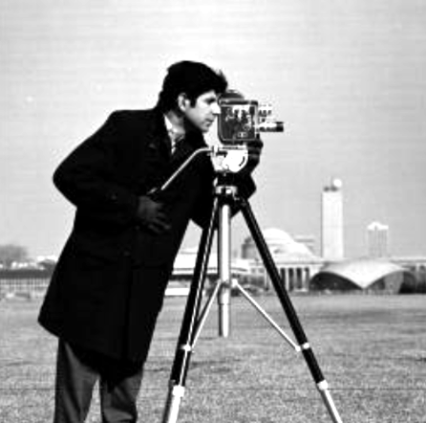
Slide 7 of 15: 7. Contrast Stretching
Input Image
Output Image
Original grayscale image with concentrated intensity histogram
Limited contrast in the original
Contrast stretched image mapping intensity range to full 0-255 range
Automatic percentile-based range (2nd-98th percentile)
Significant improvement in visual contrast

Slide 8
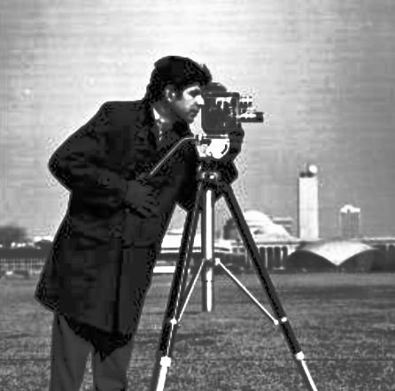
Slide 8 of 15: 8. Histogram Equalization
Input Image
Output Image
Original grayscale histogram concentrated in middle range
Low contrast due to narrow intensity distribution
Equalized histogram spread across full 0-255 range
CDF-based intensity redistribution
Significant contrast enhancement
May amplify noise if overdone

Slide 9
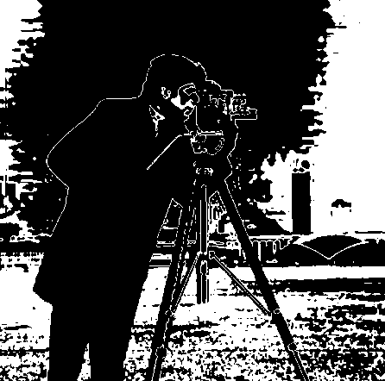
Slide 9 of 15: 9. Intensity Level Slicing
Input Image
Output Image
Original grayscale image
Looking to isolate specific intensity ranges
Highlight mode: Pixels in selected intensity range → 255 (bright), outside → 0 (dark)
width = 20 levels around median intensity
Useful for highlighting tumors, features in satellite imagery

Slide 10
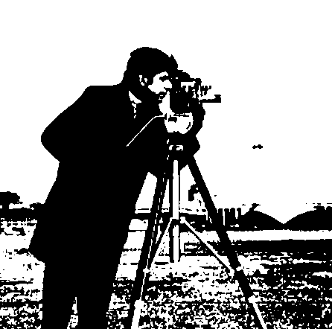
Slide 10 of 15: 10. Bit Plane Slicing
Input Image
Output Image
Grayscale image before decomposition
8-bit image with 256 possible intensity levels
Bit Plane 7 (MSB): Most significant bit - contains major structural information
Removing it produces heavily degraded image
Contains coarse features and overall shape of the image
3-4 MSB planes contain ~90% of image information

Slide 11
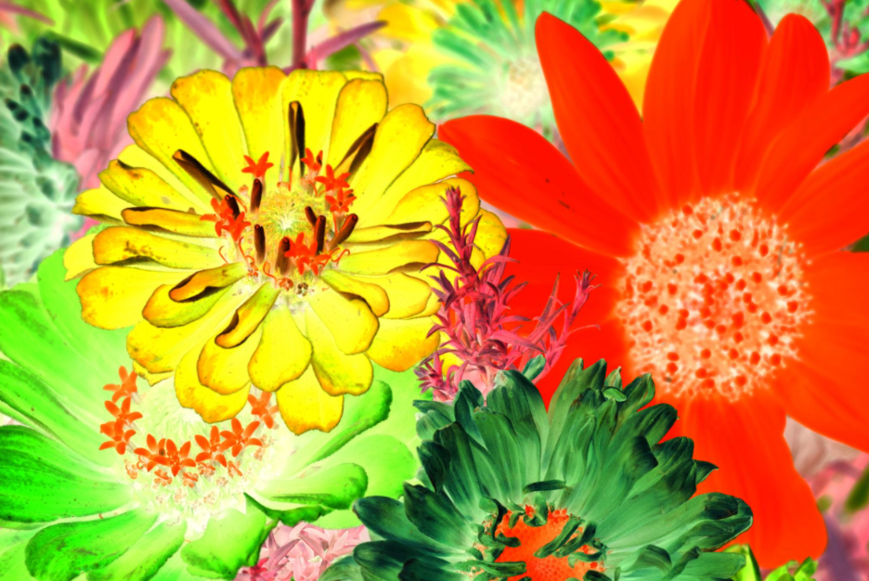
Slide 11 of 15: RGB vs Grayscale Comparison
Grayscale Processing
RGB Processing
Input: Original
Output: Negative (s = 255 - r)
Input: Original RGB
Output: Negative per channel

Slide 12
Slide 12 of 15: Results and Observations
OBSERVATIONS FROM IMPLEMENTATION RESULTS
IMAGE NEGATIVE:
• Successfully inverts pixel values for both grayscale and RGB
• Grayscale: Clean inversion, easy to interpret
• RGB: Each channel inverted independently
• Visual effect: Photo negative appearance
GAMMA CORRECTION:
• γ = 0.3: Strong brightening, very dark originals become bright
• γ = 0.5: Moderate brightening, dark details enhanced
• γ = 1.0: No change - confirms linear case
• γ = 2.0: Moderate darkening, highlights compressed
• γ = 3.0: Strong darkening, image becomes quite dark
• RGB results maintain color relationships
LOGARITHMIC TRANSFORMATION:
• Effectively expands dark details while compressing bright regions
• Grayscale: Clear enhancement of shadow areas
• RGB: Color preserved, shadow details improved
• Better at revealing faint details than gamma for very low-intensity images
CONTRAST STRETCHING:
• Automatic percentile-based range robust against outliers
• Utilizes full 0-255 dynamic range
• Both grayscale and RGB show noticeable improvement
• Particularly effective for images with narrow intensity distributions
HISTOGRAM EQUALIZATION:
• Dramatically spreads histogram for both grayscale and RGB
• Grayscale: Clear contrast enhancement
• RGB: Color preserved via HSV V-channel processing
• Can amplify noise - must be used judiciously
• Best results when original histogram is concentrated
INTENSITY SLICING:
• Highlight mode successfully isolates and brightens target range
• Darken mode keeps slice, darkens surroundings
• Parameter (width=20) controls range breadth
• Effective for feature highlighting when features have consistent intensity values
BIT PLANE SLICING:
• MSB (plane 7) contains major structural information - image recognizable
• LSB (plane 0) contains fine detail and noise - nearly invisible removal
• All 8 planes combined reconstruct the original image exactly
• Demonstrates information distribution across bit planes
• 3-4 MSB planes contain ~90% of visual information

Slide 13
Slide 13 of 15: Challenges Encountered
CHALLENGES DURING IMPLEMENTATION
1. RGB IMAGE PROCESSING:
- Ensuring consistent results across all three color channels
- For histogram equalization: converting between color spaces (RGB↔HSV/YCrCb) while preserving color fidelity
- Gamma correction and log transform applied per-channel vs. on luminance
2. NUMERICAL STABILITY:
- Logarithmic transformation: avoiding log(0) - required epsilon addition
- Normalization: ensuring proper scaling to 0-255 range without clipping
- Division by zero in contrast stretching when min == max
3. OUTPUT IMAGE QUALITY:
- Proper clipping and conversion to uint8 after each transformation
- Preventing overflow/underflow in arithmetic operations
- Maintaining image data type through chained operations
4. COMPARISON ACROSS IMAGE TYPES:
- Ensuring grayscale and RGB implementations produce valid results
- Handling different image sizes and channel structures
- Consistent saving/loading across different image formats
5. VISUAL REPRESENTATION:
- Selecting appropriate gamma values for demonstration
- Choosing effective intensity slicing range parameters
- Bit plane visualization: scaling binary values to 0-255 for visibility

Slide 14
Slide 14 of 15: Conclusion
CONCLUSION
This assignment implemented seven fundamental image enhancement techniques
using Python, NumPy, and Matplotlib. Key takeaways:
• The image negative is the simplest transformation - complete intensity
reversal with a single mathematical operation.
• Gamma correction provides intuitive control over image brightness and
contrast, with γ < 1 brightening and γ > 1 darkening.
• Logarithmic transformation is particularly effective for enhancing details
in low-intensity regions, mimicking human visual response.
• Contrast stretching with automatic percentile-based range selection
provides robust enhancement without manual parameter tuning.
• Histogram equalization redistributes pixel intensities for approximately
uniform histogram, significantly improving contrast but potentially
amplifying noise.
• Intensity level slicing isolates specific intensity ranges for highlighting
or darkening, useful for feature enhancement and segmentation.
• Bit plane slicing decomposes images into 8 bit planes, demonstrating
that 3-4 MSB planes contain ~90% of image information.
All methods properly handle both grayscale and RGB images, providing a
solid foundation for more advanced digital image processing techniques.

Slide 15
Slide 15 of 15: References
REFERENCES
1. Gonzalez, R. C., & Woods, R. E. (2008). Digital Image Processing (3rd ed.). Pearson. - Fundamental textbook covering all methods implemented.
2. Smith, S. W. (2007). The Scientist and Engineer's Guide to Digital Signal Processing. California Technical Publishing. - Image processing fundamentals.
3. Russ, J. C. (2011). The Image Processing Handbook (6th ed.). CRC Press. - Practical implementation techniques.
4. Pratt, W. K. (2007). Digital Image Processing (4th ed.). Wiley. - Mathematical foundations of image transformations.
5. Jain, A. K. (1989). Fundamentals of Digital Imaging (1st ed.). Prentice-Hall. - Classic reference on image processing methods.
6. Online Resources:
• OpenCV Documentation: https://docs.opencv.org/
• scikit-image: https://scikit-image.org/
• numpy documentation: https://numpy.org/doc/
COURSE INFORMATION:
Digital Image Processing - Elementary Methods Assignment
Python Implementation using: NumPy, Matplotlib, OpenCV, Pillow

