Slide 1
FAIRNESS IN CREDIT SCORING
Measuring and mitigating group disparities
German Credit benchmark • IBM AIF360 • 5-minute research summary
Good credit is favorable; women are the unprivileged group in this audit.

Slide 2
1 | Why audit this model?
Context • about 40 seconds
Credit access is consequential; historical data can encode structural inequality and proxy information.
Dataset: 1,000 historical German credit applications and 20 source features.
Outcome: class 1 = good credit (favorable); class 2 = bad credit.
Women (A92, A95) are unprivileged; men (A91, A93, A94) are privileged.
This is a method demonstration—not a current lending population or deployment-ready model.
German Credit fairness analysis • 2/6

Slide 3
2 | Design and mitigation
Methods • about 50 seconds
80/20 stratified split (seed 42); preprocessing fitted on training data only.
Median/mode imputation, scaled numeric data, one-hot categorical features.
Logistic regression evaluated at threshold 0.50; sex retained to expose direct and proxy-related disparities.
AIF360 Reweighing adjusts training-instance weights; same estimator and held-out test set.
AIF360 metrics: SPD, DI, EOD, AOD. Differences are women minus men; DI is women-to-men selection rate.
German Credit fairness analysis • 3/6

Slide 4
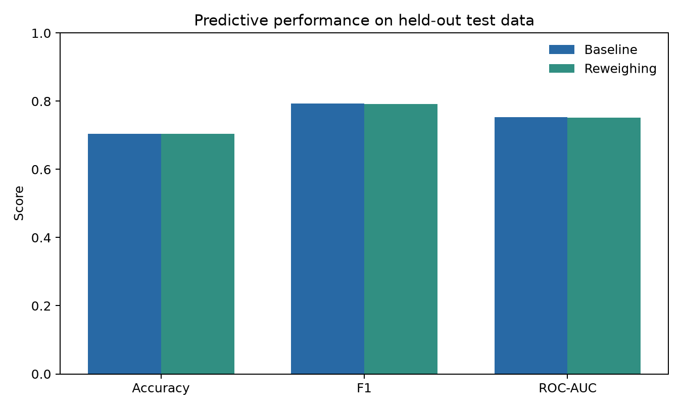
3 | Predictive performance
Held-out test set • about 55 seconds
Accuracy
0.705 → 0.705
F1
0.793 → 0.792
ROC-AUC
0.754 → 0.752
Baseline → Reweighing. Utility changes must be considered alongside group-specific errors.
German Credit fairness analysis • 4/6

Slide 5
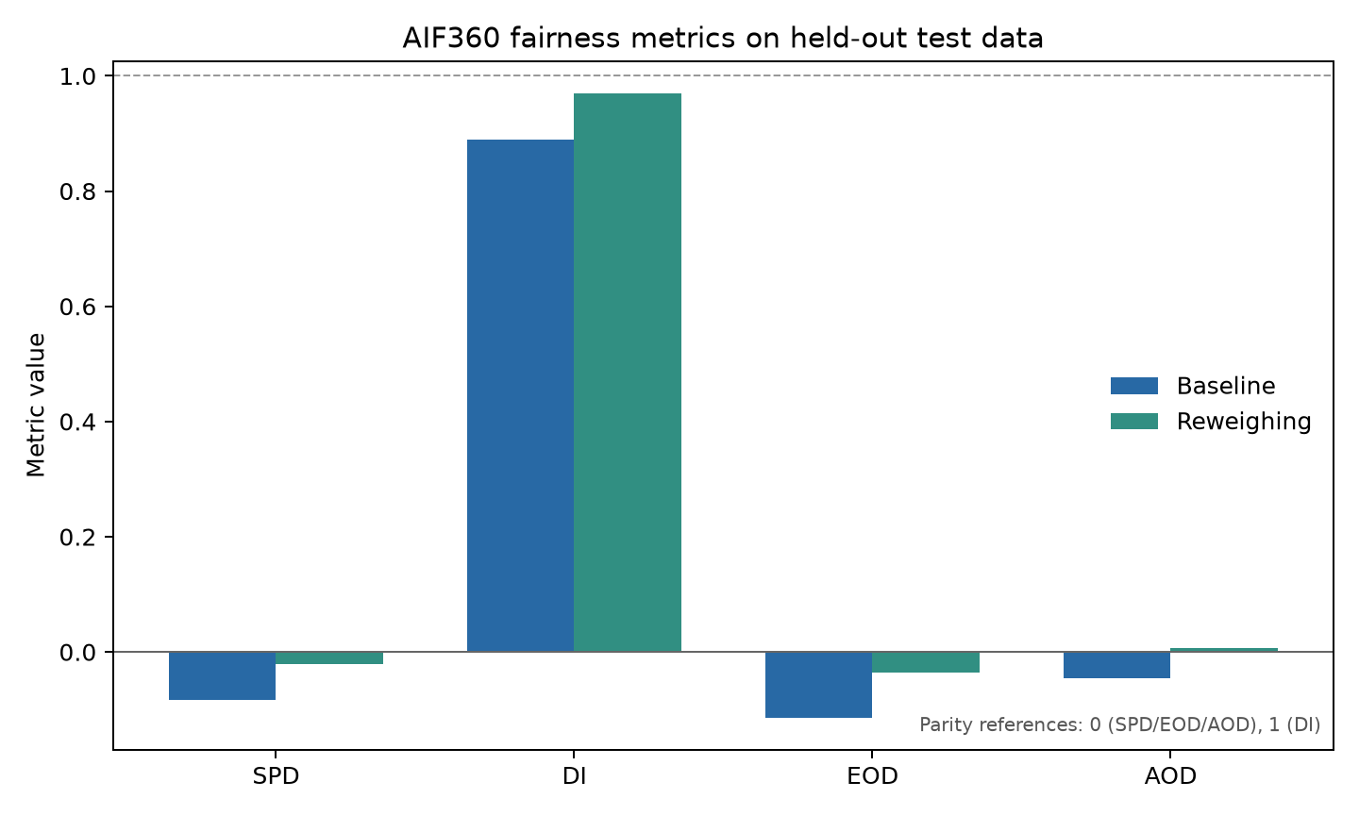
4 | Fairness metrics
AIF360 • about 65 seconds
Baseline → Reweighing
SPD: -0.083 → -0.021
DI: 0.889 → 0.970
EOD: -0.115 → -0.035
AOD: -0.045 → 0.008
Parity: 0 for differences; DI = 1. A negative difference signals fewer favorable outcomes / lower TPR for women.
German Credit fairness analysis • 5/6

Slide 6
5 | Interpretation and next steps
Takeaways • about 70 seconds
Women vs. men accuracy/recall: 0.633/0.725 baseline vs. 0.736/0.840; after reweighing 0.667/0.775 vs. 0.721/0.810.
Reweighing targets training-set group/outcome association; it cannot repair biased labels or remove every proxy.
Metric trade-offs are real: statistical parity, equal opportunity, and error-rate balance encode different goals.
Bootstrap intervals quantify split-specific uncertainty; this one split is not a deployment guarantee.
Before real use: legal and stakeholder review, appeals and human oversight, drift and intersectional monitoring, documented alerts and rollback.
Conclusion: fairness is a continuing governance process, not a single score.
German Credit fairness analysis • 6/6

