Slide 1
Healthy Thoughts
& Team Ferret Presents:
Anonymous interaction with the Mental Health First Aid team via Slack.

Slide 2
AN OPPORTUNITY TO IMPROVE
Anonymous
Informal
Anonymity can enable people to broach topics they may not be comfortable with bringing up otherwise.
Many of us might be more comfortable communicating more casually via messages than via video or audio call.
Convenient
It can be more comfortable raising an issue in a forum where you know an MHFA can respond when they’re ready to help. You don’t need to worry that you’re interrupting or imposing.

Slide 3
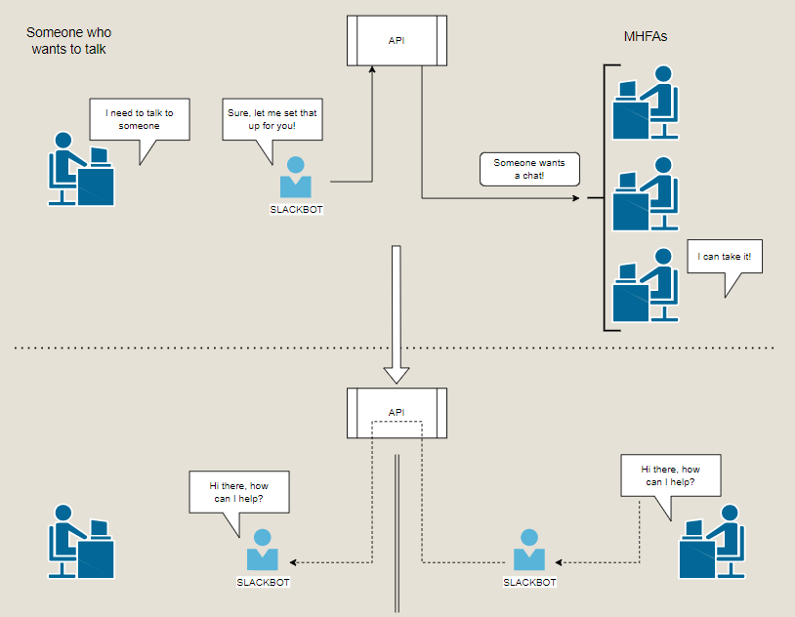
HOW DOES IT WORK?

Slide 4
Let’s see it in action

