Slide 1
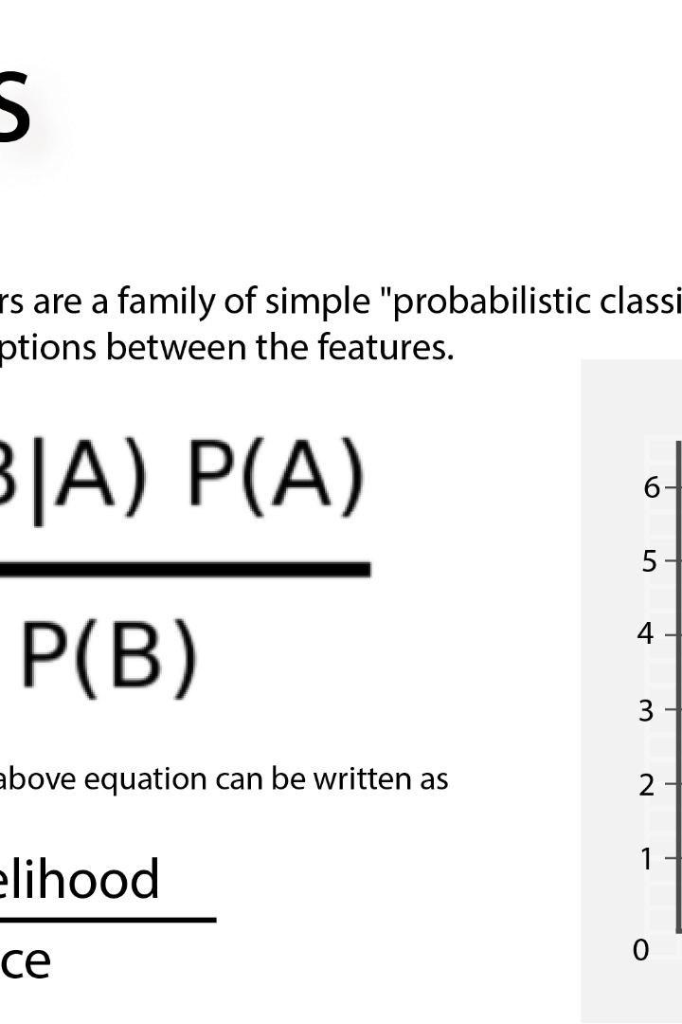
Naive Bayes - Regression
Naive Bayes is a versatile machine learning algorithm that can be used for both classification and regression tasks. In this presentation, we will explore its application in regression problems.

Slide 2

Types of Naive Bayes
1
Gaussian Naive Bayes
Assumes that the features follow a Gaussian distribution.
Suitable for continuous data where the values are real numbers.
Widely used in classification problems, especially in natural language processing.
2
Multinomial Naive Bayes
Applicable when the features represent the frequency of occurrences of events.
Commonly used in text classification, such as spam filtering or document categorization.
Assumes that the features are generated from a multinomial distribution.
3
Bernoulli Naive Bayes
Designed for binary/Boolean features.
Suitable for problems where features represent presence or absence of certain characteristics.
Often used in text classification tasks where the presence or absence of words matters.

Slide 3
Types of Naive Bayes
4
Complementary Naive Bayes
A variation that is particularly effective for imbalanced datasets.
Adjusts the probabilities to handle skewed class distributions.
Useful when dealing with datasets where one class significantly outnumbers the other.
5
Categorical Naive Bayes
Suitable for categorical features, which may not have a natural ordering.
Useful for data with discrete variables and a finite set of categories.
6
Averaged One-Dependence Estimators (AODE)
An extension of Naive Bayes that relaxes the independence assumption among features.
Considers dependencies between different features to improve accuracy.

Slide 4
Advantages of Naive Bayes in Regression
1
Interpretability
Provides interpretable probabilistic predictions and can explain the relationship between input variables and the target.
2
Robustness to Irrelevant Features
Naive Bayes regression is robust to irrelevant features, making it effective in high-dimensional datasets.
3
Handles Missing Values
Can handle missing values by ignoring them during training and making predictions.

Slide 5
Challenges and Limitations of Naive Bayes Regression
1
Independence Assumption
Issue: Naive Bayes assumes feature independence, which can be unrealistic in real-world scenarios.
Impact: Violating this assumption may lead to biased predictions, affecting model accuracy.
2
Lack of Data Diversity
Challenge: Limited data diversity can hinder Naive Bayes' ability to generalize well to unseen instances.
Implications: Model performance may suffer if training data doesn't represent real-world scenarios adequately.
3
Overfitting
Risk: Naive Bayes is prone to overfitting, especially with small datasets.
Consequences: Overfitting can result in poor generalization, as the model may memorize noise in the training data.

Slide 6
Steps to Apply Naive Bayes in Regression
1
Data Preprocessing
Clean and transform the data, handle missing values, and split into training and testing sets.
Fit the Model
2
Train the Naive Bayes regression model on the training data using the appropriate algorithm.
3
Predict
Apply the trained model to the test data to predict the target variable values.
Evaluate the Model
4
Assess the performance of the model using appropriate evaluation metrics, such as mean squared error or R-squared.

Slide 7

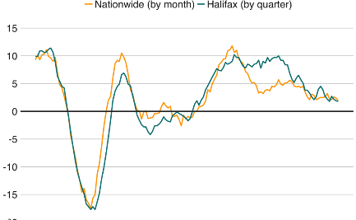
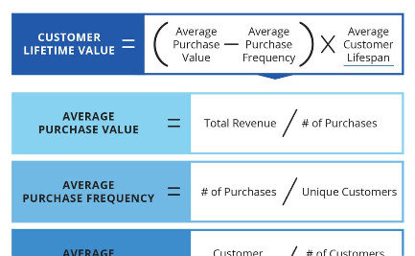
Uses of Naive Bayes Regression
Stock Price Prediction
Real Estate Valuation
Customer Lifetime Value
Naive Bayes regression can be used to predict stock prices based on historical trading data and relevant financial features.
Naive Bayes regression can estimate real estate prices based on factors like location, size, and amenities.
Naive Bayes regression can predict the lifetime value of customers based on their demographic information and past purchase behavior.

Slide 8
Evaluation and Metrics
Mean Squared Error (MSE)
R-squared
MSE measures the average squared difference between the predicted and actual target values.
R-squared represents the proportion of the variance in the target variable that is predictable from the input features.
Root Mean Squared Error (RMSE)
Mean Absolute Error (MAE)
RMSE is the square root of the MSE and provides the standard deviation of the prediction errors.
MAE calculates the average absolute difference between the predicted and actual target values.

Slide 9

Example of Naive Bayes Regression

