Slide 1
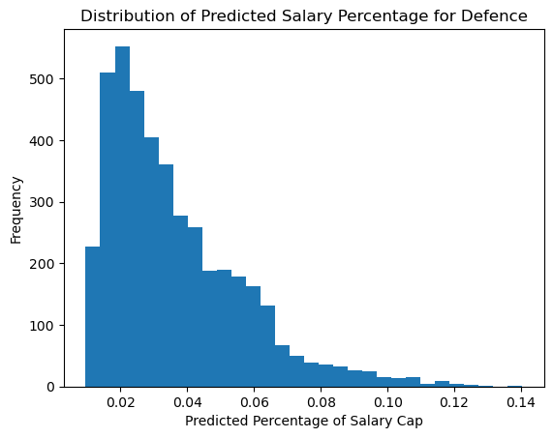
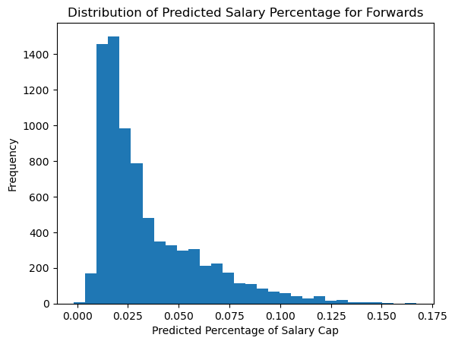
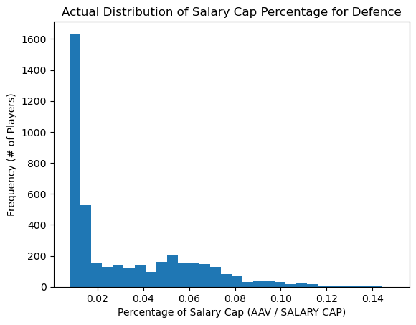
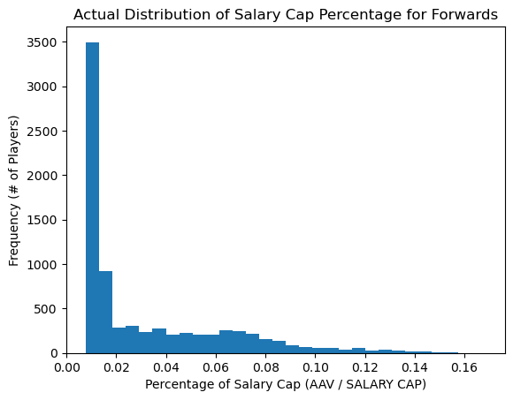
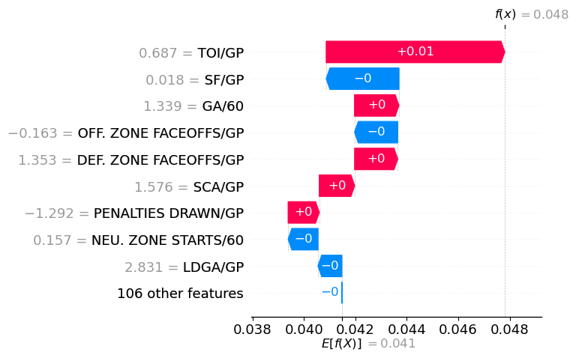
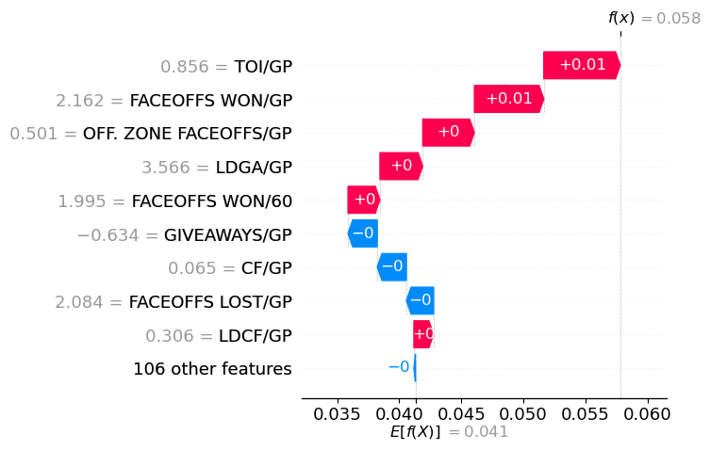
NHL Player Valuation: Determining Value from Performance
Michael Kuby, Sangmun Kim, Yuyang Chen, Haichen Sun
1. MOTIVATION: A RESULTS-BASED BUSINESS
3. DATA PIPELINE
5. MODEL DISTRIBUTIONS
Standard and advanced metrics track NHL player performance across numerous gameplay states and aspects.
Actual “cost” to roster a player ranges from ~1% to ~16.5% of the salary cap per year.
Can we predict a player’s salary based on performance?
Idea: Prediction ≈ Valuation
Valuation – Salary identifies over/under performance.
Players on leashes: Defense (short), Forwards (long)
6. DEPLOYMENT
Features:
Searchable by Player / Team
Relationships between variables for a wide range of features, including the model predictions
2. METHODOLOGY
4. MODELS: XGB Regression
Data collection from CapFriendly.com & NaturalStatTrick.com
Cleaning, Transformation, Mergers
Target labels: Player AAV / annual salary cap max
Entity resolution: performance metrics <--> salary data
Correlational analysis for two different groups of players: Forwards and Defenceman
Model Training (LR + Polynomial Features, Tree Models)
Recursive Feature Elimination with Cross Val.
Inference
Product Deployment
Forwards Model Defence Model: MSE ≈ 0.000496 MSE ≈ 0.000525
[Footer: links, additional logos (e.g., funding), QR codes etc., remove box if not needed]

