Slide 1

VEAVY’S CODE
Abhilash
Ravi Prakash

Slide 2
Agenda
Problem Statement
Developer’s Addiction to Code Editors
Weavy’s Integration
Benefits & Limitations
Q&A

Slide 3





Problem Statement
Every Company has a different app for messaging, file sharing, social events, coding etc.
This poses a problem to a developer who has to keep switching apps for messaging, file sharing, coding etc.
Having so many apps running can eat up significant system resources
This reduces developer’s productivity
How about we integrate messaging, file sharing, to-dos, social posts into dev world?

Slide 4
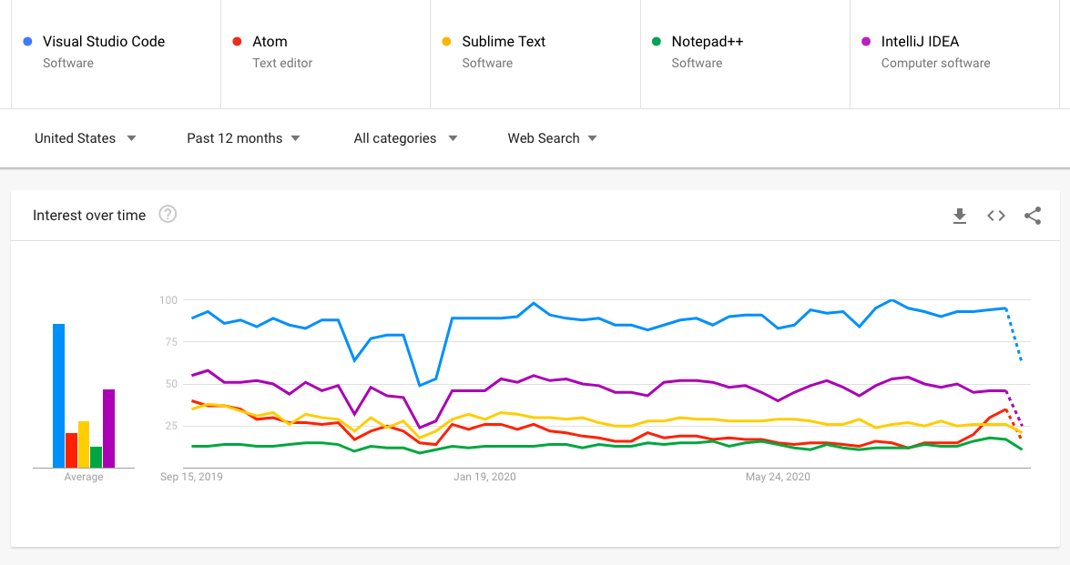
Developer’s Addiction to Code Editors
As a developer, most of my time goes in coding stuff and hence, most of my time is spent on code editor
After using a lot of code editors, I have settled for Visual Studio Code (VS Code) for various reasons
It’s a similar story with a lot of developers
Looking at the google trends, features, community support, active contributions, vscode is certainly the favorite code editor among developers
Funny Meme - VSCode

Slide 5




Weavy’s Integration
VEAVY’S CODE
VsCode allows developers to add custom extensions that help users in different ways. For ex. Docker extension, Code formatters, Prettify json etc.
VsCode provides webview API to render almost any HTML content
As weavy client sdk provides iframe, that gets embedded to the html, it’s possible to integrate weavy with vscode via webview API
Hence, adding weavy as an extension to vscode is veavy’s code.
A single weavy extension can have the functionalities of
In-app messaging
File Sharing
Feeds/Posts
Tasks
The extension registers a new command for every app

Slide 6
Benefits & Limitations
Benefits
Technical Benefit
You get most of the technical benefits weavy provides
Bundle multiple apps to a single one saving system resources
Market Fit
Students, Developers, many use VsCode.
There aren’t much collaborative extensions combining multiple functionalities to one
Collaborative note taking, code submission etc.. for students is a benefit without changing apps
Devs in many big corporations use vscode. Integrating weavy directly into vscode can help developers
Social Impact
Power of Open Source + weavy’s collaborative feature can lead to increased adoption of weavy
According to this Survey, there are 4.9m active users of vscode
Limitations
VSCode extensions don’t support modals/pop up windows. Hence, 3rd party integration need signins cannot be integrated with this extension. Even though such files can be read using file sharing, editing them is disabled in this extension.

Slide 7
CODE AND RESOURCES
Veavy’s Code - https://github.com/Better-Boy/veavy-code
Weavy Server (Custom with few changes) - https://github.com/Better-Boy/veavy-server

Slide 8
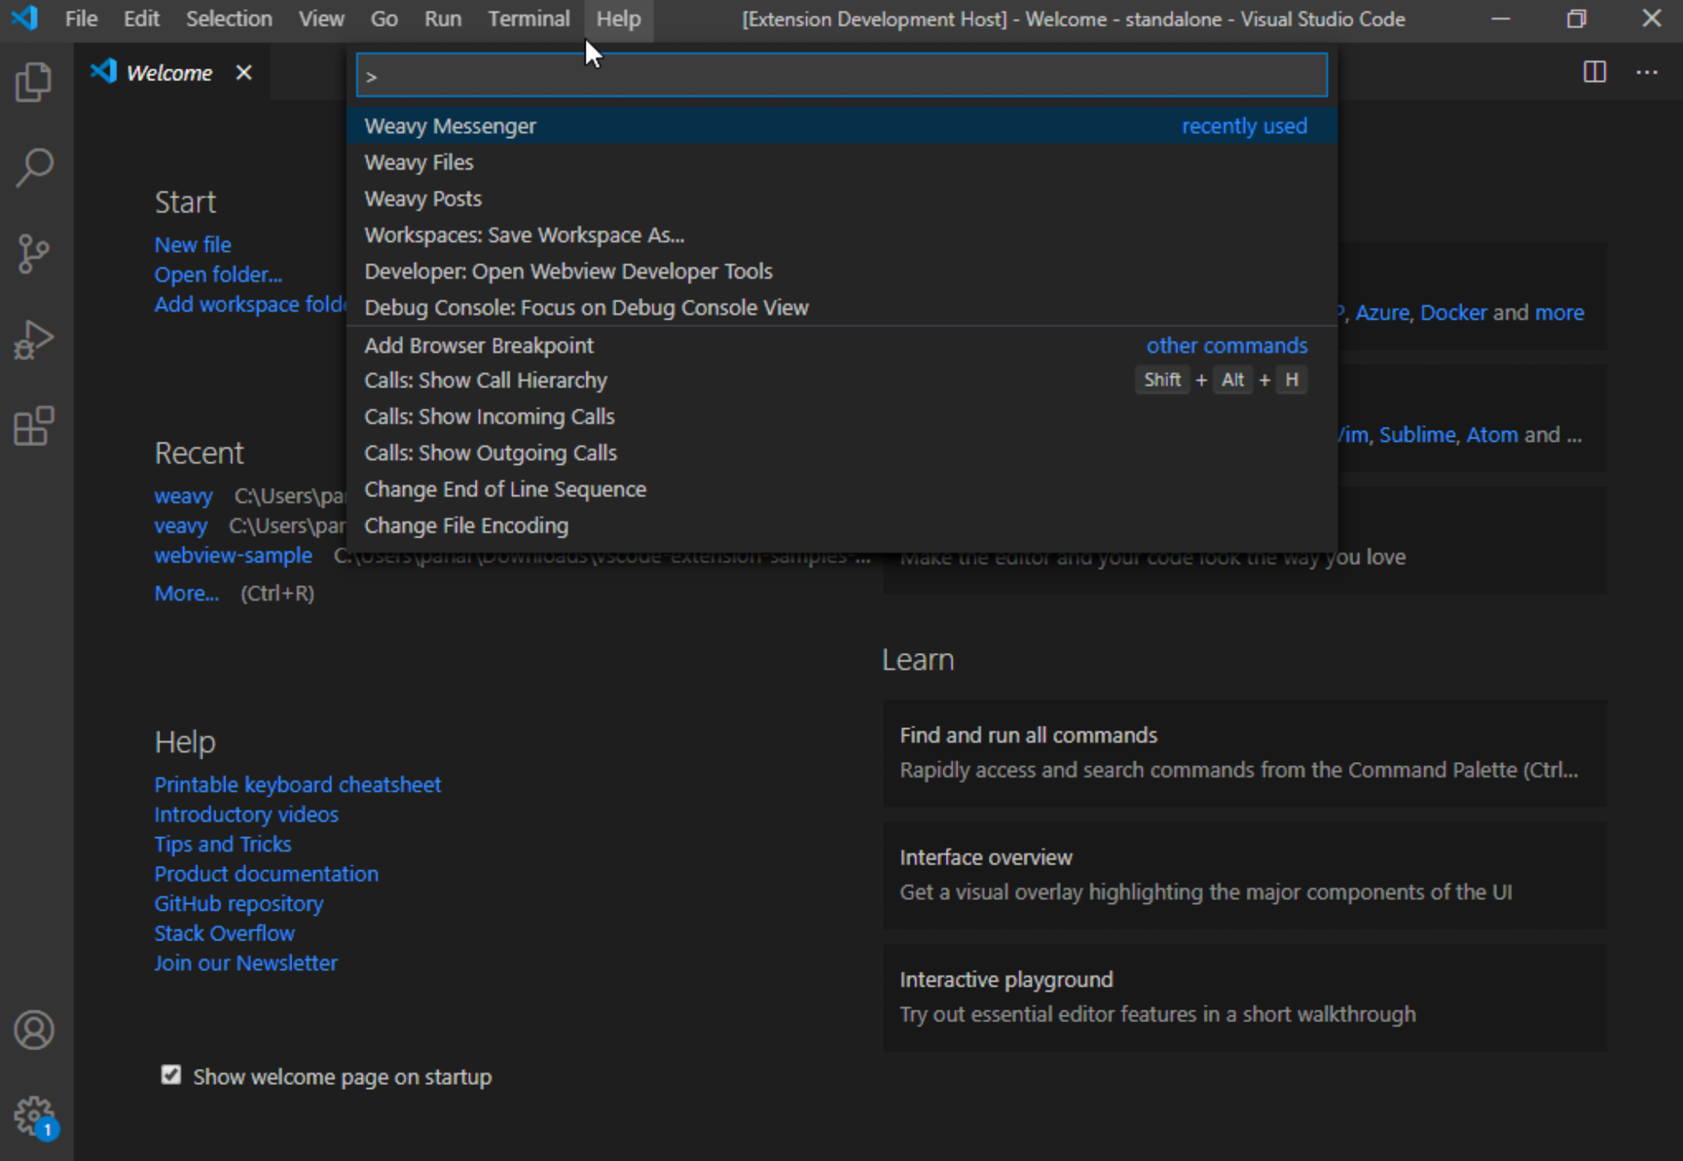
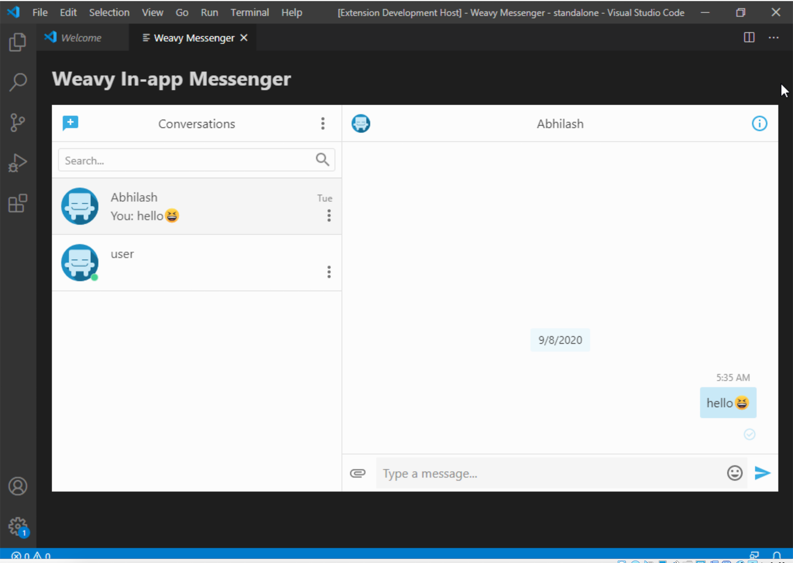
Extension Screenshots

Slide 9
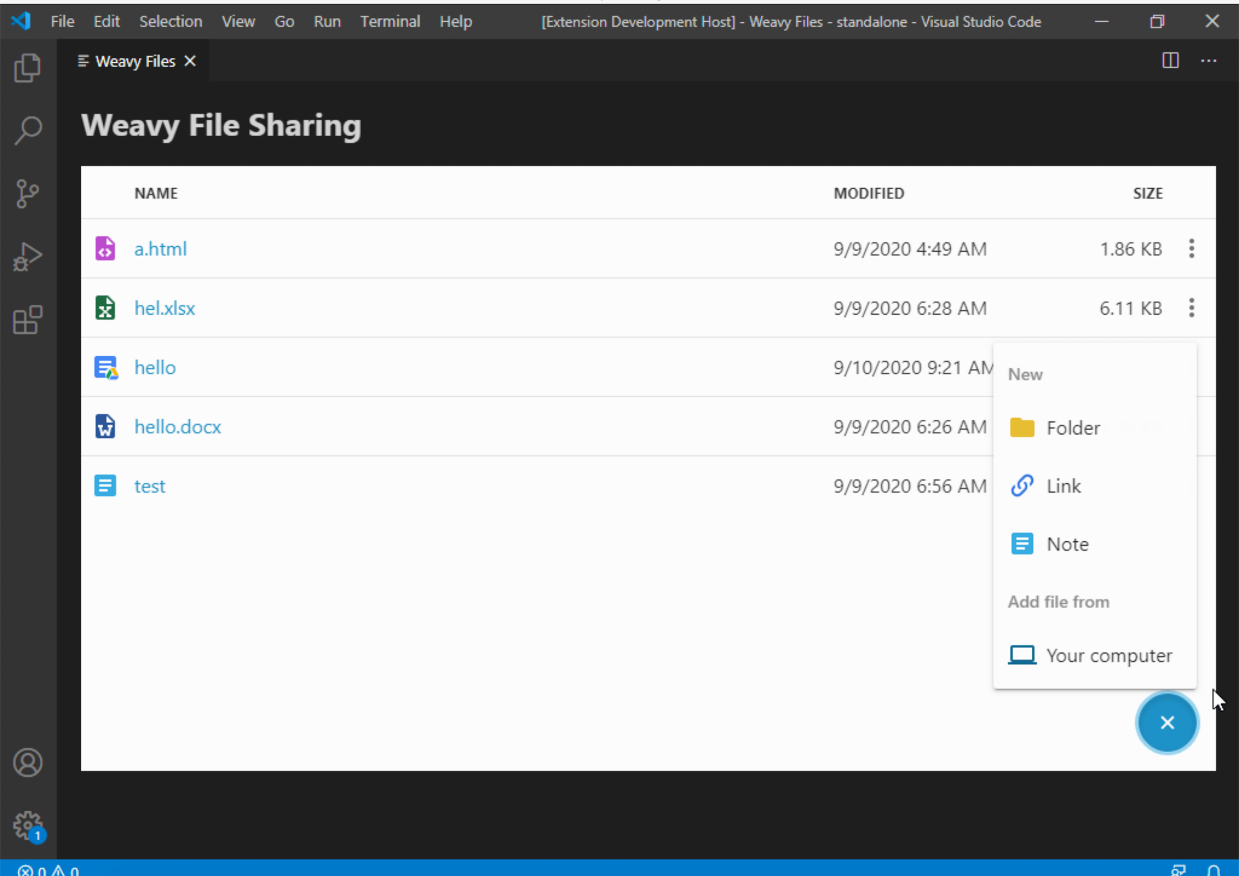
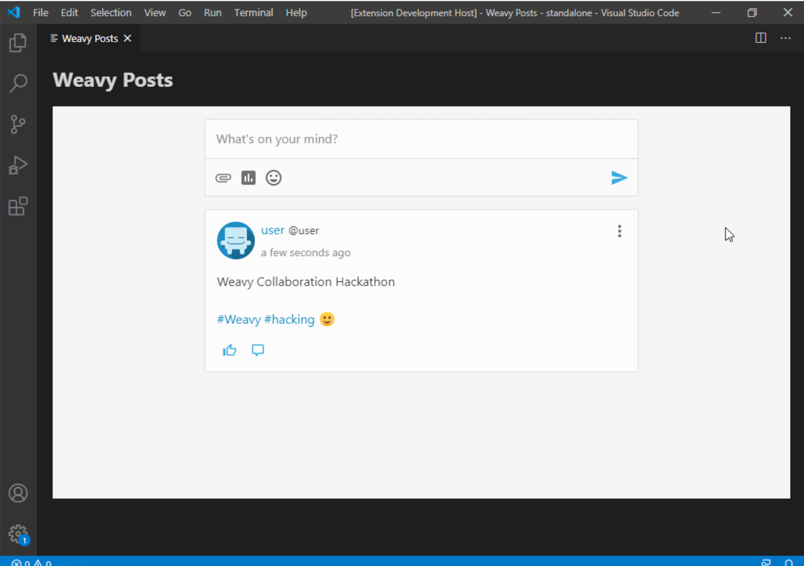
Extension Screenshots

Slide 10
Idea Extension
Build an electron cross platform desktop app which is very helpful for corporate employees/students as a one stop solution for messaging, document collaboration, file sharing etc..
Instead of having 3-4 desktop apps for each purpose, you can have a single app consisting of all weavy's features which is a lot less development time, cross platform ready and easy to use.

Slide 11
Thanks to Kris Ledel and Dave Koncsol for all their
support during the hackathon
Q&A

