Slide 1
Lifelong Machine Learning for Regression Problems
Student Name: Yihan Zhang
Student ID: 1823149
Supervisor: Steven Guan
Assessor: Rui Yang

Slide 2
Content：
1. Project Motivation and Objective
2. Introduction
3. Background and Literature Review
4. Methodology
5. Models
6. Experimental Results
7. Conclusion and Future Works

Slide 3
Project Motivation and Objective
Project Motivations:
Profits inside rapid development of commerce
Help enterprises and investors to understand their trend of stocks
Traditional machine learning approach is not ideal for long period prediction
Lifelong machine learning area has few researches on regression problems
Project Objectives:
Do research on lifelong machine learning area
Propose a lifelong machine learning framework for stock price prediction
Compare performance of different predicting models (GRU, LSTM, Bi-LSTM)

Slide 4
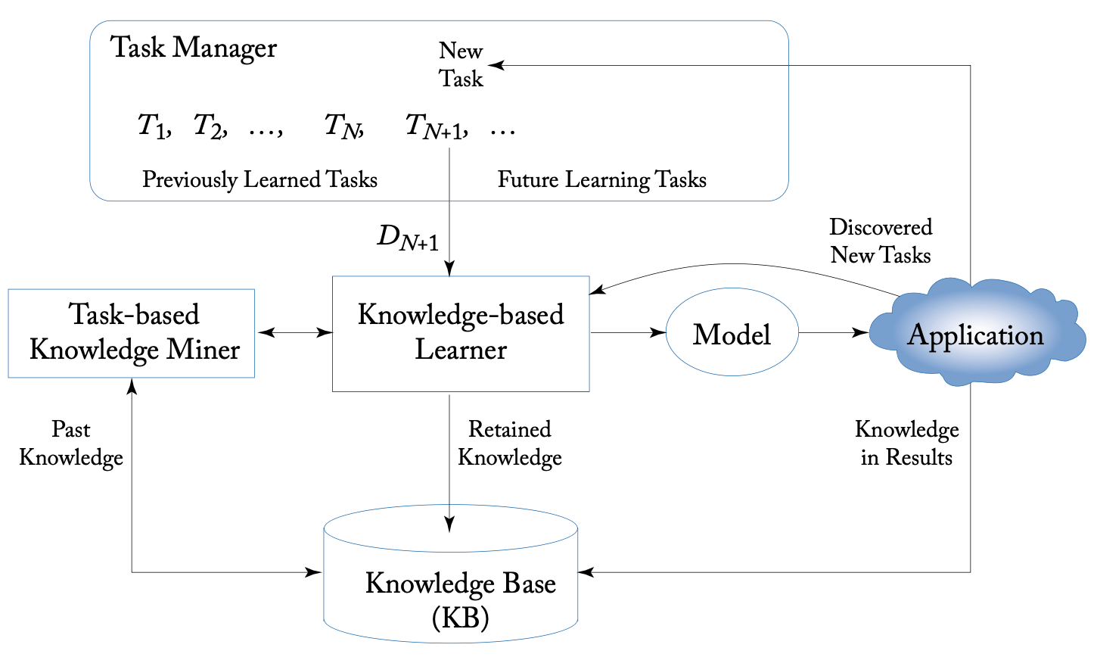
Introduction
Introduction of lifelong machine learning
An advanced machine learning paradigm
Learn continuously
Accumulate the knowledge learned in the past and utilized it to help future learning
Figure 1: Lifelong Machine Learning System Architecture
Introduction of regression problem in machine learning
Predict specific and continuous number/values
Knowledge Base (KB)
Knowledge-based Learner
Task-based Knowledge Miner
Task Manager

Slide 5
Background and Literature Review
In the mid 1980s, Michalski proposed the theory of constructive inductive learning.
In 1986, Rumelhart proposed the structure of recurrent neural network
In the mid 1990s, Thrun and Mitchell proposed the explanation-based neural network (EBBN).
Lifelong machine learning was firstly named by Thrun and Mitchell in 1995.
In 1997, Hochreiter and Schmidhuber proposed the structure of Long Short-Term Memory in order to solve the issues in conventional back-propagation and discussed some limitation of LSTM.
In 2005, Graves and Schmidhuber proposed BiLSTM and applied it to the phoneme classification.
In 2013, Ruvolo and Raton proposed an efficient algorithm for lifelong learning (ELLA)
In 2014, Kyunghyun proposed gated recurrent unit (GRU)
In 2016, Chen and Liu introduced the architecture of lifelong machine learning and summarized the differences between traditional machine learning and lifelong machine learning.
In 2018, Chen conducted a lifelong machine learning survey for sentiment classification, showed that the performance of LML is better than multi-task learning model and single task learning model.

Slide 6
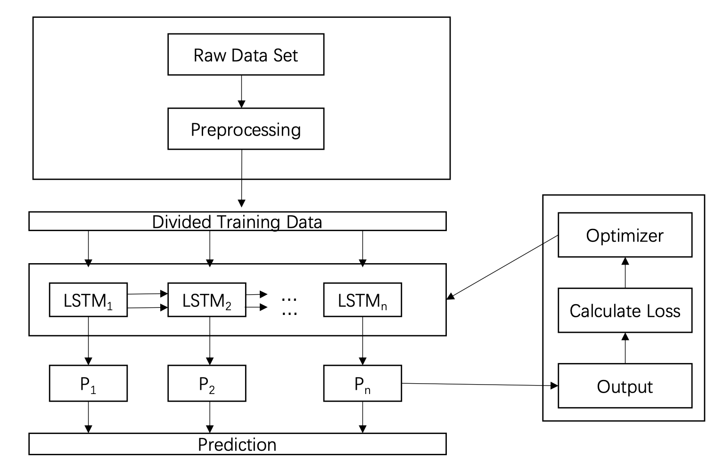
Methodology
Environment and Important packages:
Python3, TensorFlow Pandas, Numpy, Keras, sklearn
Framework (LSTM Based Structure):
Data preprocessing （Observe data’s shape and dimension, Normalization using MinMaxScaler）
Divide training and testing data
Construct time-series data through training data (Using rolling method)
Define layers and construct models
Train the model and tune hyper-parameters
Generate prediction result
Visualization for illustration
Figure 2: Proposed framework for regression problems

Slide 7
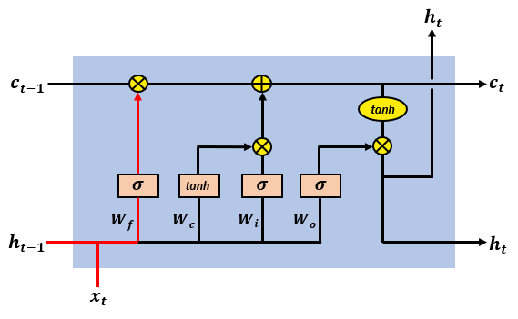
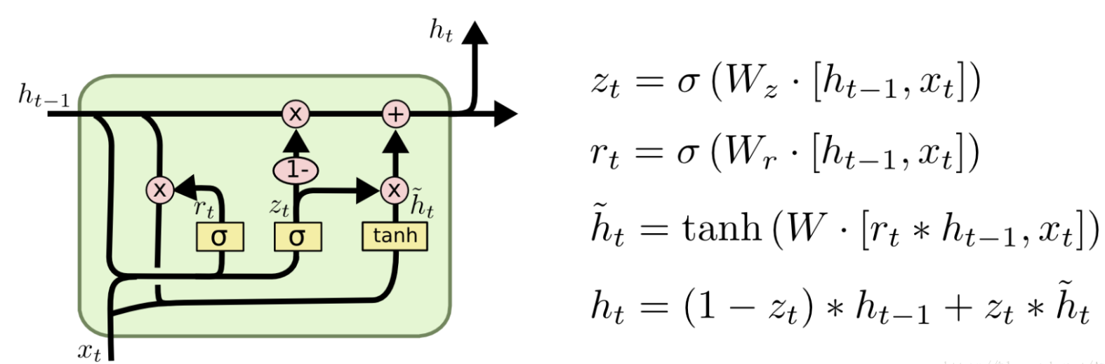
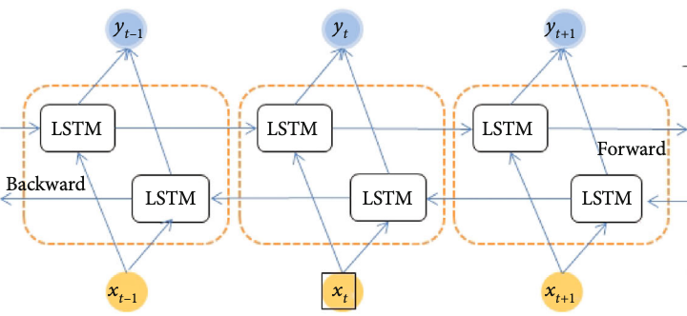
Models
LSTM (Long Short-Term Memory):
Solve the gradient vanishing and explosion issues of RNN.
Structure: input gate, forget gate, output gate.
GRU (Gate Recurrent Unit)：
A variant of LSTM with less parameter and more simple structure.
Structure: update gate, reset gate.
Bi-LSTM (Bi-directional Long Short-Term Memory):
Combination of forward LSTM and backward LSTM.
Enable to encode the information from back to forward.
Figure 3: LSTM structure
Figure 4: GRU structure and formular
Figure 5: Bi-LSTM structure

Slide 8
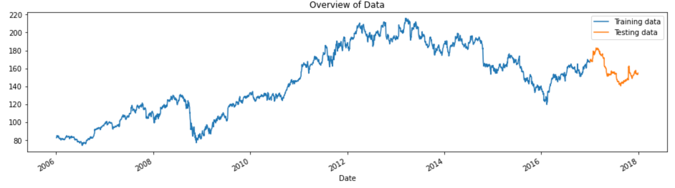
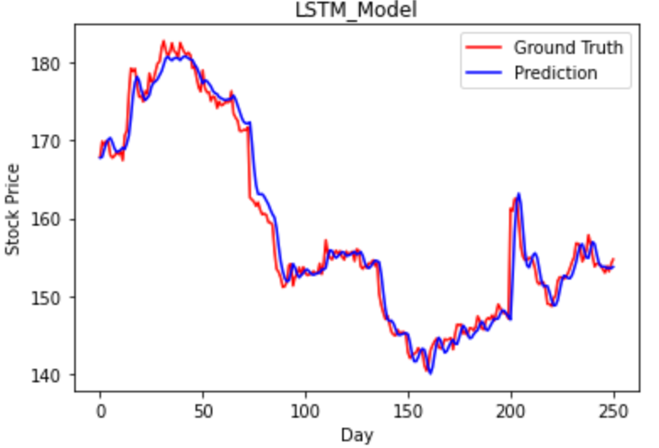
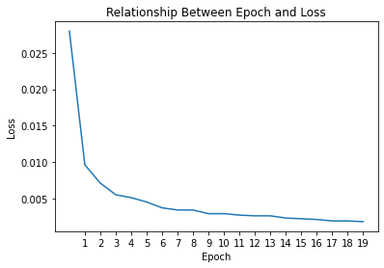
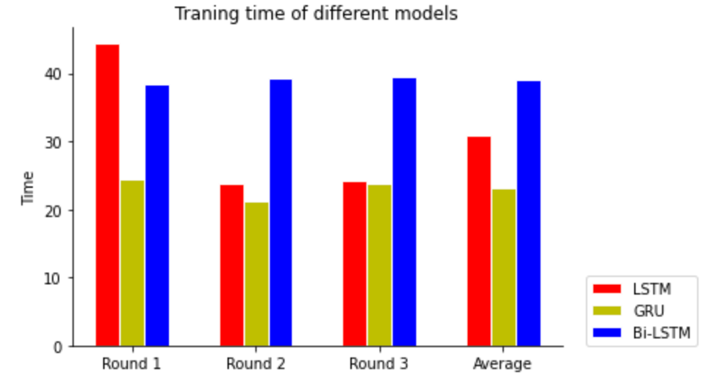
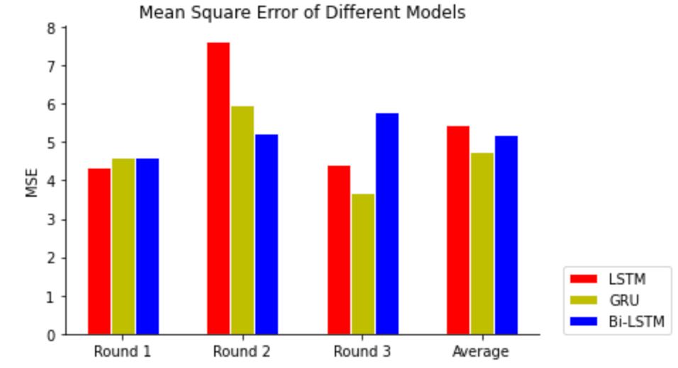
Experimental Result
Overview of dataset:
Prediction result of LSTM based model:
Comparison with GRU and Bi-LSTM based model:
Total | 3020 rows and 6 columns
2006-2016 | Training | 2769 rows
2017 | Testing | 251 rows
Figure 6: Overview of dataset
Layer 1 | LSTM (128 dimensions)
Layer 2 | Dropout (0.2)
Layer 3 | LSTM (128 dimensions)
Layer 4 | Dropout (0.2)
Layer 5 | LSTM (128 dimensions)
Layer 6 | Dropout (0.2)
Layer 7 | Dense Layer
Epoch | 20
Batch Size | 32
Optimizer | rmsprop
Learning Rate | 0.001 (default)
Decay | 0
Loss | MSE
Table 1: Settings of model
Figure 7: Prediction of LSTM model
Figure 8: Relationship between epoch and loss
Time | LSTM | GRU | Bi-LSTM
Round 1 | 44.4729 | 24.5032 | 38.4417
Round 2 | 23.7673 | 21.1196 | 39.3136
Round 3 | 24.3078 | 23.7143 | 39.4897
Average | 30.8493 | 23.1124 | 39.0817
MSE | LSTM | GRU | Bi-LSTM
Round 1 | 4.3340 | 4.6110 | 4.6208
Round 2 | 7.6449 | 5.9706 | 5.2370
Round 3 | 4.4109 | 3.6978 | 5.7812
Average | 5.4633 | 4.7598 | 5.2130
Table 2: Result of training time
Table 3: Result of mean square error
Figure 9: Comparison of training time
Figure 10: Comparison of mean square error

Slide 9
Conclusion and Future Work
Conclusion:
This project proposed a framework for regression problem and applied the framework to predict the stock price using different models.
LSTM, GRU and Bi-LSTM all perform well in the prediction task, GRU can reach the better accuracy with less training time compared with LSTM and Bi-LSTM.
The stock price can be affected by various factors.
There is no algorithm can realize the real lifelong machine learning that can implement all tasks in all fields based on current knowledge and technology.
Future Work:
Enhance the performance of models (Tune the hyper-parameter better)
Involve more covariates (Not only involve time-series factor)
Transfer knowledge to more tasks (Predict things as much as possible)
Try different advanced models and algorithms (Such as transformer)
Embed the prediction model into websites (It will gain more profits)

Slide 10
Thank You
Question?

Slide 11
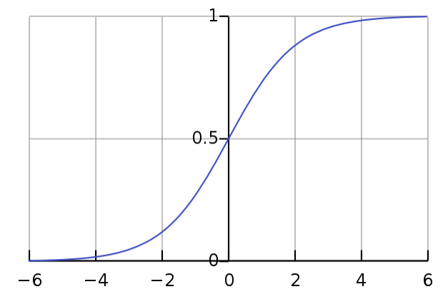
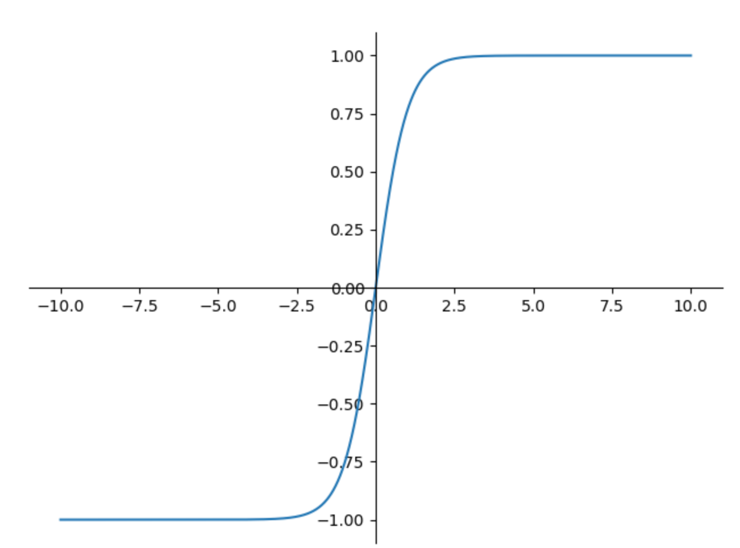

Back up Slides
LSTM Structure:
Forget Gate
$f_{t}=sigmoid\left(W_{f}.\left[h_{t−1},x_{t}\right]+b_{f}\right)$ // forget gate
Input Gate
$i_{t}=sigmoid\left(W_{i}.\left[h_{t−1},x_{t}\right] + b_{i}\right)$ // input gate
$\tilde{C_{t}}=tanh\left(W_{C}.\left[h_{t−1},x_{t}\right]+b_{C}\right)$ // new memory cell
$C_{t}=f_{t}∗C_{t−1}+i_{t}∗\tilde{C_{t}}$ // final memory cell
Output Gate
$o_{t}=sigmoid\left(W_{o}\left[h_{t−1},x_{t}\right]+b_{o}\right)$ // output gate
$h_{t}=o_{t}∗tanh\left(C_{t}\right)$ // final hidden state
$$sigmoid\left(x\right)=\frac{1}{1+e^{−x}}=\frac{e^{x}}{e^{x}+1}=1−sigmoid\left(−x\right)$$
$$tanh\left(x\right)=\frac{sinh\left(x\right)}{cosh\left(x\right)}=\frac{e^{x}−e^{−x}}{e^{x}+e^{−x}}$$
$$sinh\left(x\right)=\frac{e^{x}−e^{−x}}{2}$$
$$cosh\left(x\right)=\frac{e^{x}+e^{x}}{2}$$
Figure 11: Sigmoid function
Figure 12: Tanh function

