Slide 1

课后作业
用定理证明的方法证明以下公式：
$\left(A∧¬A\right)⇒B$
$\left(A∧B\right)∨C⇒\left(A∨C\right)∧(B∨C)$
$\left(\left(R∧¬A\right)∨X\right)∧¬\left(A∨Y\right)⇒\left(R∨X\right)∧¬(A∨Y)$

Slide 2
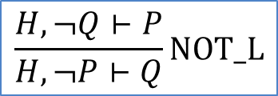
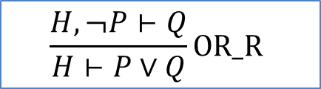
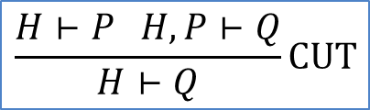
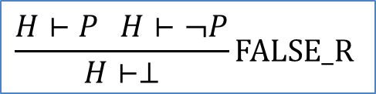
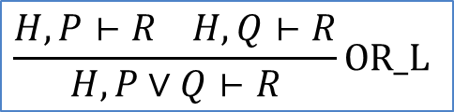
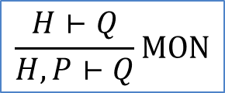
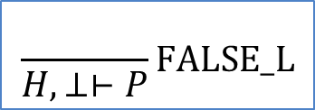
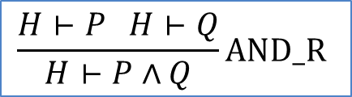
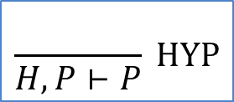
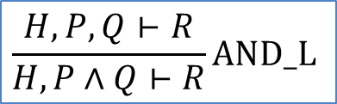
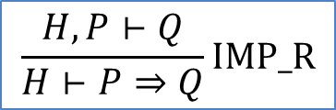
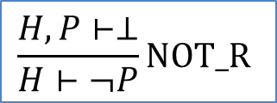
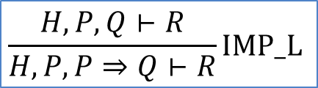
证明规则
$$\frac{}{H,P⊢P} HYP$$
$$\frac{H⊢Q}{H,P⊢Q}MON$$
$$\frac{H⊢P H,P⊢Q}{H⊢Q}CUT$$
$$\frac{}{H,⊥⊢P}FALSE_L$$
$$\frac{H⊢P H⊢¬P}{H⊢⊥}FALSE_R$$
$$\frac{H,¬Q⊢P}{H,¬P⊢Q}NOT_L$$
$$\frac{H,P⊢⊥}{H⊢¬P}NOT_R$$
$$\frac{H,P,Q⊢R}{H,P∧Q⊢R}AND_L$$
$$\frac{H⊢P H⊢Q}{H⊢P∧Q}AND_R$$
$$\frac{H,P⊢R H,Q⊢R}{H,P∨Q⊢R}OR_L$$
$$\frac{H,¬P⊢Q}{H⊢P∨Q}OR_R$$
$$\frac{H,P,Q⊢R}{H,P,P⇒Q⊢R}IMP_L$$
$$\frac{H,P⊢Q}{H⊢P⇒Q}IMP_R$$

Slide 3

Solution for 1
$⊢\left(A∧¬A\right)⇒B$ IMP_R $A∧¬A⊢B$ AND_L $A,¬A⊢B$ NOT_L $A,¬B⊢A$ HYP done

Slide 4

Solution for 2
$⊢\left(A∧B\right)∨C⇒\left(A∨C\right)∧(B∨C)$ IMP_R $\left(A∧B\right)∨C⊢\left(A∨C\right)∧\left(B∨C\right)$ AND_R $\left(A∧B\right)∨C⊢(A∨C)$ OR_R $\left(A∧B\right)∨C,¬A⊢C$ OR_L $\left(A∧B\right),¬A⊢C$ AND_L,NOT_L,HYP done $C,¬A⊢C$ HYP done $\left(A∧B\right)∨C⊢\left(B∨C\right)$ OR_R $\left(A∧B\right)∨C,¬B⊢C$ OR_L $\left(A∧B\right),¬B⊢C$ AND_L,NOT_L,HYP done $C,¬B⊢C$ HYP done

Slide 5

Solution for 3
$⊢\left(\left(R∧¬A\right)∨X\right)∧¬\left(A∨Y\right)⇒\left(R∨X\right)∧¬(A∨Y)$ IMP_R $\left(\left(R∧¬A\right)∨X\right)∧¬\left(A∨Y\right)⊢\left(R∨X\right)∧¬(A∨Y)$ AND_R $\left(\left(R∧¬A\right)∨X\right)∧¬\left(A∨Y\right)⊢\left(R∨X\right)$ AND_L, OR_R $\left(\left(R∧¬A\right)∨X\right),¬\left(A∨Y\right),¬X⊢R$ OR_L $\left(R∧¬A\right),¬\left(A∨Y\right),¬X⊢R$ AND_L, HYP done $X,¬\left(A∨Y\right),¬X⊢R$ NOT_L,HYP done $\left(\left(R∧¬A\right)∨X\right)∧¬\left(A∨Y\right)⊢¬\left(A∨Y\right)$ AND_L, HYP done

Slide 6

bonus
Fibonacci numbers
basis: $F_{0}=0, F_{1}=1$
recursion: if $F_{i}=m, F_{i+1}=n$then $F_{i+2}=m+n$ for $i≥0$
证明：$F_{k}=\frac{φ^{k}−ψ^{k}}{φ−ψ}$ where $φ=\frac{1+\sqrt{5}}{2}, ψ=\frac{1−\sqrt{5}}{2}$

Slide 7

Solution for bonus
Basis: $F_{0}=\frac{φ^{0}−ψ^{0}}{φ−ψ}=\frac{1−1}{φ−ψ}=0$ $F_{1}=\frac{φ^{1}−ψ^{1}}{φ−ψ}=1$
Induction: for any $k≥0$, $F_{k}=\frac{φ^{k}−ψ^{k}}{φ−ψ}$, $F_{k+1}=\frac{φ^{k+1}−ψ^{k+1}}{φ−ψ}$ $F_{k+2}=F_{k}+F_{k+1}$ $=\frac{φ^{k}−ψ^{k}}{φ−ψ}$ + $\frac{φ^{k+1}−ψ^{k+1}}{φ−ψ}$ $=\frac{φ^{k}\left(1+φ\right)−ψ^{k}(1+ψ)}{φ−ψ}$ $=\frac{φ^{k}\left(1+\frac{1+\sqrt{5}}{2}\right)−ψ^{k}(1+\frac{1−\sqrt{5}}{2})}{φ−ψ}$ $=\frac{φ^{k}{\left(\frac{1+\sqrt{5}}{2}\right)}^{2}−ψ^{k}{\left(\frac{1−\sqrt{5}}{2}\right)}^{2}}{φ−ψ}$ $=\frac{φ^{k+2}−ψ^{k+2}}{φ−ψ}$

