Slide 1

作业
Design a Turing machine accepting the language $L=\left\{a^{i}b^{j}c^{k} \right| i,j,k≥1, i=j+k\}$
Solution:
$M=(Q,\left\{a,b,c\right\},\left\{a,b,c,X,Y,Z\right\},δ,q_{0},B,F)$
Read $a$ and replace it with $X$, move right until encountering b
Read b and replace it with Y, move left until reaching X
Match a and b until all b are replaced by Y and encountering c
Read c and replace it with Z, move left until reaching X
Match a and c (neglect all Y) until all a are replaced by X
Accept if all c are replaced by Z

Slide 2
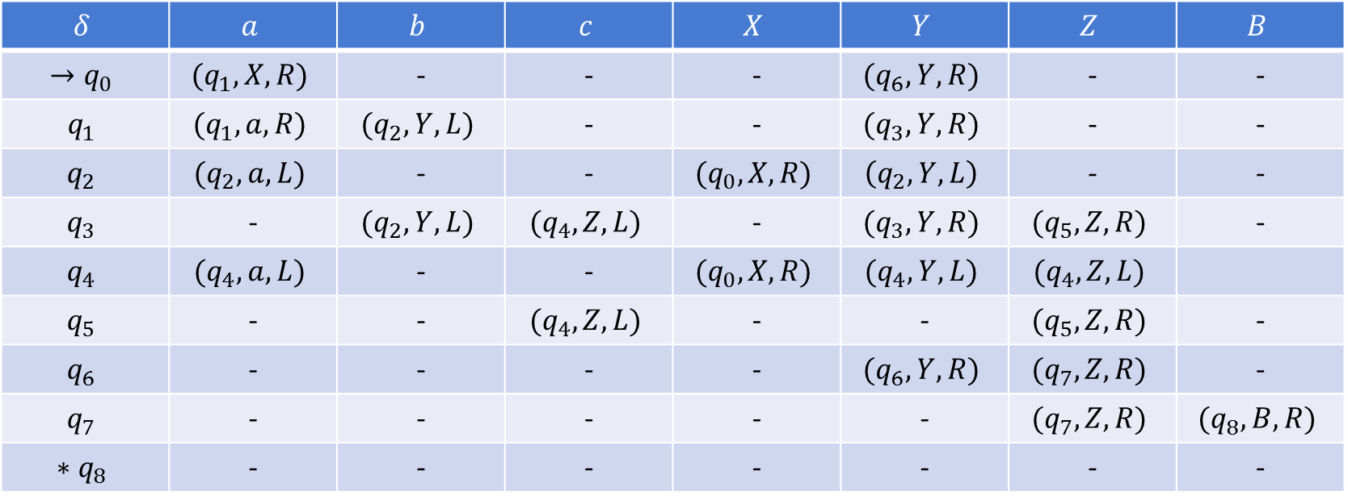
答案
$$δ$$ | $$a$$ | $$b$$ | $$c$$ | $$X$$ | $$Y$$ | $$Z$$ | $$B$$
$$→q_{0}$$ | $$(q_{1},X,R)$$ | - | - | - | $$(q_{6},Y,R)$$ | - | -
$$q_{1}$$ | $$(q_{1},a,R)$$ | $$(q_{2},Y,L)$$ | - | - | $$(q_{3},Y,R)$$ | - | -
$$q_{2}$$ | $$(q_{2},a,L)$$ | - | - | $$(q_{0},X,R)$$ | $$\left(q_{2},Y,L\right)$$ | - | -
$$q_{3}$$ | - | $$(q_{2},Y,L)$$ | $$(q_{4},Z,L)$$ | - | $$(q_{3},Y,R)$$ | $$(q_{5},Z,R)$$ | -
$$q_{4}$$ | $$(q_{4},a,L)$$ | - | - | $$(q_{0},X,R)$$ | $$(q_{4},Y,L)$$ | $$(q_{4},Z,L)$$
$$q_{5}$$ | - | - | $$(q_{4},Z,L)$$ | - | - | $$(q_{5},Z,R)$$ | -
$$q_{6}$$ | - | - | - | - | $$(q_{6},Y,R)$$ | $$(q_{7},Z,R)$$ | -
$$q_{7}$$ | - | - | - | - | - | $$(q_{7},Z,R)$$ | $$(q_{8},B,R)$$
$$∗q_{8}$$ | - | - | - | - | - | - | -

Slide 3

验证
$q_{0}aaabcc⊢Xq_{1}aabcc⊢Xaq_{1}abcc⊢Xaaq_{1}bcc⊢Xaq_{2}aYcc$ $⊢Xq_{2}aaYcc⊢q_{2}XaaYcc⊢Xq_{0}aaYcc⊢XXq_{1}aYcc⊢XXaq_{1}Ycc$ $⊢XXaYq_{3}cc⊢XXaq_{4}YZc⊢XXq_{4}aYZc⊢Xq_{4}XaYZc⊢XXq_{0}aYZc$ $⊢XXXq_{1}YZc⊢XXXYq_{3}Zc⊢XXXYZq_{5}c⊢XXXYq_{4}ZZ⊢XXXq_{4}YZZ$ $⊢XXq_{4}XYZZ⊢XXXq_{0}YZZ⊢XXXYq_{6}ZZ⊢XXXYZq_{7}Z⊢XXXYZZq_{7}B$ $⊢XXXYZZBq_{8}$ accept

