Slide 1
Hash Indices
SEI.ECNU

Slide 2
Hash Table
A hash table implements an unordered associative array that maps keys to values.
It uses a hash function to compute an offset into the array for a given key, from which the desired value can be found.
Space Complexity: O(n)
Operation Complexity:
Average: O(1)
Worst: O(n)

Slide 3
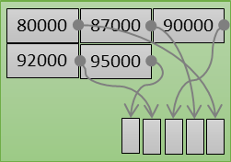
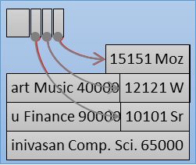
Static Hash Table
Assumptions:
You know the number of tuples ahead of time.
Each key is unique.
Perfect hash function.
If key₁≠key₂, then hash(key₁)≠hash(key₂)
Hash(‘Einstein’)
Hash Index
Bucket Nodes
Data Blocks

Slide 4
Hash Table
Design Decision #1: Hash Function
How to map a large key space into a smaller domain.
Trade-off between being fast vs. collision rate.
Design Decision #2: Hashing Scheme
How to handle key collisions after hashing.
Trade-off between allocating a large hash table vs. additional instructions to find/insert keys.

Slide 5
Hash Functions
We do not want to use a cryptographic hash function for our join algorithm.
We want something that is fast and will have a low collision rate.
Best Speed: Always return '1'
Best Collision Rate: Perfect hashing
A comprehensive hash function benchmark suite
https://github.com/aappleby/smhasher

Slide 6
Hash Functions
CRC-64 (1975)
Used in networking for error detection.
MurmurHash (2008)
Designed to a fast, general purpose hash function.
Google CityHash (2011)
Designed to be faster for short keys (<64 bytes).
Facebook XXHash (2012)
From the creator of zstd compression.
Google FarmHash (2014)
Newer version of CityHash with better collision rates.

Slide 7
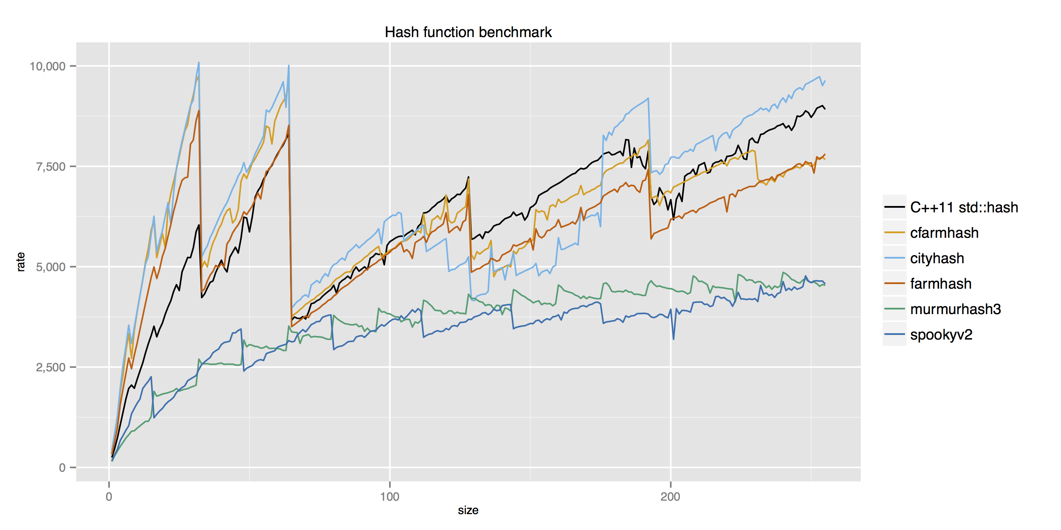
Hash Function Benchmark
2.6 GHz Intel Core i7/clang v3.6.0 (throughput in MB/s given byte array input of varying size)
32
64
192
128
https://github.com/apavlo/hash-function-benchmark

Slide 8
Hashing Schemes
Chained Hashing
Linear Probe Hashing
Robin Hood Hashing
Cuckoo Hashing
Extendible Hashing
Linear Hashing

Slide 9
Chained Hashing
Maintain a linked list of buckets for each slot in the hash table.
Resolve collisions by placing all elements with the same hash key into the same bucket.
To determine whether an element is present, hash to its bucket and scan for it.
Insertions and deletions are generalizations of lookups.

Slide 10
Chained Hashing
hash(B) | B
hash(key)
A
B
C
hash(A) | A
hash(D) | D
D
hash(C) | C
hash(E) | E
E
F
Hyper: 64-bit Bucket Pointers
48-bit Pointer
16-bit Bloom Filter
hash(F) | F

Slide 11
Linear Probe Hashing
Single giant table of slots.
Resolve collisions by linearly searching for the next free slot in the table.
To determine whether an element is present, hash to a location in the table and scan for it.
Must store the key in the table to know when to stop scanning.
Insertions and deletions are generalizations of lookups.

Slide 12
Linear Probe Hashing
To reduce the # of wasteful comparisons during the join, it is important to avoid collisions of hashed keys.
This requires a chained hash table with ~2× the number of slots as the # of elements in R.
hash(B) | B
hash(key)
A
hash(A) | A
B
hash(C) | C
C
hash(D) | D
D
E
hash(E) | E
F
hash(F) | F

Slide 13
Robin Hood Hashing
Variant of linear hashing that steals slots from "rich" keys and give them to "poor" keys.
Each key tracks the number of positions they are from where its optimal position in the table.
On insert, a key takes the slot of another key if the first key is farther away from its optimal position than the second key.

Slide 14
Linear Probe Hashing
hash(B) | B [0]
hash(key)
A
hash(A) | A [0]
A[0] == C[0]
A[0] == E[0]
# of "Jumps" From First Position
B
hash(C) | C [1]
C[1] > D[0]
C[1] == E[1]
C
hash(D) | D [1]
D[1] < E[2]
D
E
F

Slide 15
Linear Probe Hashing
hash(B) | B [0]
hash(key)
A
hash(A) | A [0]
A[0] == E[0]
B
hash(C) | C [1]
C[1] == E[1]
C
hash(E) | E [2]
D[1] < E[2]
D
E
hash(D) | D [2]
D[2] > F[0]
F
hash(F) | F [1]

Slide 16
Cuckoo Hashing
Use multiple tables with different hash functions.
On insert, check every table and pick anyone that has a free slot.
If no table has a free slot, evict the element from one of them and then re-hash it find a new location.
Look-ups are always O(1) because only one location per hash table is checked.

Slide 17
Cuckoo Hashing
Hash Table #1
Hash Table #2
Insert X
hash1(X) hash2(X)
hash₂(Z) | Z
hash₂(Y) | Y
hash₁(X) | X
hash₁(Y) | Y
Insert Y
hash1(Y) hash2(Y)
Insert Z
hash1(Z) hash2(Z)
hash₂(X) | X
hash1(Y)
hash2(X)

Slide 18
Cuckoo Hashing
Threads have to make sure that they don’t get stuck in an infinite loop when moving keys.
If we find a cycle, then we can rebuild the entire hash tables with new hash functions.
With two hash functions, we (probably) won’t need to rebuild the table until it is at about 50% full.
With three hash functions, we (probably) won’t need to rebuild the table until it is at about 90% full.

Slide 19
Extendible Hashing
Chained-hashing approach where we split buckets instead of letting the linked list grow forever.
Multiple slot locations can point to the same bucket chain.
Reshuffling bucket entries on split and increase the number of bits to examine.
Data movement is localized to just the split chain.

Slide 20
Extendable Hashing
global
2
00010…
1
local
Find A
hash(A) = 01110…
01110…
00…
01…
2
local
10101…
10…
10011…
11…
11010…
2
local

Slide 21
Extendable Hashing
global
2
00010…
1
local
Find A
hash(A) = 01110…
01110…
00…
01…
2
local
Insert B
hash(B) = 10111…
10101…
10…
10011…
11…
10111…
11010…
2
local

Slide 22
Extendable Hashing
global
2
00010…
1
local
Find A
hash(A) = 01110…
01110…
00…
01…
2
local
Insert B
hash(B) = 10111…
10101…
10…
10011…
11…
10111…
2
local
Insert C
hash(C) = 10100…
11010…

Slide 23
Extendable Hashing
global
2
00010…
1
local
Find A
hash(A) = 01110…
01110…
000…
010…
2
local
Insert B
hash(B) = 10111…
10101…
100…
10011…
110…
10111…
001…
Insert C
hash(C) = 10100…
11010…
2
local
011…
101…
111…
3

Slide 24
Extendable Hashing
global
3
00010…
1
local
Find A
hash(A) = 01110…
01110…
000…
010…
3
local
Insert B
hash(B) = 10111…
100…
10011…
110…
001…
Insert C
hash(C) = 10100…
11010…
2
local
011…
101…
111…
10101…
3
10111…

Slide 25
Linear Hashing
The hash table maintains a pointer that tracks the next bucket to split.
When any bucket overflows, split the bucket at the pointer location.
Use multiple hashes to find the right bucket for a given key.
Can use different overflow criterion:
Space Utilization
Average Length of Overflow Chains

Slide 26
Linear Hashing
8
Find 6
hash₁(6) = 6 % 4 = 2
Split Pointer
20
0
5
0
9
1
13
2
3
6
7
hash₁(key) = key % n
11

Slide 27
Linear Hashing
8
Find 6
hash₁(6) = 6 % 4 = 2
Split Pointer
20
Insert 17
hash₁(17) = 17 % 4 = 1
0
5
17
0
9
1
13
2
Overflow!
3
6
7
hash₁(key) = key % n
11

Slide 28
Linear Hashing
8
Find 6
hash₁(6) = 6 % 4 = 2
Split Pointer
20
Insert 17
hash₁(17) = 17 % 4 = 1
0
5
17
0
9
1
13
2
Overflow!
3
6
4
7
hash₁(key) = key % n
11
hash₂(key) = key % 2n

Slide 29
Linear Hashing
8
Find 6
hash₁(6) = 6 % 4 = 2
Split Pointer
Insert 17
hash₁(17) = 17 % 4 = 1
5
17
0
1
9
1
Find 20
hash₁(20) = 20 % 4 = 0
13
2
Overflow!
3
6
4
7
20
hash₁(key) = key % n
11
hash₂(key) = key % 2n

Slide 30
Linear Hashing
8
Find 6
hash₁(6) = 6 % 4 = 2
Split Pointer
Insert 17
hash₁(17) = 17 % 4 = 1
5
17
0
1
9
1
Find 20
hash₁(20) = 20 % 4 = 0
hash₂(20) = 20 % 8 = 4
13
2
Overflow!
3
6
4
7
20
hash₁(key) = key % n
11
hash₂(key) = key % 2n

Slide 31
Linear Hashing
8
Find 6
hash₁(6) = 6 % 4 = 2
Split Pointer
Insert 17
hash₁(17) = 17 % 4 = 1
5
17
0
1
9
1
Find 20
hash₁(20) = 20 % 4 = 0
hash₂(20) = 20 % 8 = 4
13
2
Overflow!
3
6
4
Find 9
hash₁(9) = 9 % 4 = 1
7
20
hash₁(key) = key % n
11
hash₂(key) = key % 2n

Slide 32
Linear Hashing
Splitting buckets based on the split pointer will eventually get to all overflowed buckets.
When the pointer reaches the last slot, delete the first hash function and move back to beginning.
The pointer can also move backwards when buckets are empty.

Slide 33
Linear Hashing
8
Delete 20
hash₁(20) = 20 % 4 = 0
Split Pointer
5
17
0
1
9
1
13
2
Overflow!
3
6
4
7
20
hash₁(key) = key % n
11
hash₂(key) = key % 2n

Slide 34
Linear Hashing
8
Delete 20
hash₁(20) = 20 % 4 = 0
hash₂(20) = 20 % 8 = 4
Split Pointer
5
17
0
1
9
1
13
2
Overflow!
3
6
4
7
hash₁(key) = key % n
11
hash₂(key) = key % 2n

Slide 35
Linear Hashing
8
Delete 20
hash₁(20) = 20 % 4 = 0
hash₂(20) = 20 % 8 = 4
Split Pointer
0
5
17
Insert 21
hash₁(21) = 21 % 4 = 1
0
9
21
1
13
2
Overflow!
3
6
7
hash₁(key) = key % n
11

Slide 36
Other Type Indices

Slide 37
Comparison of Ordered and Hashing
Cost of periodic re-organization
Relative frequency of insertions and deletions
Average access time v.s. Worst-case access time
Expected type of queries:
Hashing is generally better at retrieving records having a specified value of the key.
If range queries are common, ordered indices are to be preferred
In practice:
PostgreSQL supports hash indices, but discourages use due to poor performance
Oracle supports static hash organization, but not hash indices
SQLServer supports only B+-trees

Slide 38
Covering indices
Add extra attributes to index, so (some) queries can avoid fetching the actual records
Store extra attributes only at leaf
Why?
Particularly useful for secondary indices
Why?

Slide 39
Write Optimized Indices
Performance of B+-trees can be poor for write-intensive workloads
One I/O per leaf, assuming all internal nodes are in memory
With magnetic disks, < 100 inserts per second per disk
With flash memory, one page overwrite per insert
Two approaches to reducing cost of writes
Log-structured merge tree
Buffer tree

Slide 40
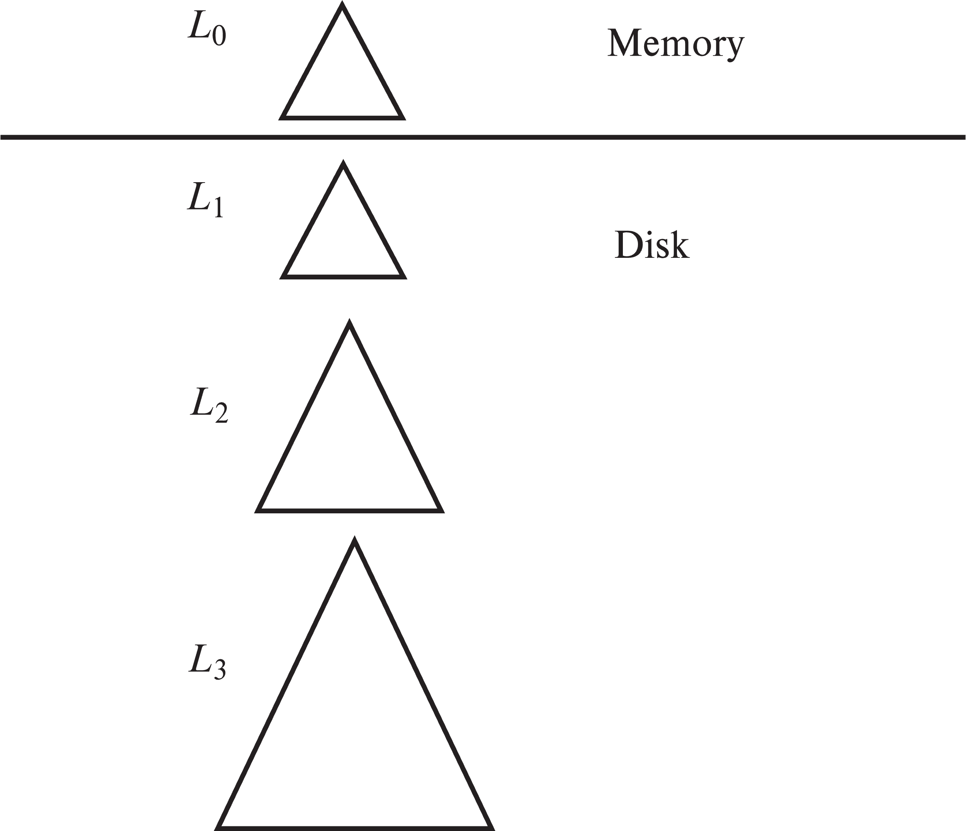
Log Structured Merge (LSM) Tree
Consider only inserts/queries for now
Records inserted first into in-memory tree (L₀ tree)
When in-memory tree is full, records moved to disk (L₁ tree)
B⁺-tree constructed using bottom-up build by merging existing L₁ tree with records from L₀ tree
When L₁ tree exceeds some threshold, merge into L₂ tree
And so on for more levels
Size threshold for L_{i+1} tree is k times size threshold for L_{i} tree

Slide 41
LSM Tree
Benefits of LSM approach
Inserts are done using only sequential I/O operations
Leaves are full, avoiding space wastage
Reduced number of I/O operations per record inserted as compared to normal B⁺-tree (up to some size)
Drawback of LSM approach
Queries have to search multiple trees
Entire content of each level copied multiple times

Slide 42
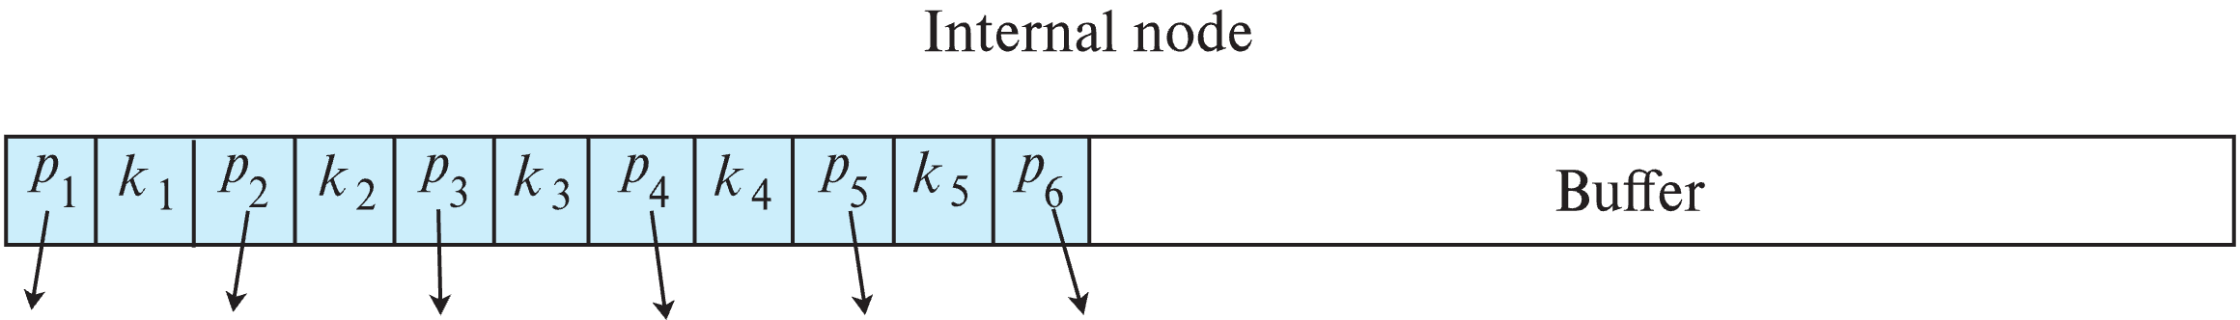
Buffer Tree
Each internal node of B⁺-tree has a buffer to store inserts
Inserts are moved to lower levels when buffer is full
With a large buffer, many records are moved to lower level each time
Per record I/O decreases correspondingly
Benefits
Less overhead on queries
Can be used with any tree index structure
Used in PostgreSQL Generalized Search Tree (GiST) indices

Slide 43
Bitmap Indices

