Slide 1
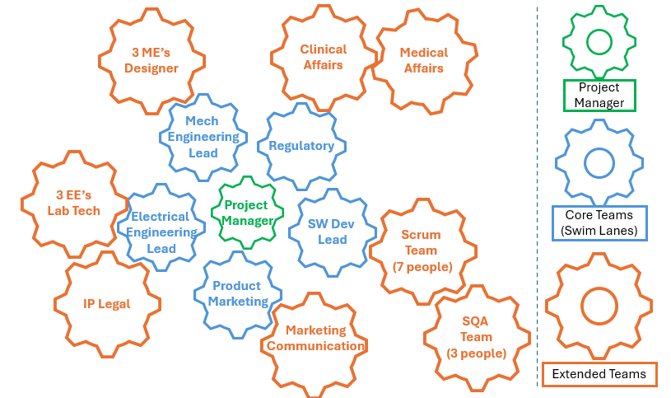
3 ME’s
Designer
Clinical
Affairs
Medical
Affairs
Project Manager
Mech
Engineering
Lead
Regulatory
3 EE’s
Lab Tech
Project
Manager
Electrical
Engineering
Lead
SW Dev
Lead
Core Teams
(Swim Lanes)
Scrum
Team
(7 people)
Product
Marketing
IP Legal
Marketing
Communication
SQA
Team
(3 people)
Extended Teams

Slide 2
Project Manager
Swim Lane
Owner
Swim Lane
Owner
Swim Lane
Owner
Swim Lane
Owner
Swim Lane
Owner
Swim Lane
Owner
Extended Team
Extended Team
Extended Team
Extended Team
Extended Team
Extended Team
Swim Lane
Owner
Swim Lane
Owner
Swim Lane
Owner
Swim Lane
Owner
Swim Lane
Owner
Swim Lane
Owner
Extended Team
Extended Team
Extended Team
Extended Team
Extended Team
Extended Team

