Slide 2
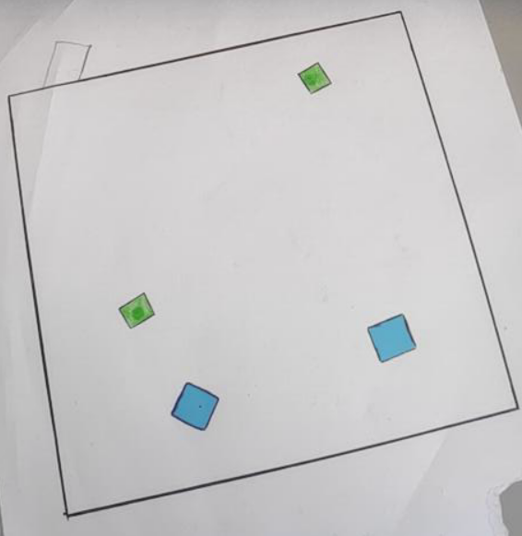
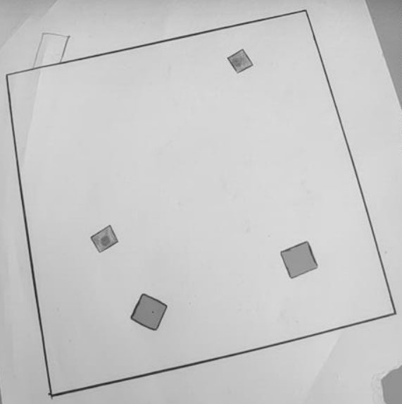
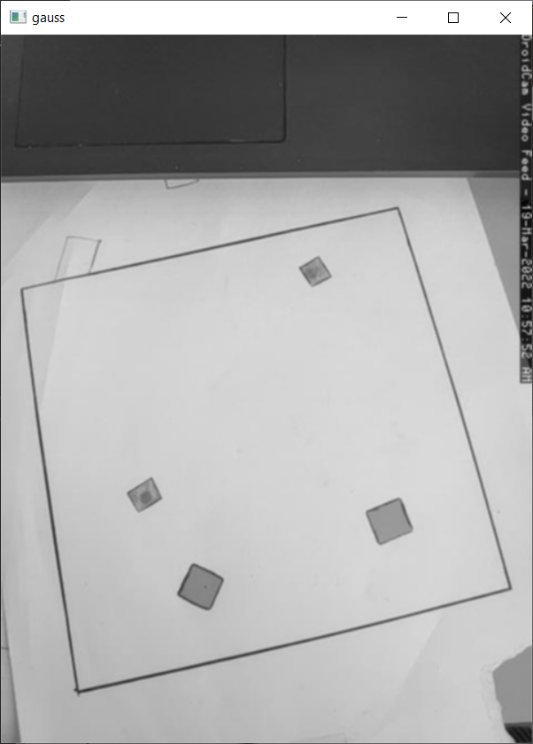
Preparing image for processing
Input image
Grayscale
Gaussian blur

Slide 3
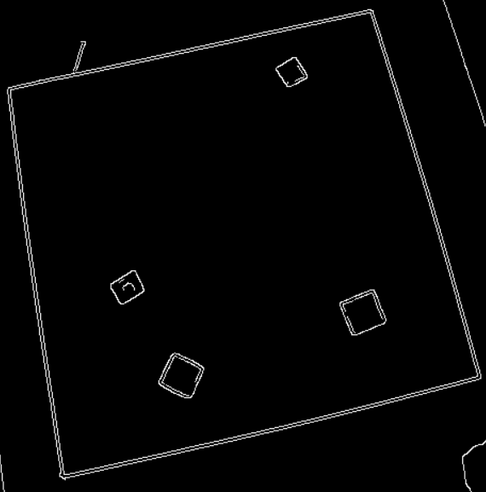
Canny edge detector

Slide 4
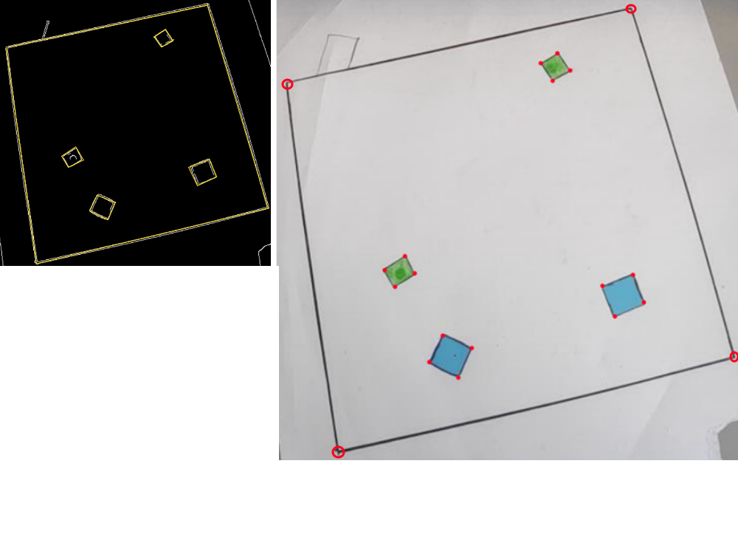
Polygon approximation
Ramer-Douglas-Peucker algorithm
Curve consisting of line segments→similar
curve with fewer points

Slide 5
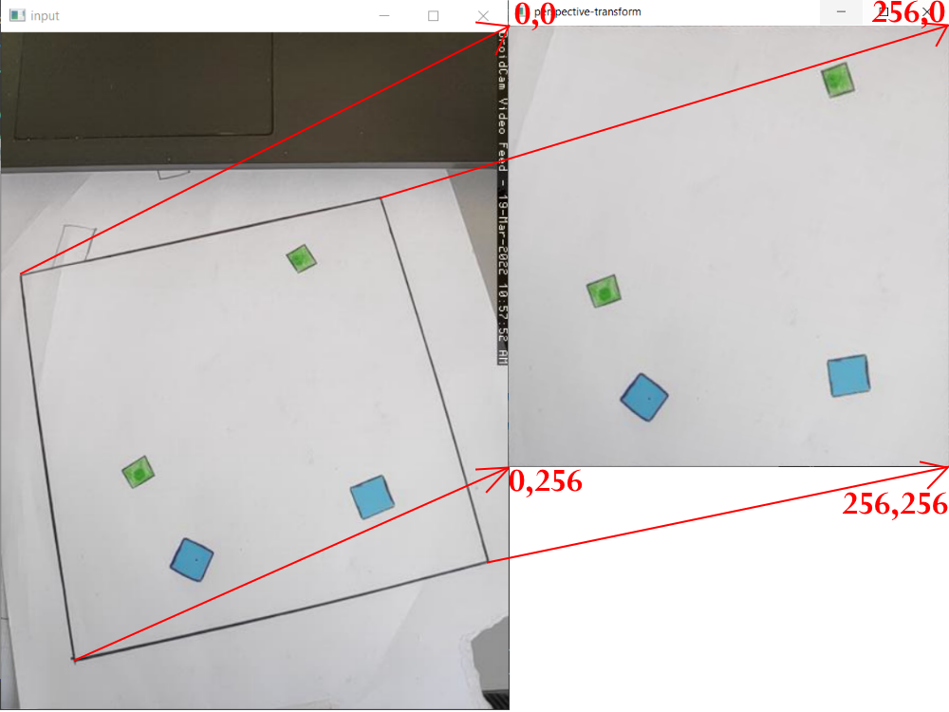
Perspective transformation

Slide 6
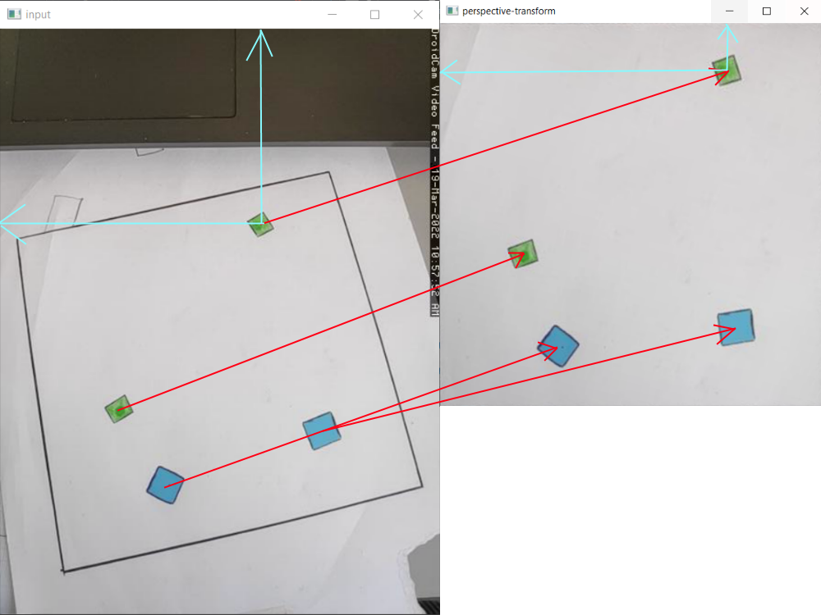
Transform center points of squares
1 Byte for X and Y coordinates
Easy data transfer to MCU

