Slide 1
Notes:
Thanks for coming

Slide 2
OSINT Basics And Tools

Slide 3
Ethics
Don’t hack without permission
Active members sign an ethics code every semester! The presence of a vulnerability in a system is NOT an invitation. Thank you.

Slide 4
What is OSINT?
According to the US DOD:
“Open-source intelligence (OSINT) is intelligence that is produced from publicly available information and is collected, exploited, and disseminated in a timely manner to an appropriate audience for the purpose of addressing a specific intelligence requirement.”
Basically using public information to get what you want. What you want depends

Slide 5
Examples of OSINT.
A lot of people mistake OSINT as “just googling things”, although that can be one aspect of it! Osint can include googling in a specific way to find certain information/vulnerabilities (google hacking/dorking) but can also be:
Using information from an NMAP scan to exploit a vulnerability in a software.
Finding relatively/exactly where a picture was taken.
Looking through social media posts for answers to security questions.
Finding Missing People (Trace Labs CTF)
Finding devices that are vulnerable to some CVE.

Slide 6
Google Dorking
A lot of people may think they know how to google things but do you “really” know how to? Google has a lot of “commands” such as “filetype”, “site” and “intitle” that you can leverage to find things you wouldn’t be able to. This is possible because companies and people don’t realize what google actually has.
Examples:
intitle:”LiveView / – AXIS” | inurl:view/view.shtml
intext:username:root AND intext:password filetype:txt
(for the examples if you use things like robots.txt properly, this would not be public!)

Slide 7
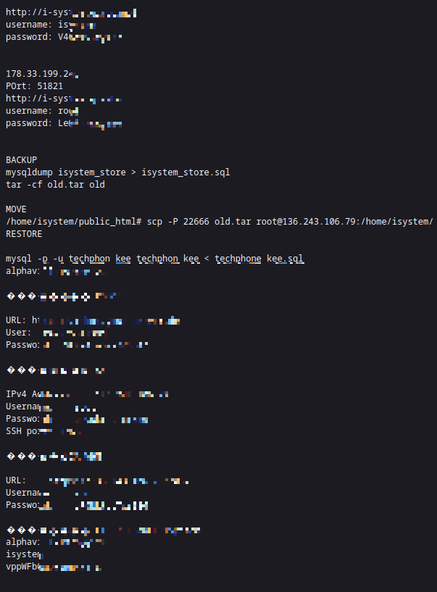
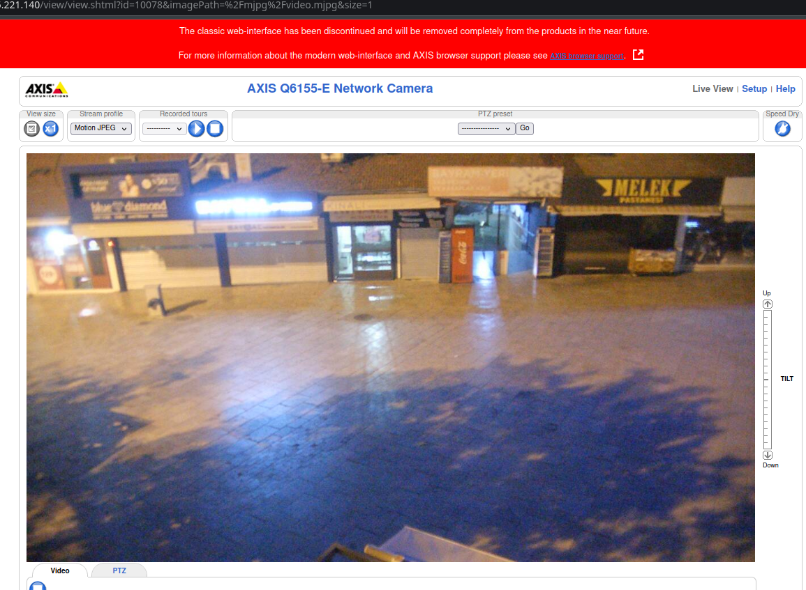
Google Dork examples cont:

Slide 8
OSINT Tools
Unfortunately there are too many osint tools to go over as there are many niche tools (for example: one that scans google docs for owner information, one that will show deleted Reddit posts, etc.) But fortunately, there are a TON listed here (and I mean a ton! Protip for any cyber stuff: add “awesome” in front of it to get a lot of information crammed into a tiny github):
https://github.com/jivoi/awesome-osint
I’ll go over some of my favorite tools, but often you will need specific tool for specific thing.

Slide 9
Usefulness of OSINT
OSINT Is very useful as it is a way to get information for free, and information that Everyone has access to. It is also important to know as if you are doing a security audit of a company, you may want to try to see if they or their employees are actually putting the company at risk by what they post online! OSINT can also be as simple as googling “how to make a cake”, so it is a very broad category.
A lot of people also don’t realize what is online about them! A way to practice OSINT can be seeing what is available on YOU online. (I.E. using just your name, what could a person leverage?)

Slide 10
My Personal Favorite OSINT Tools
The next few slides I will show some of my favorite OSINT tools that I use whenever I do things such as CTFs. At the end of the day, if your CTF gives you something like “Here is a barcode”, your osint tool would probably have to be something that gets information on a barcode.

Slide 11
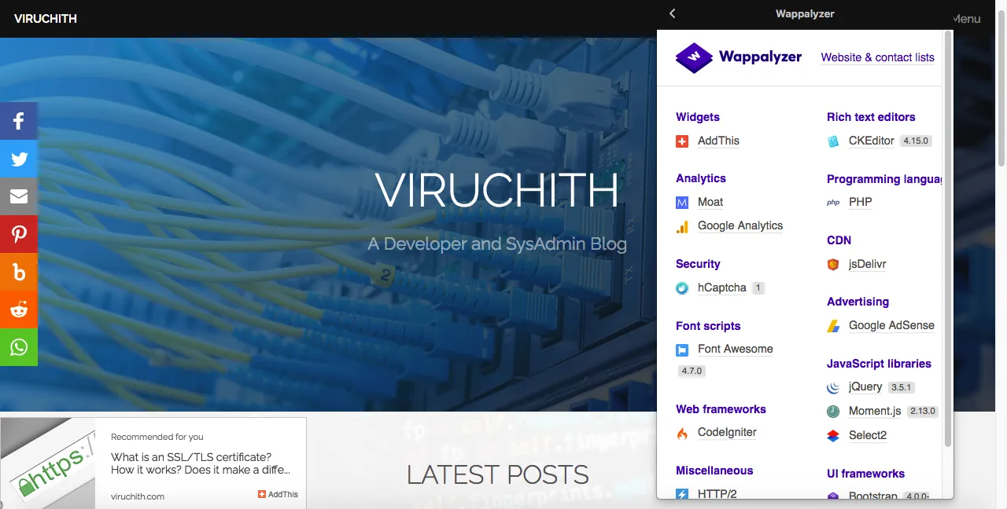
Wappalyzer
Wappalyzer (portmanteau of “Website Application Analyzer”) is a google chrome and firefox add on that can give you information on any website you visit. This is good for Website Exploitation as it can tell you if the Site is running any vulnerable software.

Slide 12
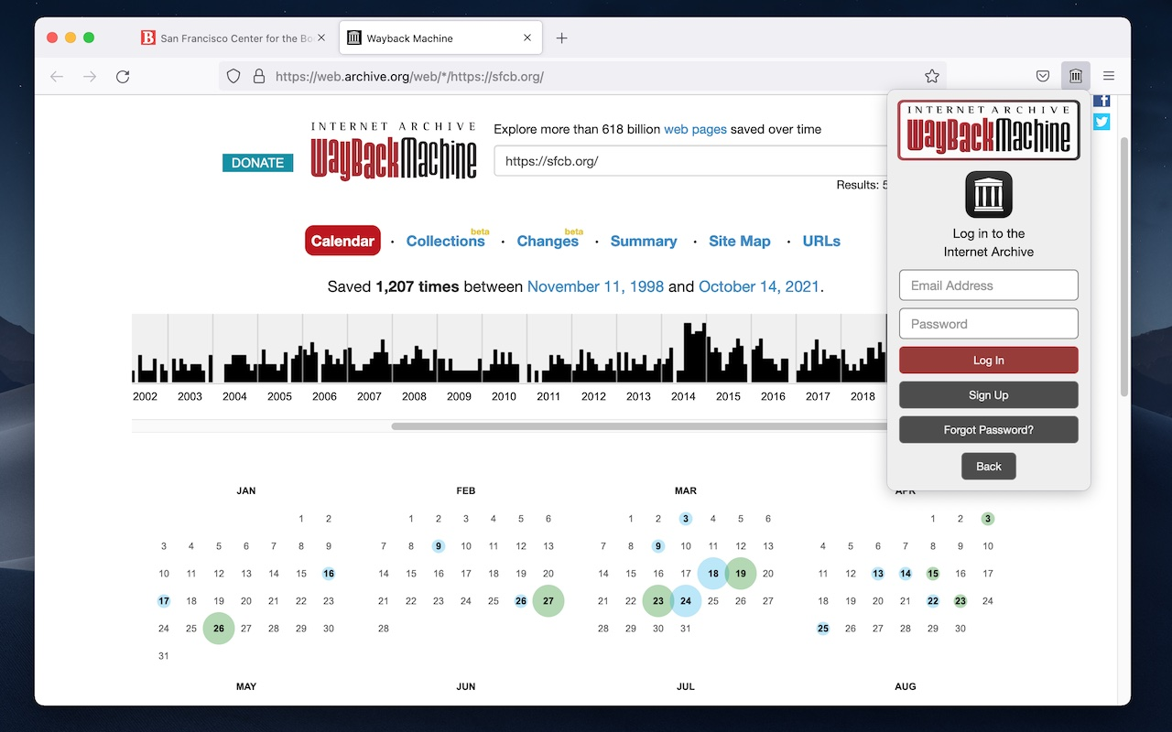
Wayback Machine
Wayback machine is a website that has “snapshots” on many different website. What this means is it will have an older version of a webpage even if the website was deleted or heavily changed! This can show early stages of a website in development and show sensitive information.

Slide 13
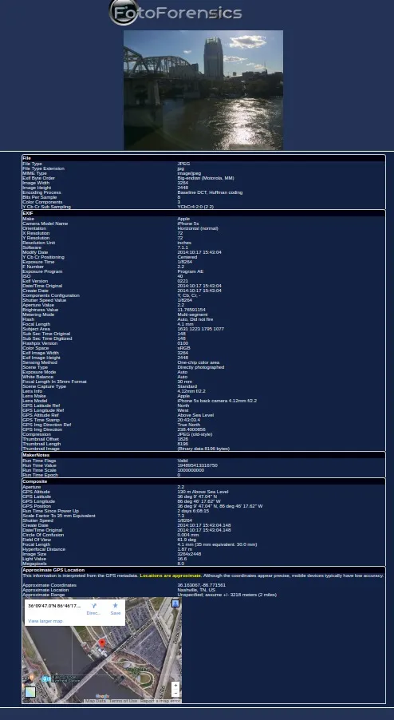
FotoForensics
FotoForensics is a website that allows you to look at metadata on photos! Some people don’t realize that photos they take with their phone can store the exact gps location! Most social medias will remove this automatically, but personal websites may not.

Slide 14
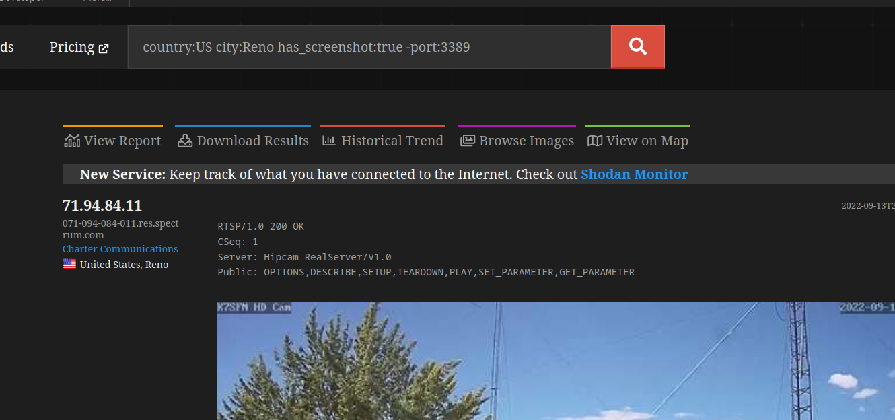
Shodan.io
Shodan is a tool that scans the Entire internet once a week and keeps what it finds on their website. You can use it for all sorts of searches, such as for specific organizations and their computers, or for other things. Below is a search I did for things in Reno that had some footage but wasn’t a computer.

Slide 15
Reverse Image Search
Something some people may not realize, but you can actually search by images on google and other platforms! I do have to stress this is NOT a great way to see if a photo is unique, BUT is a great way to see if a photo ISN’T unique. (That may seem confusing but basically, if you don't see results that doesn't mean a photo is unique, it could be on a website that has google crawling blocked like twitter).
This is a great way to also see if any photo has been fabricated. For example: In a crypto ctf challenge, there was a photo with no metadata or hidden file in it, so we reverse image searched it and saw that the exact photo was online, but it didn’t have some flags. Knowing the crypto had to do with the flags, we searched for flag ciphers and found how to decrypt the message!

Slide 16
Google
Already talked about this, but I seriously mean this google is your best friend. Well not really, don’t use google for your regular day to day life, but for OSINT google is an amazing resource!.

Slide 17
QnA and Example NCL Problems

Slide 18
Practice!
https://github.com/NevadaCyberClub/knowledge-base under Club_Made_Ctf/Challenges/OSINT is where you can find some practice challenges I made. The solutions may or may not be up yet, so feel free to dm me more help if needed.

