Slide 2
DISCLAIMER
Although port scanning is not illegal it is still a gray area and if done incorrectly could lead to an unintentional Denial of Service attack, or Accidental exploitation of a vulnerable service, which IS Illegal. It can also set off intrusion detection

Slide 3
What is a Server?
A server is a computer, like your phone or laptop, with a specific purpose. Some examples of servers and functions include:
Database Servers
Game Servers
Web Servers
DNS Servers
Email Servers
And much more!
Servers help companies split tasks that need to be done on a computer into different machines. Usually servers can be accessed remotely over the internet or internal network. This means that sometimes anyone is able to see your server, which may or may not be a good idea….

Slide 4
What is a Port?
A port is an entry point into a server or computer through some network protocol such as tcp or udp.
Whenever you want to communicate with something remotely through a network, that connection is held on a port
Usually Servers will host programs on ports, some have specific numbers, but you can technically host any program on any port! For example, http is port 80, ssh is port 22, and dns on port 53.
A way to think of a port is like a door to a classroom in a school
The doors can be open or closed
Each room could be different things, such as a class, club, or meeting
Anyone can go into an open door

Slide 5
What is Port Scanning?
Port scanning is a way to find what services/programs are running on each port.
Port scanners like NMAP, go to every single port and makes a connection to see what could be running on it. Think of it like you going down the school hall and seeing what classes are being held by peaking in.
Not all ports have to have something on them (there are more than 65000 of them on a single computer!), but you can hold any program on any port

Slide 6
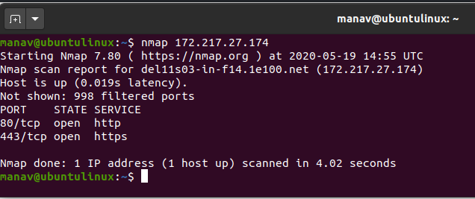
Port Scanning with nmap
As mentioned nmap can help us scan a server for what services can be running
Nmap has many different modes and ways to scan to bypass IDS and such
https://www.stationx.net/nmap-cheat-sheet/ is a great resource

Slide 7
Webservers
All websites, for the most part, are held on a webserver.
Whenever you connect to something like google.com, you get connected to a webserver!
HTTP is on port 80 usually and HTTPS on 443 usually.
Directories such as google.com/some/part/of/site do NOT change the port or what server you are on usually.

Slide 8
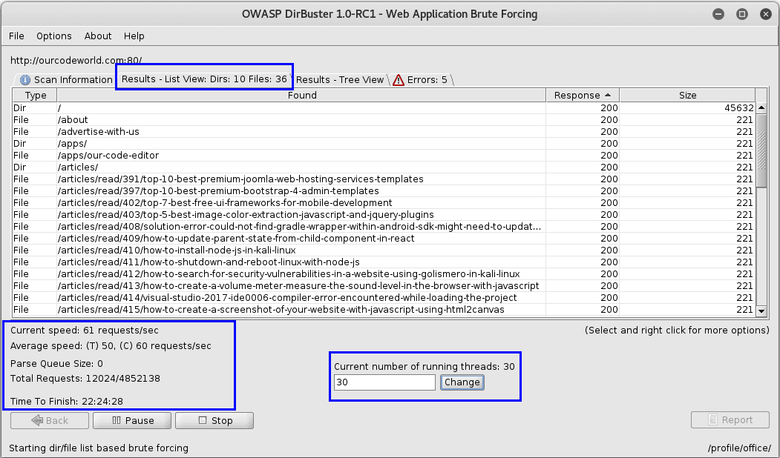
Brute Forcing with Dirbuster
Not all websites will have links to every part of the website! Sometimes some directories Even though accessible to anyone can only be accessed if you know the link.
Some companies will utilize this as a part of the technique called “Security through obscurity” (which is a terrible technique) Thinking that they can have private data held unauthorized, just because the link to it is not obvious, or directly accessible.
A bypass of this can be Brute Forcing the directories by trying a ton of different directories! Do note that this will cause A LOT of web traffic and can lead to unintentional DOS of smaller companies.
A good resource to learn dirbuster is:
https://null-byte.wonderhowto.com/how-to/hack-like-pro-find-directories-websites-using-dirbuster-0157593/

Slide 9
Custom Scanners
Though mostly out of scope, sometimes you may need to make your own scanner as you need it to scan for something very specific. This is out of scope of this presentation, but you can use libraries like Scapy or even Bash to make whatever scanner you want! Some example scanners I have made for myself as research or for CTF competitions so you get and idea are:
Unsecure IP Camera scanner: Scans ip addresses for any unauthenticated rtsp ports with some security camera feed
Email server user enumeration: Using bash, this scanner connected to an email server and tested to see if a username existed in a given wordlist
Custom port scanner: Even though nmap exists, it’s good to know how to make a port scanner from scratch fast if the system you pivoted to during a pentest does not have connection to the outside internet and you cant get nmap on it.

Slide 10
Testing it out…

