Slide 1
Graph Embedding
Struc2Vec

Slide 2
Node2Vec
Biased Random Walk
Word2Vec

Slide 3
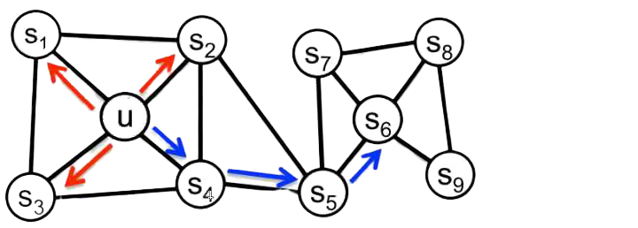
Node2Vec
Biased Random Walk
BFS
DFS

Slide 4
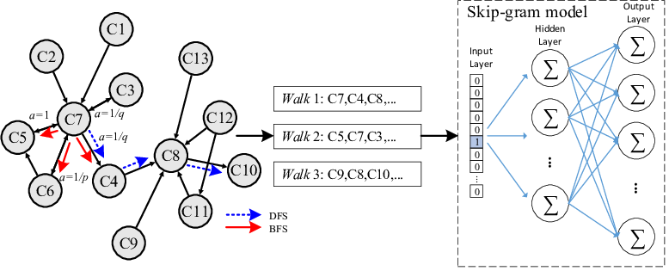
Node2Vec
Biased Random Walk
Word2Vec

Slide 5
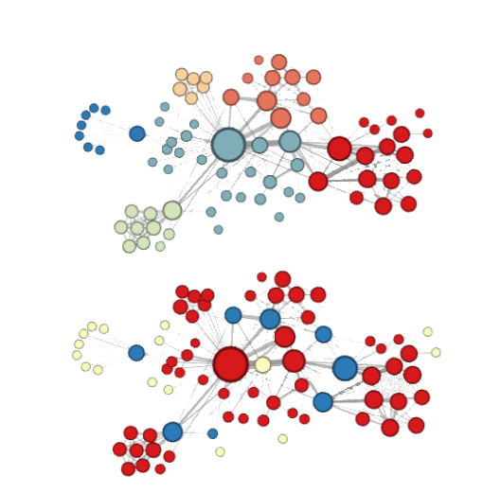
Node2Vec
Homophily
(network communities)
Structural equivalence
(structural roles)

Slide 6
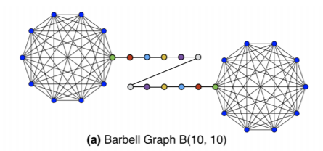
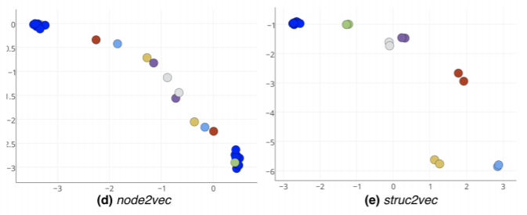
Struc2Vec

Slide 7
Struc2Vec
1.Structural similarity
2.Construct a weighted multilayer graph
3.Random walk
4.Word2Vec , Skip-Gram

Slide 8
Struc2Vec
1.Structural similarity
2.Construct a weighted multilayer graph
3.Random walk
4.Word2Vec , Skip-Gram

Slide 9
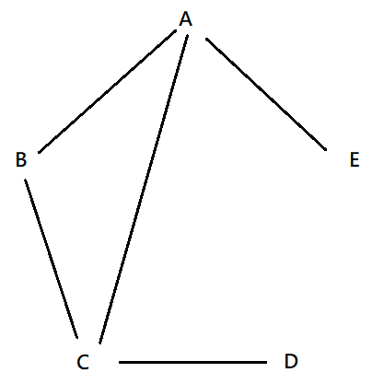
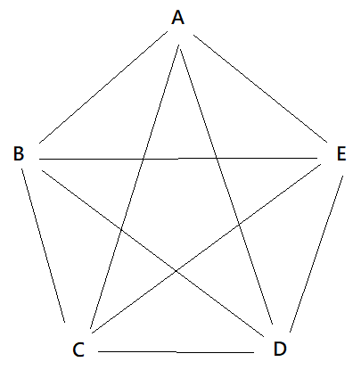
Struc2Vec
1.Structural similarity
2.Construct a weighted multilayer graph
3.Random walk
4.Word2Vec , Skip-Gram

Slide 10
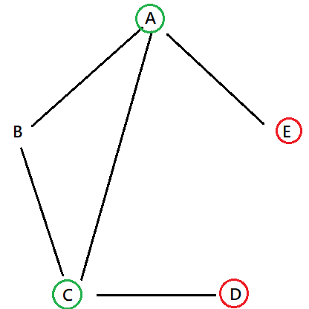
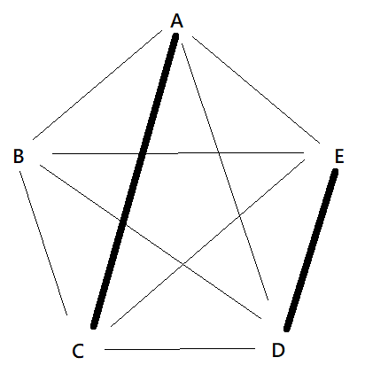
Struc2Vec
1.Structural similarity
2.Construct a weighted multilayer graph
3.Random walk
4.Word2Vec , Skip-Gram

Slide 11
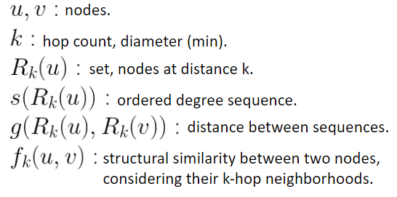
Struc2Vec
1.Structural similarity
2.Construct a weighted multilayer graph
3.Random walk
4.Word2Vec , Skip-Gram

Slide 12
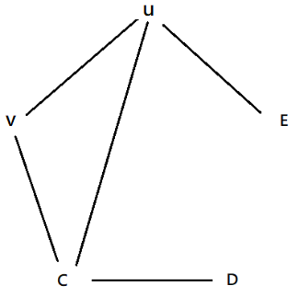
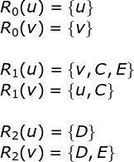
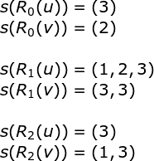
Struc2Vec
1.Structural similarity
2.Construct a weighted multilayer graph
3.Random walk
4.Word2Vec , Skip-Gram

Slide 13
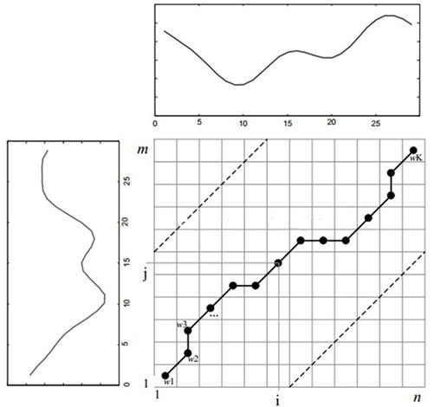
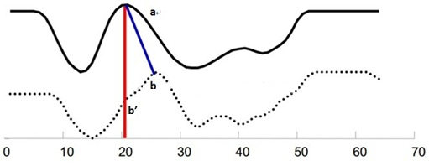
Dynamic Time Warping

Slide 14
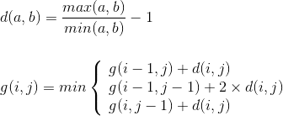
Dynamic Time Warping

Slide 15

Dynamic Time Warping
5 | 4 | 1.5 | 1.5 | 0.2
3 | 2 | 0.5 | 0.5 | 1
2 | 1 | 0 | 0 | 2
1 | 0 | 1 | 1 | 5
1 | 0 | 1 | 1 | 5
 | 1 | 2 | 2 | 6

Slide 16
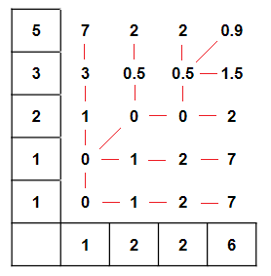
Dynamic Time Warping
5 | 4 | 1.5 | 1.5 | 0.2
3 | 2 | 0.5 | 0.5 | 1
2 | 1 | 0 | 0 | 2
1 | 0 | 1 | 1 | 5
1 | 0 | 1 | 1 | 5
 | 1 | 2 | 2 | 6

Slide 17
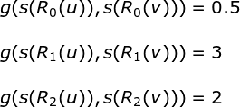
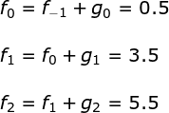
Struc2Vec
1.Structural similarity
2.Construct a weighted multilayer graph
3.Random walk
4.Word2Vec , Skip-Gram

Slide 18
Struc2Vec
2.Construct a weighted multilayer graph
2.Construct a weighted multilayer graph
3.Random walk
4.Word2Vec , Skip-Gram

Slide 19
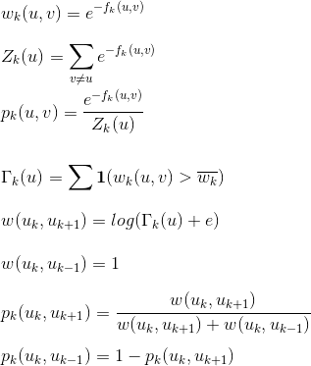
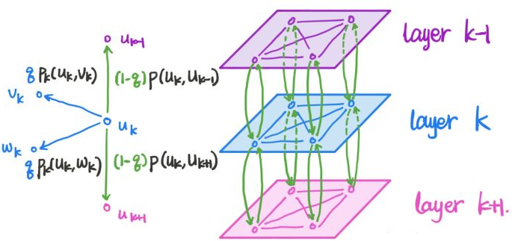
Struc2Vec
2.Construct a weighted multilayer graph
2.Construct a weighted multilayer graph
3.Random walk
4.Word2Vec , Skip-Gram

Slide 20

Struc2Vec
2.Construct a weighted multilayer graph
2.Construct a weighted multilayer graph
3.Random walk
4.Word2Vec , Skip-Gram

Slide 21
Struc2Vec
Complexity
O(Structural similarity)
=O(DTW X nodes pairs X K layers)
=O( n X n(n-1)/2 X k )
=O(k n³)
2.Construct a weighted multilayer graph
3.Random walk
4.Word2Vec , Skip-Gram

Slide 22

Struc2Vec
Complexity
O(Structural similarity)
=O(DTW X nodes pairs X K layers)
=O( n X n(n-1)/2 X k )
=O(k n³)
2.Construct a weighted multilayer graph
3.Random walk
4.Word2Vec , Skip-Gram
Optimization
1.DTW
compressed ordered degree sequence.
2.nodes pairs
compute log(n) th pairs .
3.K
decrease.

Slide 23
References
1.struc2vec: Learning Node Representations from Structural Identity
https://arxiv.org/pdf/1704.03165.pdf
2.notes
https://zhuanlan.zhihu.com/p/63175042
https://zhuanlan.zhihu.com/p/42559966
3.introduce graph embedding
https://www.itread01.com/content/1544498355.html
4.struc2vec code
https://zhuanlan.zhihu.com/p/56733145
https://github.com/shenweichen/GraphEmbedding
5.DTW
http://mirlab.org/jang/books/dcpr/dpDtw.asp?title=8-4%20Dynamic%20Time%20Warping&language=english

Slide 24
Thanks!

