Slide 1
Sales Forecasting

Slide 2
Agenda
Overview
LSTM
Seq2Seq
Keras Implementation for Sales Forecasting
Difficulties and Tips
Future Works

Slide 3
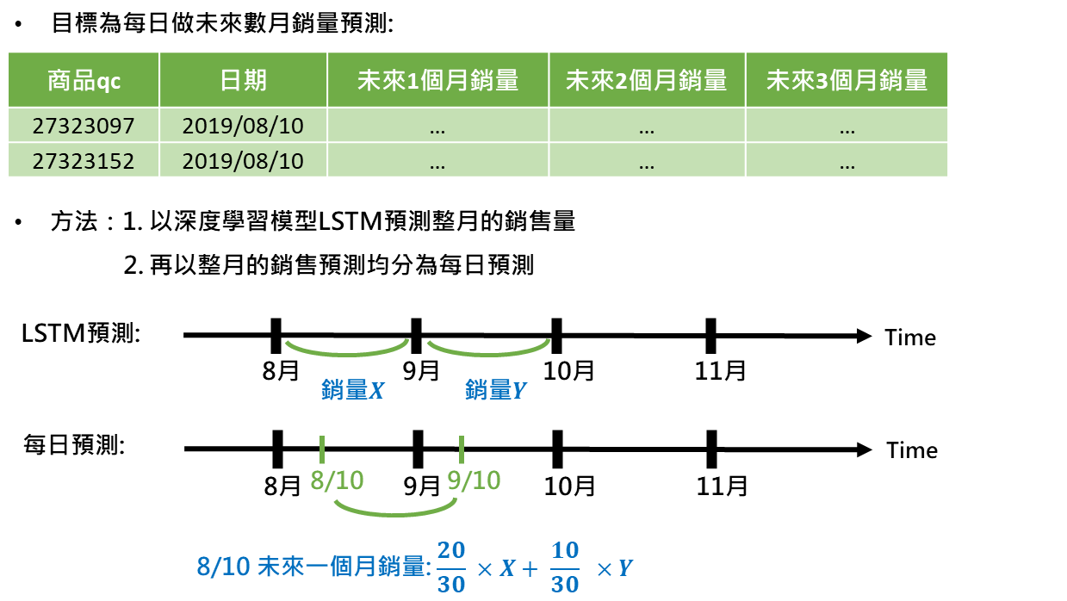
Overview
Order Data Summary
Total Record # | 472,252
Unique Product ID # | 1,494
Record # per ID | 316
Model Forecasting
N Month Historical Sales
Future 4 Month Sales
Time
Now

Slide 4
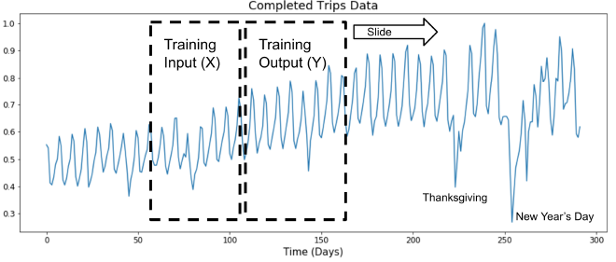
Overview – Generate Training Data
Use sliding window to generate training data
Product: ABC
Time | Sales
201710 | 12
201711 | 10
201712 | 10
201801 | 7
201802 | 22
201803 | 15
201804 | 6
201805 | 5
201806 | nan
201807 | 2
201808 | 14
201809 | 12
201810 | 17
201811 | 19
X
X
X
Y
Y
Y

Slide 5
Overview – Train Test Split
X
Y
X
Y
Training Set
Test Set
Time series
Test Time

Slide 6
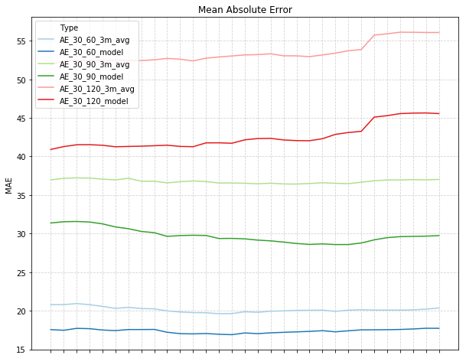
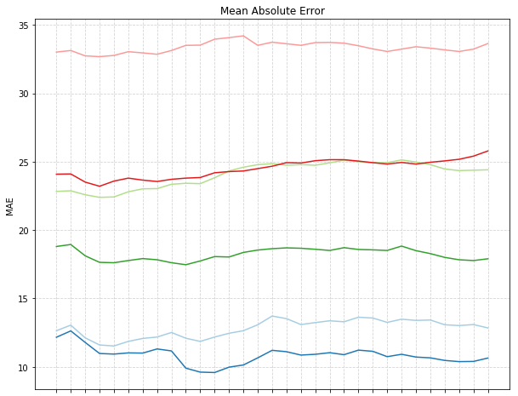
Overview – Results
Lower20%
Lower25%
Lower25%
Lower20%
Lower15%
Lower17%
~450 products
~70 products

Slide 7



















NN vs RNN
Standard Neural Network
Recurrent Neural Network
$$x^{<1>}$$
$$y^{<1>}$$
$$y^{<1>}$$
$$y^{<2>}$$
$$y^{<t>}$$
$$w_{ay}$$
$$w_{ay}$$
$$w_{ay}$$
$$x^{<2>}$$
$$y^{<2>}$$
$$a^{<1>}$$
$$a^{<2>}$$
$$a^{<t−1>}$$
$$a^{<0>}$$
$$x^{<t>}$$
$$y^{<t>}$$
$$w_{aa}$$
$$w_{aa}$$
$$w_{aa}$$
$$w_{aa}$$
Inputs and outputs could be different lengths in different examples.
Doesn’t share features learned across different positions.
$$w_{ax}$$
$$w_{ax}$$
$$w_{ax}$$
$$x^{<1>}$$
$$x^{<2>}$$
$$x^{<t>}$$

Slide 8



















Close Look at RNN Cell
$$ŷ^{<t>}$$
softmax
$$y^{<1>}$$
$$y^{<2>}$$
$$y^{<t>}$$
$$w_{ay}$$
$$a^{<t>}$$
$$w_{ay}$$
$$w_{ay}$$
$$w_{ay}$$
$$w_{aa}$$
$$a^{<t>}$$
$$a^{<t−1>}$$
X
+
tanh
$$a^{<1>}$$
$$a^{<2>}$$
$$a^{<t−1>}$$
$$w_{ax}$$
$$a^{<0>}$$
$$w_{aa}$$
$$w_{aa}$$
$$w_{aa}$$
$$w_{aa}$$
X
RNN cell
$$w_{ax}$$
$$w_{ax}$$
$$w_{ax}$$
$$x^{<t>}$$
$$x^{<1>}$$
$$x^{<2>}$$
$$x^{<t>}$$
$$a^{<t>}=\tanh\left(W_{ax}x^{<t>}+W_{aa}a^{<t−1>}+b_{a}\right)$$
$$ŷ^{<t>}=\operatorname{softmax}\left(W_{ay}a^{<t>}+b_{y}\right)$$

Slide 9





The Problem of Long-Term Dependencies
$$y^{<100>}$$
Gap between relevant information and point needed could be very large. (vanishing or exploding gradients)
➔ RNNs become unable to capture relevant information when the gap is too large.
$$a^{<0>}$$
$$x^{<1>}$$
$$x^{<2>}$$
$$x^{<100>}$$

Slide 10
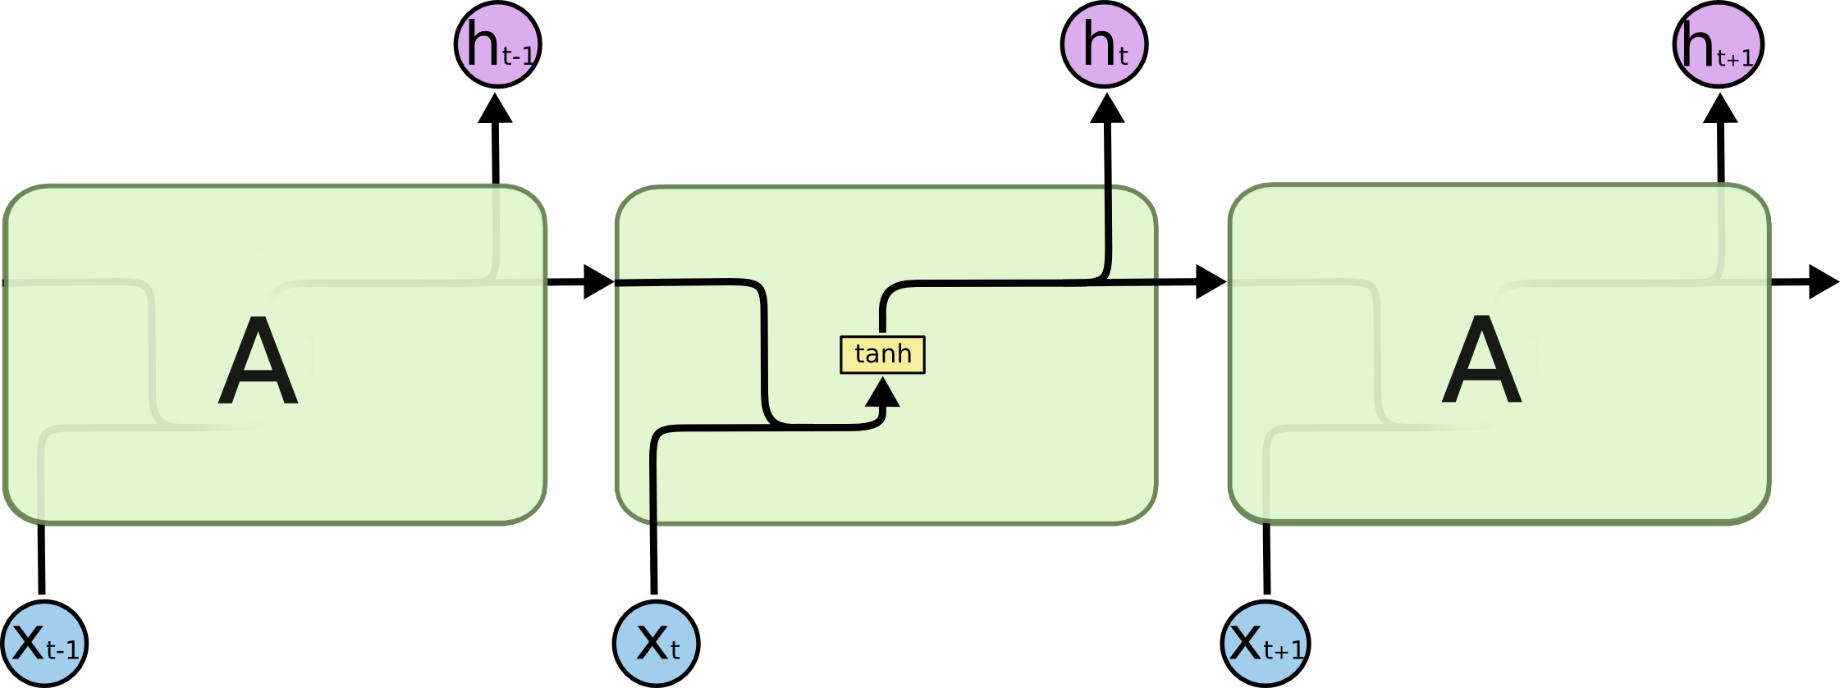

Long Short Term Memory (LSTM)
Notes:
http://colah.github.io/posts/2015-08-Understanding-LSTMs/

Slide 11
Long Short Term Memory (LSTM)
Core Idea of LSTM: the cell state runs straight down the entire chain, with only some minor linear interactions. It’s very easy for information to just flow along it unchanged.
Three Gates: LSTM has gates with sigmoid output to protect and control the cell state.

Slide 12
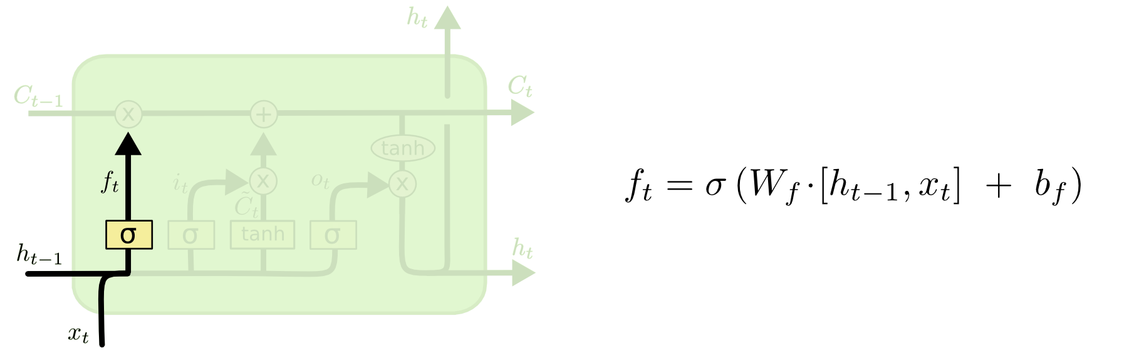
Step-by-Step – Forget Gate
Decide what old information to throw away from the cell state

Slide 13
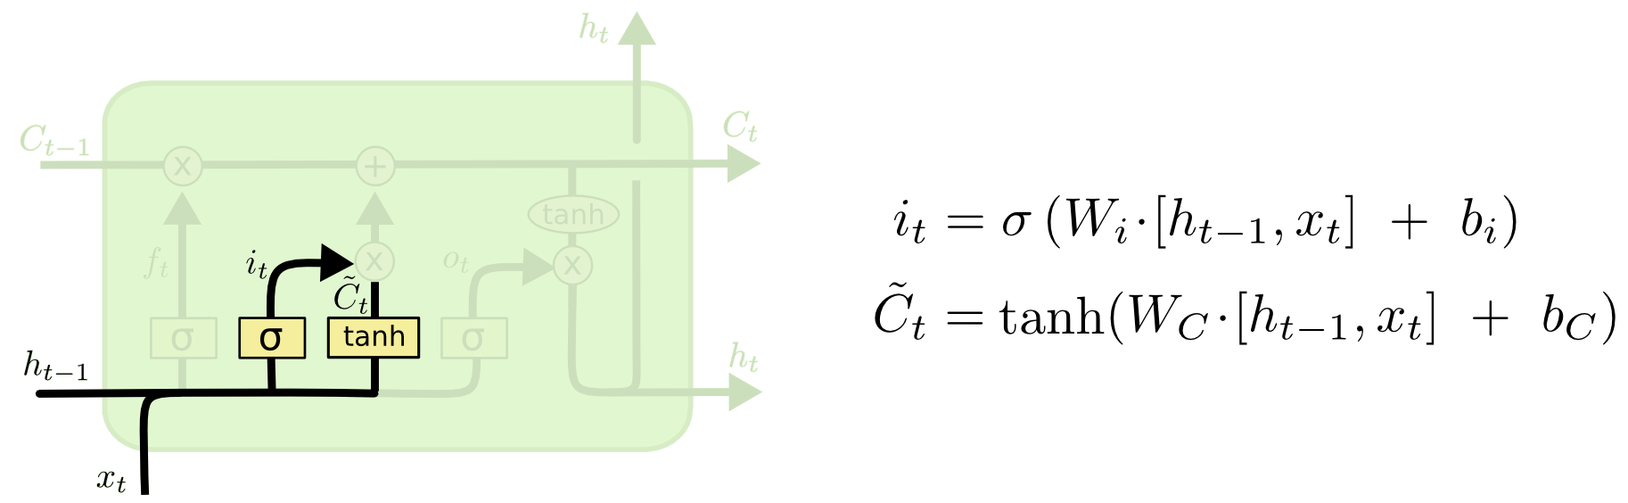
Step-by-Step – Update Gate
Decide what new information to store in the cell state
Create a vector of new cell state candidate

Slide 14
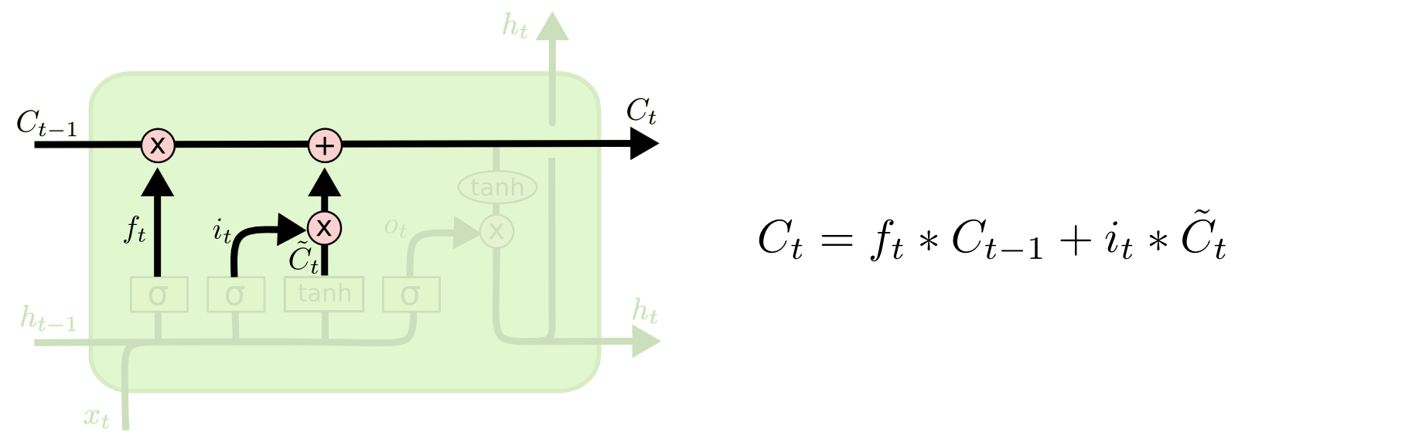
Step-by-Step – Update Cell State
Just actually update the old cell state with forget and update gates

Slide 15
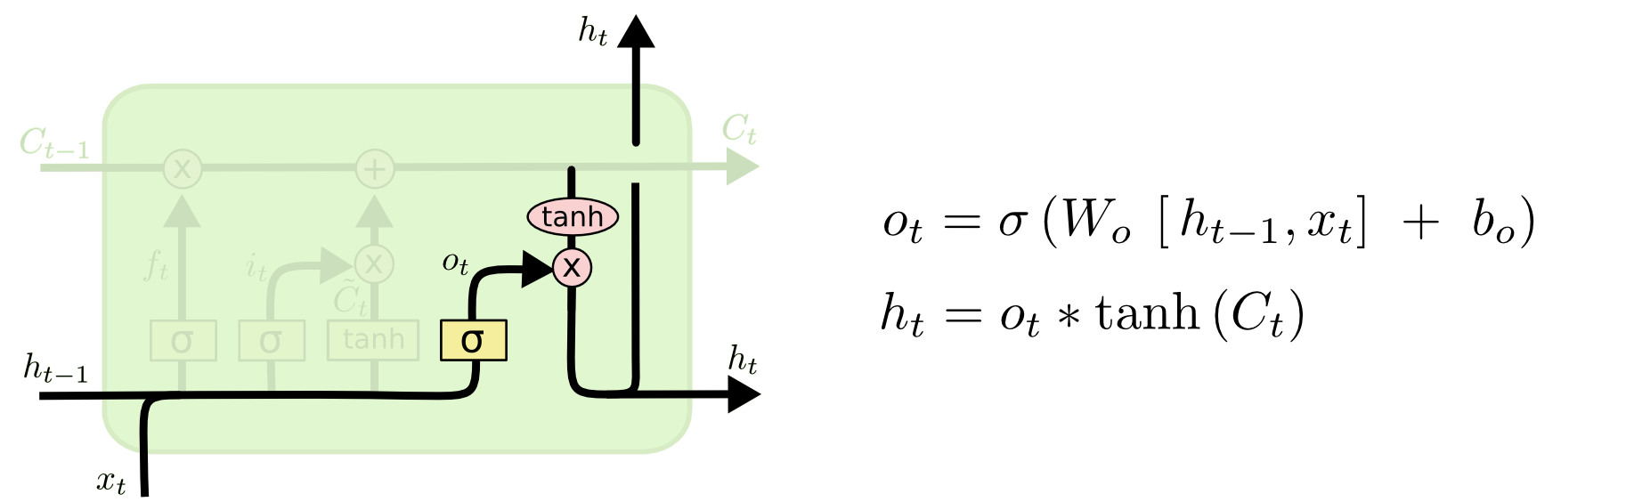
Step-by-Step – Output Gate
Decide what we are going to output

Slide 16
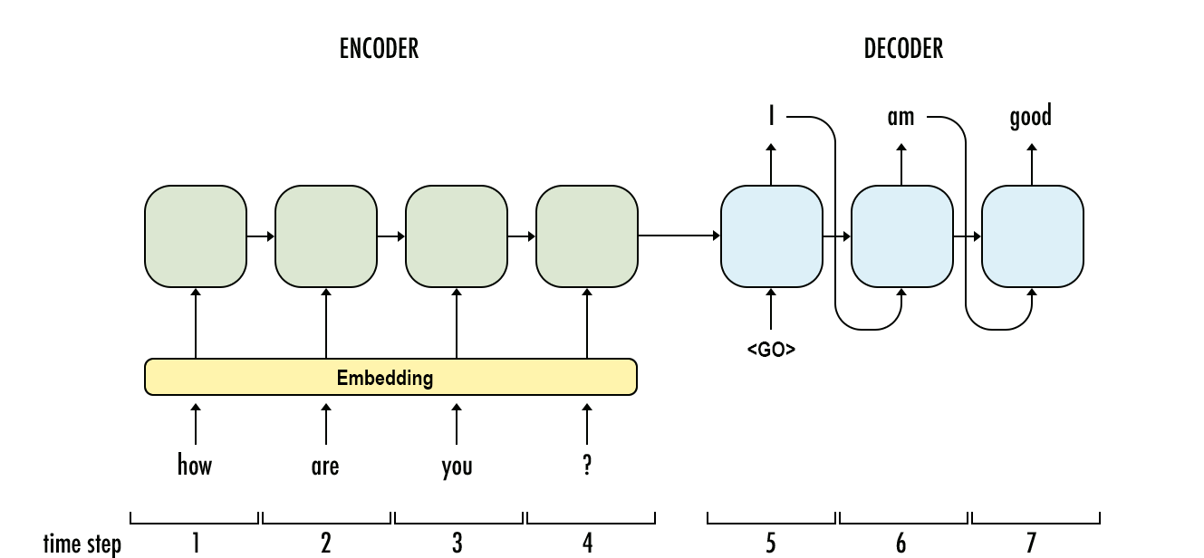
Seq2Seq
Seq-to-seq is an encoder-decoder architecture that encodes an input sequence to a vector of fixed dimension, and decodes the target sequence from that vector.
LSTM could be used to encode and decode sequences.

Slide 17






Seq2Seq for Time Series Forecasting
$$X_{T+1}$$
$$X_{T+F}$$
LSTM
LSTM
LSTM
LSTM
$$X_{1}$$
$$X_{T}$$
$$X_{T}$$
$$X_{T+F−1}$$
Teacher forcing only when training
Encoder
Decoder

Slide 18
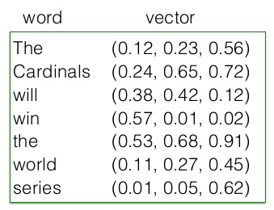
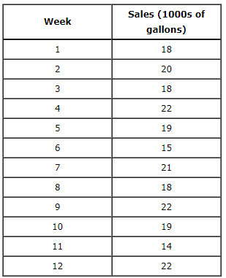
Implement Seq2Seq Using Keras
Keras LSTM layer requires input shape as three dimensions: (sample number, time step number, feature number)
➔
(1, 7, 3)
➔
(1, 12, 1)

Slide 19
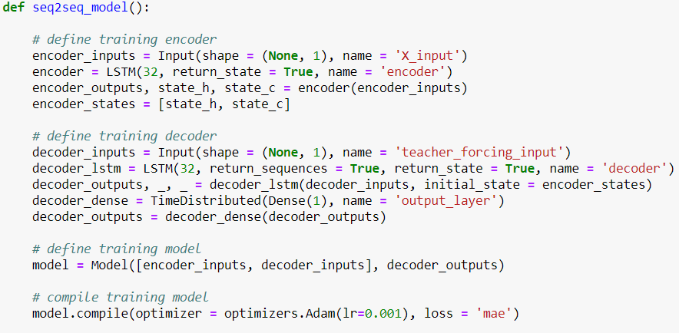
Implement Seq2Seq Using Keras
Training model

Slide 20
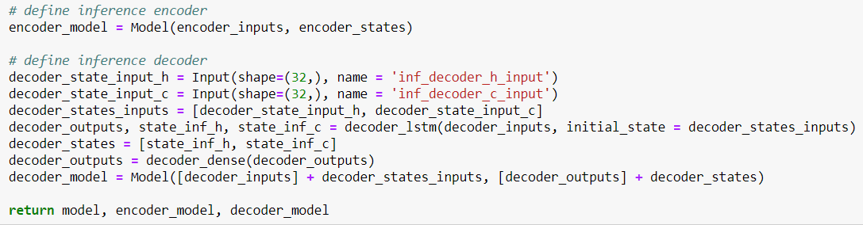
Implement Seq2Seq Using Keras
Inference models

Slide 21
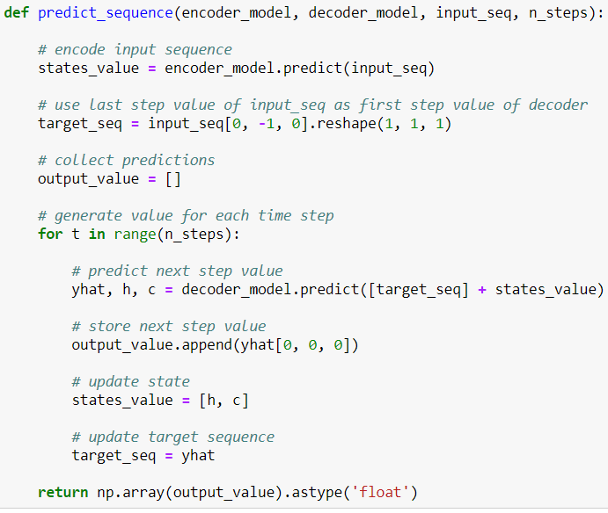
Implement Seq2Seq Using Keras
Inference

Slide 22
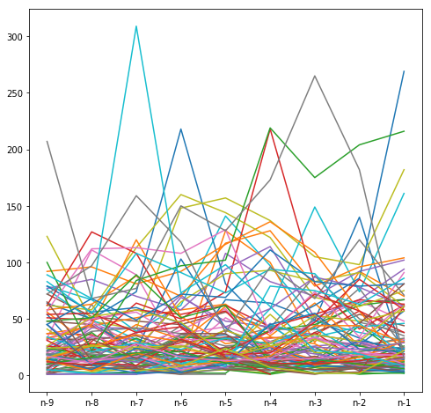
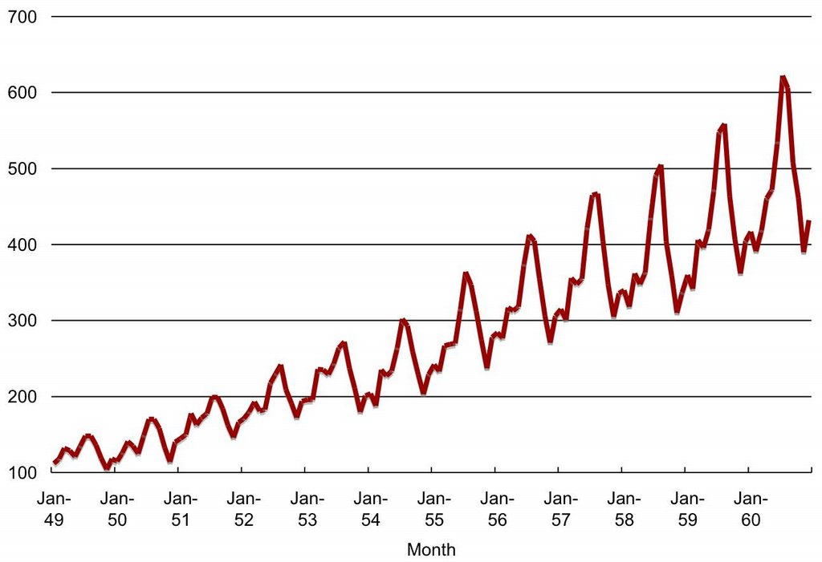
Difficulties and Tips

Slide 23
Difficulties and Tips
Too many products to forecast
( >1000 products for some brands)
Too sparse sales data
Too short sales data
(<9 months for most products)
Group similar products before modelling; Use LSTM model to learn from similar products’ data
Aggregate sales data by month
Use LSTM model to learn from similar products’ data
Extreme sales number
Sales number varies a lot between products
Sales from platforms including both online and offline ones
Smooth extreme sales before modelling; Collect event data
Normalize each sliding window before modelling
?

Slide 24
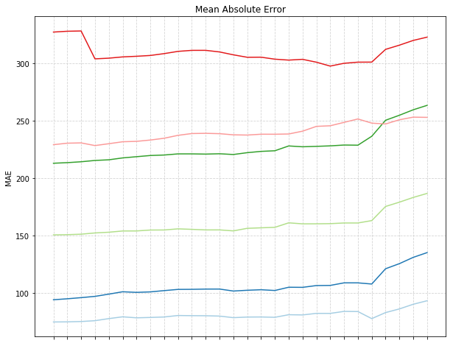
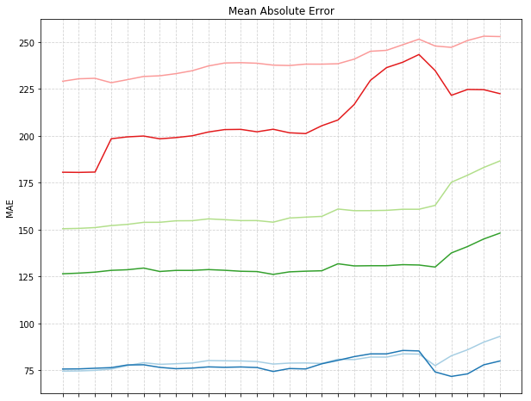
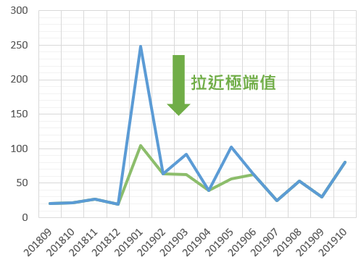
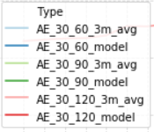
Smooth Extreme Sales
Improve model performance
Prevent extreme forecasting value

Slide 25
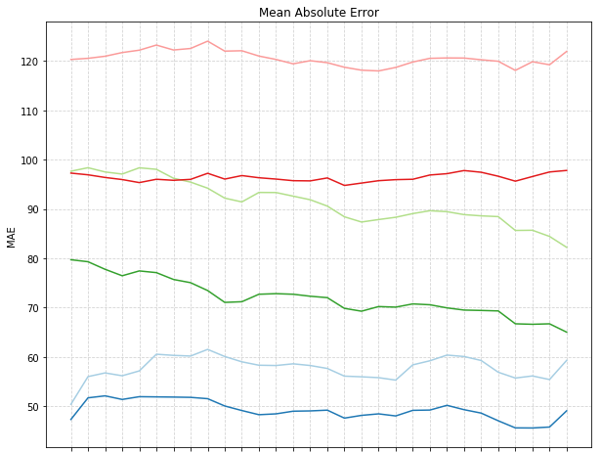
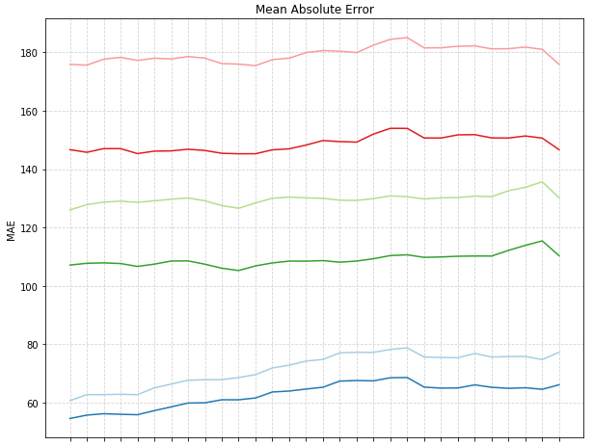
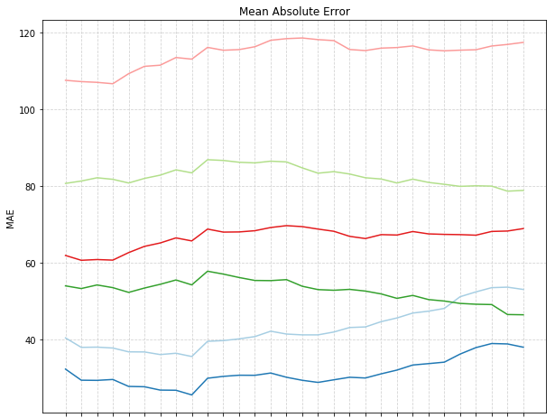
Build Models by Groups
Improve model performance by grouping similar products
Tune for optimal historical sales length and hyper-parameters for each group

Slide 26
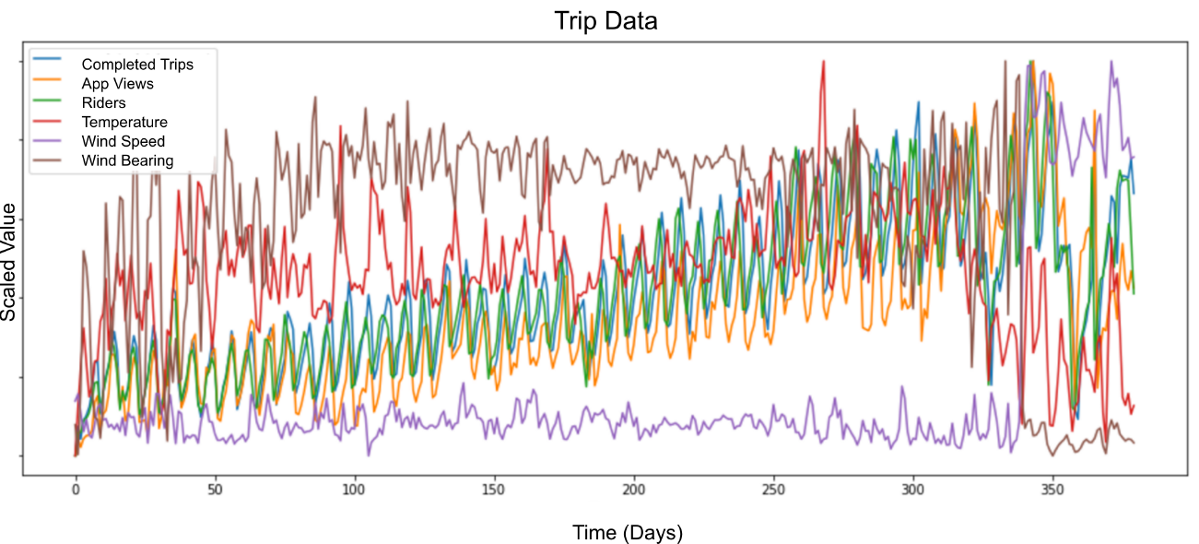
Future Works
Incorporate other relevant features (price, marketing event information etc.)

Slide 27
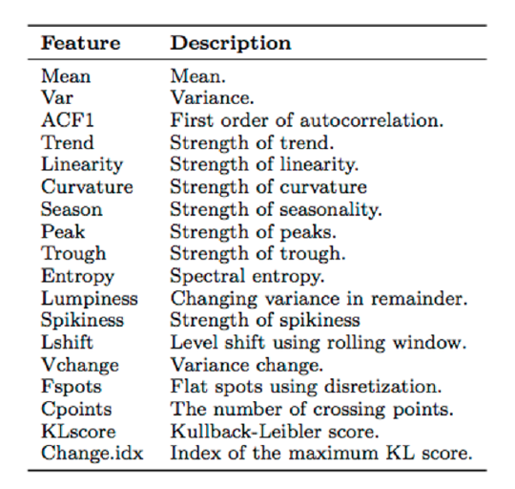
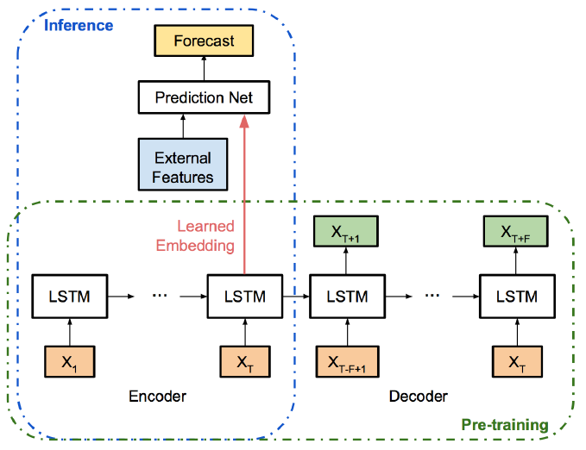
Future Works
Incorporate other relevant features (price, marketing event information etc.)

Slide 28
Thank You

