Slide 1
Graph Embedding
Node2Vec

Slide 2

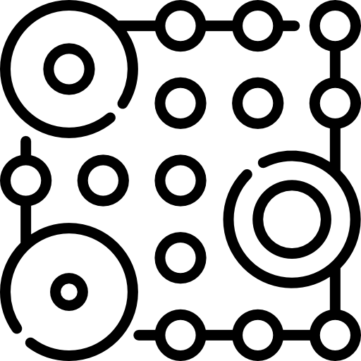

Feature Engineering
on Graph
Hand Craft
(domain specific)
Decompose
data matrix
Feature Learning
(node representation)

Slide 3
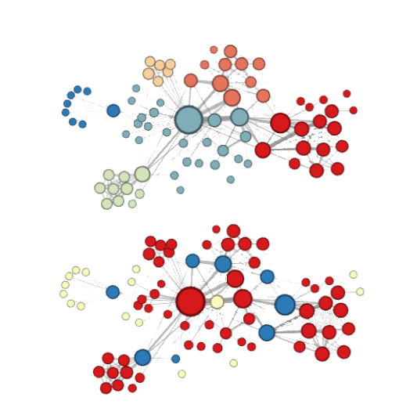
Node2Vec
Why ?
Homophily
(network communities)
Structural equivalence
(structural roles)

Slide 4
Node2Vec
Biased Random Walk
Word2Vec

Slide 5
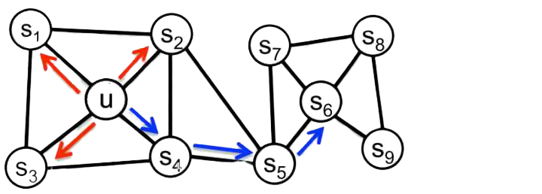
Node2Vec
Biased Random Walk
BFS
DFS

Slide 6
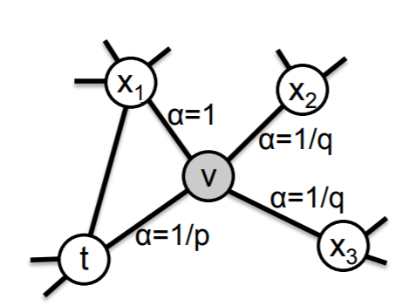
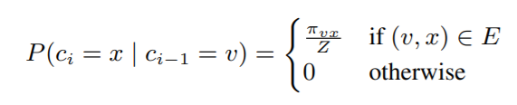

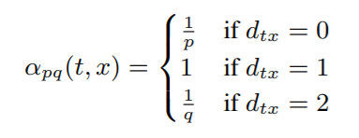
Node2Vec
Biased Random Walk

Slide 7
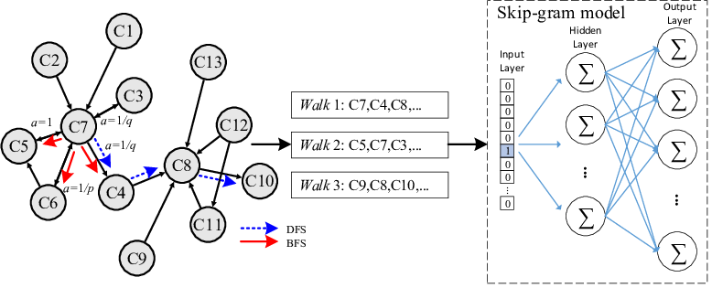
Node2Vec
Biased Random Walk
Word2Vec

Slide 8
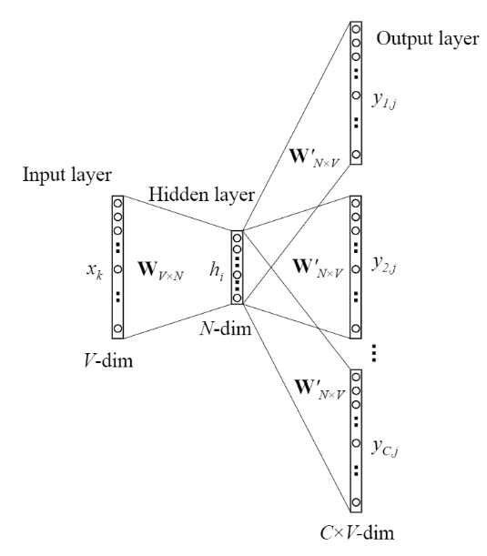



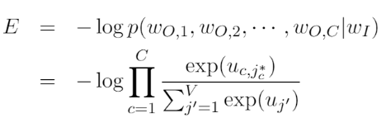
Node2Vec
Word2Vec

Slide 9
Node2Vec
Word2Vec
input representation
output representation

Slide 10
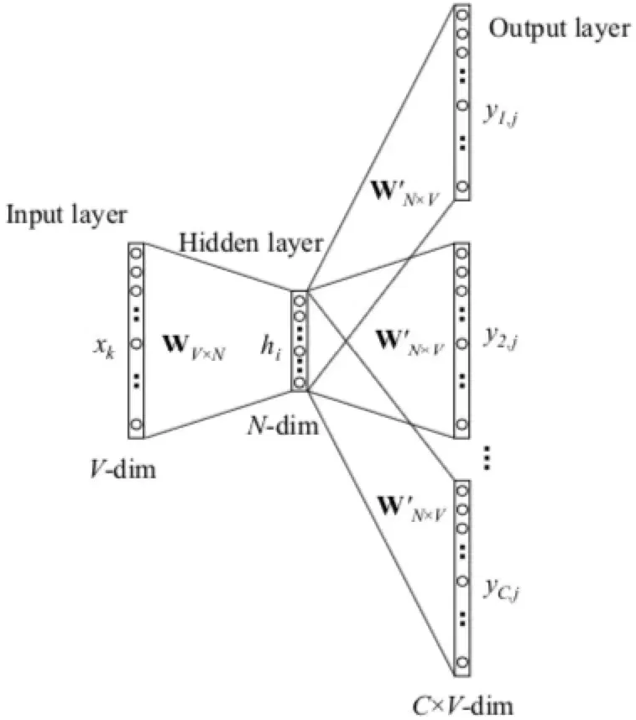
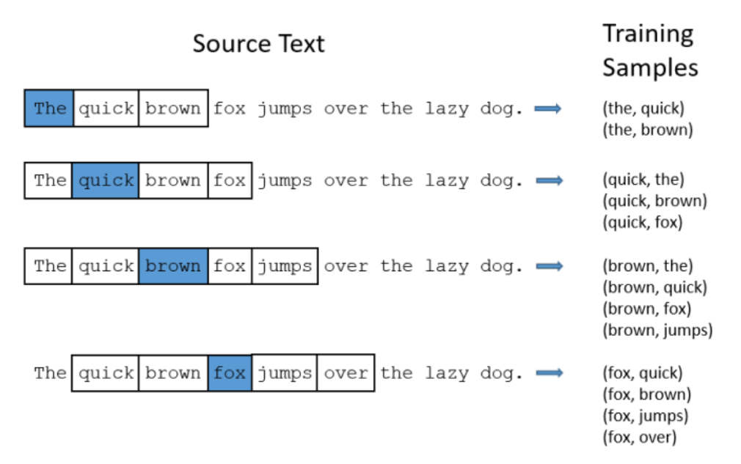
Node2Vec
Word2Vec
window size = 2

Slide 11
Application
in Real Problem
Node
Classification
predicting missing label in social network
predicting functional labels of proteins
Node
Clustering
identify nodes with similar roles
recommendation system

Slide 12
Application
in Real Problem
Node
Classification
predicting missing label in social network
predicting functional labels of proteins
Node
Clustering
identify nodes with similar roles
recommendation system
Link
Prediction

Slide 13
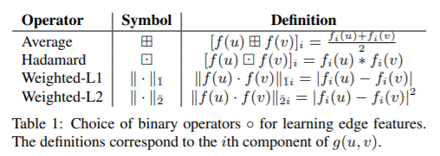
Application
in Real Problem
Node
Classification
predicting missing label in social network
predicting functional labels of proteins
Node
Clustering
identify nodes with similar roles
recommendation system
Link
Prediction
identify real-world friends
discover novel interactions between genes

Slide 14
Application
in Real Problem
Node
Classification
predicting missing label in social network
predicting functional labels of proteins
Node
Clustering
identify nodes with similar roles
recommendation system
Link
Prediction
identify real-world friends
discover novel interactions between genes

Slide 15
Node2Vec
Word2Vec
Demo

Slide 16
Pros & Cons
Pros | Cons
scalable: O(|V|d) can capture structural equivalence | too many parameter not easy to capture structural equivalence

Slide 17
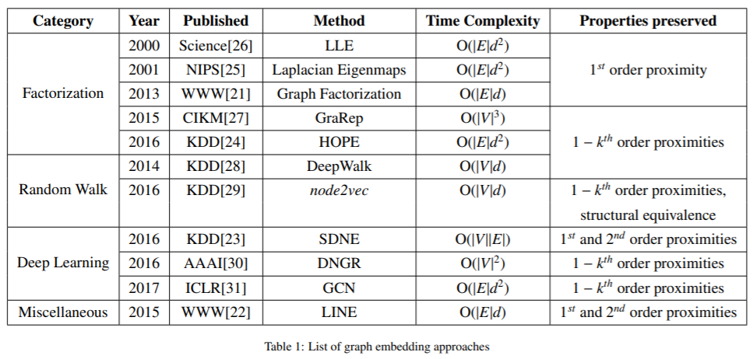
Pros & Cons

Slide 18
Pros & Cons
Tuning Parameter:
Biased Random Walk | Word2Vec
return parameter: p in-out parameter: q walk_length: l num_walks: r | window size dimensions learning rate epoch

Slide 19
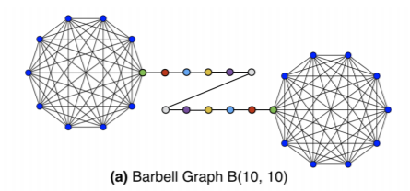
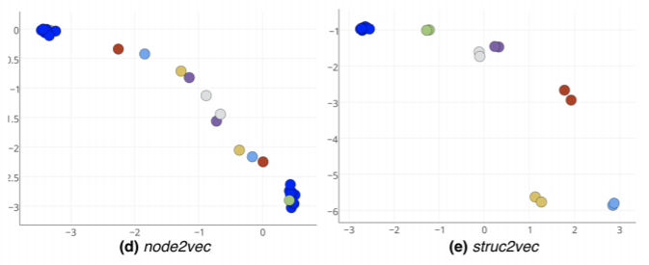
Next move...
Node2Vec
↓
Struc2Vec

Slide 20
Thanks!

