Slide 1
Hashing
Oneil Hsiao
2019.08.19

Slide 2
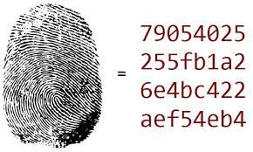
> What is hashing?
> Components for doing hashing
> Applications of hashing
H(x)

Slide 3
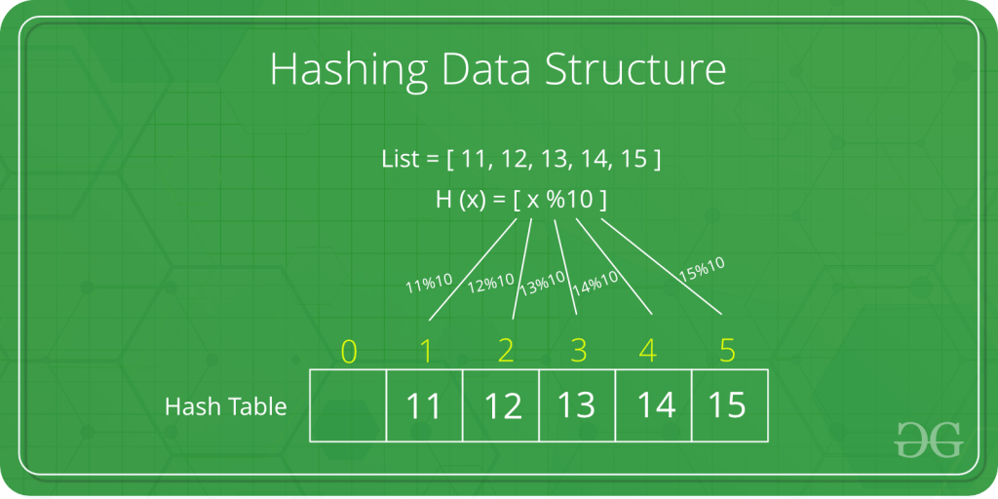
What is hashing?
A hash function H(x)
A hash table
- Collision Handling
- Chaining
- Open addressing
https://www.geeksforgeeks.org/hashing-data-structure/
Notes:
Collision Handling

Slide 4
Components for doing hashing
An ideal hash function:
it is quick to compute the hash value for any given message.
it is infeasible to generate a message from its hash value.
it is infeasible to modify a message without changing the hash value.
it is infeasible to find two different messages with the same hash value.
A hash function H(x)
A hash table
- Collision Handling
- Chaining
- Open addressing
Notes:
Collision Handling

Slide 5
Components for doing hashing
Here, p = 334214459 is a prime number, and tableSize is the number of slots in the table. Theoretical bounds on the minimum table size is between 1.25N~4N, N is number of samples to be hashed. K is the sample value (could be text or numeric numbers)
Each h_{i} uses its own randomly generated constants a_{i} and b_{i}. These constants produce a set of weak hash functions, but they limit the number of slots under heavy contention and allow the table to be built successfully in most of our trials.
A hash function H(x)
A hash table
- Collision Handling
- Chaining
- Open addressing

Slide 6
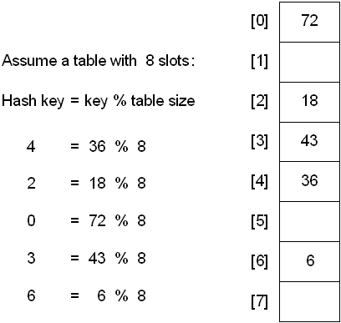
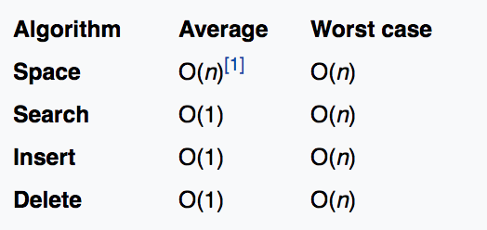

Components for doing hashing
A hash table is a data structure that implements an associative array abstract data type, a structure that can map keys to values.
A hash function H(x)
A hash table
- Collision Handling
- Chaining
- Open addressing

Slide 7
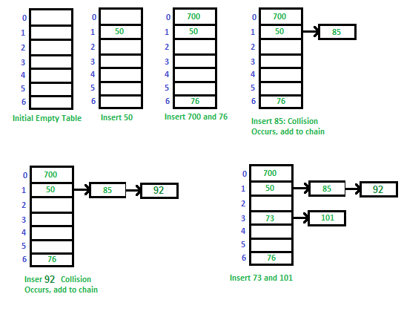
Components for doing hashing
Let us consider a simple hash function as “key mod 7” and sequence of keys as 50, 700, 76, 85, 92, 73, 101.
A hash function H(x)
A hash table
- Collision Handling
- Chaining
- Open addressing

Slide 8
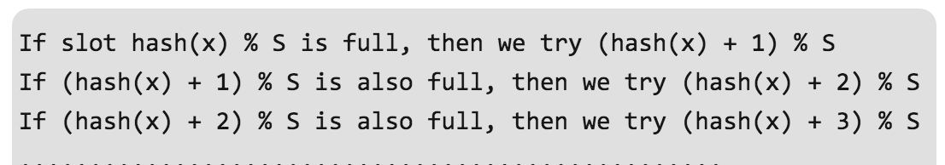
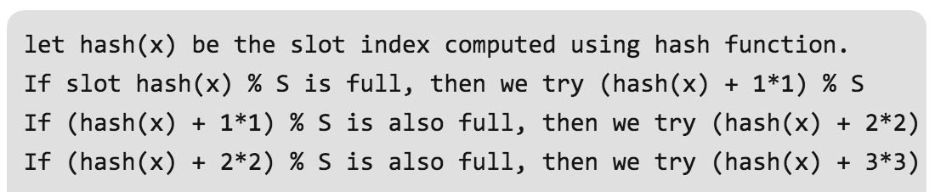

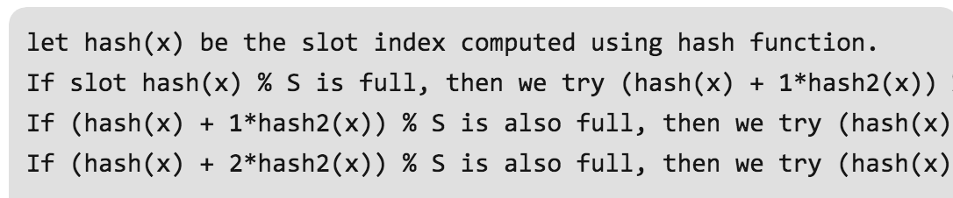
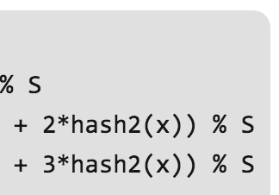
Components for doing hashing
a) Linear Probing
b) Quadratic Probing
A hash function H(x)
A hash table
- Collision Handling
- Chaining
- Open addressing
c) Double Hashing

Slide 9
Applications of hashing
Usage of hash functions
Verifying the integrity of files or messages
Password protection and verification
Can also be used in the generation of pseudorandom bits.
Pattern Searching (Rabin-Karp Algorithm): to detect plagiarism
https://www.geeksforgeeks.org/rabin-karp-algorithm-for-pattern-searching/
Rabin Karp algorithm matches the hash value of the pattern with the hash value of current substring of text, and if the hash values match then only it starts matching individual characters. So Rabin Karp algorithm needs to calculate hash values for following strings.
1) Pattern itself. 2) All the substrings of text of length m.

Slide 10

Applications of hashing
Rabin-Karp Algorithm
Lets say you have a string “ABCDEACDOE” and you want to find pattern "BCD" in this string
brute-force string-searching algorithm

Slide 11
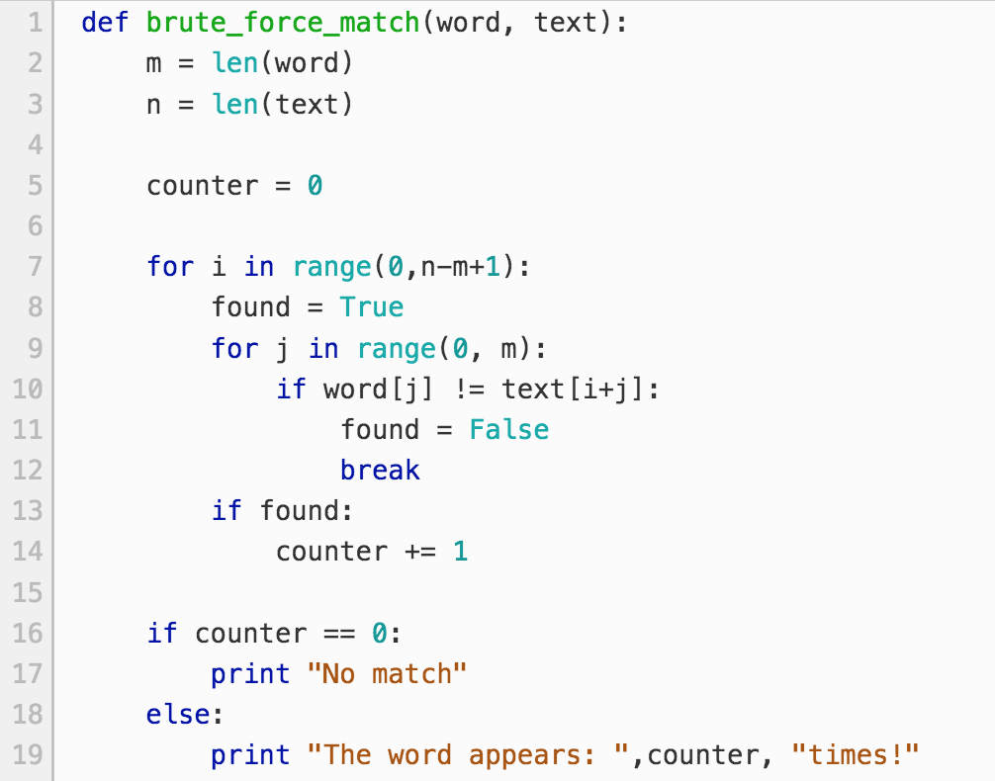
Applications of hashing
Rabin-Karp Algorithm
B
C
D
Lets say you have a string “ABCDEACDOE” and you want to find pattern "BCD" in this string
this algorithm takes O(mn) of time complexity

Slide 12
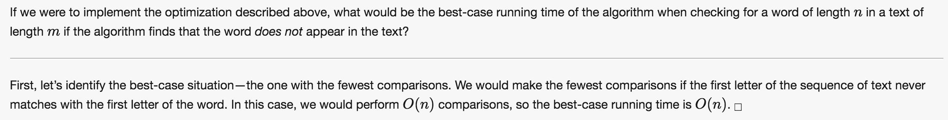
Applications of hashing
Rabin-Karp Algorithm
B
C
D
Lets say you have a string “ABCDEACDOE” and you want to find pattern "BCD" in this string

Slide 13
Applications of hashing
Rabin-Karp Algorithm
B
C
D
Lets say you have a string “ABCDEACDOE” and you want to find pattern "BCD" in this string
We calculate the hash of first three letter substring (abc) in string. To keep matters simple, lets say we use base 7 for this calculation
(in actual scenario we should mod it with a prime to avoid overflow):
0
1
2
substring = a*7 +b*7 +c*7 =97*1+98*7+99*49 =5634 pattern = b*7 +c*7 +d*7 =98*1+99*7+100*49=5691
0
1
2

Slide 14
Applications of hashing
Rabin-Karp Algorithm
B
C
D
5691
Lets say you have a string “ABCDEACDOE” and you want to find pattern "BCD" in this string
So you compare two hash values and since they are different, you move forward. Now you reach to second substring “bcd” in string.
We can calculate the hash of this string without rehashing everything. As you can see, the window has moved forward only by dropping one character and adding another:
0
1
2
0
1. drop a => (a*7 + b*7 +c*7 ) – a*7 2. divide everything by 7 => (b*7 +c*7 )/7 => b*1 + c*7
3. add d => b*7 + c*7 + d*7
4. This input string would be => (5634 - 97)/7+ 100*49 = 5691
1
2
0
1
2

Slide 15
Applications of hashing
Rabin-Karp Algorithm
B
C
D
5691
Lets say you have a string “ABCDEACDOE” and you want to find pattern "BCD" in this string
Assume the text is length n and the length of the word is m.
The best- and average-case running time of Rabin-Karp is O(m+n) because the rolling hash step takes O(n) time and once the algorithm finds a potential match,
it must verify each letter to make sure that the match is true and not a result of a hashing collision and therefore must check each of the m letters in the word.

Slide 16
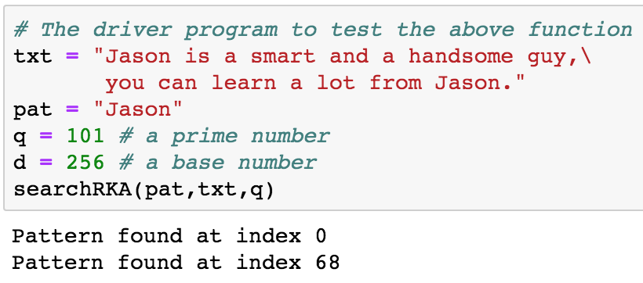
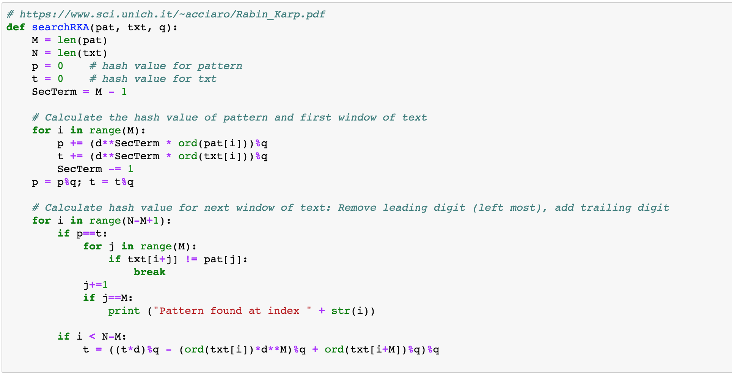

Slide 17
Ｑ&A

