Slide 1
Predicting Best Neighborhoods for Opening a New Restaurant
Author: Betul Dincer
Date: May 23, 2020

Slide 2
Introduction
Our goals are to:
detect the best neighborhood for a client to open a restaurant in Toronto city
analyze all the neighborhoods in the city to understand the distribution of different types of restaurants
detect the neighborhoods where the similar restaurants are located
offer these neighborhoods as the best possible locations to open a new restaurant

Slide 3
Introduction
We want to maximize the number of potential customers for the new restaurant
If we select neighborhoods where similar restaurants are common, we can reach to maximum number of customers
An example:
we want to open an Italian restaurant
we want to detect the neighborhoods where Italian restaurants are very common
this means people in these neighborhoods like Italian food and they would potentially be interested in a new Italian restaurant

Slide 4
Data
First data source: Toronto neighborhood data
Second data source: locations and categories of all restaurant in Toronto
Getting the location and type of each restaurant will enable us to detect the most popular restaurant types in each neighborhood
Using this information along with the appropriate machine learning technique, we will be able to detect the best neighborhood for a client to open a restaurant at

Slide 5
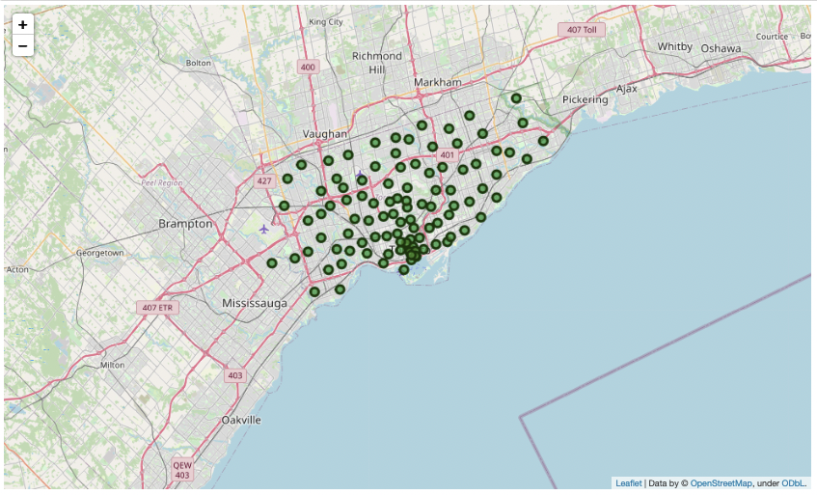
Methodology
Step 1: Downloading neighborhood information, creating a map of neighborhoods to examine

Slide 6
Methodology
Step 2: Downloading all venue information using Foursquare API located in each neighborhood in Toronto, selecting restaurants from the venues and getting categories for the restaurants
Step 3: Creating a restaurant-based feature matrix where we calculate the percent of restaurants of each category for each neighborhood
Step 4: Applying k-means clustering based on this restaurant-based feature matrix to group the neighborhoods in terms of the restaurant categories.
Step 5: Experimenting with different k values and generating maps with group labels to investigate results

Slide 7
Results
We cluster the neighborhoods by the restaurant types and generate a map summarizing the results
For each category, we can examine neighborhoods included in that cluster as well as the most common restaurant types
We can determine the best neighborhood for a given restaurant category

Slide 8
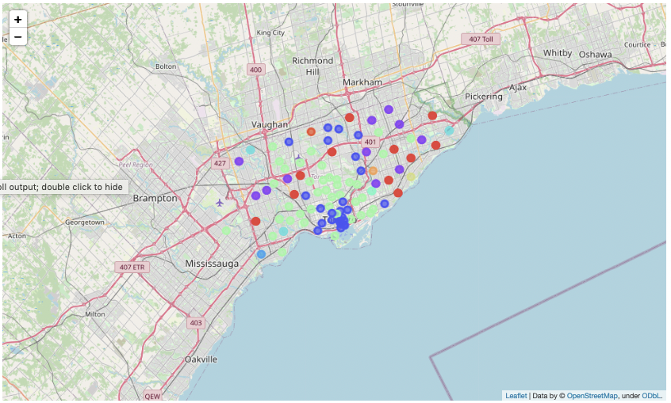
Results
Map of Toronto neighborhoods colored by the clusters we learned:

Slide 9
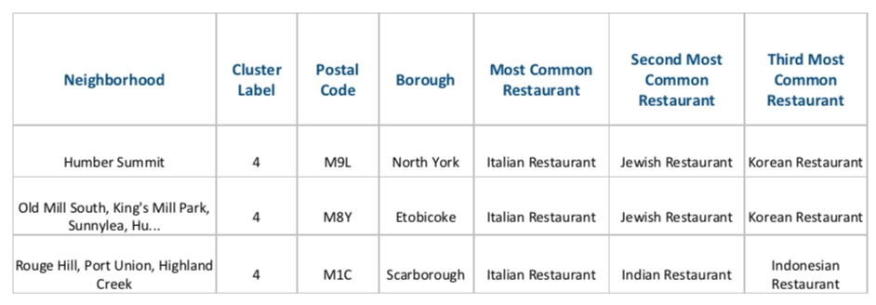
Results
Example: Cluster 4 is a good choice for opening a new Italian restaurant!

Slide 10
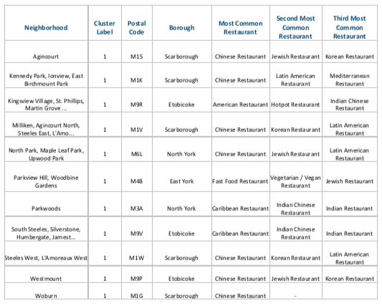
Results
Example: Cluster 1 is a good choice for opening a new Chinese restaurant!

Slide 11
Discussion
Some restaurant categories such as Asian or fast food are very common and dispersed across many neighborhoods
difficult to output a true optimal location for these restaurants
Some restaurant categories such as Turkish are quite rare
difficult to learn a reasonable pattern

Slide 12
Conclusion
Our goal is to determine the best neighborhoods in Toronto to open a restaurant
We collect multiple data sources:
Toronto neighborhoods from Wikipedia
Coordinates of neighborhoods using Geospatial
Restaurant information using Foursquare API
We use k-means clustering to cluster the neighborhoods according to the restaurant categories
Now, it is easy to analyze all the maps and tables and decide on the place to open the restaurant!

