Slide 1
Tracking hand and eye movements for enhancing AI agent activation
By: TEAM 10 Beulah Karrolla Rakhi Rakhi

Slide 2
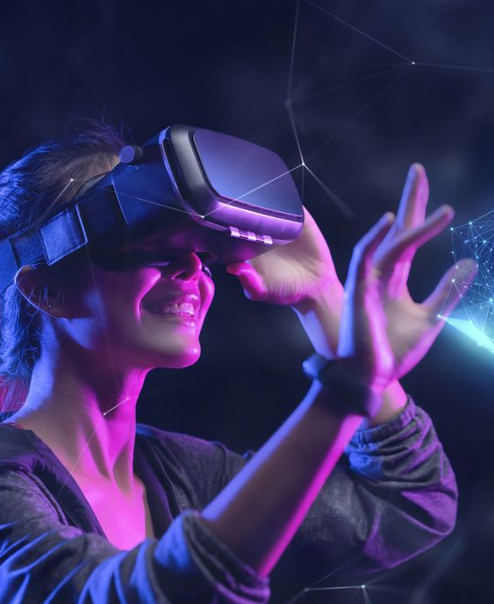


introduction
This project aims to create a system that tracks hand and eye movements in images with an end goal to trigger camera enabled conversational agents.
We plan to do eye and hand detection before proceeding to track their movement. In response to user inputs, we are enabling the agent to react quickly to wake-up signals.
Traditional Computer Vision techniques:
Eye Detection : NCC Template matching SIFT descriptor classification
Hand Detection : HSV skin matching with Connected components
Our project targets the use case where the image of human waving hand and looking at the screen is tracked to activate the system, for instance the the system responds with, "Hi, How can I help you?" once the wake signal is detected.

Slide 3
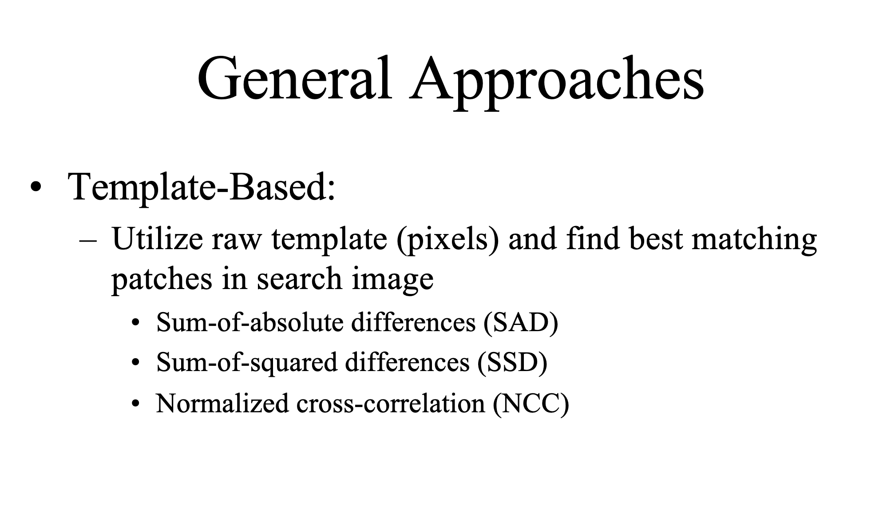
EYE DETECTION USING TEMPLATE MATCHING
Initial approach : Capturing the Scale Invariant Feature transform (SIFT) key points and descriptors of the eye regions and
Applying classification algorithms (KNN or Decision Tree)
Dataset : Eye-Dataset(Kaggle)
Accuracy:
KNN: 93%
Decision Tree: 91%
Drawback on our test data set.
Template Matching: Find areas of search image(S) that are similar to given template image(T)

Slide 4
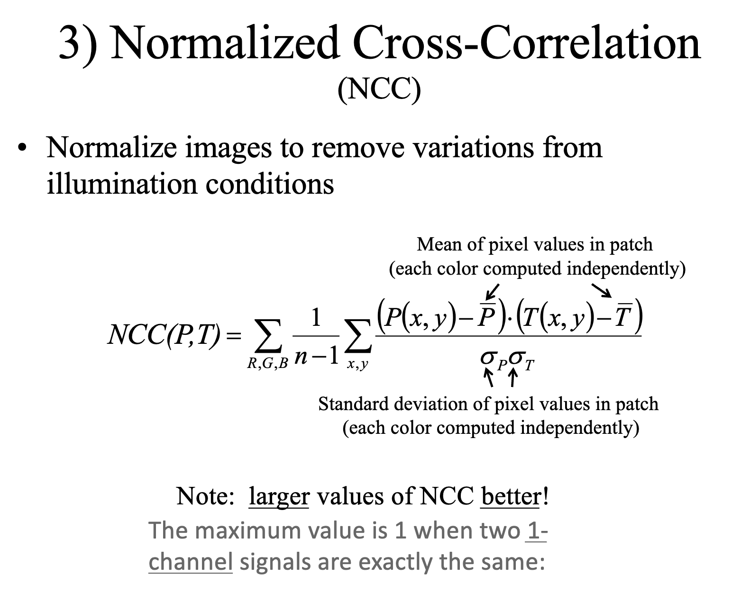
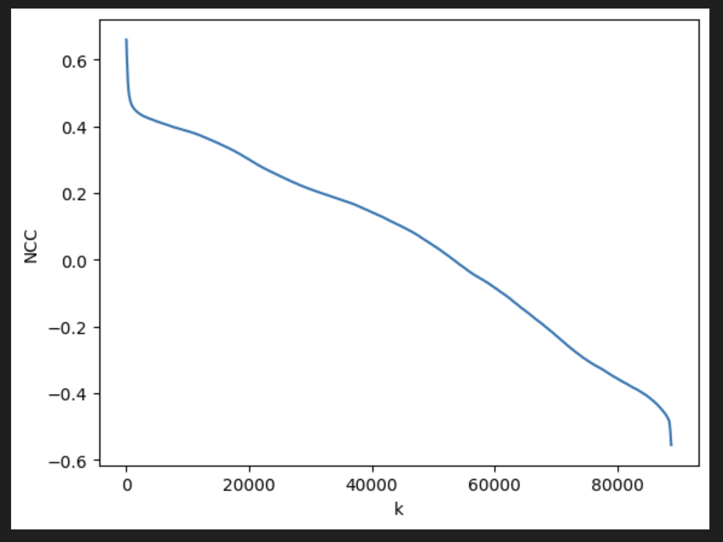
NCC based template matching
SSD and SAD are subjective to changes in illumination.
NCC was the best option to fix a generalized template to match any search image.
SLIC Super pixel Segmentation.
We observed that as we increased the number of super pixels(k), the NCC value for the possible match kept decreasing.

Slide 5
TEMPLATE MATCHING FOR OUR USE CASE
Decided to follow the traditional NCC template matching algorithm.
Fixing an eye template (generalized).
Experimented with different images randomly => Importance of scaling and re-sizing
Resizing every test image to the original complete image of the template.
Sliding a window over the search image and hopping 10 pixels at a time from top left corner to bottom right corner to find the best match for the template.
Time constraints with Template matching for larger search areas. (Decreasing the size of the template)

Slide 6
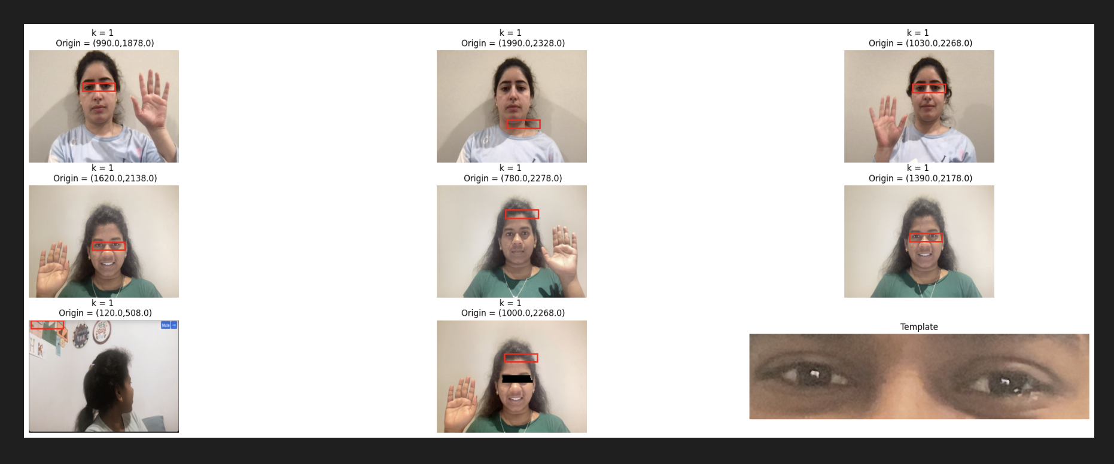
RESULTS ON EYE DETECTION
For the eye matching template at Image 9, we have experimented with various test cases:
Presence and absence of eyes
Images 1,3,4,6 :The template was able to correctly identify the eyes patch from any image(same/different person, same/diff image.,. etc)
Images 2, 5, 8 : Absence of eyes, gives the next closest match, shape of the forehead.
Image 7: Absence of eyes and no close match => first patch of the image is returned (implies no detection was made).

Slide 7
HAND DETECTION

