Slide 1

INF1070: Digital Presentation
Training Room 2:
Formatting and Modifying Slides
© Monkey Business Images/shutterstock

Slide 2
Presentation Outline
In this training room you will learn how to format and manipulate slide content. Specifically, you will
copy, cut, and paste text
format and modify text boxes, fonts, styles, size, and colour
align text and change line spacing
promote and demote text
add and modify bulleted and numbered lists
add and modify WordArt
apply themes
The estimated completion time for Training Room 2 is 80 minutes.
All PowerPoint Screen Shots: Microsoft product screen shot(s) reprinted with permission from Microsoft Corporation.

Slide 3
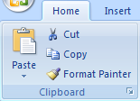
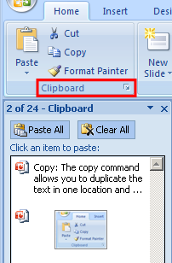
Copy, Cut, and Paste Text
It is easy to rearrange or repeat text within a slide or from one slide to another using the Cut, Copy, and Paste commands.
Cut: The Cut command removes text from one location and allows you to move the text to a new location. Select the desired text and click the Cut button. You will see the text disappear. Next, position the cursor in the new location and click the Paste button. You will see the text added.
Copy: The Copy command allows you to duplicate the text in one location and place a copy in another location. Select the text and click the Copy button, (the selected text remains in its original location). Next, place the cursor in the new location and click the Paste button.
Clipboard: The Clipboard stores up to 24 items that you have either cut or copied. To access the clipboard, choose the dialogue box launcher in the Clipboard group.

Slide 4
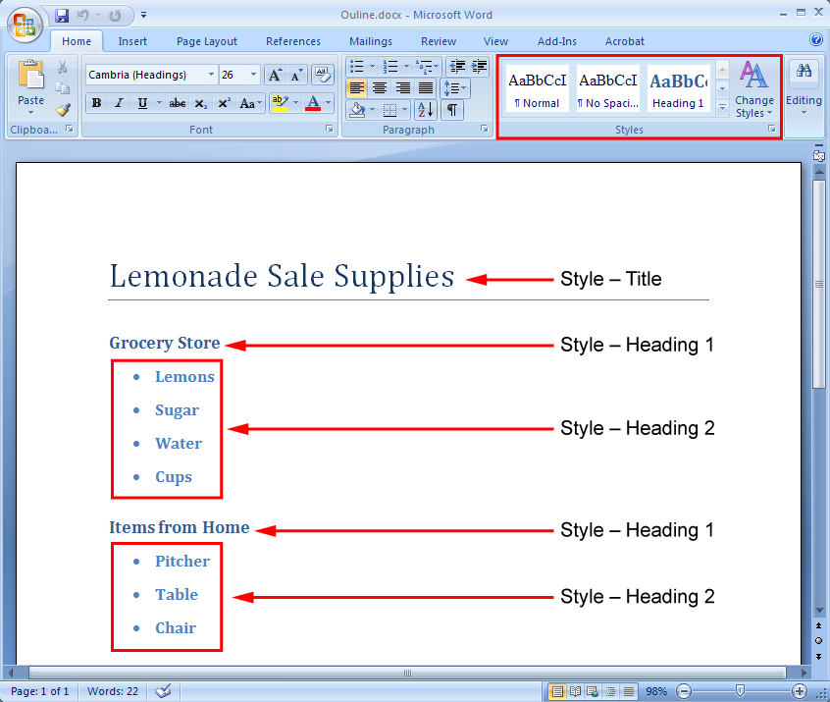

Insert Text from Another Source
You can import text from other programs that use Headings or Styles, such as Microsoft Word or an HTML file. Click on the bottom half of the New Slide button, and then choose Slides from Outline. Locate the file you want to import and click Insert.
Go to the Project 3 Instructional Videos in the Toolkit, and watch the demonstration “Importing Text” to learn how to import text from a Word file that uses Styles.

Slide 5
Size Text Boxes
You can change the size and shape of the text box by clicking on the sizing handles and dragging to the desired size.
To move the text box, hover your mouse on the text box until you see a four-headed arrow to drag and drop to the new location.
Sizing handles
Go to the Project 3 Instructional Videos in the Toolkit, and watch the demonstration “Working with Text Boxes” to learn how to size and format text boxes.

Slide 6
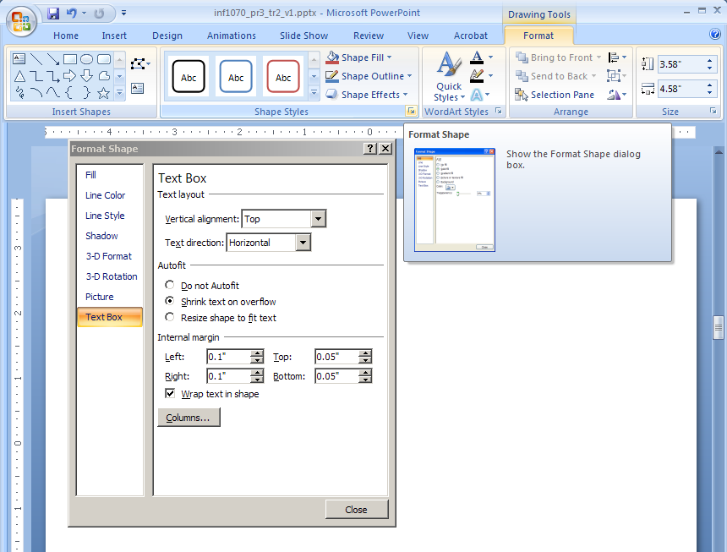
Format Text Boxes
You can format a text box in two ways to change its appearance:
Select the text box. The Drawing Tools tab will appear at the top. Select the Format tab.
Right-click on the
text box, and then
select the Format
Shape menu.
Explore and experiment
with the many commands
on the Ribbon or in the
dialog box.

Slide 7
Try It! Size and Format a Text Box
Take some time now to insert and resize a text box in the space below. Be adventurous and have fun exploring all of the different formatting options.

Slide 8
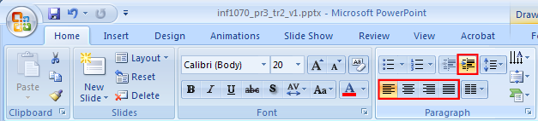
Align Text and Change Line Spacing
You can control text alignment and line spacing from the Home tab in the Paragraph group.
Text can be aligned to the left, centre, or right in the text box, as seen in the command buttons. The Justify button aligns text equally on both the left and right sides of the text box.
Line spacing allows you to adjust the spacing between each line of text.

Slide 9
Modify Font Size and Colour
It is important to choose font sizes and colours that are easy for your audience to read. Your font colour should also work well with the background colours.
Changing the colour and font size can add emphasis and draw attention to important information. For example, use a larger font size for headings and titles.

Slide 10
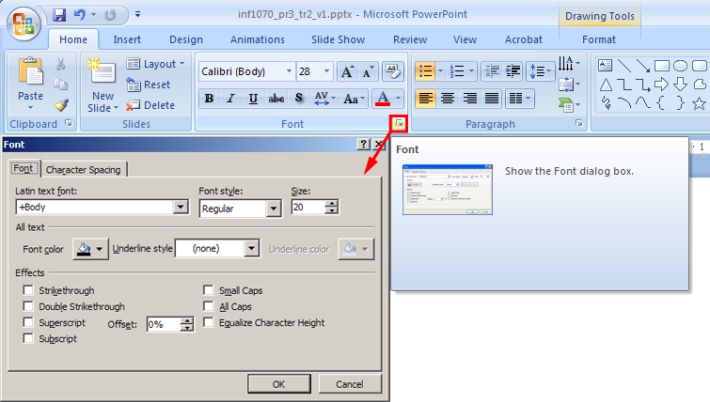
Modify Fonts and Font Styles
Fonts, such as Times New Roman and Arial, refer to the design of the characters. Choose a font that is easy for your audience to read and that corresponds with the theme or tone of your presentation—consider Times News Roman or Arial for a formal presentation and Comic Sans MS for a more informal presentation.
You can modify font options using the commands in the Font group in the Home tab, or launch the dialogue box to open the Font window. Limit the number of fonts that you use.
Font Styles are effects, such as Bold, Italic, Underline, or Shadow. Use styles sparingly, yet consistently, to avoid distracting the audience.

Slide 11
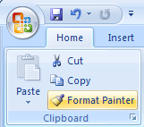
Format Text Using Format Painter
The Format Painter command allows you to copy text formatting properties (such as font, size, style, and colour) from selected text and apply those properties to other text. This is a quick and easy way to achieve consistency of styles throughout your presentation.
Format Painter is found in the Clipboard group on the Home tab. Follow these steps:
Select the text that has the desired formatting properties.
Double-click the Format Painter button; your cursor will now have a paintbrush attached to it.
Select the text to which you want to apply the formatting. The formatting properties are then applied automatically.
Go to the Project 3 Instructional Videos in the Toolkit, and watch the demonstration “Format Painter” to see how use the Format Painter option.

Slide 12

Promote and Demote Text
You can emphasize information by arranging text into levels using the Increase List Level and Decrease List Level buttons found in the Home tab.
Lemonade Sale Supplies
Grocery Store
Lemons
Sugar
Water
Cups
Items from Home
Pitcher
Table
Chair
Go to the Project 3 Instructional Videos in the Toolkit, and watch “Indenting Text” to learn how to quickly indent text to create headings and subheadings.

Slide 13

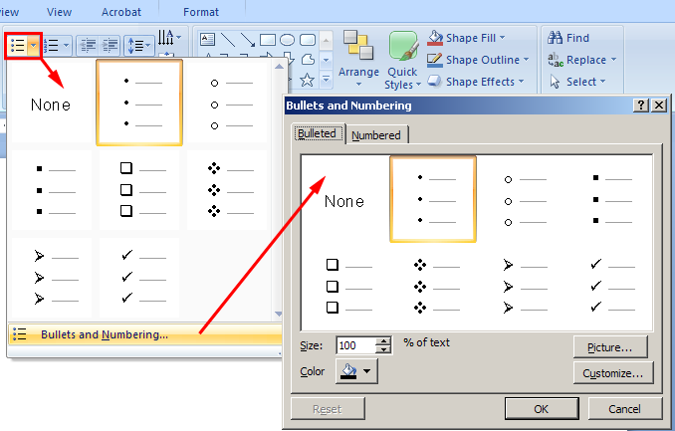
Add and Modify Bulleted Lists
Bulleted lists are used in the following ways:
to present information in point form
to break information into quick, easy-to-read bits of data for your audience
to list information
To add bullets, select the lines of text and click the Bullets button in the Paragraph group under the Home tab.
To modify the bullets, click the arrow on the right side of the Bullets button. Choose the bullet style you want or click on Bullets and Numbering at the bottom of the dialogue box to access even more options.

Slide 14

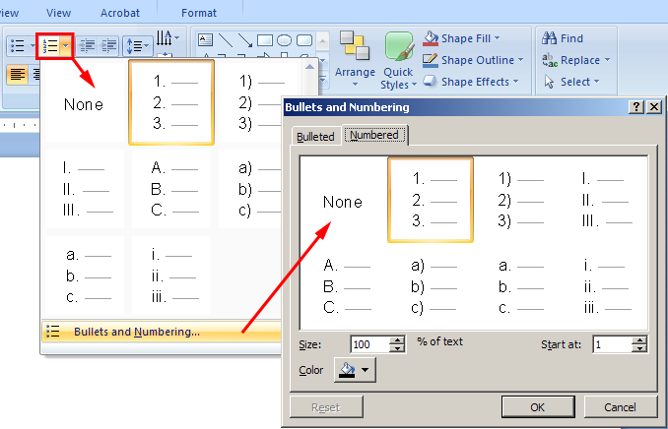
Add and Modify Numbered Lists
Numbered lists are used to give order or sequence to a list. Use a numbered list instead of a bullet list only if the order of items is important.
To number a list, select the lines of text, and then click the Numbering button in the Paragraph group under the Home tab.
To modify the numbering style, click the arrow on the right side of the Numbering button. Choose the numbering style you want or click on Bullets and Numbering at the bottom of the dialogue box to access even more options.

Slide 15

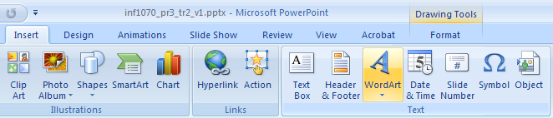
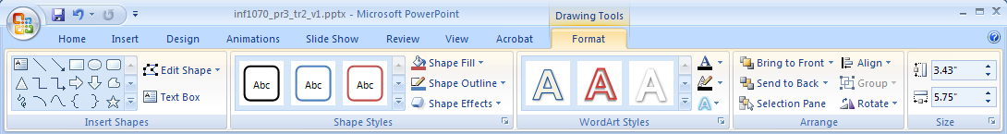
Add and Modify WordArt
Transform text into eye-catching images using the special effects of WordArt. You can change the text shape, fill, and outline. You can even add shadows, glows, reflections, and 3-D rotation.
The WordArt command is located under the Insert tab in the Text group.
You can modify WordArt under Drawing Tools using the Format tab.

Slide 16
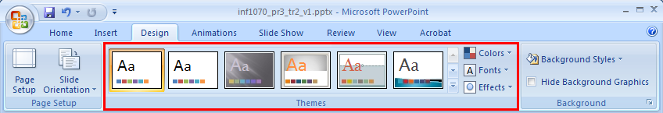

Apply Themes
PowerPoint 2007 helps you build stunning presentations quickly with the use of built-in-themes, which include coordinated colours, preformatted fonts, and effects. You can apply themes to your slides under the Design tab in the Themes group.
Click on the Help button and go to the Office Online PowerPoint Help and How-to website. Locate “PowerPoint Demos,” and then view “Demo: Add colors, fonts, and effects with PowerPoint 2007 themes.”

Slide 17
Try It! Apply Themes
Create a new PowerPoint presentation with the following slides:
Slide 1 Title Slide Layout
title: “PowerPoint”
subtitle: “Applying Themes”
Slide 2 Title and Content Layout
title: “Time Table”
text: input your school timetable (courses and teachers); practise using the Indent List Level button and adding bullet and numbered lists
Now experiment applying different themes to your slides. Notice how the look of your slides changes instantly!

Slide 18
Summary
You have completed Training Room 2. In this training room you have learned how to format and manipulate text and text boxes. Specifically, you learned to
copy, cut, and paste text
promote and demote text
add and modify WordArt
modify fonts, styles, size, and colour
align text and change line spacing
format text using Format Painter
add and modify bulleted and numbered lists

Slide 19
Ready to Move On?
You can repeat this training room until you are comfortable with the concepts presented. When you are ready, proceed to Time to Practise 2. There you will practise using the software and assess your understanding of the learning concepts presented. If you need help, you can
review the training room
use the Office Online Help and How-to website to get tip information, demonstrations, tutorials, and quizzes
check with your teacher or find a learning partner

Slide 20
Time to Practise 2
Begin Time to Practise 2 if you are comfortable demonstrating the skills presented in this training room.
When you are done Time to Practise 2, go to Training Room 3.
© 2009 Alberta Education

