Slide 1

INF1070: Digital Presentation
Training Room 3: Working with Visual Content
© Zsolt Nyulaszi/shutterstock

Slide 2
Presentation Outline
In this training room you will learn to
insert graphics, shapes, and other objects
modify graphics, shapes, and other objects
arrange graphics and other content
insert and modify charts
insert and modify tables
The estimated completion time for Training Room 3 and Time to Practise 3 is three hours.
All PowerPoint Screen Shots: Microsoft product screen shot(s) reprinted with permission from Microsoft Corporation.

Slide 3

Add Graphics
Graphics add visual appeal and bring life to your presentation.
All of the following are considered graphics:
Clip Art
photographs
illustrations
shapes
© digitalife/shutterstock

Slide 4
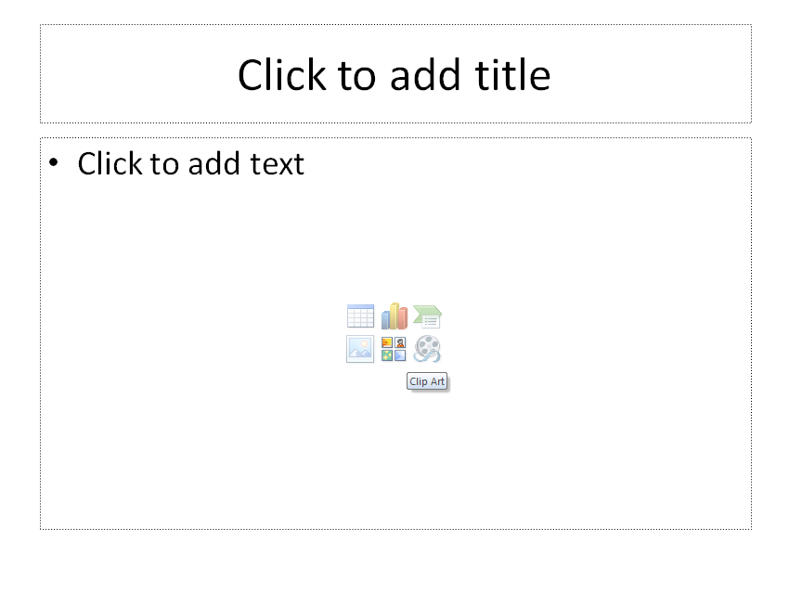
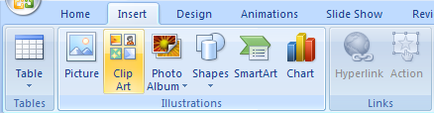
Add Clip Art
PowerPoint has an extensive collection of premade graphic images called Clip Art. There are two ways to insert Clip Art:
In a new slide created using the Title and Content layout, click the Clip Art icon.
Go to the Insert tab and click on the Clip Art button in the Illustrations group.

Slide 5
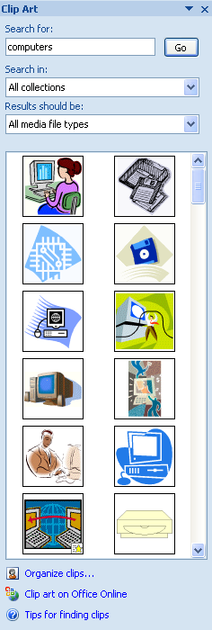
Clip Art Task Pane
When you click to insert Clip Art, the Clip Art task pane will open. Use this pane to enter search terms and find images that will suit your presentation.

Slide 6

Add Pictures
You can add pictures to your presentation from a variety of sources including the following:
web pages
digital cameras
scanners
image-editing software programs
When using a scanner or a camera, you must first load pictures into a folder on your computer.
Always obtain copyright permission for any images that are not your own—that you scan or download from the Internet.
© keellla/shutterstock

Slide 7
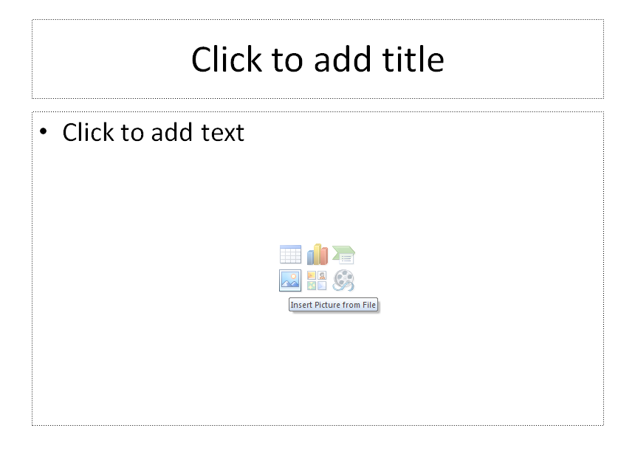
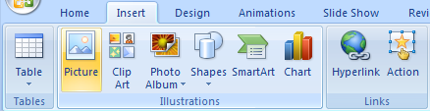
Insert Pictures
There are two ways to insert pictures:
In a new slide created using the Title and Content layout, click the Insert Picture icon.
Go to the Insert tab and click on the Picture button in the Illustrations group.
You will need to locate the folder where your images are stored, and select the file you want to insert.

Slide 8
SmartArt Diagrams
SmartArt diagrams organize text visually, making it easier for your audience to understand and remember important information.
INF1070: Digital Presentation
Microsoft Certification Exam 77-603
Microsoft Certified Application Specialist

Slide 9
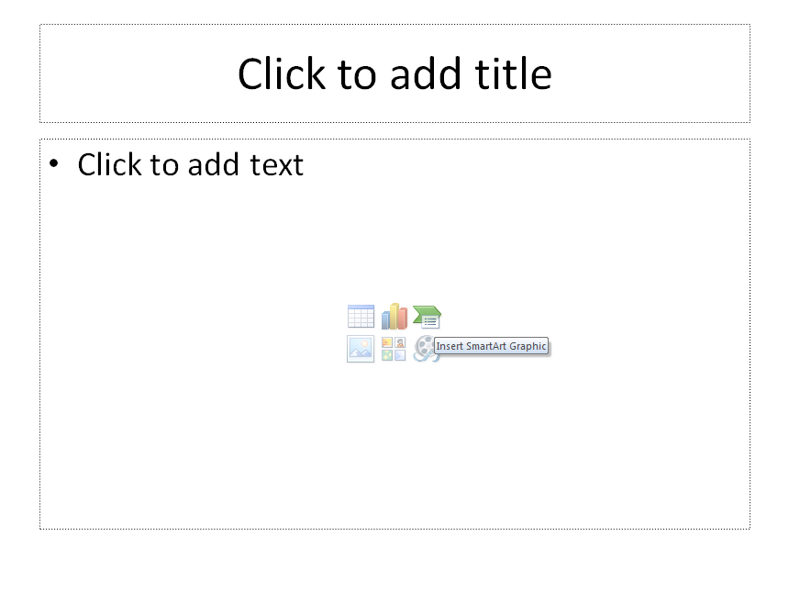
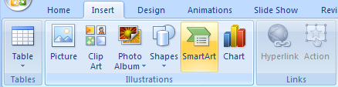
Add SmartArt Diagrams
There are two ways to insert SmartArt:
In a new slide created using the Title and Content layout, click the SmartArt icon.
Go to the Insert tab and click on the SmartArt button in the Illustrations group.

Slide 10
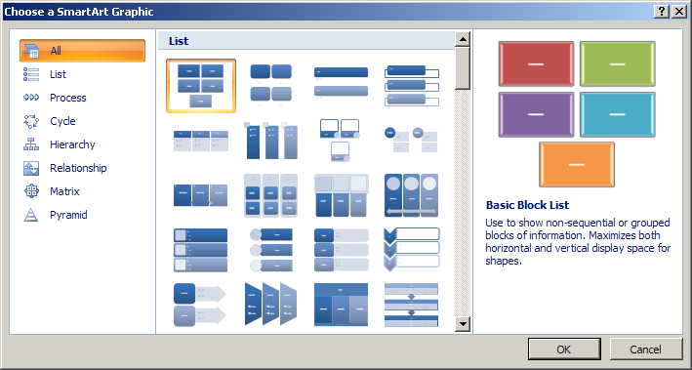
Create SmartArt Diagrams
Once you have clicked on SmartArt, you will need to choose which type of diagram you wish to include. Then follow the prompts to create your very own SmartArt.

Slide 11
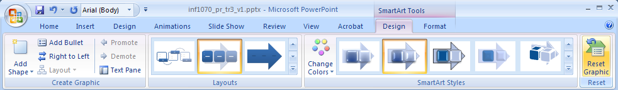

Apply Styles to SmartArt Diagrams
Styles are predefined formatting properties such as colour, line style, glow, or 3-D that give your graphic a professional look quickly and easily.
INF1070:
Digital Presentation
Microsoft Certification Exam 77-603
Microsoft Certified Application Specialist
To apply styles to SmartArt, click on your SmartArt. The Drawing Tools tab will appear. Click on the Design tab. To undo any changes you have made, click the Reset Graphic button.
Click on the Help button to go to the Office Online Help and How-to website, and then view “Demo: Spice up your text with SmartArt graphics.”

Slide 12
Try it! Explore, Experiment, and Create a SmartArt Graphic
Click on the Help button and go to the Office Online PowerPoint Help and How-to website. View the following demonstrations:
“Demo: Add text to a SmartArt graphic”
“Demo: Animate your SmartArt graphic”
Practise creating a SmartArt graphic similar to the one on the previous slide, and then create a SmartArt graphic of your choice.
You may also wish to view the following demonstrations on the PowerPoint Help and How-to website:
“Demo: Add lines or callouts to your SmartArt graphic”
“Demo: Add a shape to your SmartArt graphic“
“Demo: Add a gradient fill to your SmartArt graphic”
“Demo: Make a shape invisible in your SmartArt graphic “
“Demo: Format lines in your SmartArt graphic”
“Demo: Fix common SmartArt mistakes”

Slide 13
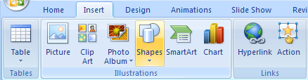
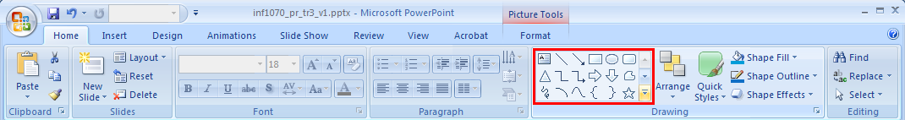
Add Shapes to Slides
You can also easily add ready-made shapes to your presentation. Click on the Insert tab, and then select Shapes in the Illustrations group.
You will also find shapes under the Home tab in the Drawing group. To see all of the available shapes, click the bottom arrow to the right of the Shapes group.
Tip: To draw perfect squares or circles hold the Shift key as you drag your mouse to the desired shape size.

Slide 14



Modify Graphics
PowerPoint 2007 makes it easy to manipulate and customize graphics (including pictures, shapes, Clip Art, and illustrations) you have included in your presentation.
You can modify the size and rotation of the graphic, adjust the line and fill colour, and even add effects.
© Sean Jolly/shutterstock

Slide 15
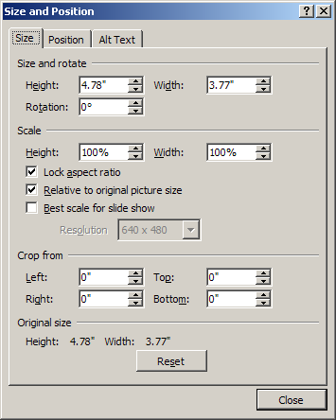
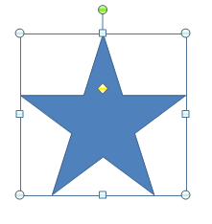
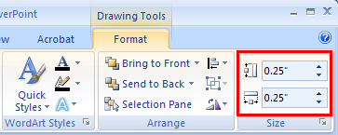
Change the Size of a Graphic
There are three ways to change the size of a graphic:
Click on the graphic, and then click on and drag the sizing handles. Remember to hold the Shift key to maintain proper proportion as you resize the graphic.
Click on the graphic. The Drawing Tools tab will appear. Click on the Format tab and enter specific measurements in the Size group.
Right-click on the graphic and select Size and Position to access even more options.

Slide 16
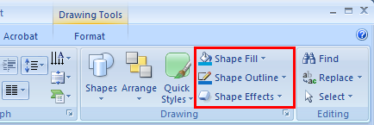

Change the Colour of a Graphic
To change the line or fill colour of a graphic, click on the graphic and use either the Drawing group under the Home tab or the Drawing Tools Format tab.
Use the same techniques to change the weight and style of the outline, or add textures, colour gradients, and even fill to shapes. Do you really want to impress? Start with a shape and fill the shape with a picture. The possibilities are endless.
© keellla/shutterstock

Slide 17
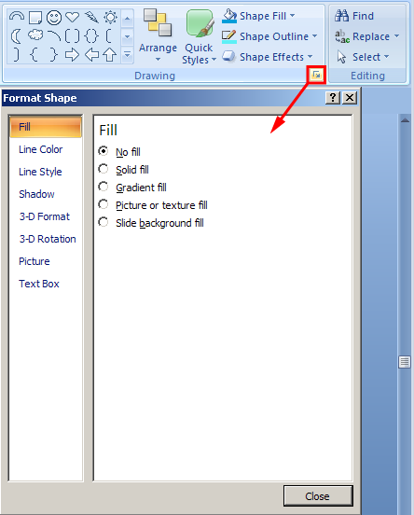
Format a Graphic
You can modify and customize Clip Art, shapes, and pictures by changing the Format. As you’ve learned to do earlier, select the graphic to access the Drawing Tools or Picture Tools Format tab. Depending on the kind of graphic you have selected, you will launch the Format dialog box from either the Picture Styles or Shape Styles groups.
Go to the Project 3 Instructional Videos in the Toolkit, and watch the demonstration ”Formatting Graphics” to see how to apply different formatting options to graphics.

Slide 18

Add an Effect to a Graphic
Also in the Drawing Tools Format tab is the Shape Effects/Picture Effects button. Use this command to add the following effects to your graphics:
shadow
reflection
glow
soft edges
bevel
3-D rotation

Slide 19
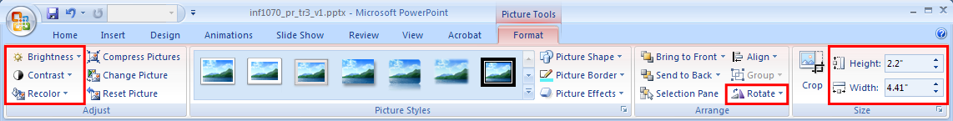
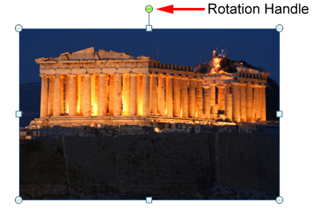

Working with Photographs
Just like with other graphics, photographs often need to be formatted to fit your presentation.
As always, click on the photograph to access the Picture Tools Format tab. Use the Recolor button to change your picture to black and white or to sepia for a more dramatic effect. The Contrast and Brightness buttons are also available here.
© Sean Jolly/shutterstock
Still in this part of the ribbon, look to the right for the Rotate button and the Size group. You can also rotate an image by using the green rotation handle that appears when you click on the image.

Slide 20
Try it! Practise Creating and Modifying Graphics
Can you create a star that looks like the one shown here? Insert a new slide and try it now.
After you’ve created your star, get creative with graphics. Practise using Clip Art, Shapes, SmartArt, photographs, and more. Remember to size, format, add effects, rotate, and so on.
You may also wish to view the following demonstrations on the Office Online PowerPoint Help and How-to website:
“Demo: Put your photos in PowerPoint”
“Demo: Create a vacation keepsake using your photos”
“Demo: Add text on top of a photo”
“Demo: Add pictures to your SmartArt graphic”
“Demo: Use 3-D effects”

Slide 21
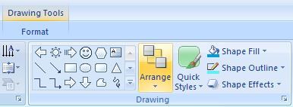
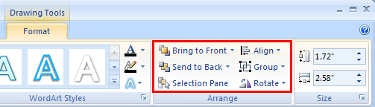
Place Illustrations in Order
You can layer illustrations and text to create depth, add visual interest, and make good use of slide space. The Arrange command allows you to move objects forward and backward.
text text text text
text text text text
Find the arrange button under the Home tab in the Drawing group or by selecting the object, right-clicking, and then selecting either Bring to Front or Send to Back. You can also find the buttons in the Drawing Tools Format tab.

Slide 22
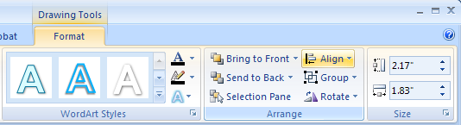

Align Objects
The Align command, found under the Drawing Tools Format tab, helps create a professional and visually appealing presentation by automatically lining up objects, like graphics, in a variety of ways. To align multiple objects, hold down the Shift key as you click on each object.
Go to the Project 3 Instructional Videos in the Toolkit, and watch the demonstration “The Align Command” to see how the Align command is used to automatically align objects.

Slide 23
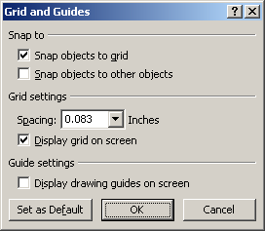
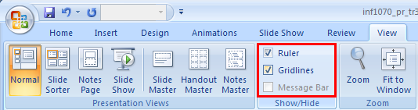
Display Grids and Guides
Gridlines can also help you lay out and align text and objects. Gridlines are not visible in a slide show and they will not print.
To insert gridlines, under the Drawing Tools Format tab, in the Arrange group, click on the arrow under the Align button. Either select View Gridlines or Grid Settings. You can also click on the View tab and check Gridlines in the Show/Hide group.

Slide 24
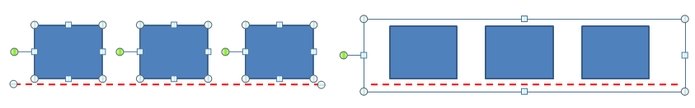
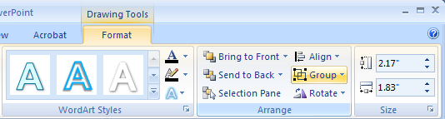
Group Graphics
Grouping pulls together multiple objects (such as graphics or shapes) to behave as a single object. Grouping objects helps you build more complex graphics and work faster, as modifications such as rotate, move, resize, or changing line and colour attributes can be applied to all the grouped objects at the same time. You can group and ungroup objects any time.
To start, hold the Shift key and click on each object. Then, under the Drawing Tools Format tab, click the Group, Regroup, or Ungroup button as required.

Slide 25
Connect Graphics
A connector line attaches shapes together at red connector boxes. The shapes stay connected together no matter how your arrange them on the slide. The connector lines are visible to your audience.
Connector line shapes can be straight, curved, elbow, or free-form and can be with or without arrows. You can format connector lines by right-clicking on the line.
Go to the Project 3 Instructional Videos in the Toolkit, and watch the demonstration “Connector Lines” to see how to use connector lines.

Slide 26

Try it! Practise Ordering, Aligning,
Connecting, and Grouping Graphics
Can you recreate these graphics? Insert a new slide and give it a try now.
Follow these hints:
Draw the boxes.
Align to bottom and distribute horizontally.
Format the connectors in 3-point green connectors, and then move the boxes to test the connections.
Follow these hints:
Draw and format the individual shapes.
Arrange the shapes.
Group the shapes.
Need help? Go to the Project 3 Instructional Videos in the Toolkit, and watch the demonstrations “Try it! Recreating Graphic 1” and “Try it! Recreating Graphic 2” to see how to recreate these graphics.

Slide 27
Try it! Design Your Own Logo
Companies use logos to create an identity and promote brand recognition. Let creativity be your guide as you insert a new slide, and practise working with graphics to design your own personal logo or monogram.
Have fun exploring, experimenting, and expanding your skills with graphics. Layer and manipulate shapes, pictures, Clip Art, text boxes, and more to create a personalized graphic.
When you are done, right-click on the object and select Save as Picture. Save the graphic in your INF1070 course folder as “logo.” You will use your logo in Training Room 4.

Slide 28
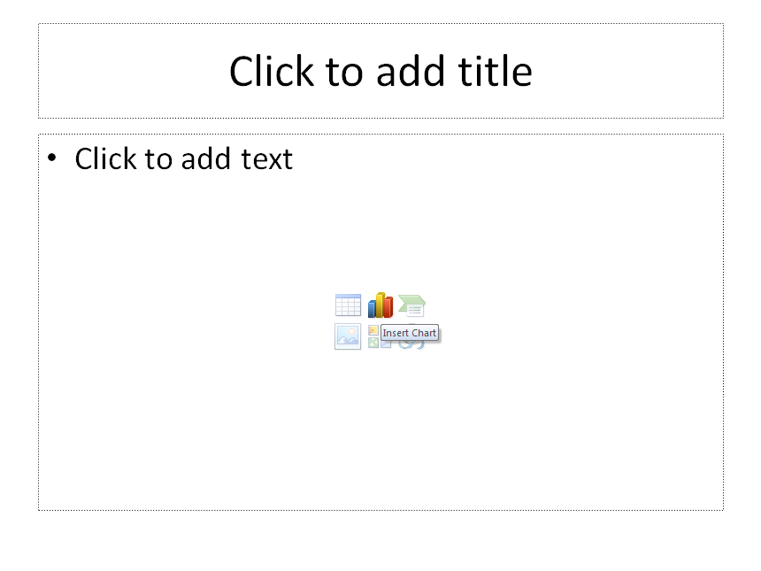
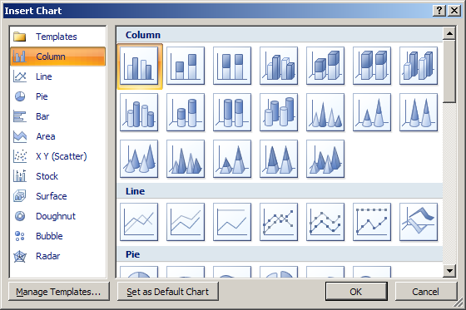
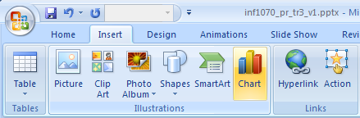
Insert a Chart
Charts display numeric data visually so it’s easier for your audience to process, compare, and remember large amounts of information.
To insert a chart, click the Insert Chart icon in the Slide Content placeholder, or click the Chart button under the Insert tab. Select the type of chart you want.

Slide 29
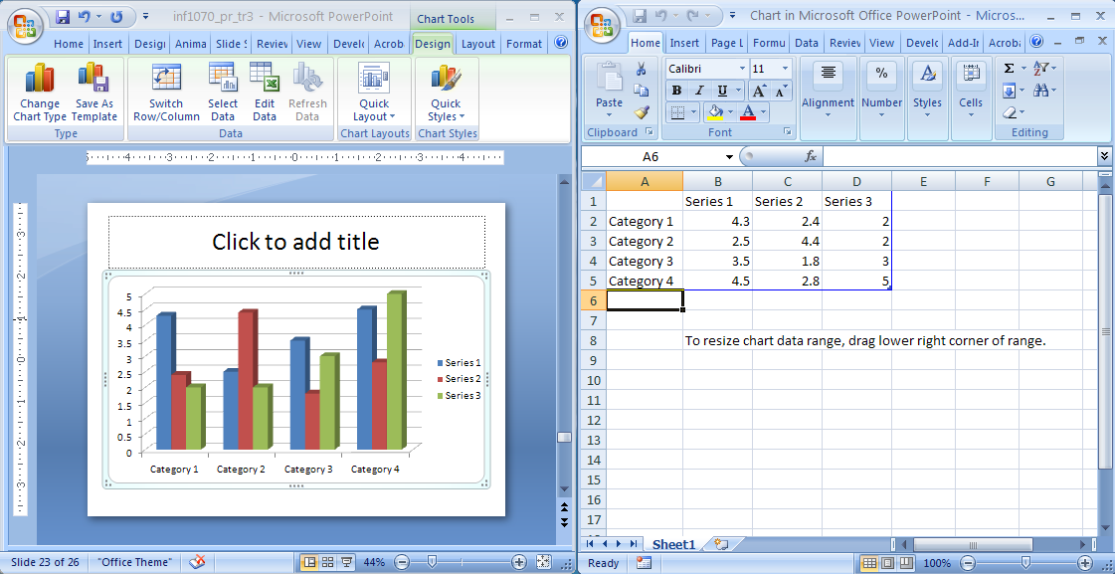
Create Charts
When you choose a chart type, a default Excel worksheet with sample data automatically opens for you to edit—just click the cells and replace the sample data with your own.
The next slide provides an example of how you might use charts.

Slide 30
Science 10 Lab Data

Slide 31
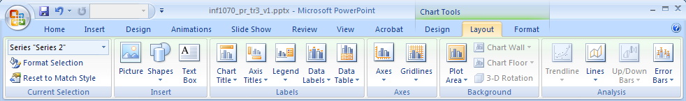
Modify Charts
After adding your own data, you will need to modify your chart to add titles, labels, formatting, and so on. To access the tools you need, select your chart and look for the Chart Tools tab on the Ribbon.

Slide 32
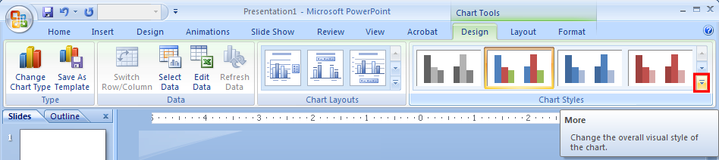
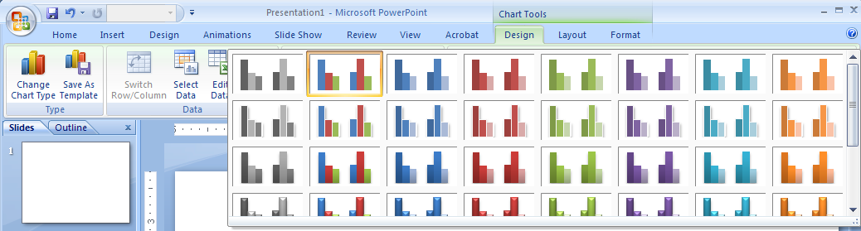
Apply Styles to a Chart
You can easily customize the look of a chart by applying preformatted Quick Styles to change colours, effects, and background. Under the Chart Tools Design tab, choose a style from the Chart Styles group. Click the More button to see all the available Quick Style options.

Slide 33
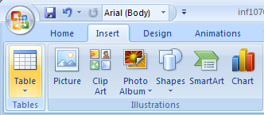
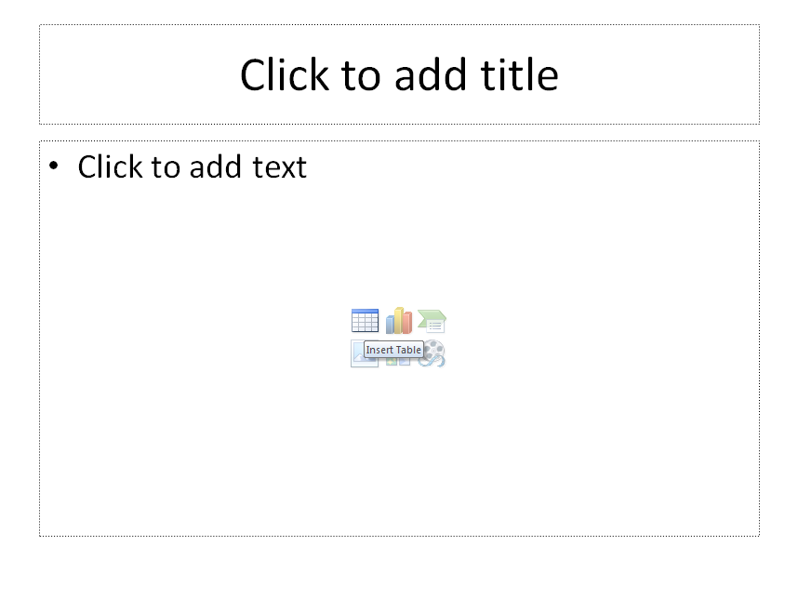
Insert and Modify Tables
Tables are an easy way to organize information. To insert a table, click the Insert Table icon in the Slide Content placeholder, or click the Table button under the Insert tab.
Select the number of rows and columns you will need for your table and enter the information into the table cells.
MICROSOFT OFFICE CERTIFICATION
Microsoft Office Programs | Certification Exams
PowerPoint 2007 | Exam 77-603
Word 2007 | Exam 77-601
Excel 2007 | Exam 77-602
Access 2007 | Exam 77-605

Slide 34
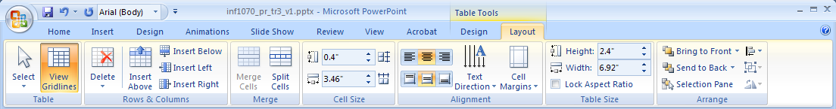
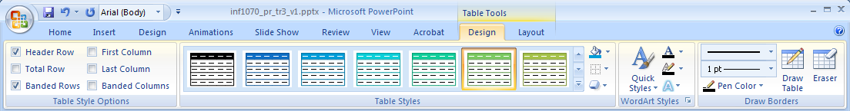
Modify and Apply Styles to a Table
To customize your table, select the table, and use the Layout and Design tabs under the Table Tools tab just as you did with charts.
MICROSOFT OFFICE CERTIFICATION
Microsoft Office Programs | Certification Exams
PowerPoint 2007 | Exam 77-603
Word 2007 | Exam 77-601
Excel 2007 | Exam 77-602
Access 2007 | Exam 77-605

Slide 35
Try it! Practise Creating a Table
Can you recreate and then modify the following table? Try it now.
 | Assign 1 | Assign 2 | Test
Connor | 72 | 78 | 80
Hannah | 58 | 64 | 72
Jordon | 78 | 60 | 68
Lilly | 96 | 94 | 100
Hudson | 65 | 63 | 65
Need help? Go to the Project 3 Instructional Videos in the Toolkit, and watch the demonstration “Try it! Creating a Table” to see how to recreate the table.
You may also wish to view the following demonstration on the Office Online PowerPoint Help and How-to website: “Demo: Work with tables in a document, presentation, or message.”

Slide 36
Try it! Practise Creating a Chart
Can you recreate this chart using your table and charting skills? Try it now. Don’t forget to add the title and axes.
Need help? Go to the Project 3 Instructional Videos in the Toolkit, and watch the demonstration “Try it! Duplicating the Chart” to see how to recreate this chart.

Slide 37
Summary
You have completed Training Room 3. In this training room you have learned how to work with visual content. Specifically you learned to
create and change presentation elements
insert graphics, shapes, and other objects
modify graphics, shapes, and other objects
arrange graphics and other content
insert and modify charts
insert and modify tables

Slide 38
Ready to Move On?
You can repeat this training room until you are comfortable with the concepts presented. When you are ready, proceed to Time to Practise 3.
If you need help, you can
review the training room
use the Office Online Help and How-to website to get tip information, demonstrations, tutorials, and quizzes
check with your teacher or find a learning partner

Slide 39
Time to Practise 3
Begin Time to Practise 3 if you are comfortable demonstrating the skills presented in this training room.
When you are done Time to Practise 3, go to Training Room 4.
© 2009 Alberta Education

