Slide 1
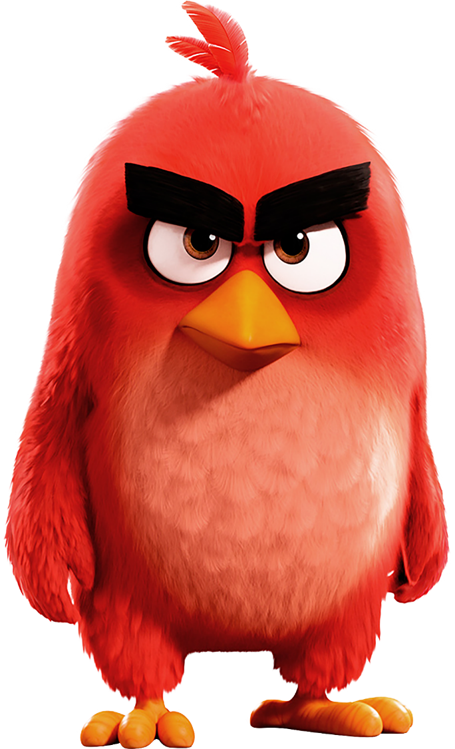

FLAPPY ANGRY BIRD
Prepared By: Bikesh Sitikhu

Slide 2
Content
Introduction
Pygame
Used Library
Variables used
Build-in function used
User define functions

Slide 3
INTRODUCTION
Flappy Angry Bird is the computer game written in Python.
Developed using pygame a python module.

Slide 4
Pygame
cross-platform set of Python modules
designed for writing video games
includes computer graphics and sound libraries
API
Repository: https://github.com/pygame/pygame/
Website: www.pygame.org

Slide 5
Used library
Random
Sys
Pygame

Slide 6
Variable used
FPS = 32
SCREENWIDTH = 1000
SCREENHEIGTH = 500
SCREEN = pygame.display.set_mode((SCREENWIDTH, SCREENHEIGTH))
GROUND_Y = SCREENHEIGTH * 0.8
GAME_IMAGES = {}
GAME_SOUNDS = {}
PLAYER = 'media/img/player1.png'
BACKGROUND = 'media/img/background.jpg'
PIPES = 'media/img/pipe.png'

Slide 7
Built-in functions used
To set caption of the game
pygame.display.set_caption('Flappy Angry Bird')
To load image
Pygame.image.load(image_path).convert_alpha()
To rotate image of pipe
pygame.transform.rotate(pygame.image.load(PIPES).convert_alpha(), 180)
To load the sounds
GAME_SOUND[‘action’] = pygame.mixer.Sound(audio_path)
To render image in screen
SCREEN.blit(image_name, (x,y))

Slide 8
To play sound
GAME_SOUND[‘action’].play()
To update display
pygame.display.update()
FPSCLOCK.tick(FPS)

Slide 9
User define functions
welcomeScreen()
Handles the type event, key event
mainGame()
Defines the position of player
Generates random pipes using getRandomPipe()
Generates 10 random pipes
5 as a upper pipe
5 as a lower pipe

Slide 10
Score check and update if the mid position of the player crosses the mid postion of the pipes
If score equals 10, difficulty level is increased by increasing the velocity of pipe
If again score equals 20, difficulty level is again increased
Moves the lower and upper pipes
By decreasing the x coordinates of pipes
And at certain condition the new set of pipe is generated
All the image generated and loaded is rendered in the screen using blit function at the pre defined FPS

Slide 11
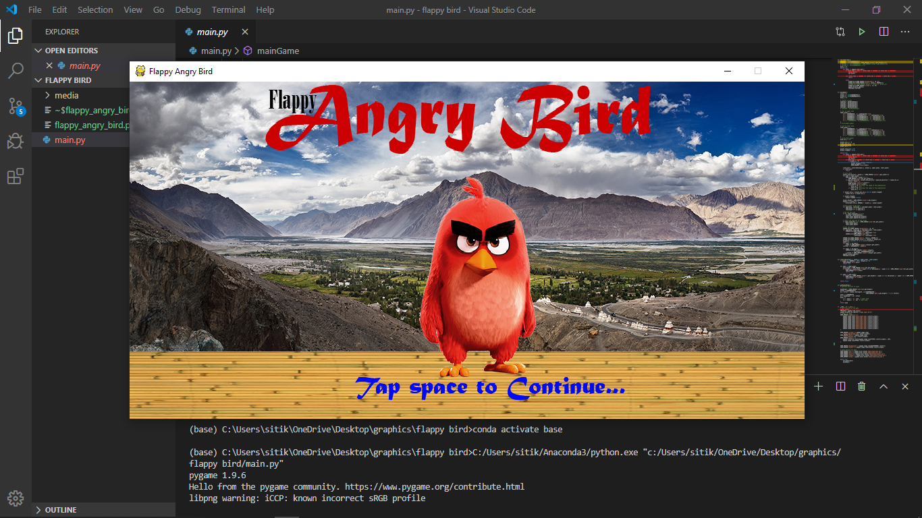
Screenshots

Slide 12
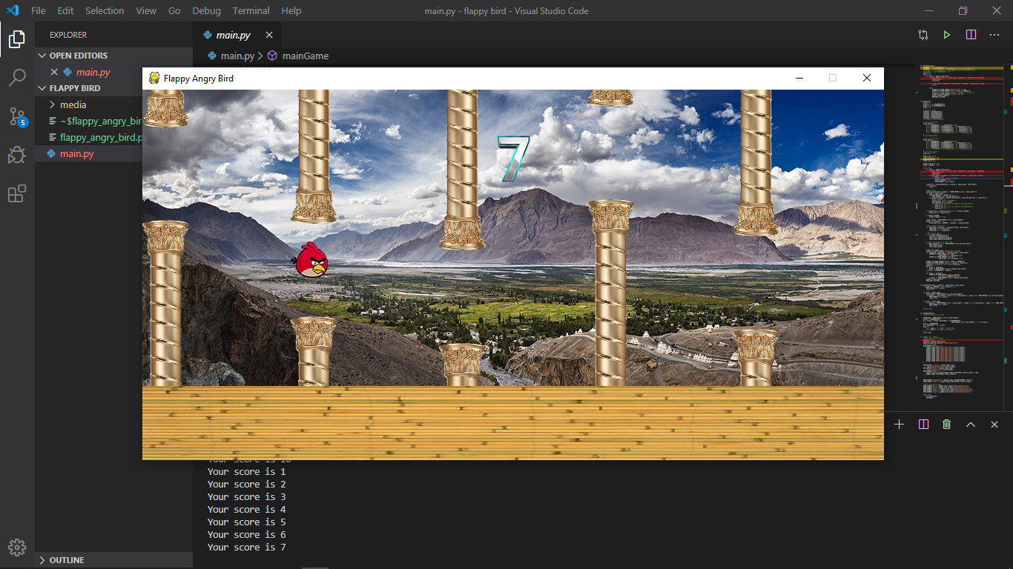

Slide 13

Thank You!!!

