Slide 1
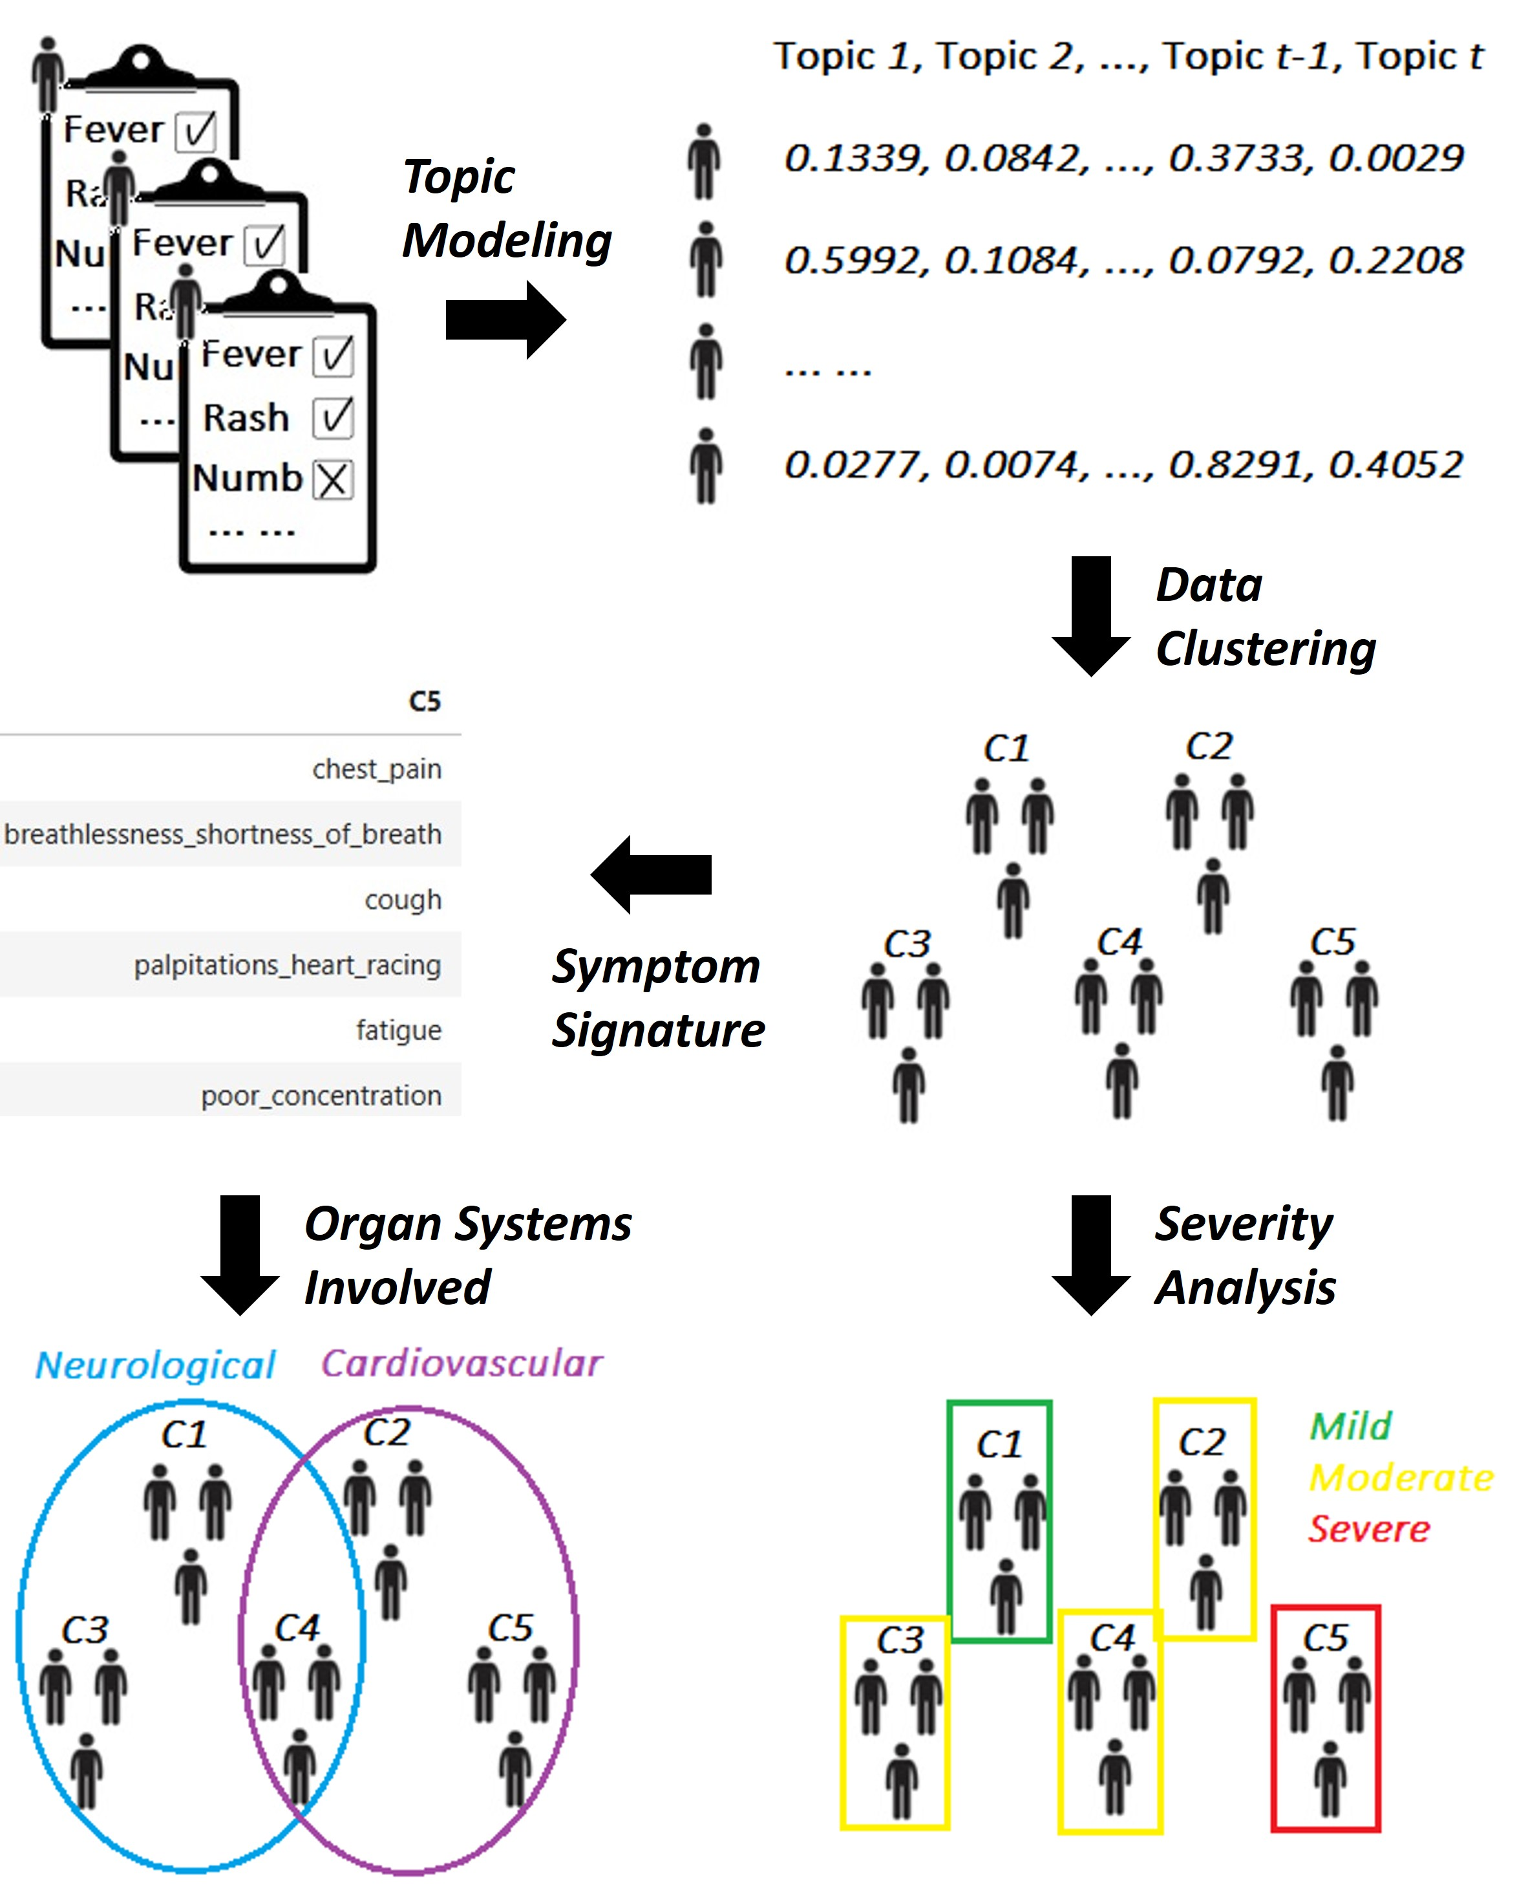
Figure 1
Figure 1
Notes:
Figure 1. A schematic of topic modeling-based symptoms analysis pipeline and its outputs. The input patient-by-symptom binary (presence or absence of a symptom) table is transformed into a patient-by-topic table by topic modeling so that unsupervised clustering analysis can be applied to identify patient clusters. For each cluster, we output the top 6 symptoms with largest topic scores as the signature of the patient cluster. The clusters are grouped into multiple endotypes by mapping its symptom signature to related organ systems, followed by hierarchical agglomerative clustering. Each cluster is distinct but has one or more tags of organ systems. In parallel, we calculate severity of each cluster by adding the topic proportion values of all patients across all symptoms in the cluster.

Slide 2
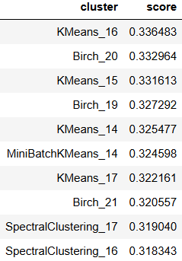
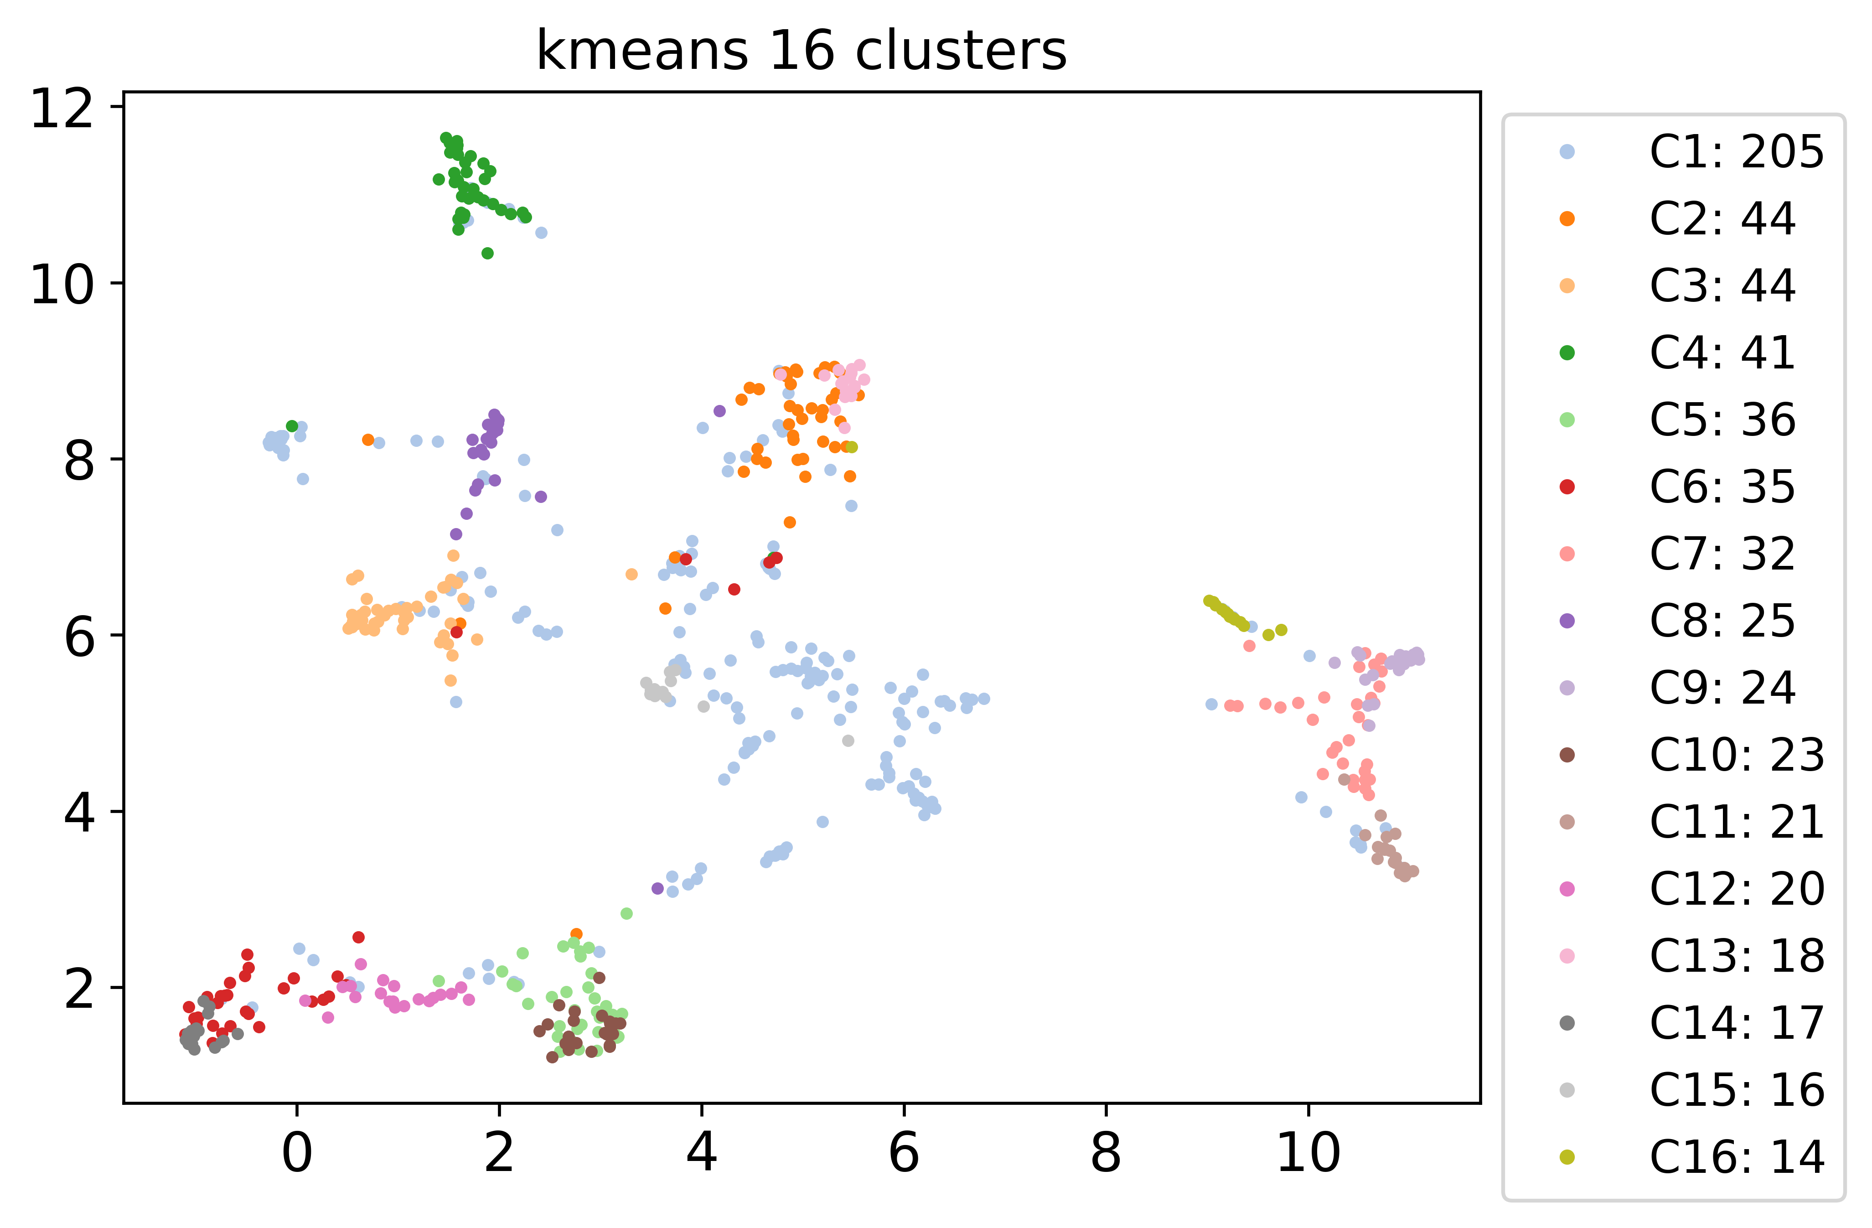
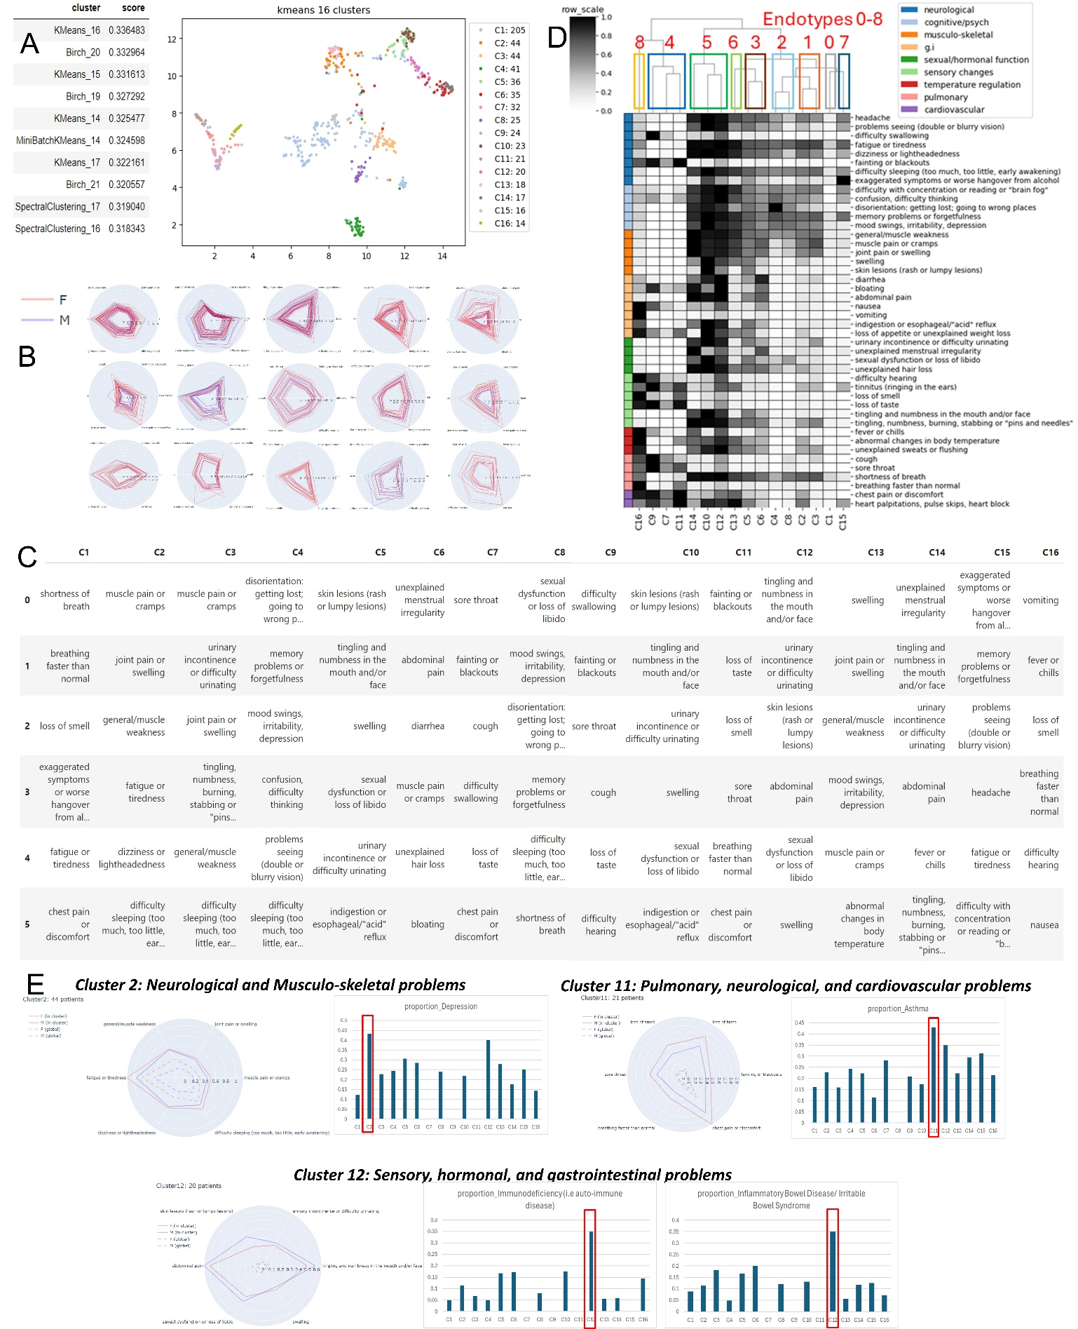
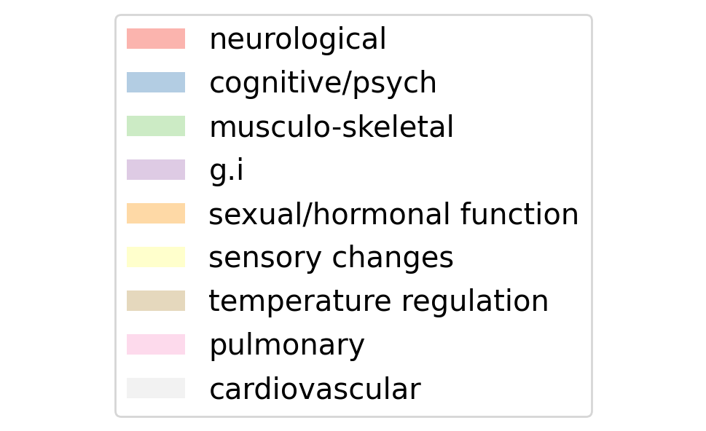
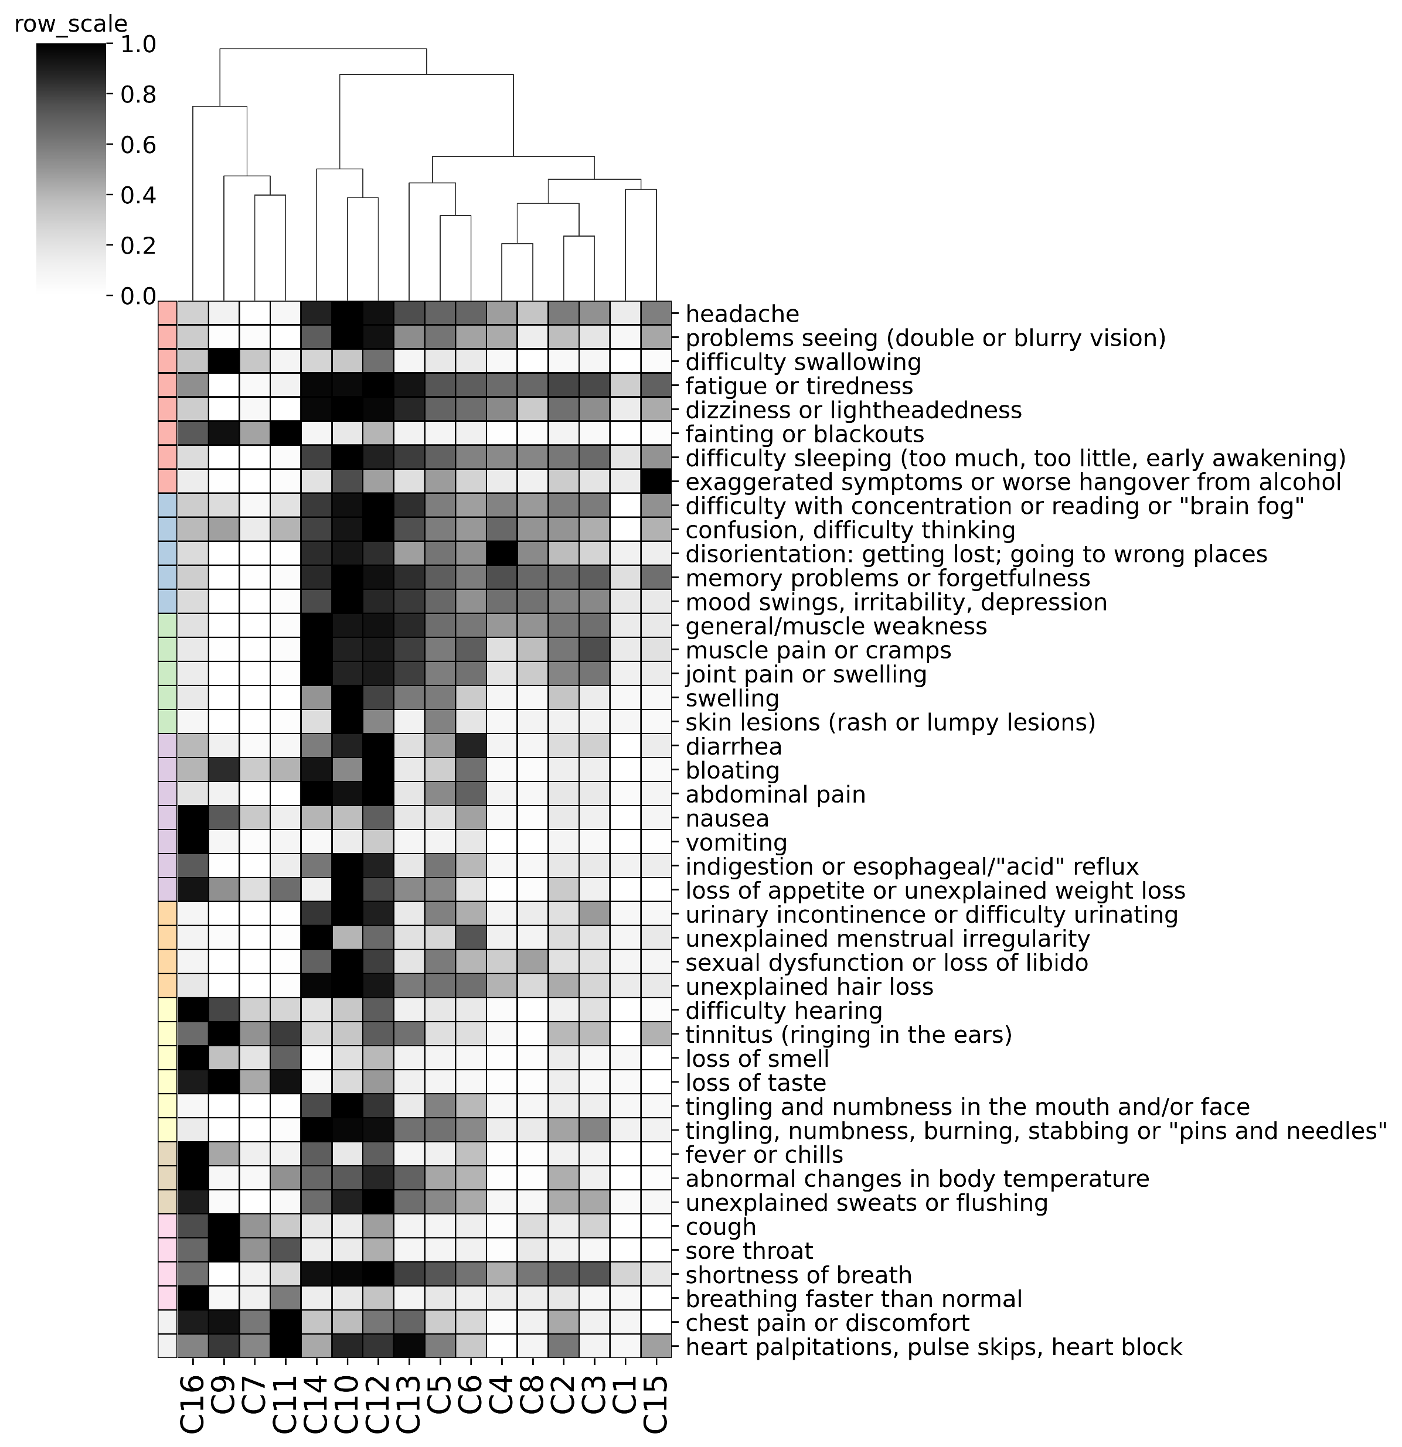
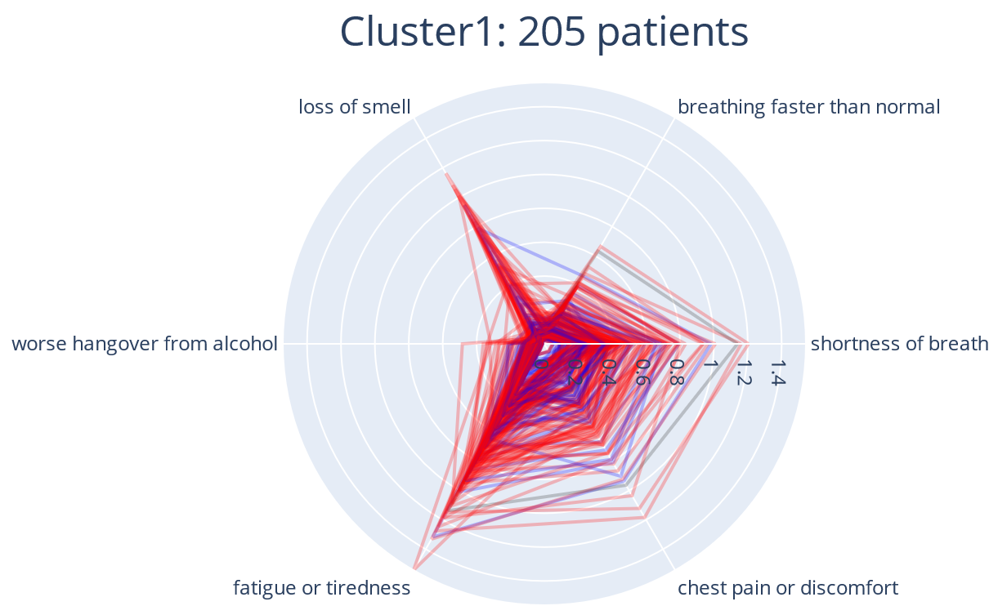
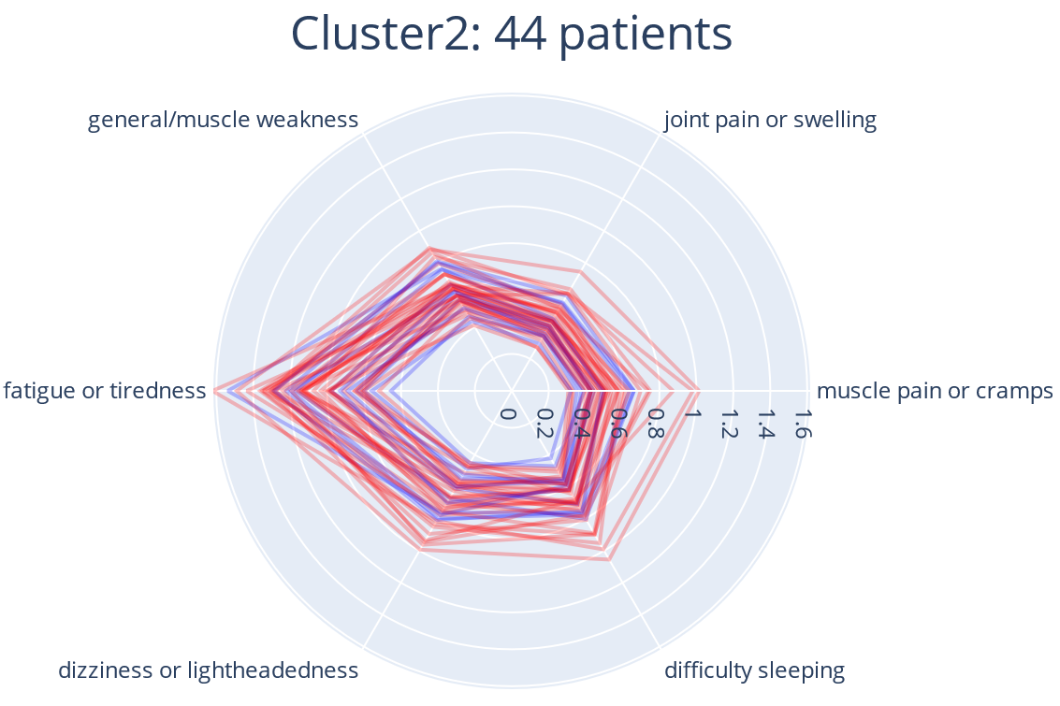
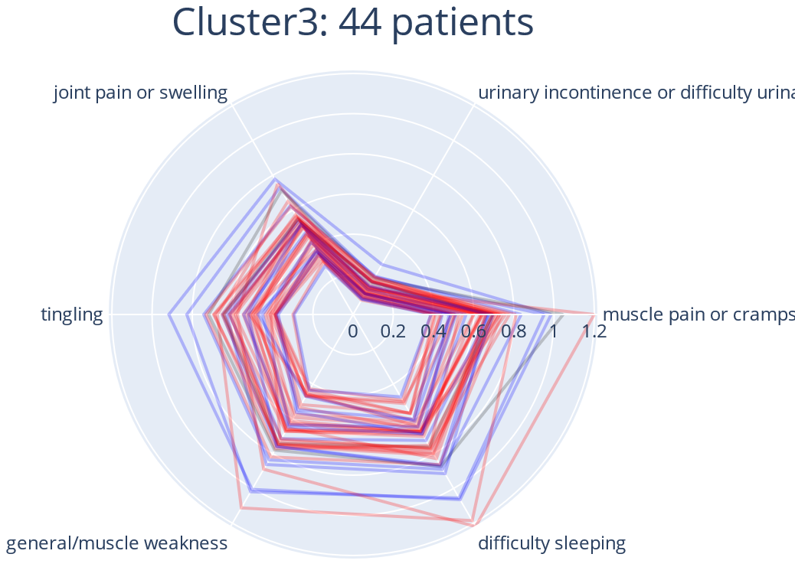
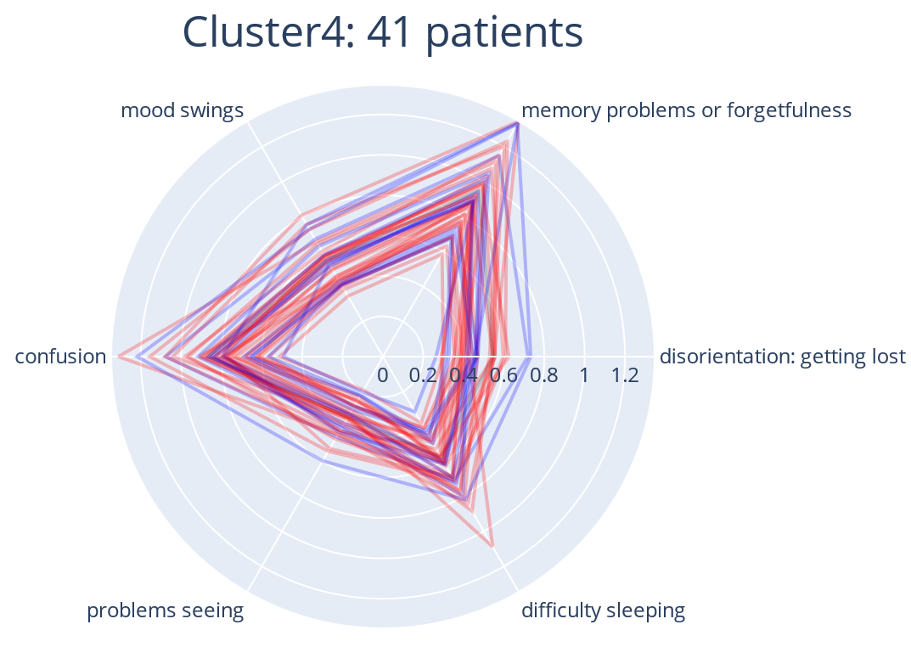
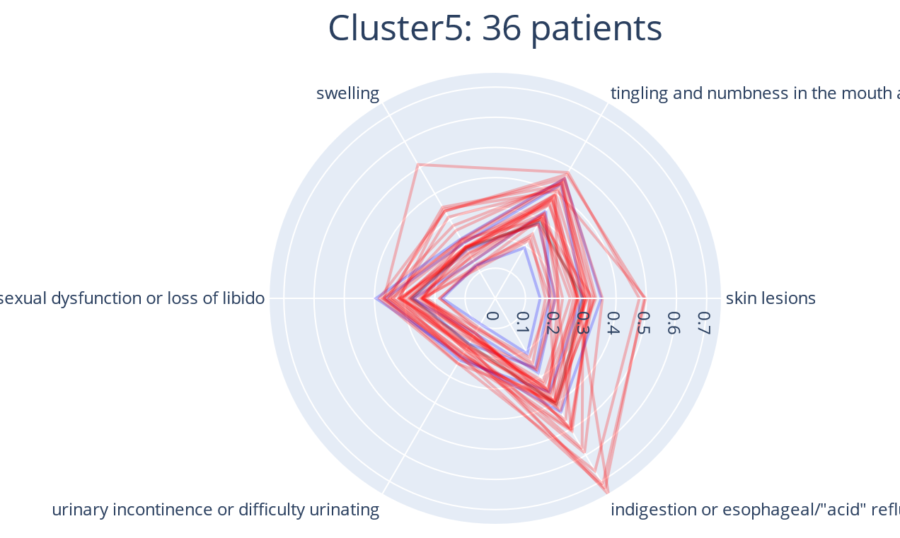
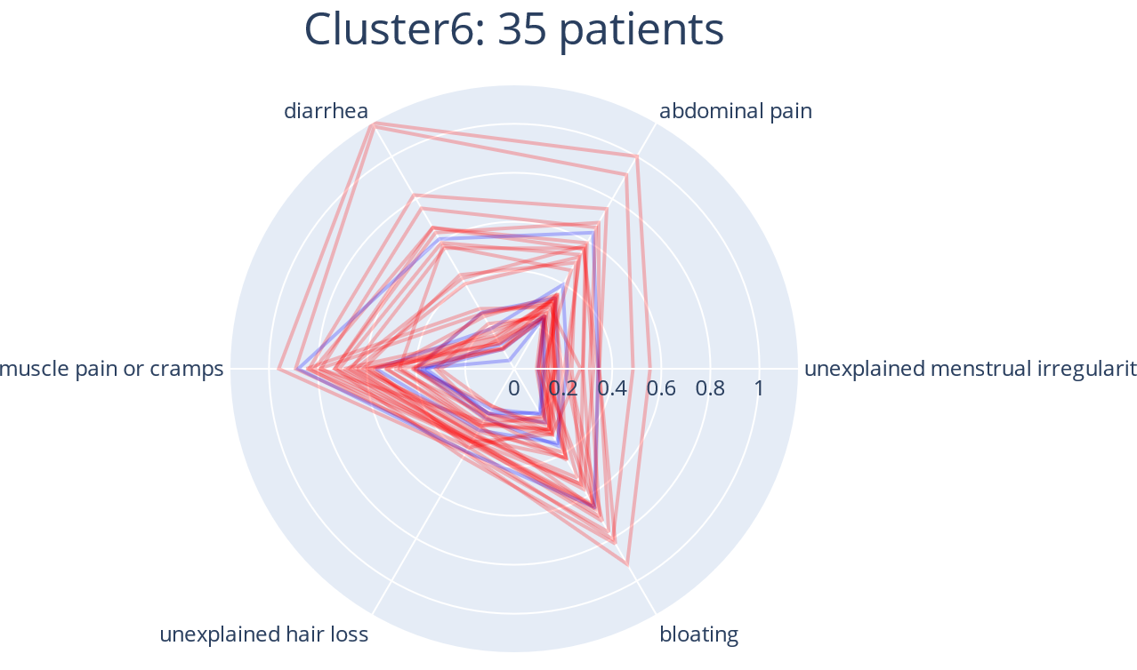
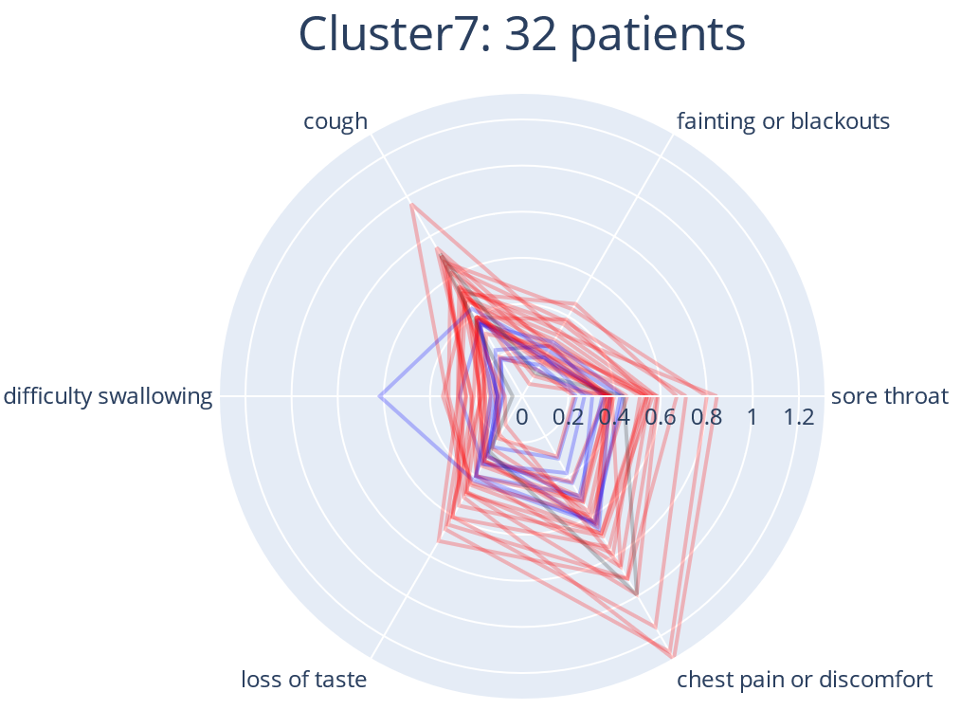
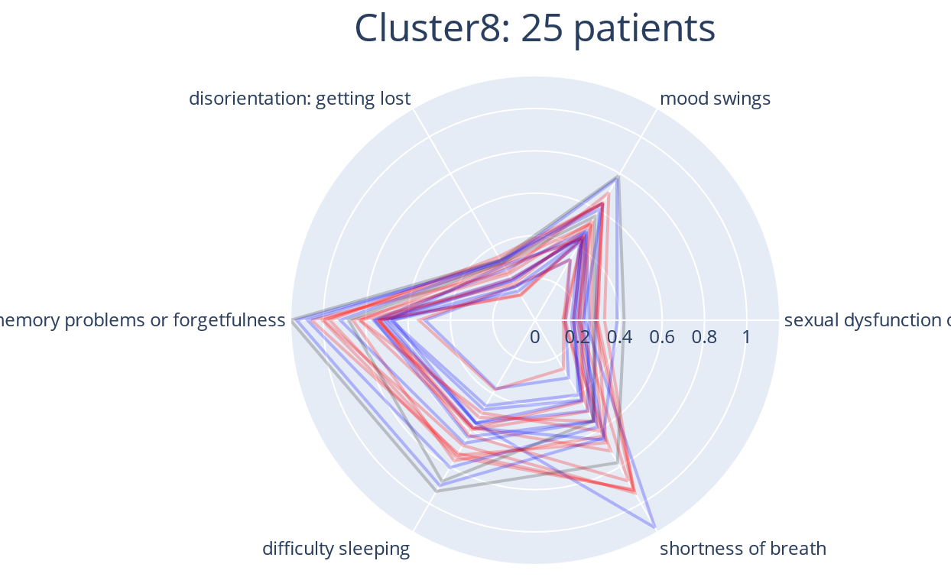
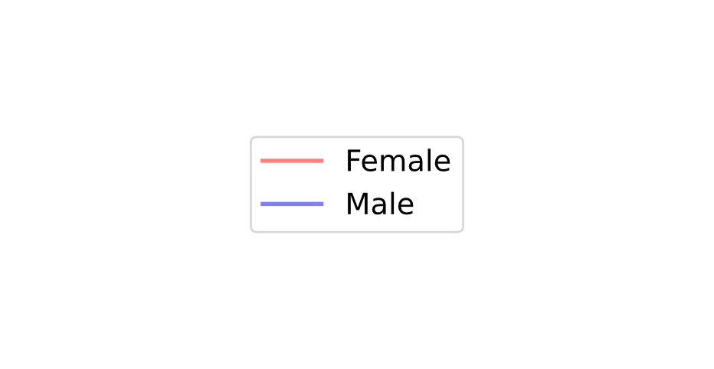
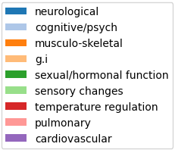
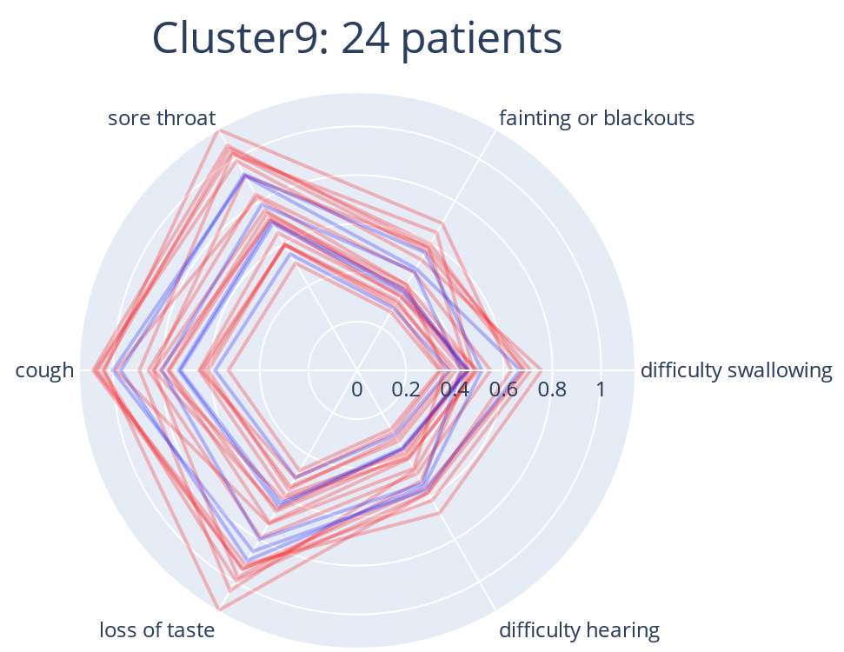
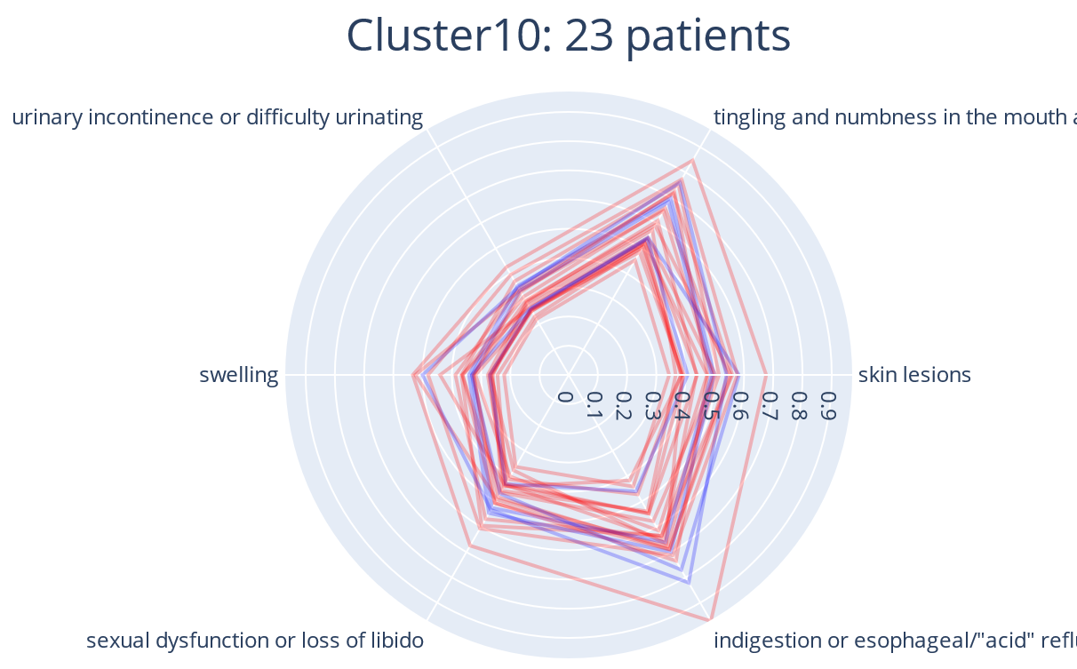
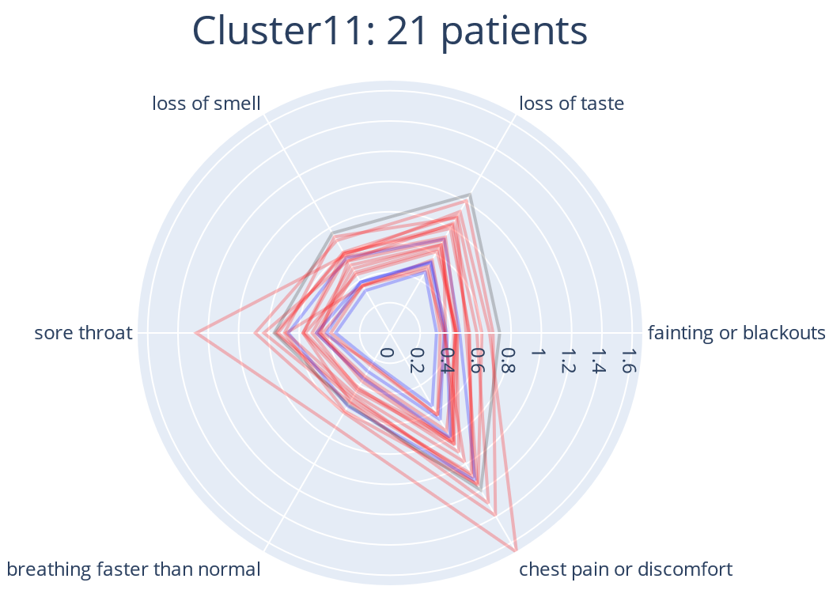
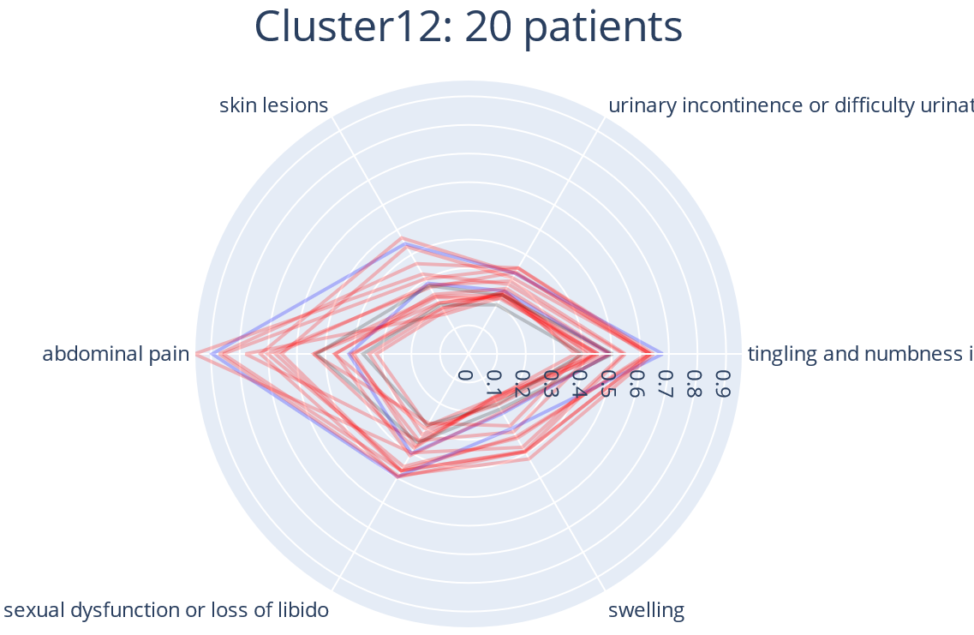
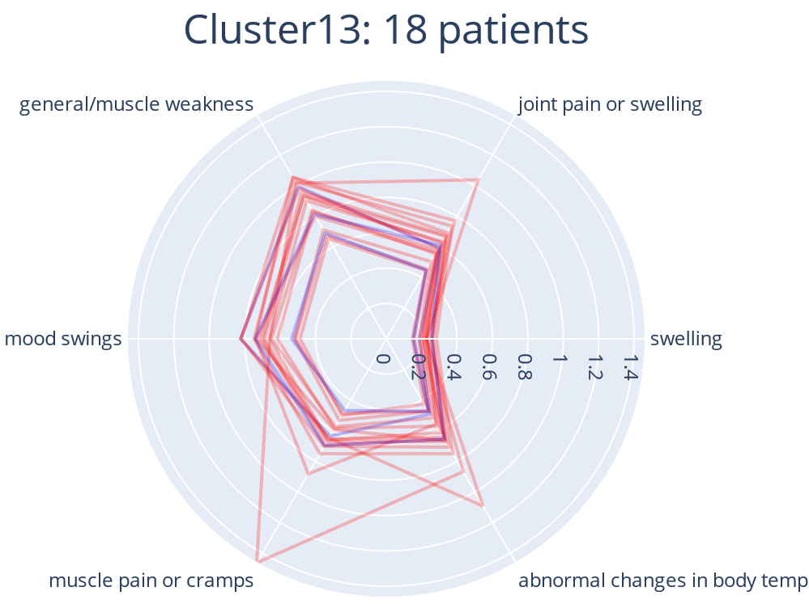
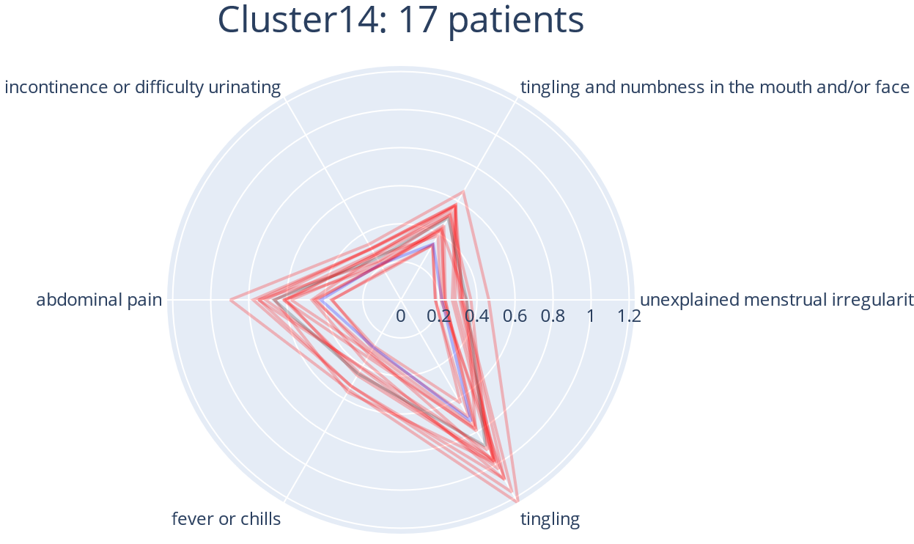
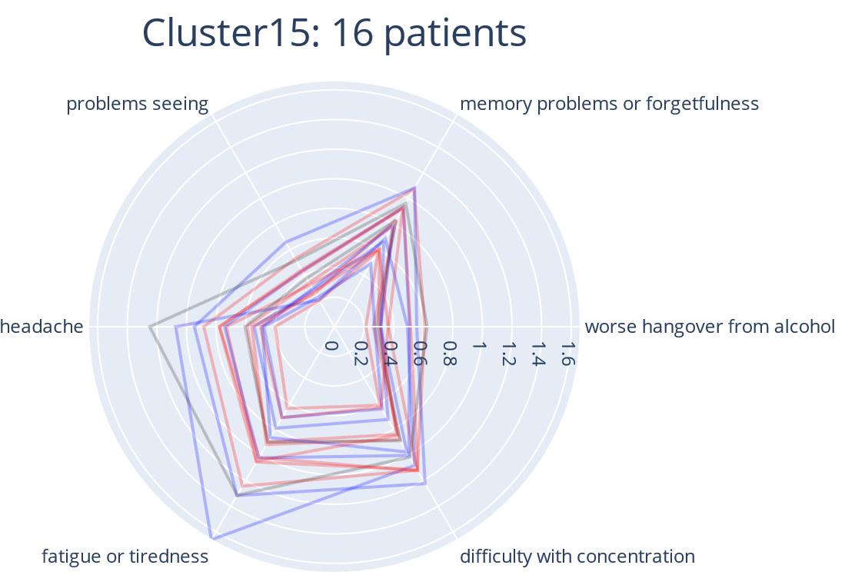
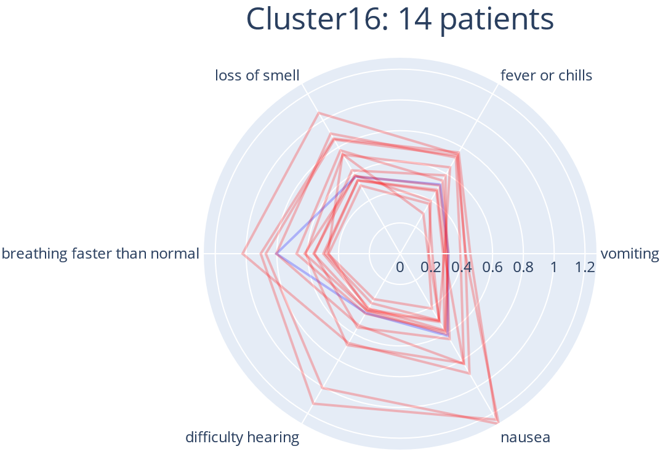
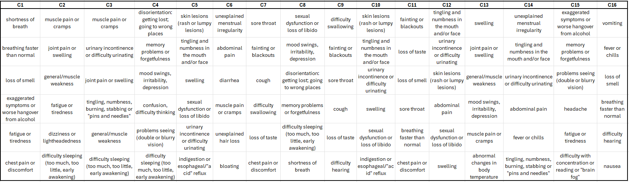
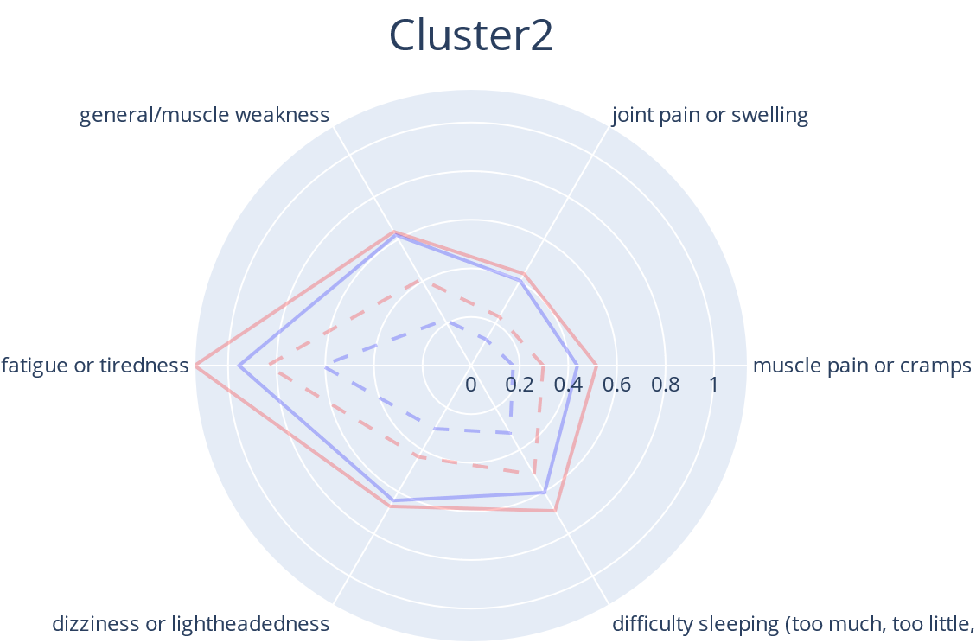
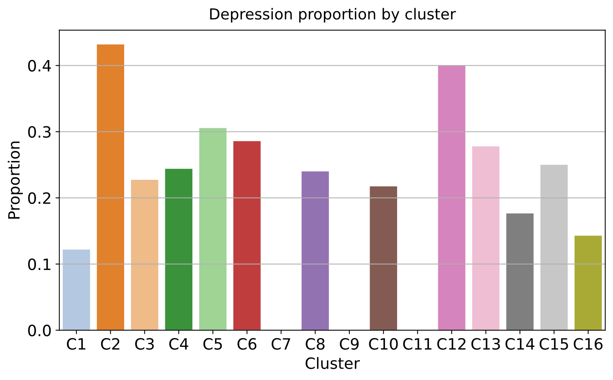
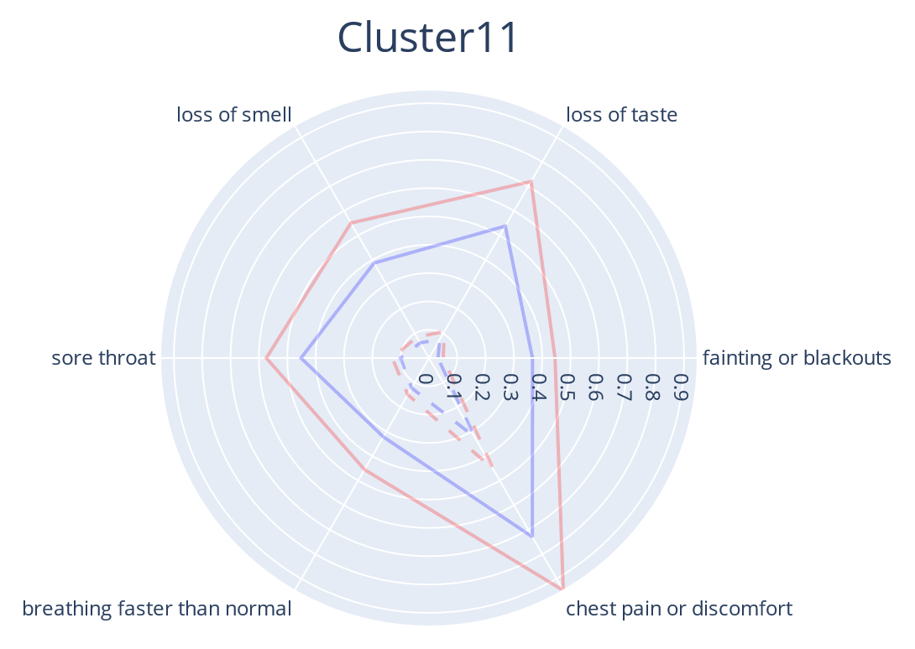
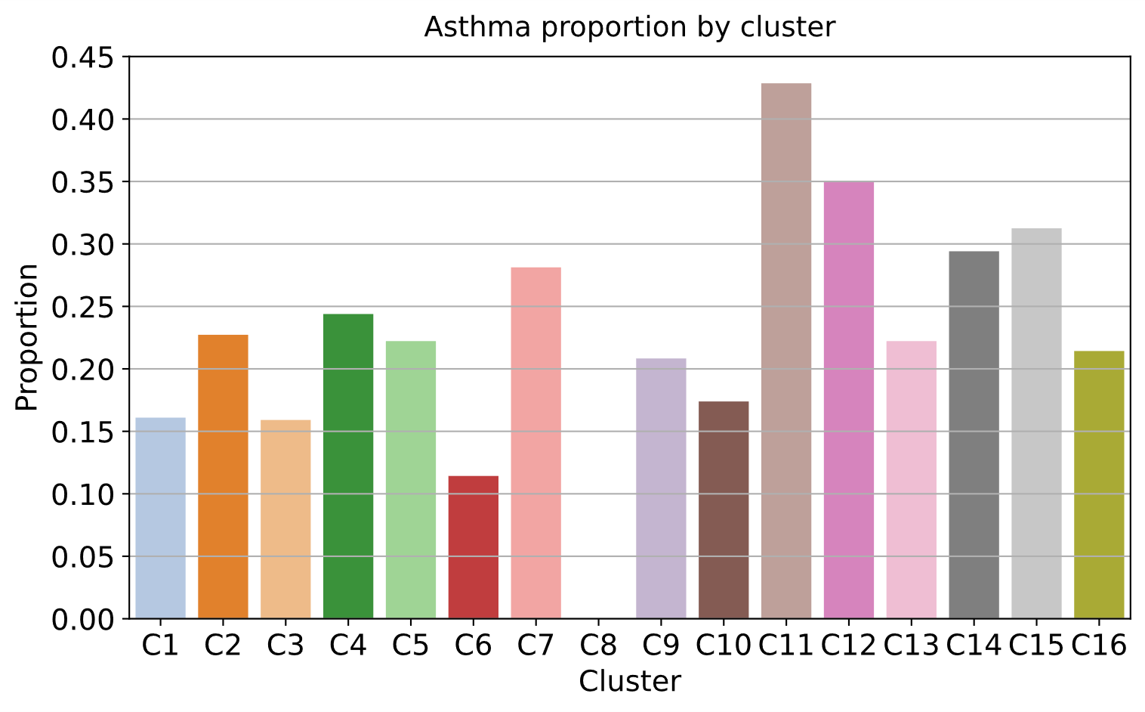
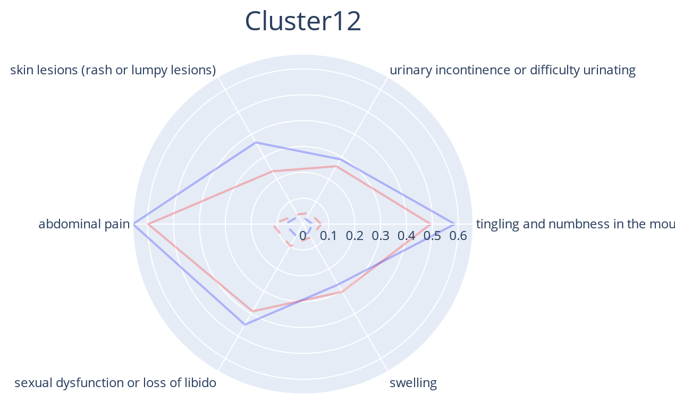
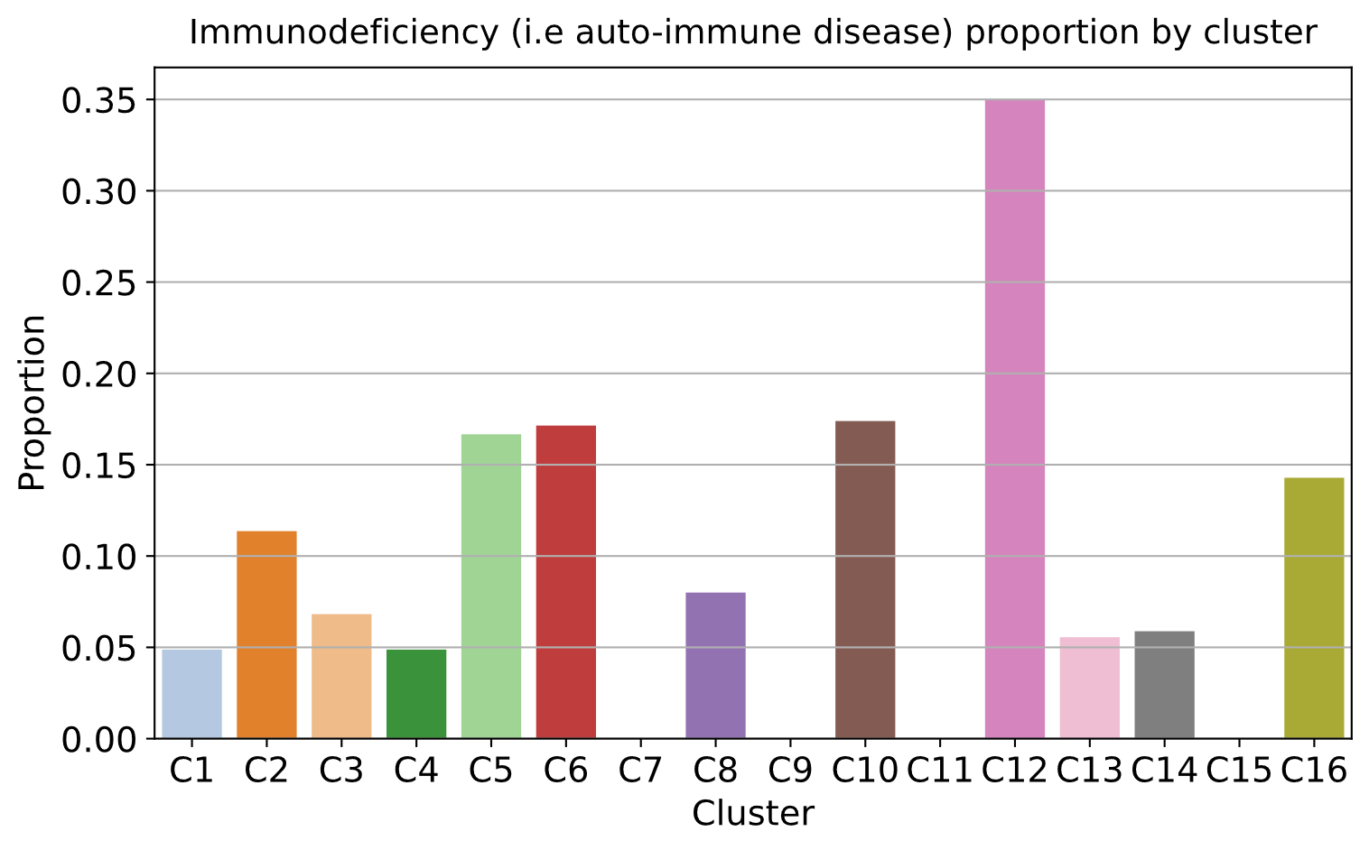
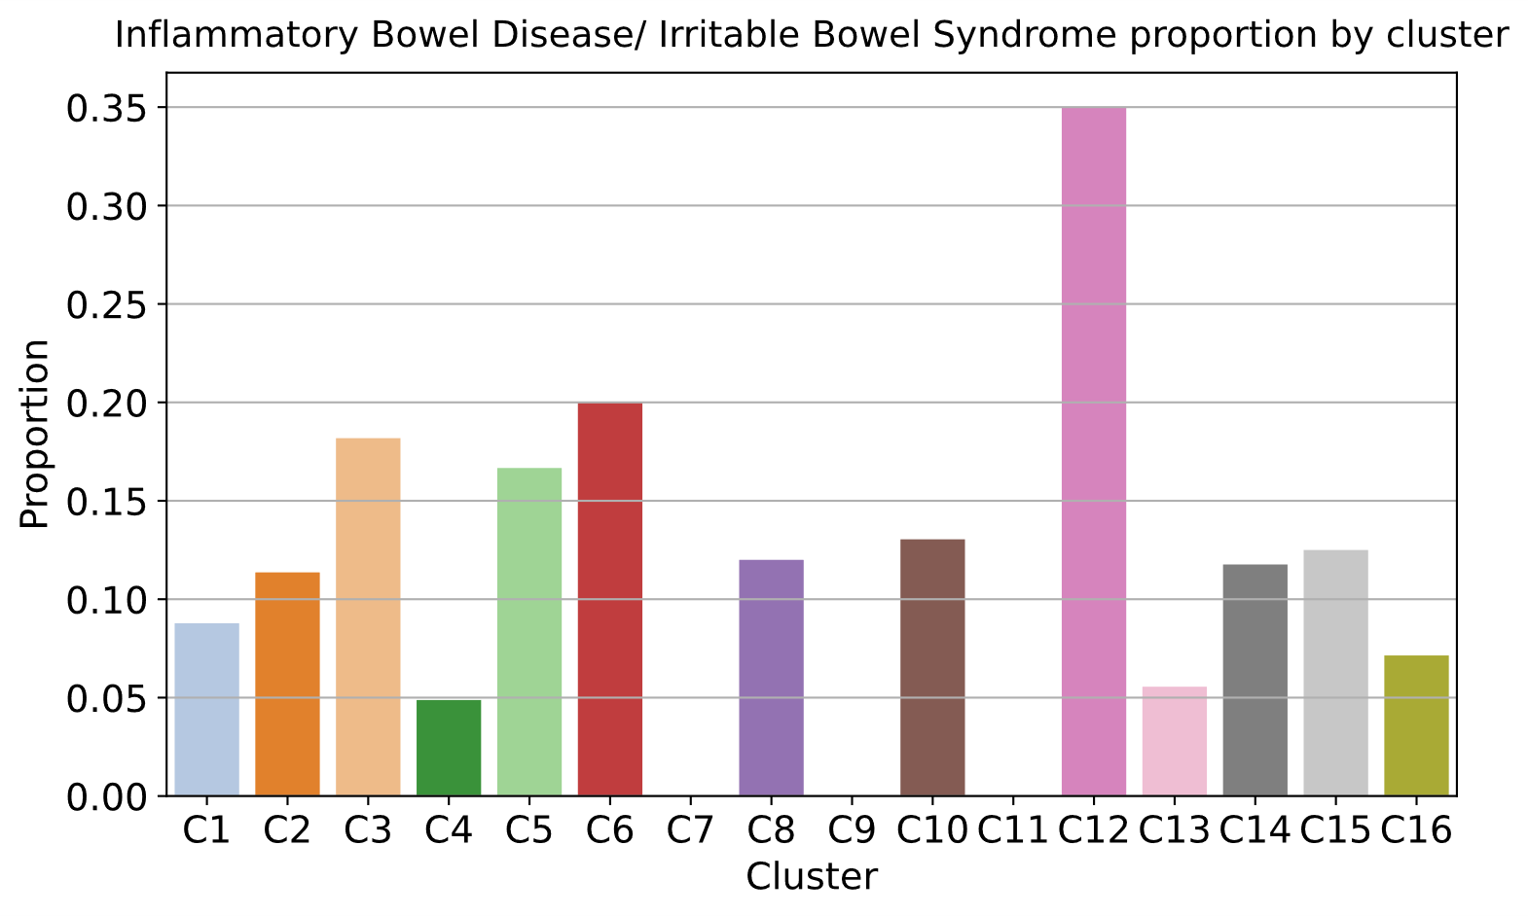

Figure XX
A
D
Endotypes 0–8
8 4 5 6 3 2 1 0 7
B
C
E
Cluster 2: Neurological and musculo-skeletal problems
Cluster 11: Pulmonary, neurological, and cardiovascular problems
Cluster 12: Sensory, hormonal, and gastrointestinal problems
Figure 2
Notes:
Figure 2. Identification of COVID patient clusters, symptom signatures, and their association with pre-existing conditions from walk-in clinic cohort (Sinai). A) UMAP visualization of the 16 patient clusters. The table lists Silhouette scores produced by different clustering algorithms and numbers of clusters. Each dot on UMAP corresponds to one patient (n=615) color-coded using cluster identifier (C1-C16). B) Star charts visualizing top 6 signature symptoms identified in each cluster (C2 to C15; C1 is mild with few symptoms). Topic proportions in the patient by symptom table for each cluster are normalized before being visualized. Each ring corresponds to one patient and all patients in each cluster are plotted together for demonstrating their consistent symptom profiles. Female patients are colored in red (males in blue). C) Table listing symptom signatures of individual clusters. Each column corresponds to one cluster, and the top 6 symptoms are ranked based on their topic proportions, from high to low (Row 0 to Row 5). D) Grayscale heatmap visualizing 16 symptom clusters being merged into 9 endotypes associated with predefined organ systems, following dendrogram. Each row in heatmap is a symptom and each column a patient cluster. Rows/symptoms of the same organ system are put together, with colors in leftmost row indicating the organ system. A darker gray scale indicating a higher level of association between the cluster and the symptom, quantified using topic proportions. Cluster 1 (mild) corresponds to Endotype 0 (E0). Clusters with similar symptom signatures were grouped together using hierarchical clustering analysis. E) Interpretation of each cluster. Each cluster is annotated with one or multiple organ systems involved based on its top 6 signature symptoms. Three examples (Clusters 2, 11, and 12) are included. Four rings in each star chart are plotted to show the average topic proportion of all patients in a cluster for all females in the cluster (red line), all males in the cluster (blue line), all females in the cohort (red dotted line), and all males in the cohort (blue dotted line). For each pre-existing condition that is related to the organ systems, a bar chart is created to visualize proportions of patients with the pre-existing condition in all patients in the cluster (one bar per cluster and the cluster of interest is highlighted).

Slide 3
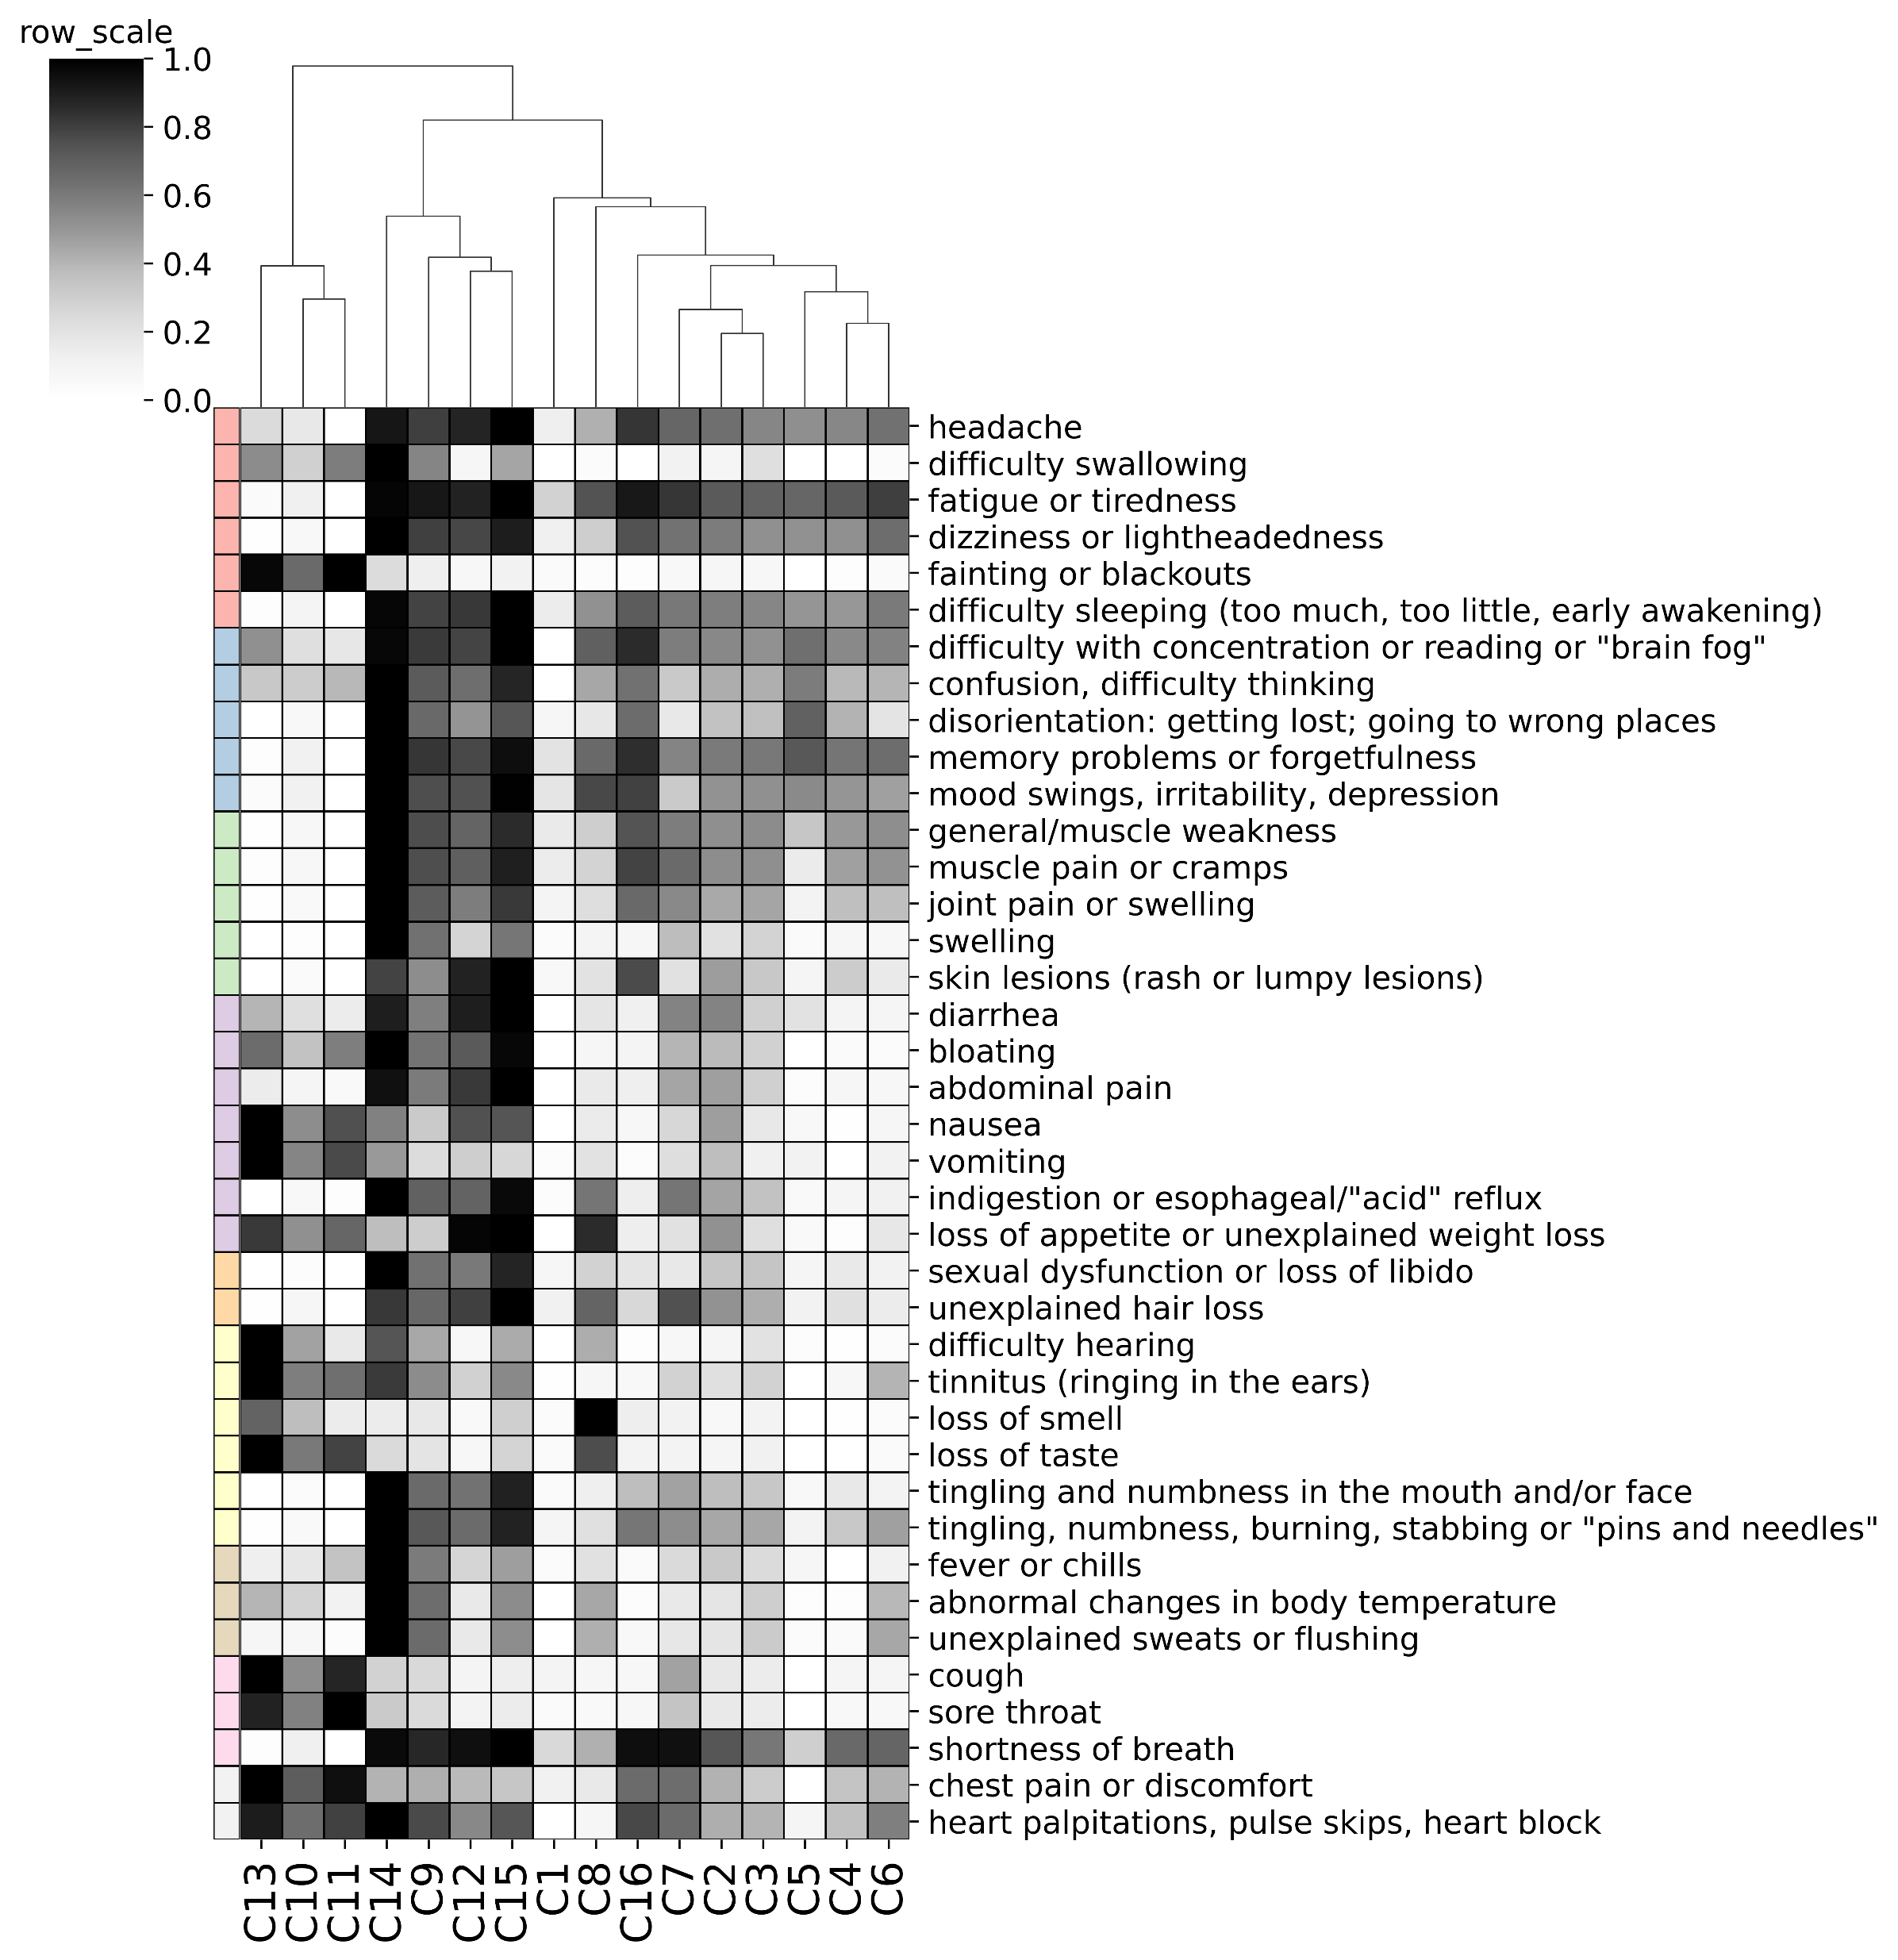
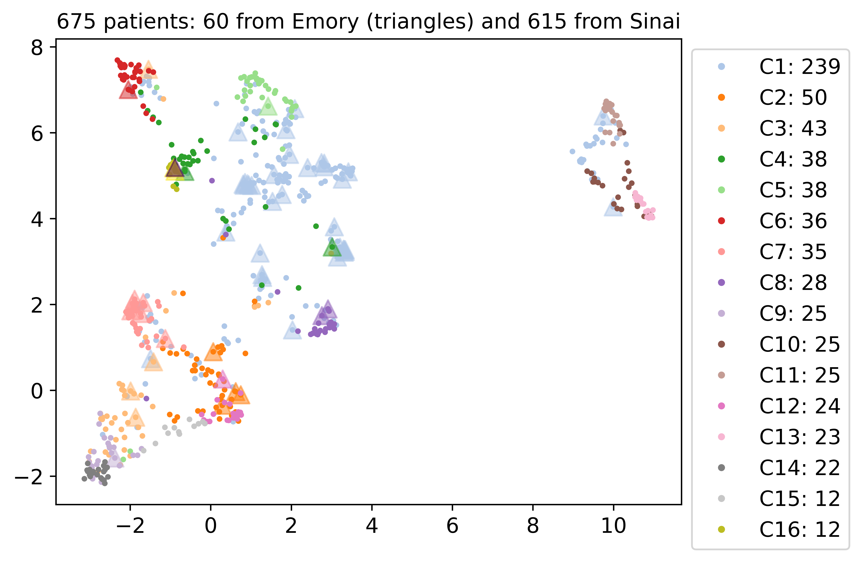
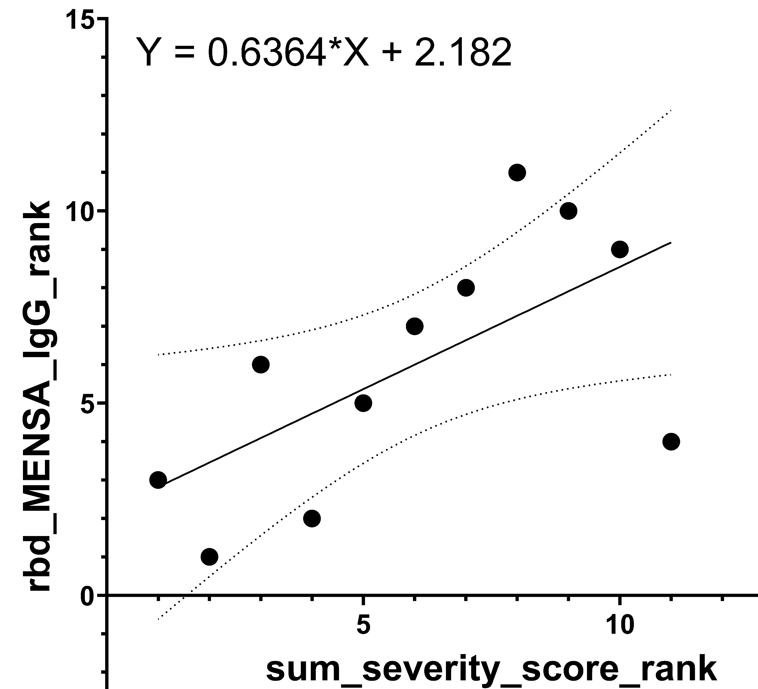
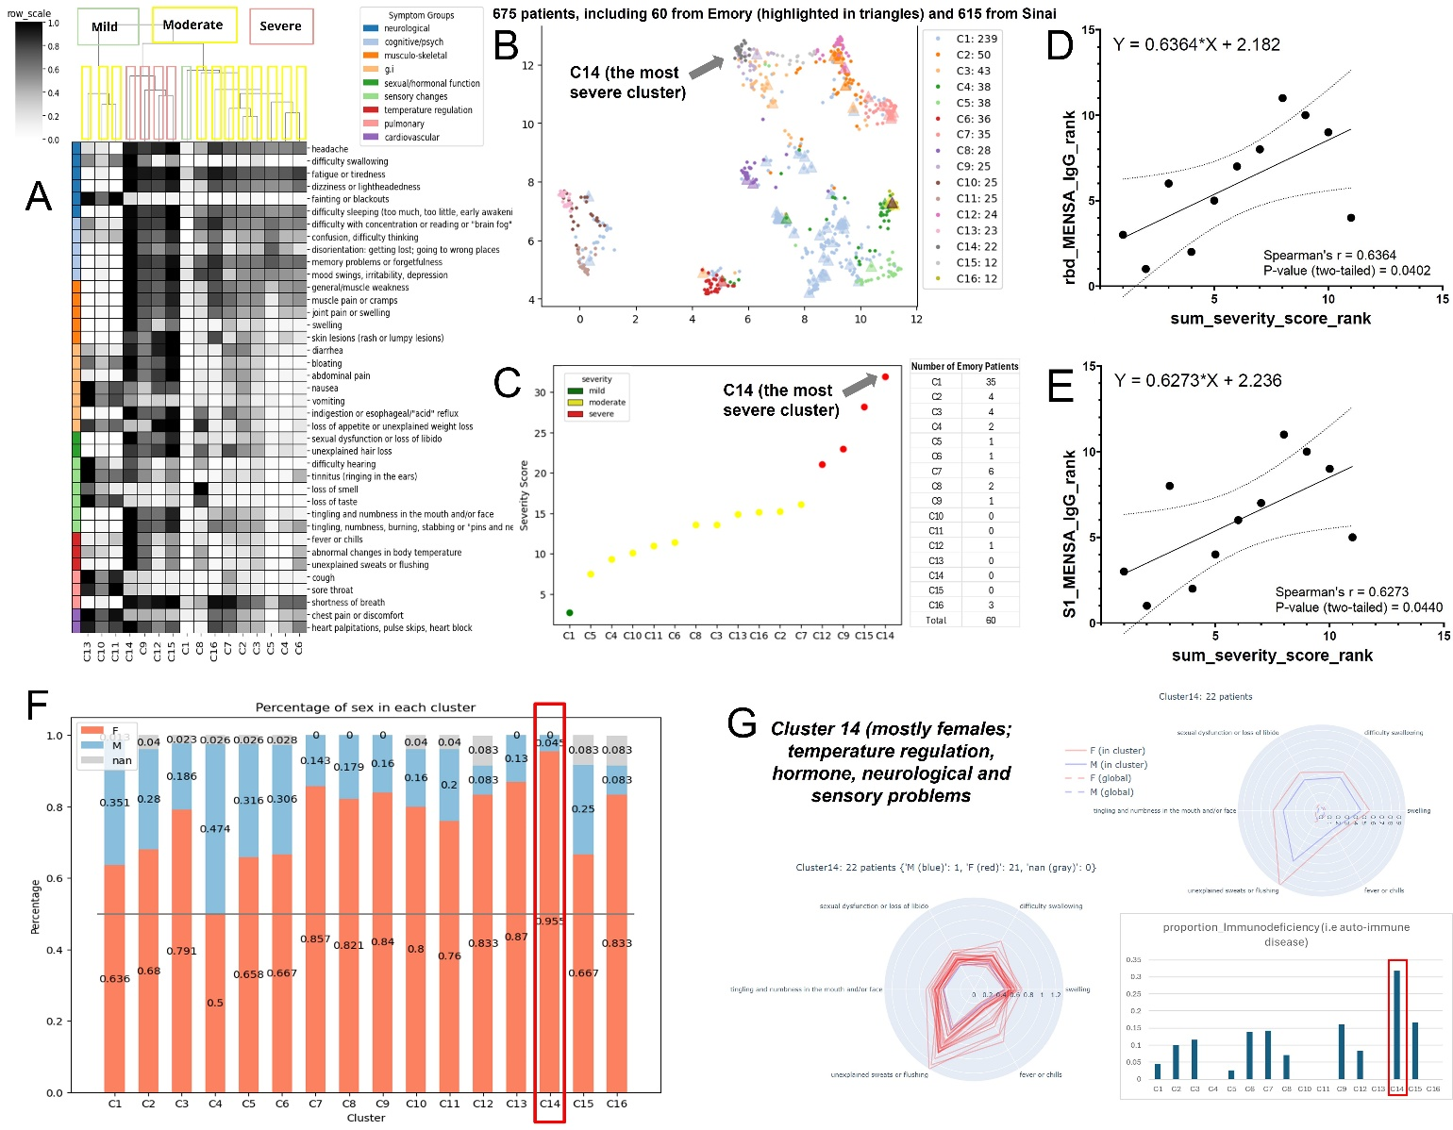
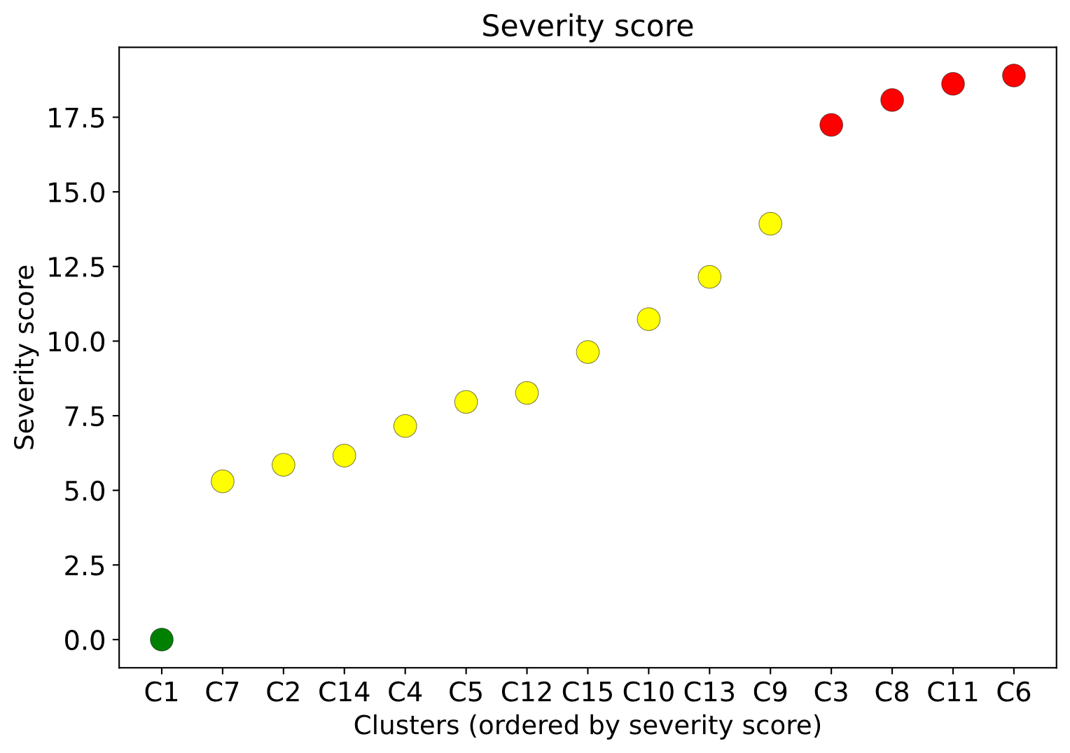
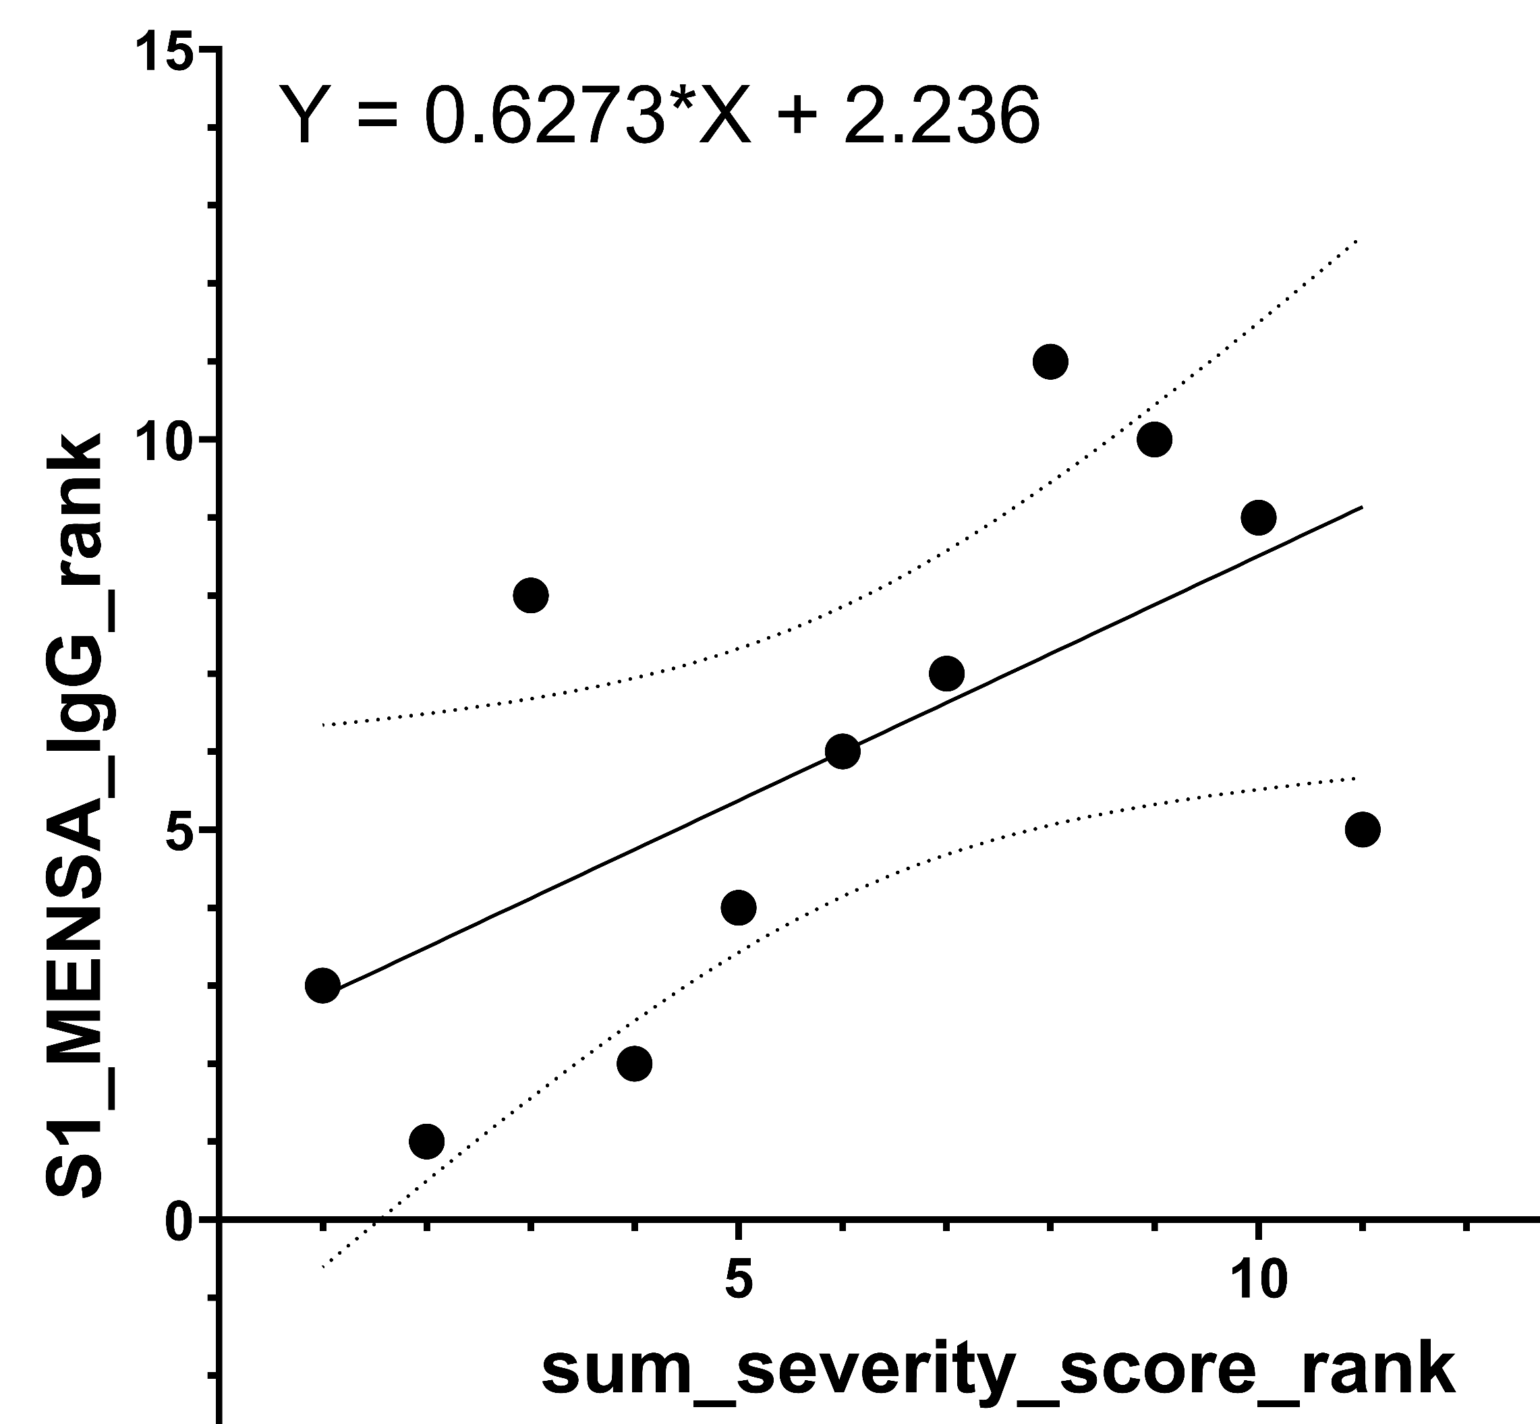
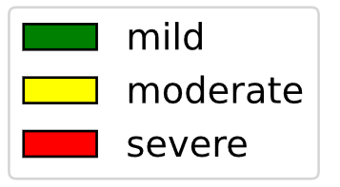
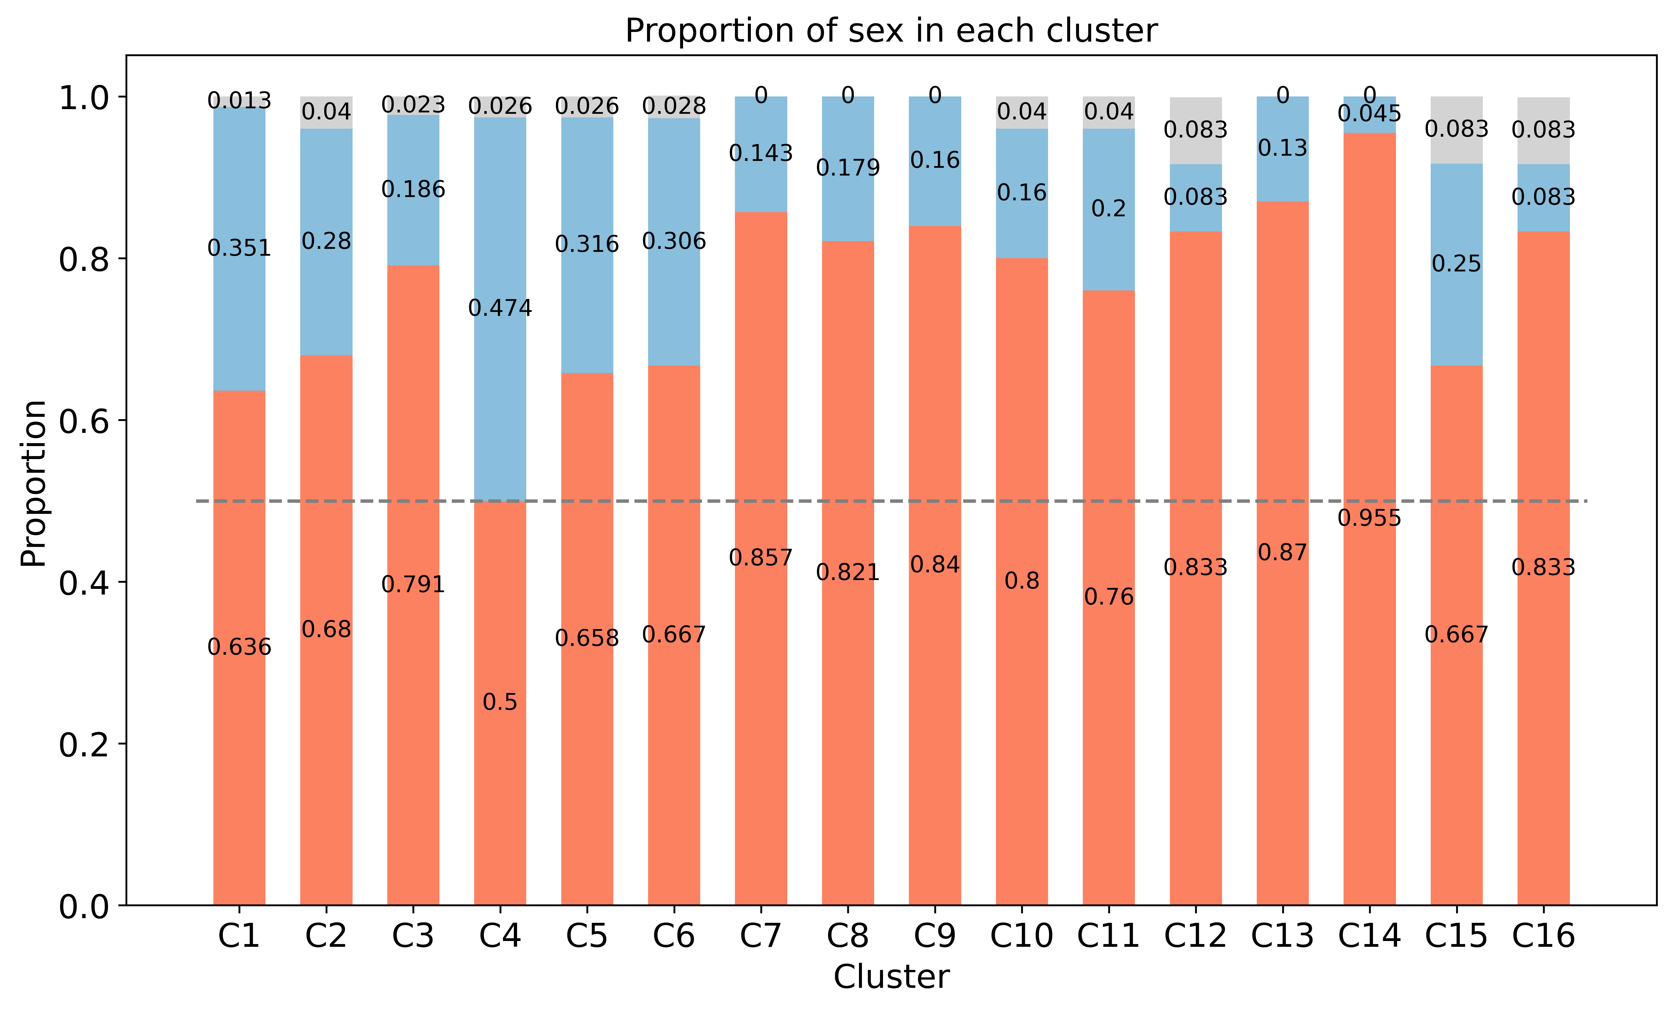
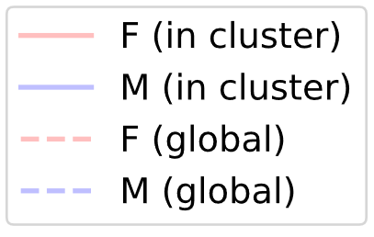
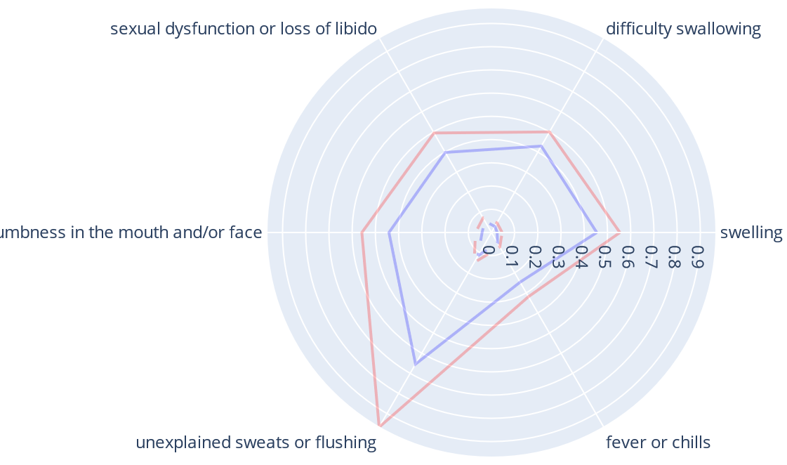
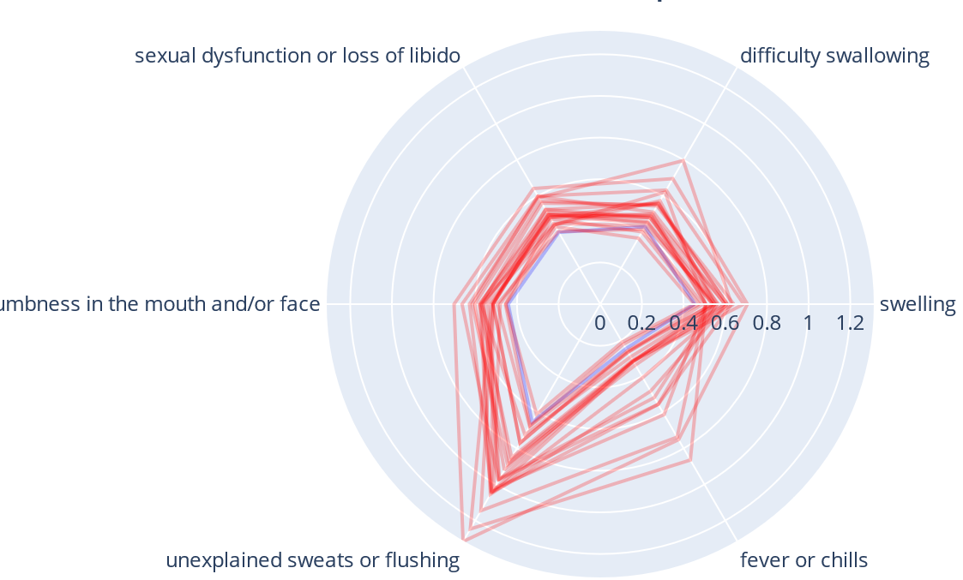
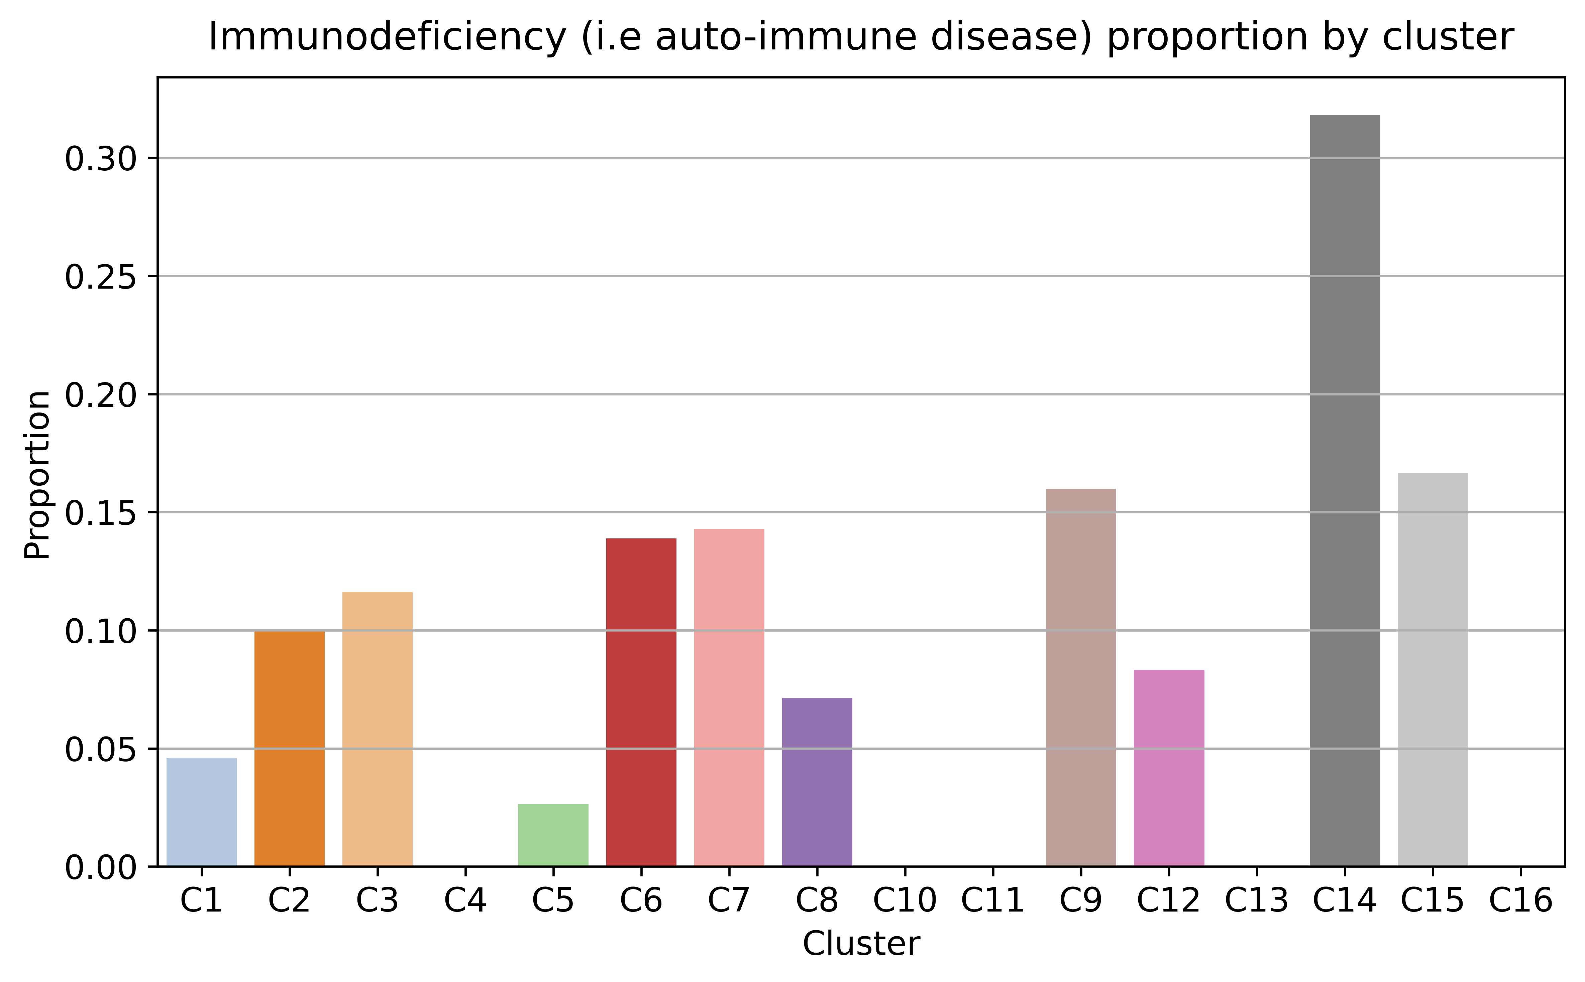
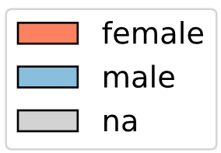
Figure 2
A
675 patients: 60 from Emory (triangles) and 615 from Sinai
B
D
C14 (the most severe cluster)
C
E
C14 (the most severe cluster)
F
G
Cluster 14 (mostly females): temperature regulation, hormone, neurological, and sensory problems
Number of Emory Patients
C1 | 35
C2 | 4
C3 | 4
C4 | 2
C5 | 1
C6 | 1
C7 | 6
C8 | 2
C9 | 1
C10 | 0
C11 | 0
C12 | 1
C13 | 0
C14 | 0
C15 | 0
C16 | 3
Total | 60
Figure 2
Notes:
Figure 3. Interpretation of severity of SARS-COV-2 infection and long COVID by association of symptom severity with antibody assay data (Emory + Sinai cohorts). Surveys from Emory (n=60) and Sinai (n=615) are merged into input to the topic modeling method. A) Grayscale heatmap visualizing the cluster-by-symptom matrix. Each row is a symptom and each column a patient cluster identified from the merged cohort (n=675). Symptoms are mapped to 9 predefined organ systems. Three severity groups (mild/green, moderate/yellow, and severe/red) are identified and colored in the dendrogram, based on a cluster-specific severity score, which is defined by sum of topic portions across all symptoms. B) UMAP visualization of 16 patient clusters identified by the topic modeling-based method, ranked based on their sizes. Cluster #14 (dark grey) is highlighted as the most sever patient group, which corresponds to Cluster #12 in Sinai-only analysis (Figure 2). C) Identification of severity groups from a ranked view of cluster-severity plot. The 16 clusters (X-axis) were ranked based on the severity score (Y-axis). An elbow method was used to separate patient clusters into three groups: mild, moderate, and severe (also visualized in the dendrogram in Figure 3A). D-E) Non-parametric rank-based analysis (X-axis: disease severity of patient clusters, ranked based on sum of topic proportions across symptoms associated with the cluster; Y-axis: mean of antibody titers of all Emory samples within the cluster; 11 out of 16 clusters contain Emory patients) showing significant correlation between topic modeling-predicted severity score and SARS-COV-2 RBD IgG and S1 IgG in antibody binding assay (MENSA [citation]). Spearman’s r = 0.6364 with two-tailed p-value = 0.0402 and Spearman’s r = 0.6273 with two-tailed p-value = 0.0440 were identified for MENSA RBD and S1, respectively. The straight line is plotted from linear regression analysis with two curved lines showing 95% confidence interval. F) Bar graph showing proportions (Y-axis) of female (ochre) and male (blue) across clusters (X-axis), showing that Cluster #14 is mostly female. G) Star charts showing the 22 patients in Cluster #14, reporting symptoms associated with at least 4 types of organ systems. The bar chart highlights that 32% of the patients in this cluster have pre-existing condition with their immune systems.

Slide 4
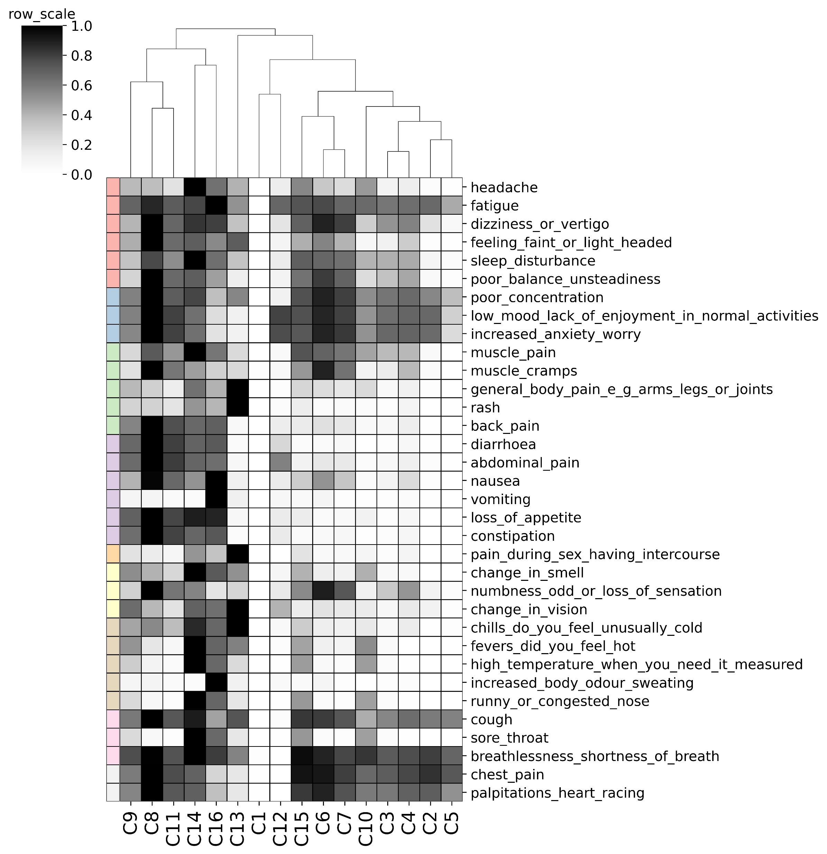
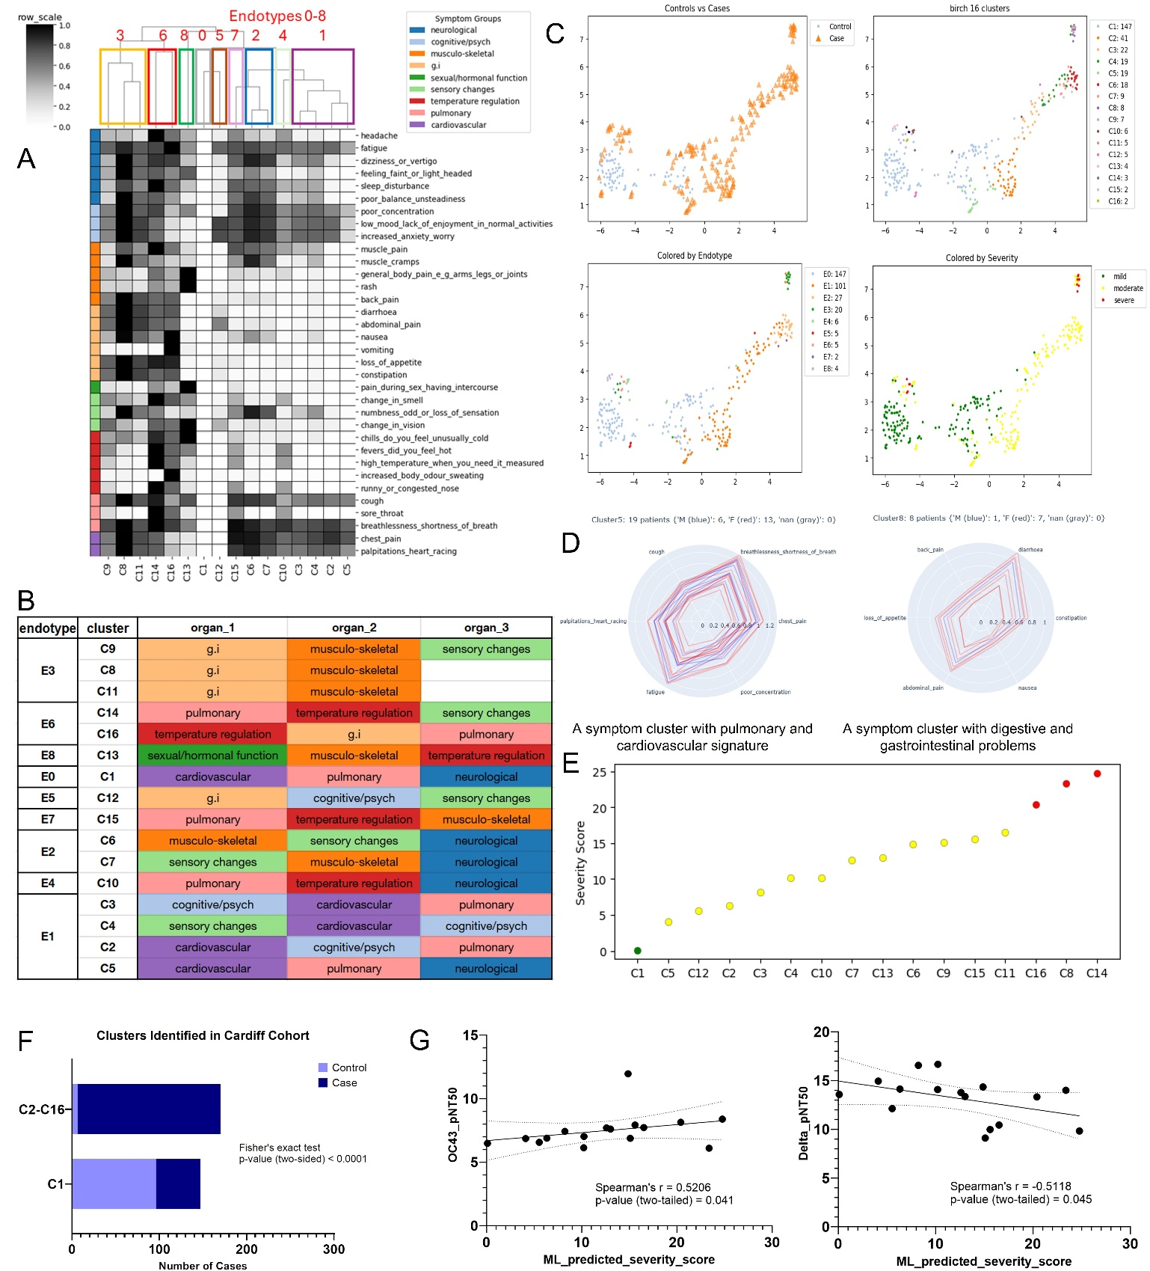
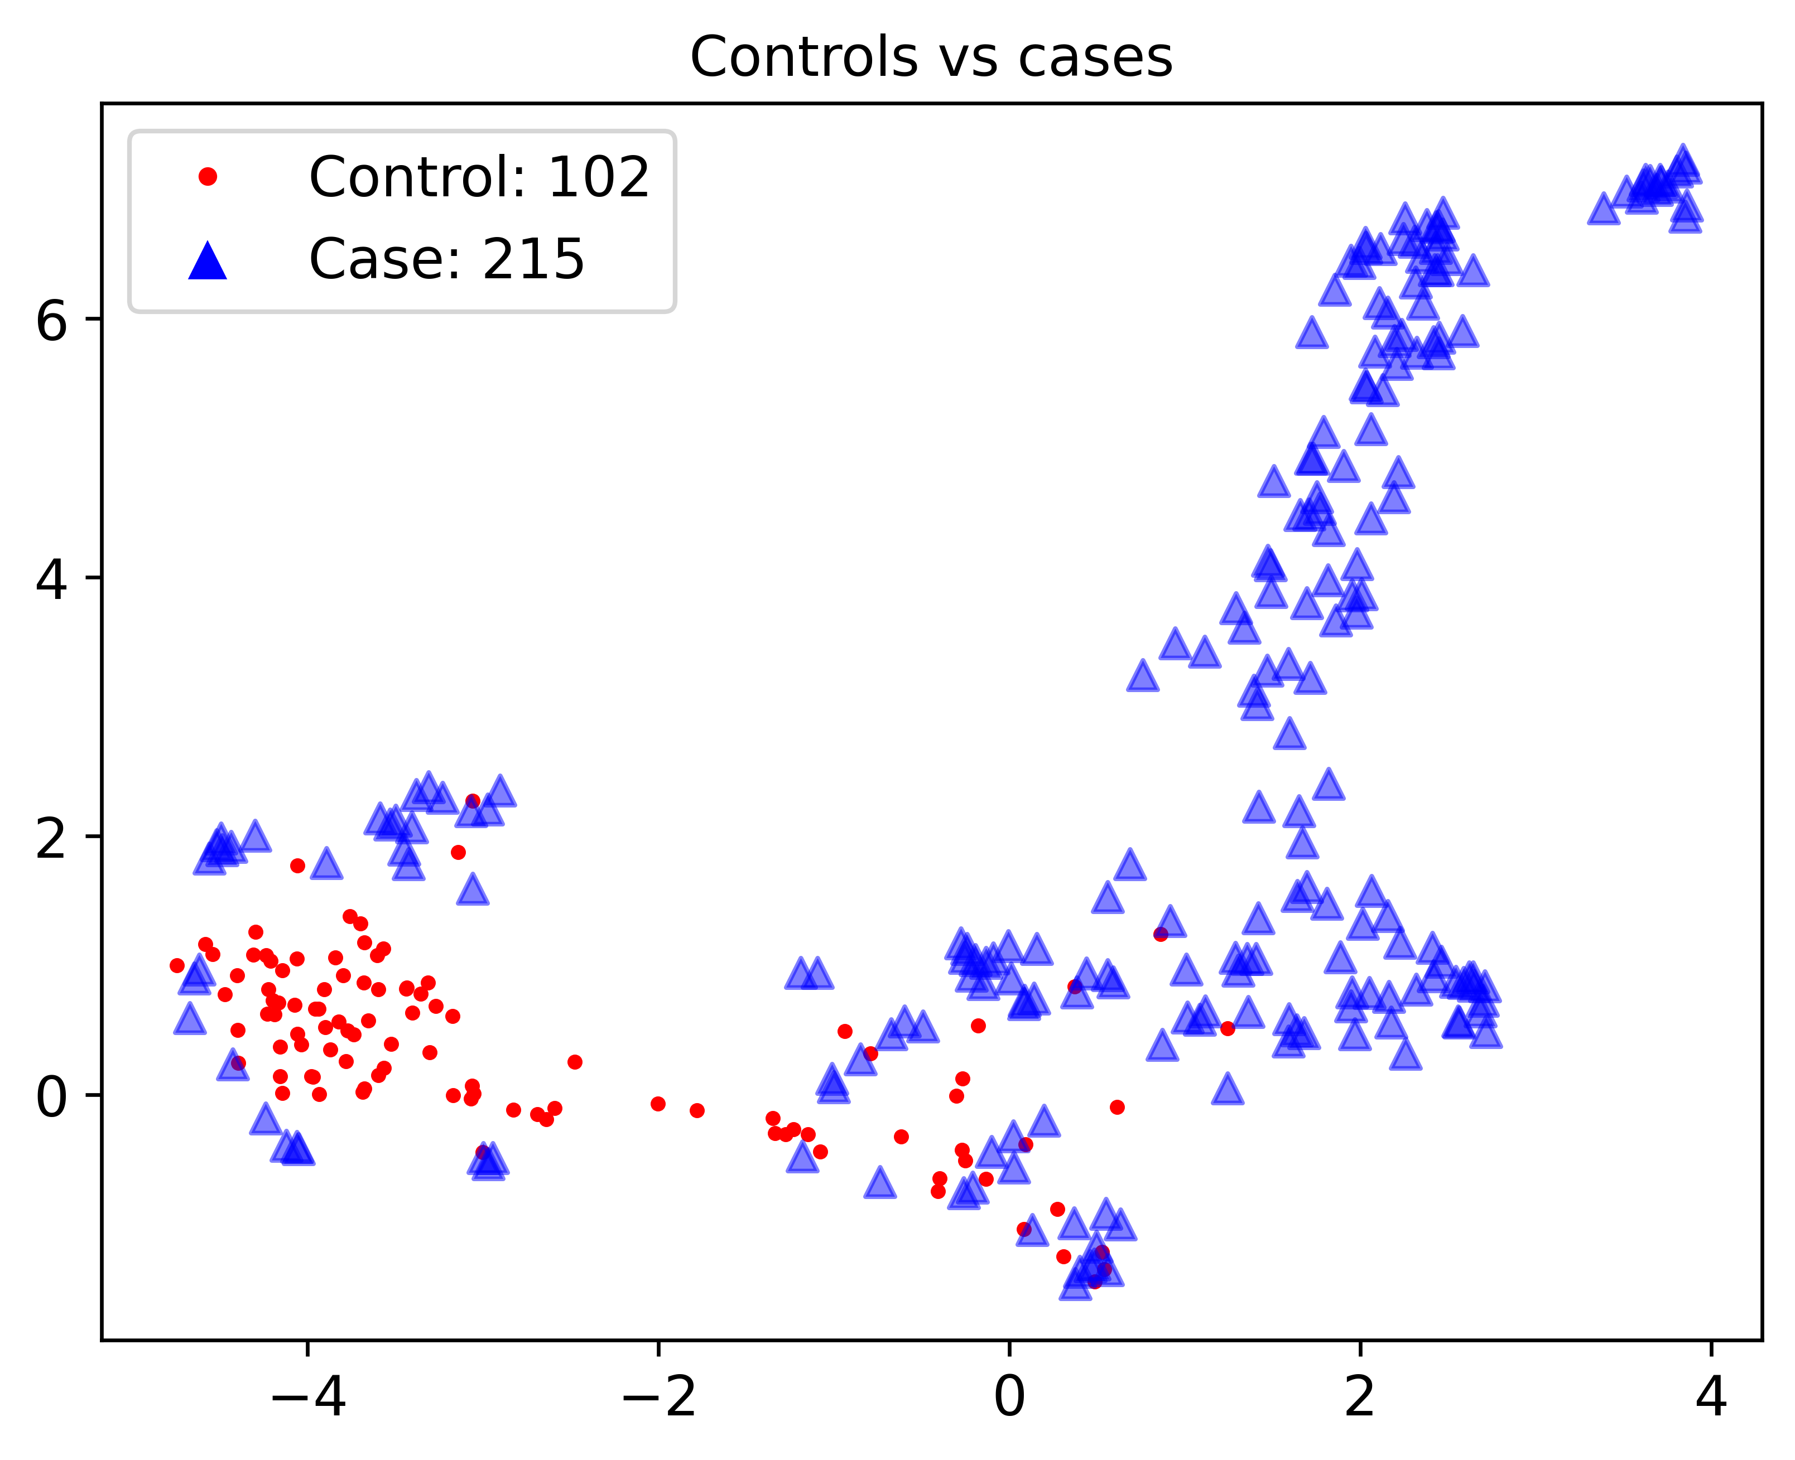
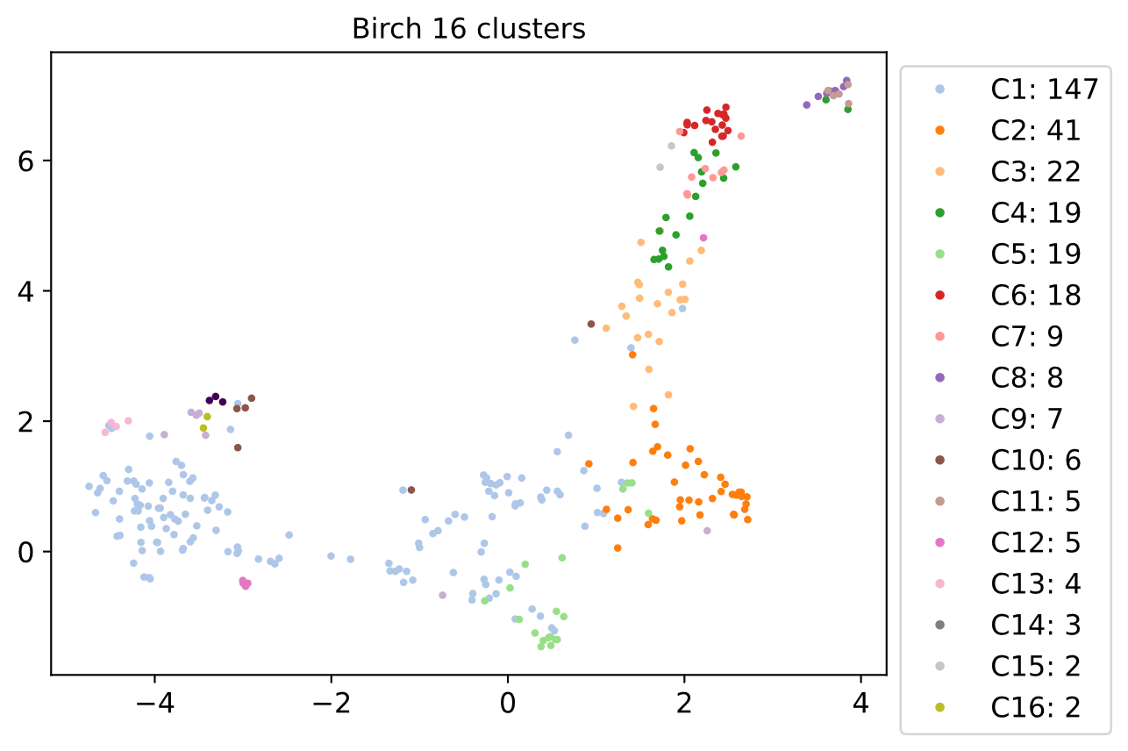
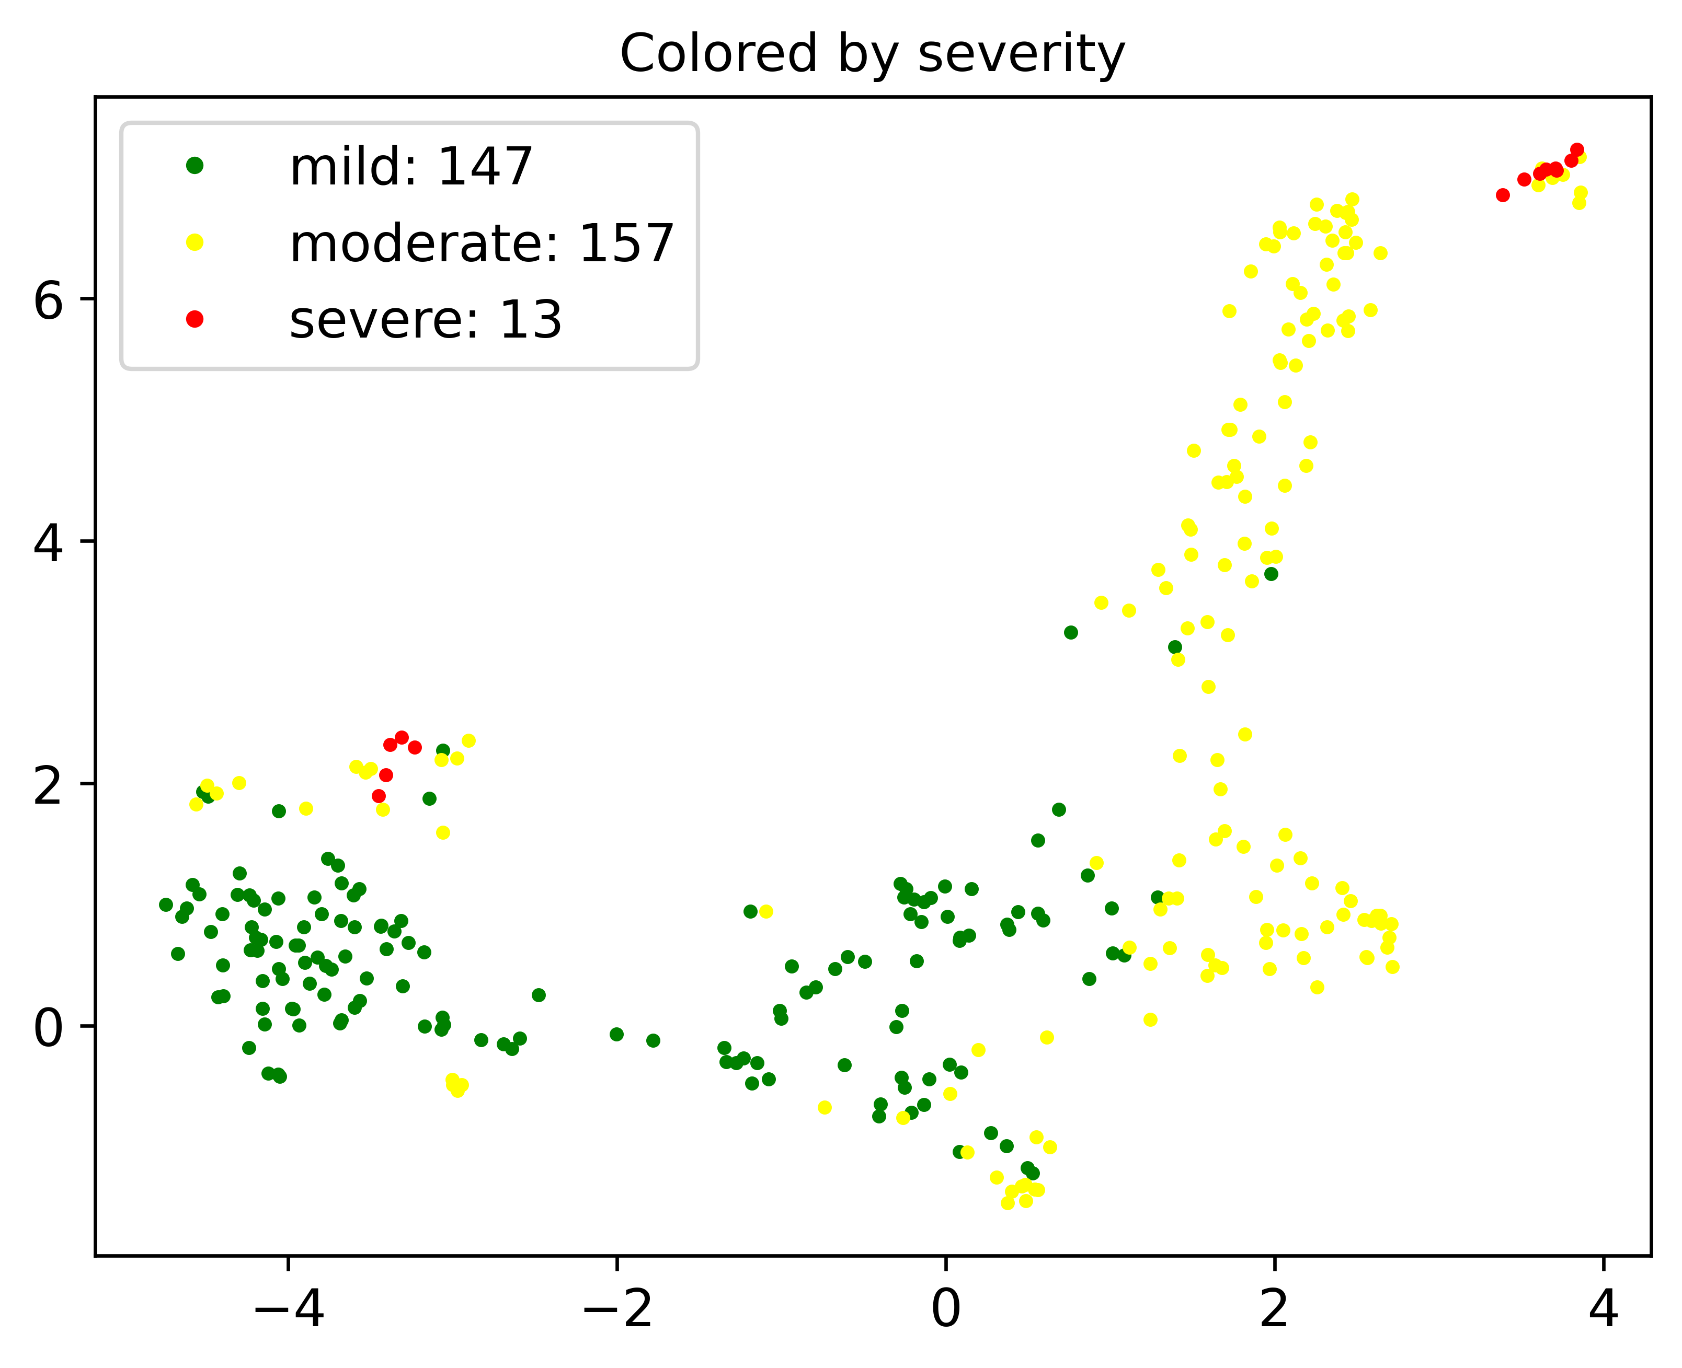





Figure 4
A
Endotypes 0–8
3 6 8 0 5 7 2 4 1
C
D
B
E
F
G
Figure 4
Notes:
Figure 4. Identification of long COVID endotypes in a case-control study (Cardiff). A) Grayscale heatmap showing 16 patient clusters (columns; C1 to C16) and 9 endotypes (dendrogram; E0 to E8) were identified from Cardiff cohort (n=317, including 215 long COVID cases versus 102 controls) across 34 symptoms (rows; organized into 9 pre-defined organ systems). B) Table listing members of endotypes and their signature organ systems (up to 3 included and colored in the same way as in Figure 4A). C) UMAP visualization of patients, colored based on disease phenotype (upper left), symptom clusters (upper right), endotype (lower left), and severity (lower right). D) Star charts showing two symptom clusters of interest. Cluster #5 is the one with cardiovascular and pulmonary symptoms including chest pain, shortness of breath, and heart racing. Cluster # 8 a severe cluster with GI (gastrointestinal) symptoms including diarrhea, nausea, and loss of appetite. Individual patients in the same cluster have consistent profiles across the signature symptoms. E) Identification of severity groups from a ranked view of cluster-severity plot. The 16 clusters (X-axis) were ranked based on the severity score (Y-axis). An elbow method was used to separate the patient clusters into three groups: mild (green), moderate (yellow), and severe (red). F) Bar graph showing significant overlapping between clustering results and cases/controls (Fisher’s exact test p-value < 0.0001). Cluster #1 (mild with few symptoms reported) includes controls and cases with mild symptoms, while Clusters #2 to #16 correspond to cases with moderate and severe symptoms. G) Linear regression analysis for visualizing correlation between viral neutralization and severity score (X-axis: rank of patient clusters based on sum of topic proportions across all symptoms. Y-axis: mean of antibody titer values of all patients in the same cluster). Serum antibody titers of OC43, a betacoronavirus, has a modestly positive correlation (Spearman’s r = 0.5206, p-value = 0.041) with long COVID severity. In contrast, correlation between long COVID severity and neutralization capability of Delta variant is modestly negative (Spearman’s r = -0.5118, p-value = 0.045).

Slide 5
















Figure 5
A
C
H
B
D Symptoms reported more at infection but less after 1 year
E Symptoms increasingly reported after infection and then reduced after 1 year
G
F Symptoms increasingly reported after infection and after 1 year
J
I
Figure 5
Notes:
Figure 5. Identification of changes of COVID symptoms and severity in a longitudinal study (UCSF cohort). A) UMAP visualization of 15 symptom clusters (C1 to C15) identified from first-visit surveys post-SARS-COV-2 infection (n=669). B) Table of 12 endotypes (E0 to E11) and their signature organ systems (up to 3 included). C) Identification of severity groups from a ranked view of cluster-severity plot. The 15 clusters (X-axis) were ranked based on the severity score (Y-axis). An elbow method was used to separate the patient clusters into three groups: mild (green), moderate (yellow), and severe (red). D-F) Line graphs showing frequency of self-reported symptoms at three time points post-SARS-COV-2 infection: 0 to 85 days, 85 days to 1 year, and after1 year. Some symptoms disappeared after 1 year (D), while others did not alleviate (E) or even became worse (F). G) Histogram showing distribution of surveys across time (X-axis: 3-year duration, yearly separated by red lines). At each visit per quarter (pink line), there is a peak for number of completed surveys. Surveys of 457 patients were completed in the first quarter. H) Box plot showing the change of health status (quantified by EQ-5D) for patients (n=162) who have surveys at both before and after Day 85 post SARS-COV-2 infection. The first available survey before Day 85 and the last survey after Day 85 were used, when multiple surveys are available. I) Linear regression analysis for visualizing correlation between EQ-5D and severity score (X-axis: rank of patient clusters based on sum of topic proportions across all symptoms. Y-axis: mean of EQ-5D of all patients in the same cluster). There is significant negative correlation (Spearman’s r = -0.6679, p-value = 0.008) between ML-predicted severity and EQ-5D. J) Pie charts visualizing composition of not-recovered (left, n=55, EQ-5D decreased after Day 85) and recovered (right, n=87, EQ-5D increased) patients in percentages of symptom clusters (C1 to C15). Percentage of Cluster #4 (Endotype #3, Musculo-skeletal and other problems) is large in not recovered but small in recovered. In contrast, percentage of Cluster #9 (Endotype #6, GI problems only) is large in recovered but small in not recovered. K) Box plot confirming significant change of EQ-5D scores of patient clusters between the first survey before Day 85 and the last survey after Day 85 (X-axis: EQ-5D scores in the past week of the same visit; Y-axis: 15 clusters ranked by severity in the first survey). Patients in Cluster #4 reported lower EQ-5D after Day 85, while those in Cluster #9 have significantly increased EQ-5D (p-value < 0.05 in Wilcoxon signed rank test).

Slide 6












Figure XX
A
B
1
2
3
4
5
C
D
Endotype female composition
Endotype male composition
Severity female composition
Severity male composition
E
F
G
Figure XX
Notes:
Figure 6. Comparison of characteristics of endotypes and symptom severity levels post-SARS-COV-2 infection across cohorts. A) Grayscale heatmap visualizing association between patient clusters across sites (X-axis) and organ systems involved (Y-axis) using column-based normalization. 5 distinct organ system-specific meta-cluster are found in different cohorts: #1: GI problems reported by Cardiff and UCSF; #2: Pulmonary problems by Sinai_Emory and UCSF; #3: Musculo-skeletal problems by all sites; #4: Cardiovascular problems by Cardiff; and #5: Hormonal problems by Sinai_Emory and UCSF. B) Grayscale heatmap visualizing association between patient clusters across sites (X-axis) and organ systems involved (Y-axis) using row-based normalization. Endotype with cardiovascular problems reported by Cardiff is distant from the others in organ-system dendrogram. Neurological and sensory problems are the closest organ systems. C) Clusters identified in individual cohorts (47 clusters in total) are merged into 10 endotypes, based on a common set of symptoms reported across cohorts. Clusters identified from cohort-specific symptoms, which cannot be assigned to any of the 10 endotypes, are grouped into E_unassigned. D) Pie charts visualizing composition of females (left) and males (right) in endotypes. Female contains a larger percentage of patients with sexual-hormonal problems (E5) than male. E) Identification of global severity levels of patient clusters in different cohorts by normalizing cluster-specific/local severity scores across cohorts on common set of symptoms. The 47 clusters (X-axis) include 2 mild (green), 38 moderate (yellow), and 7 severe (red). None of the UCSF clusters (circle) was globally severe, compared with those in Sinai_Emory (triangle) and Cardiff (square). None of the Sinai_Emory clusters (triangle) was globally mild. F) Pie charts visualizing composition of females (left) and males (right) in severity levels. Female contains a larger percentage of moderate and severe cases than male. G) Symptom severity reported by UCSF patients (first surveys used) is significantly smaller than that of Sinai_Emory or Cardiff (non-parametric ANOVA test p-value = 0.0003). Each dot is a patient cluster identified across cohorts (X-axis) with its global severity score (Y-axis).

