Slide 1
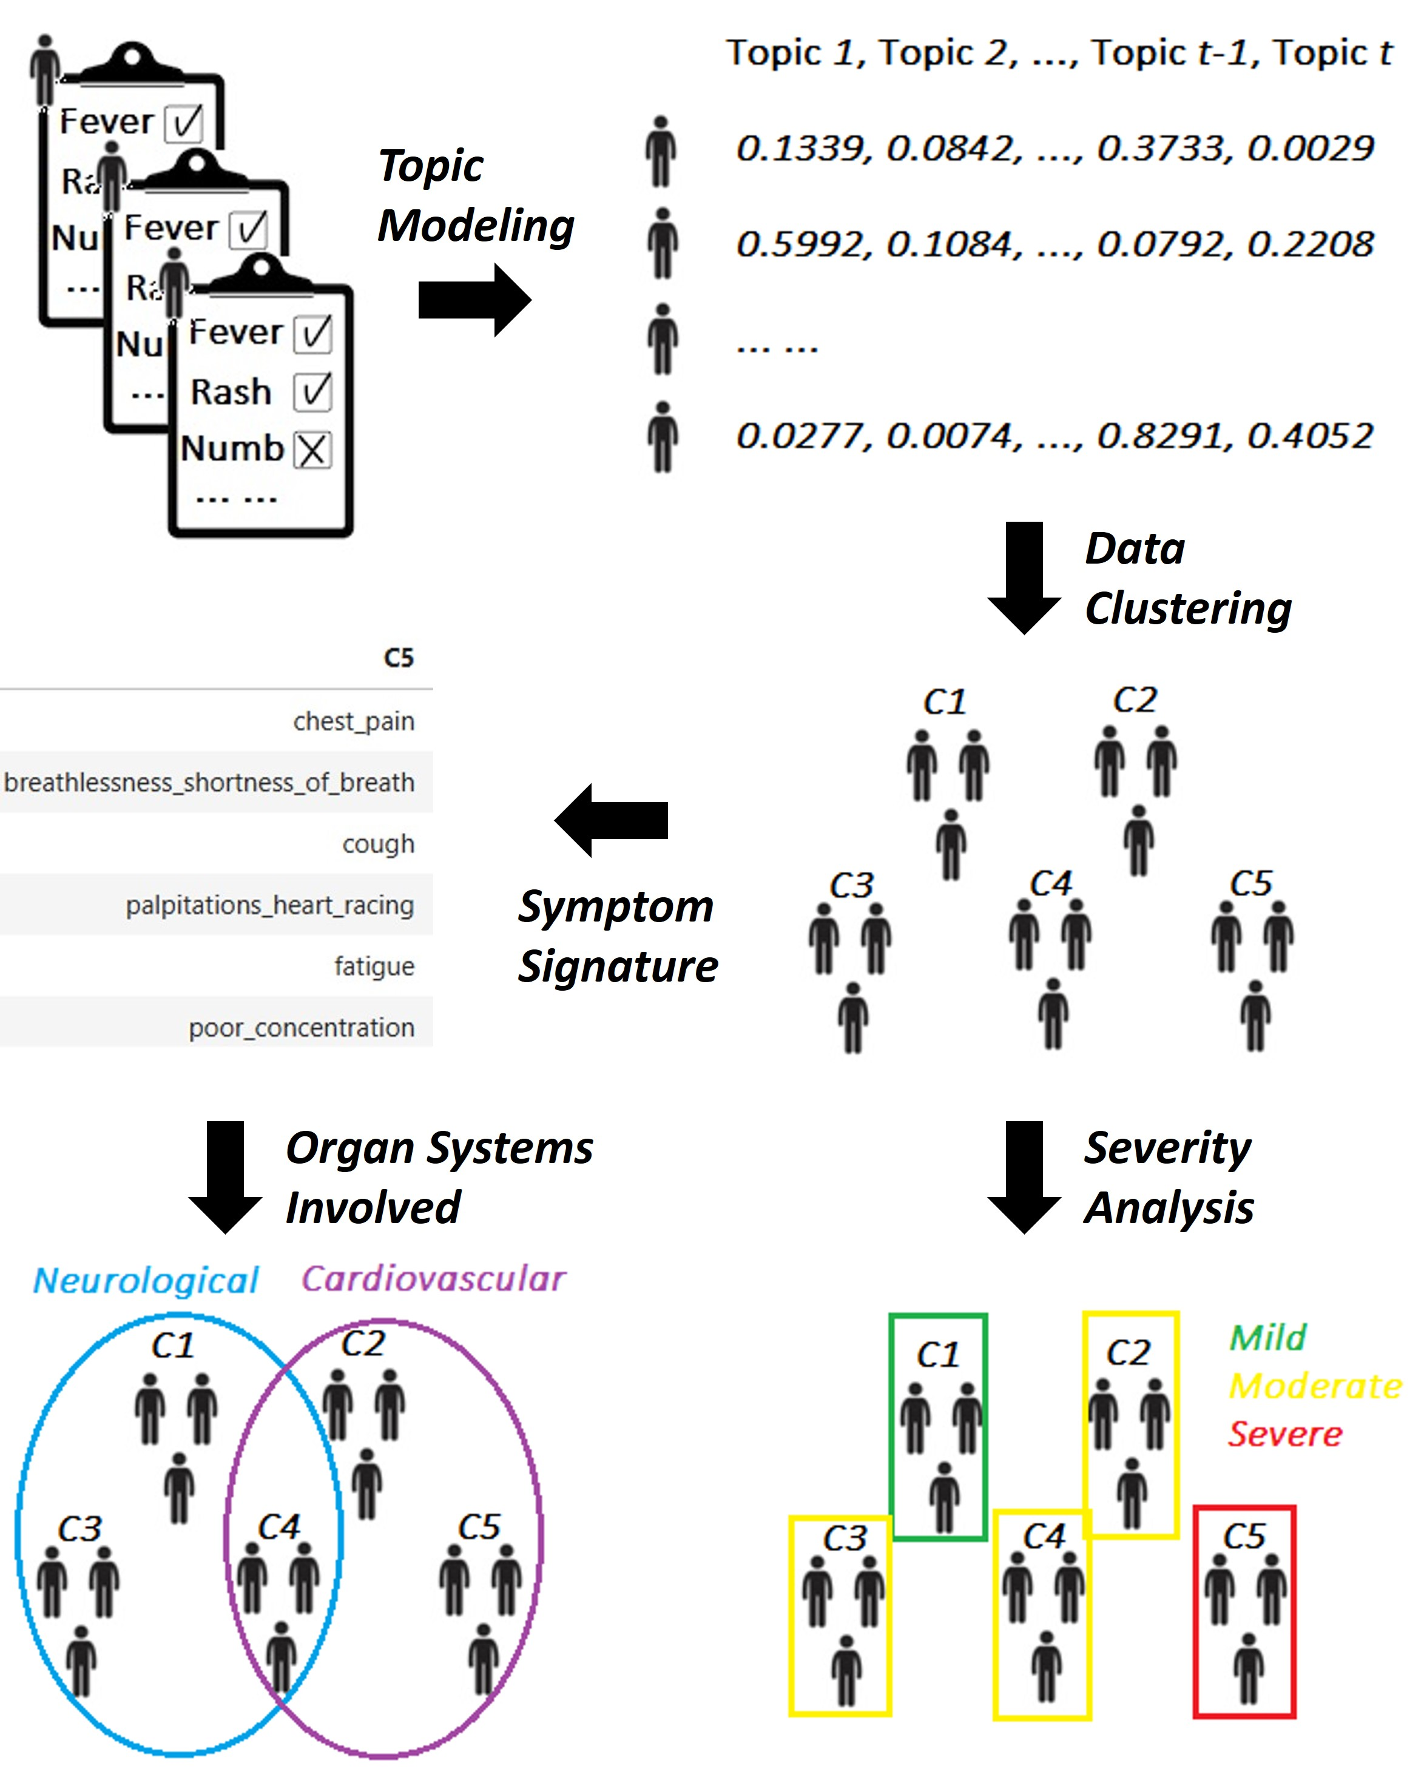
Figure 1
Figure 1
Notes:
Figure 1: Schematic of our machine learning analysis pipeline, step by step.

Slide 2
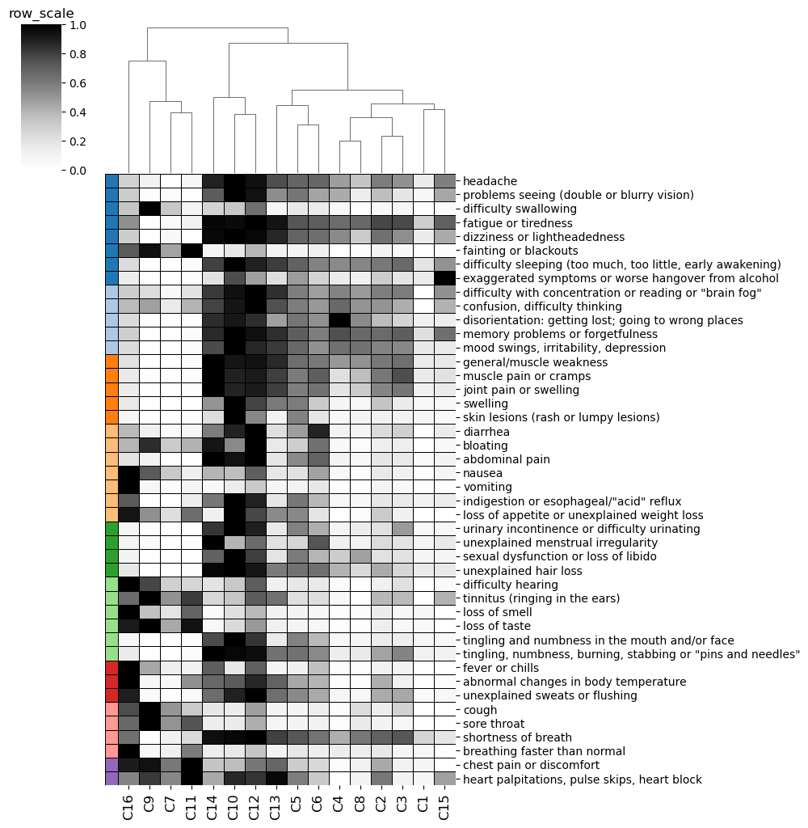
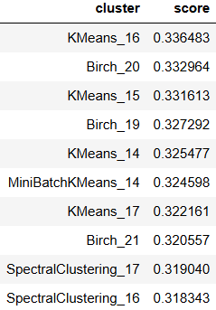
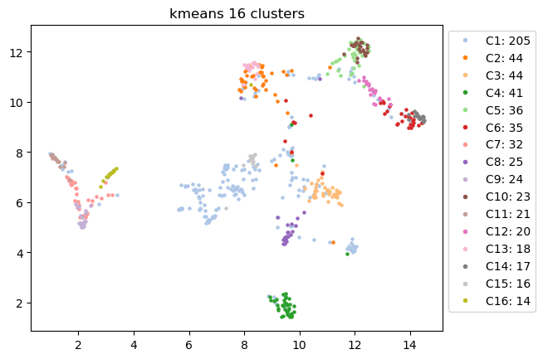
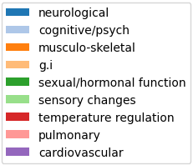
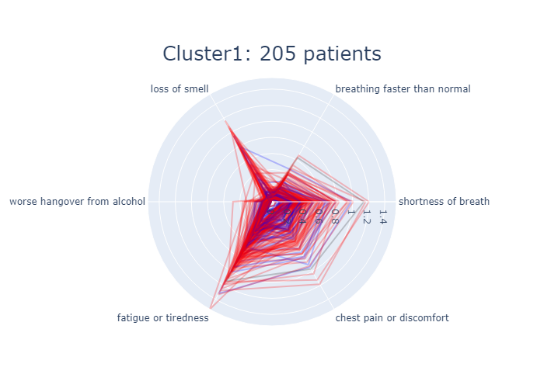
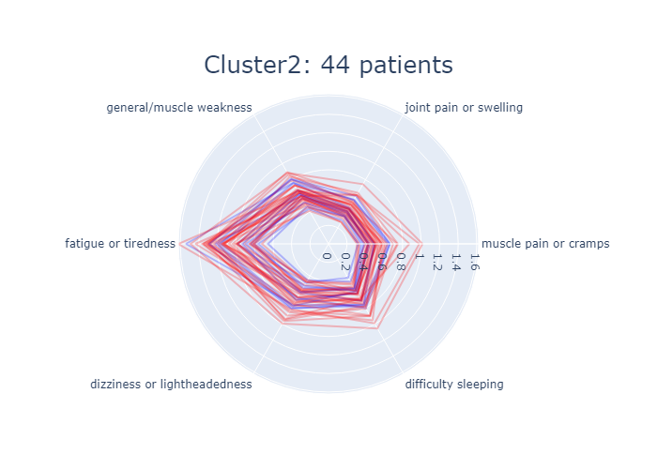
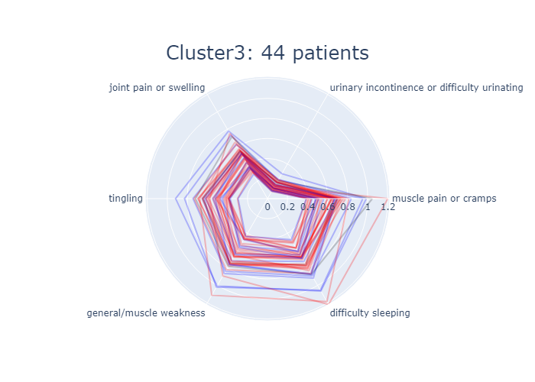
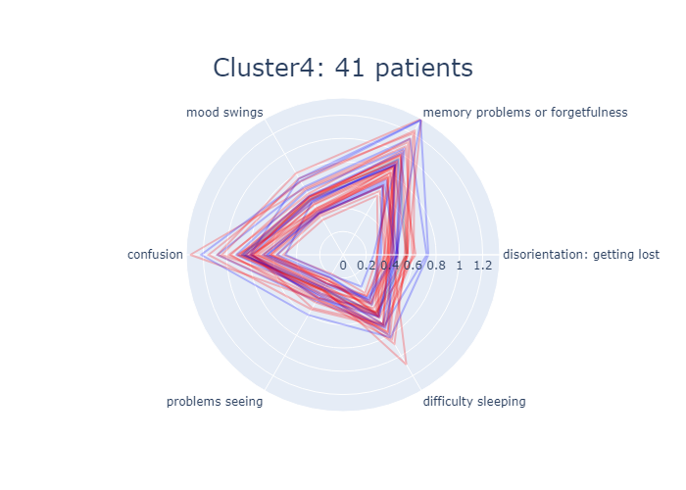
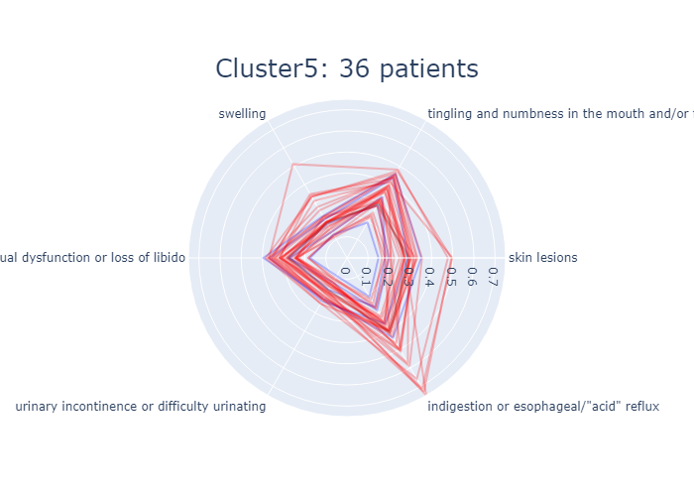
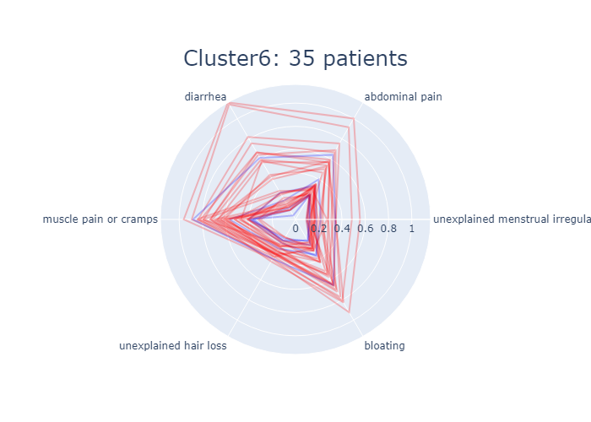
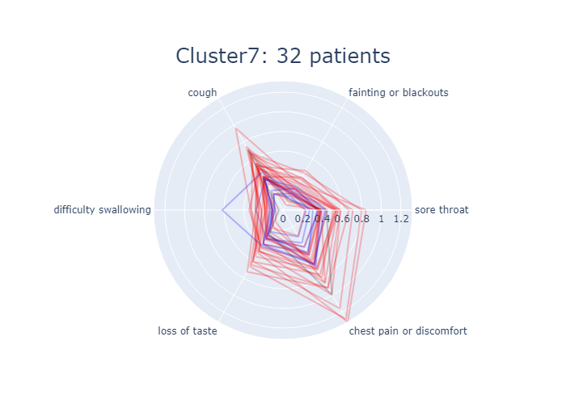
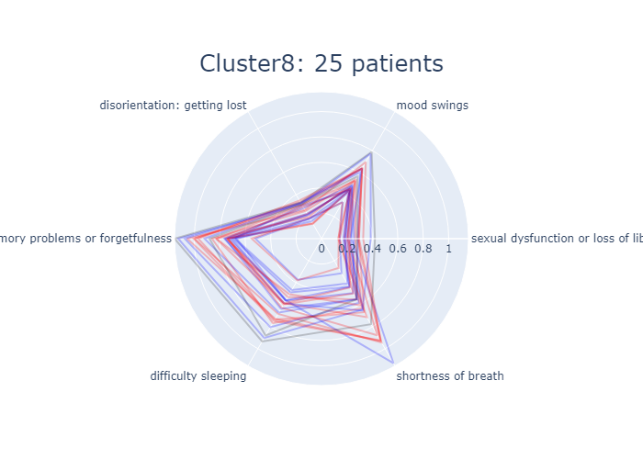
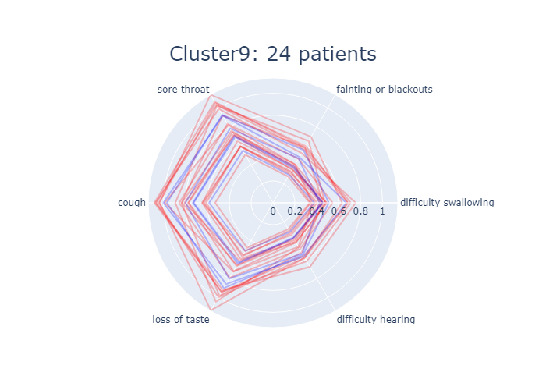
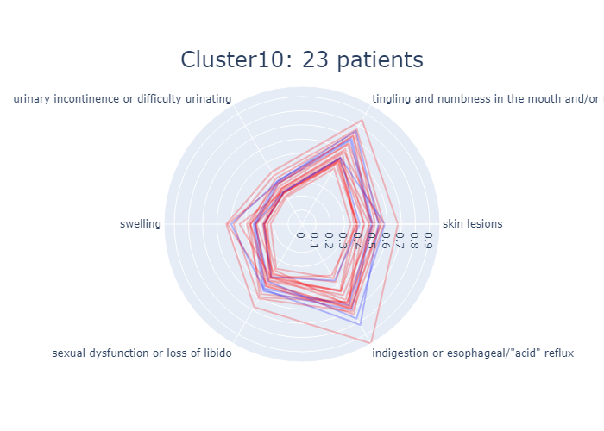
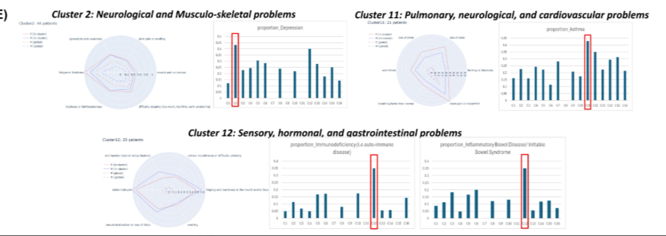
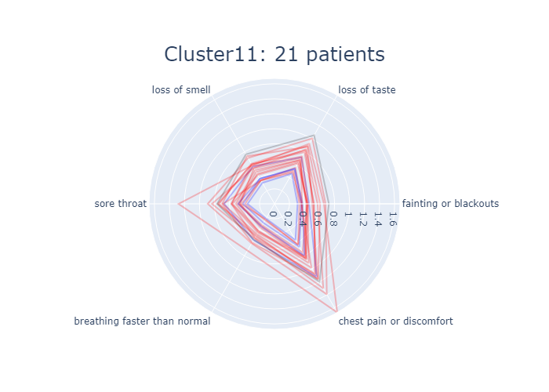
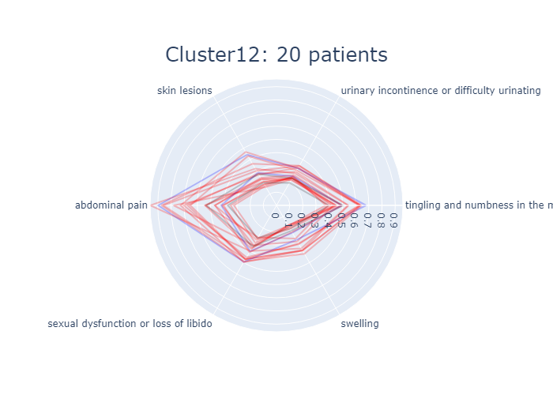
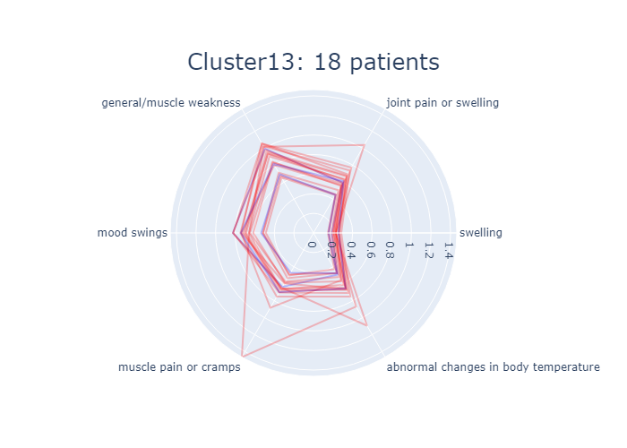
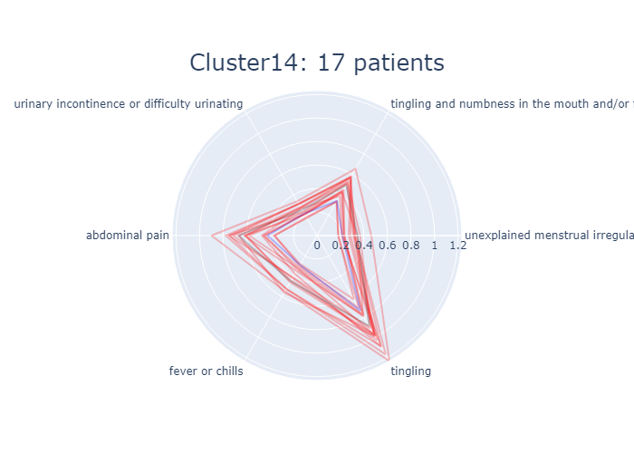
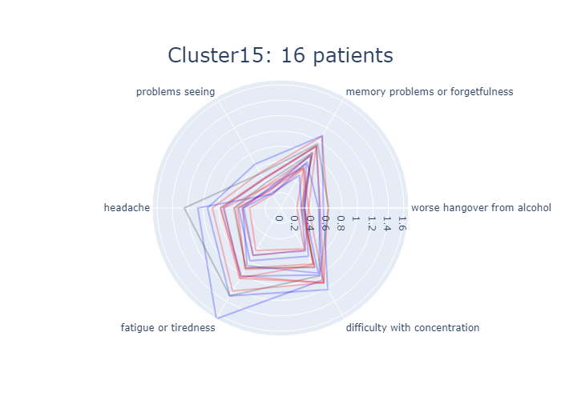
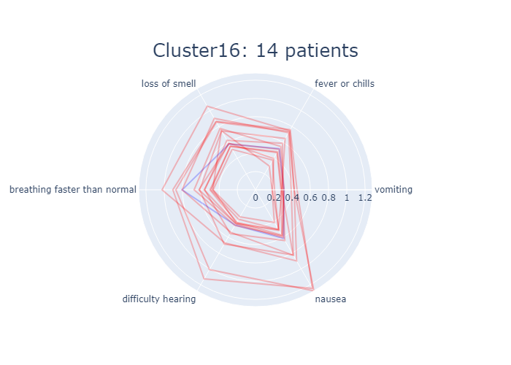

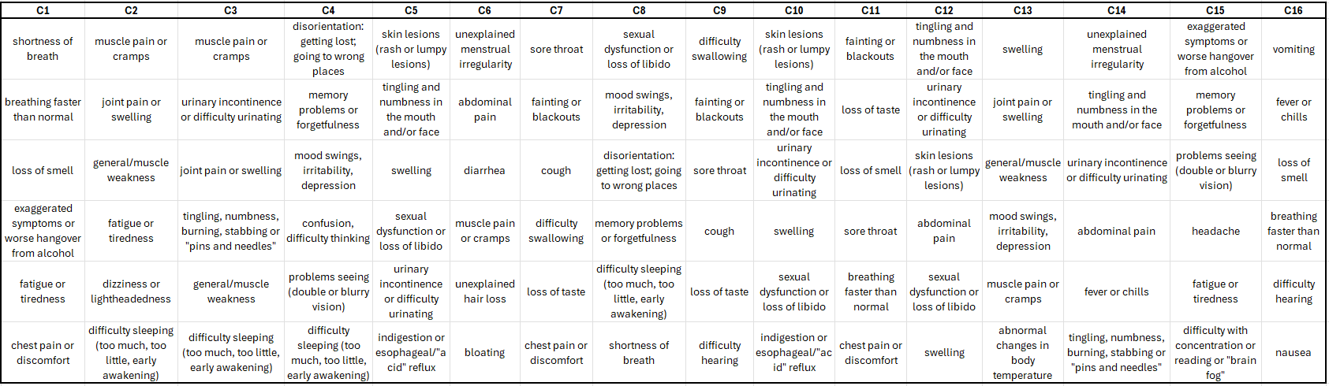
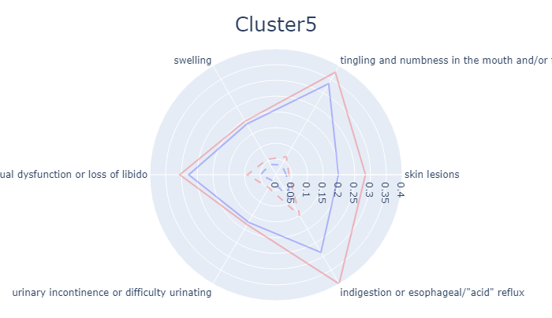
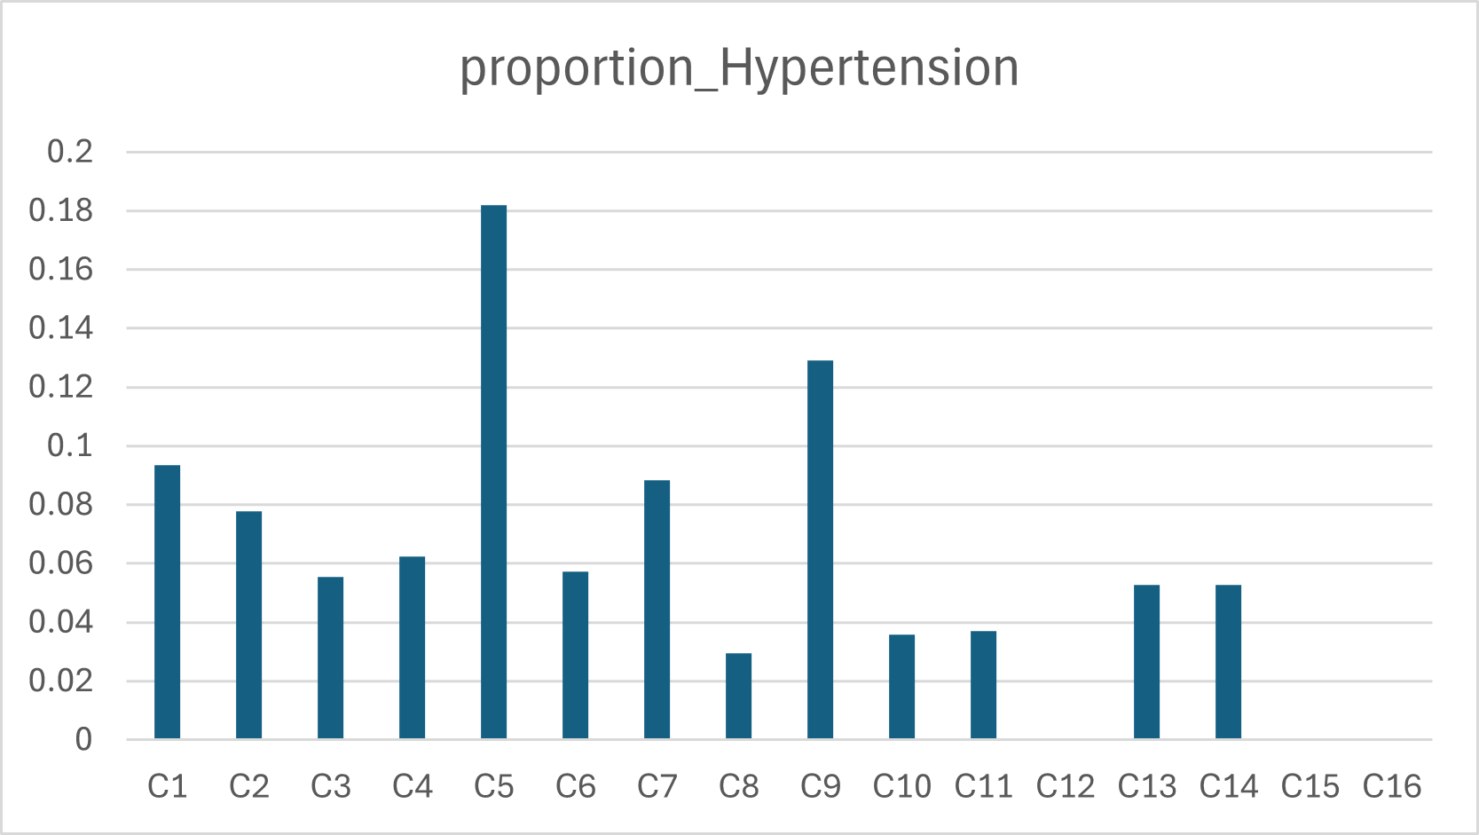
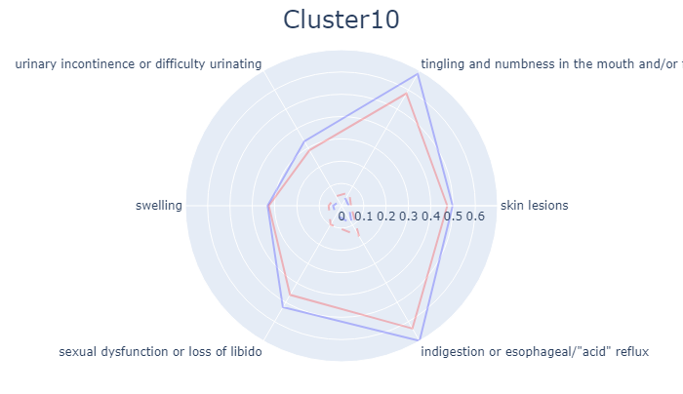
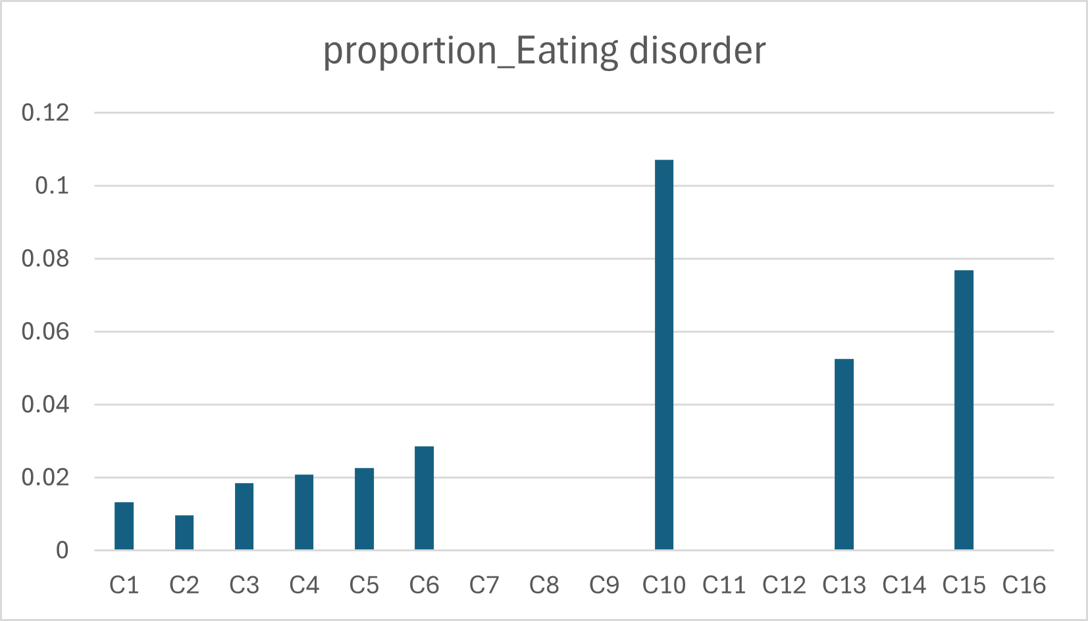
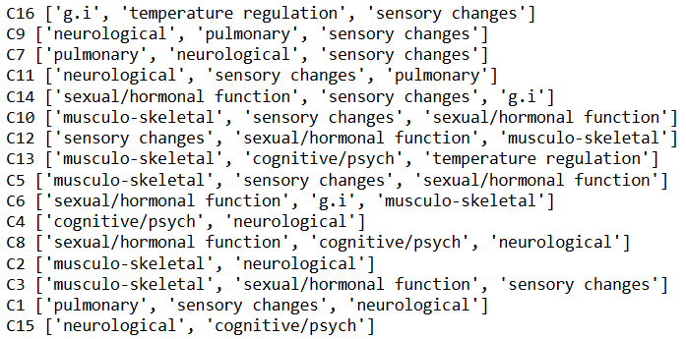
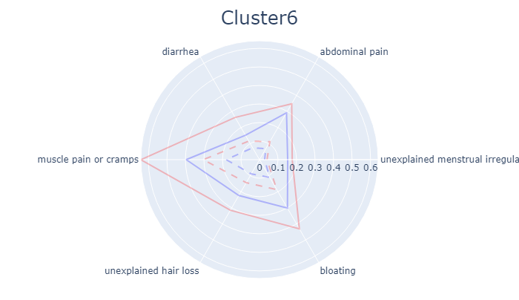
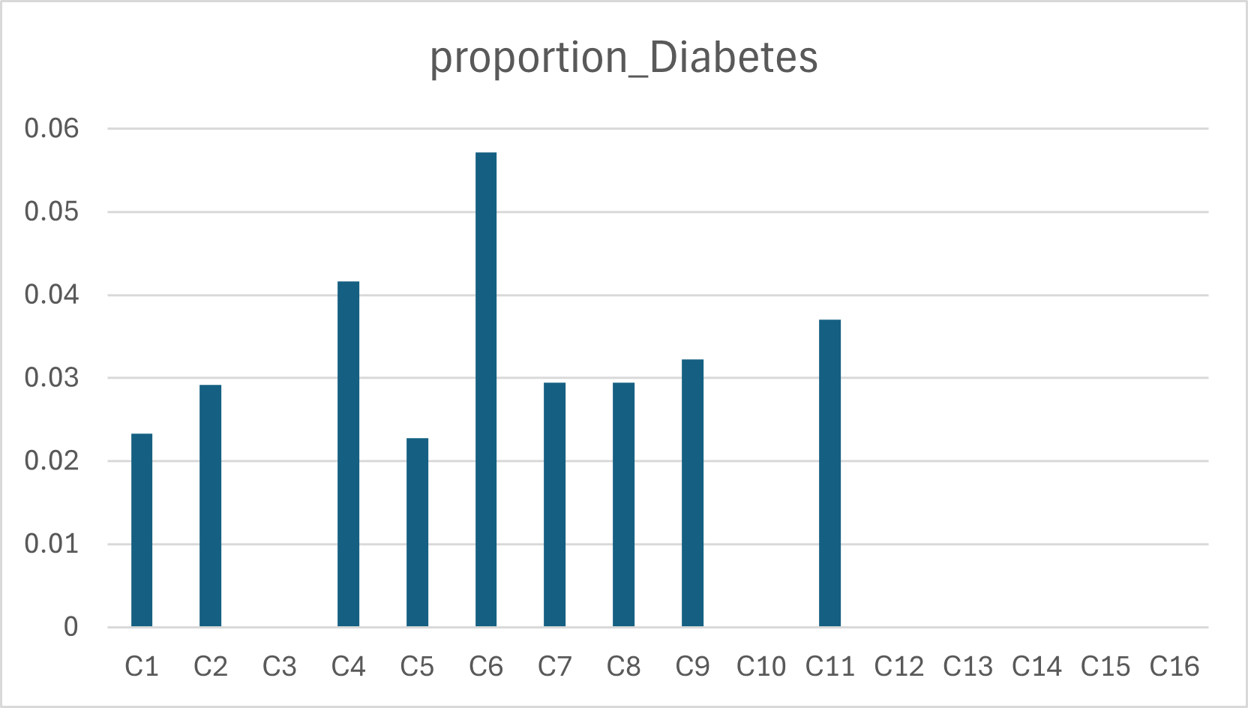
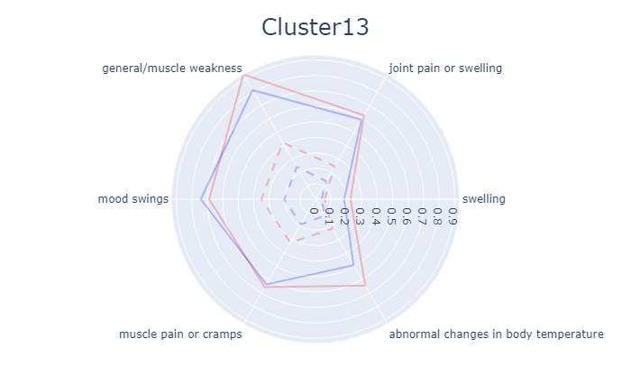
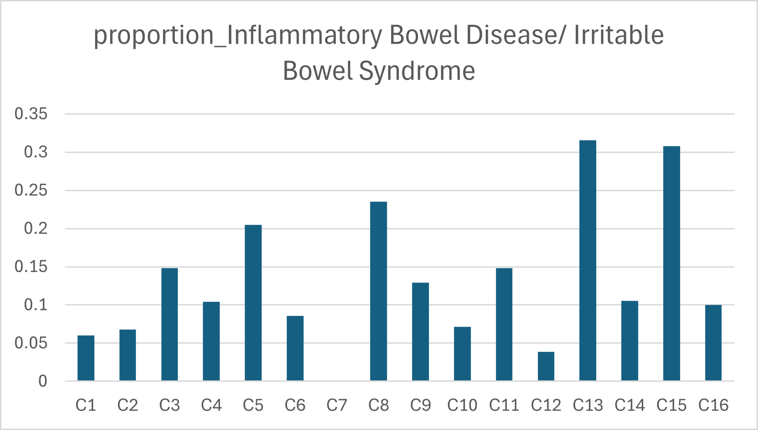

Figure XX
a)
b)
Endotypes 0-8
8 4 5 6 3 2 1 0 7
c)
d)
e)
Figure 2
Notes:
Figure 2: sinai_n615

Slide 3
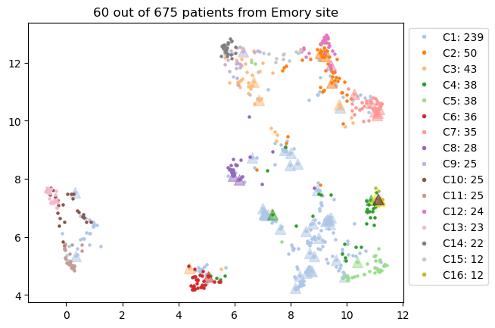
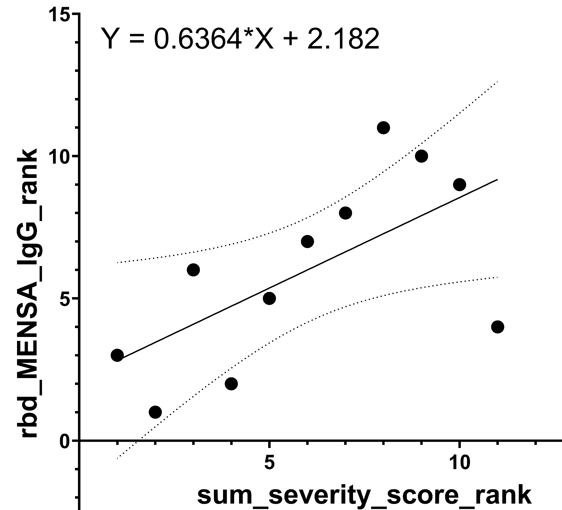
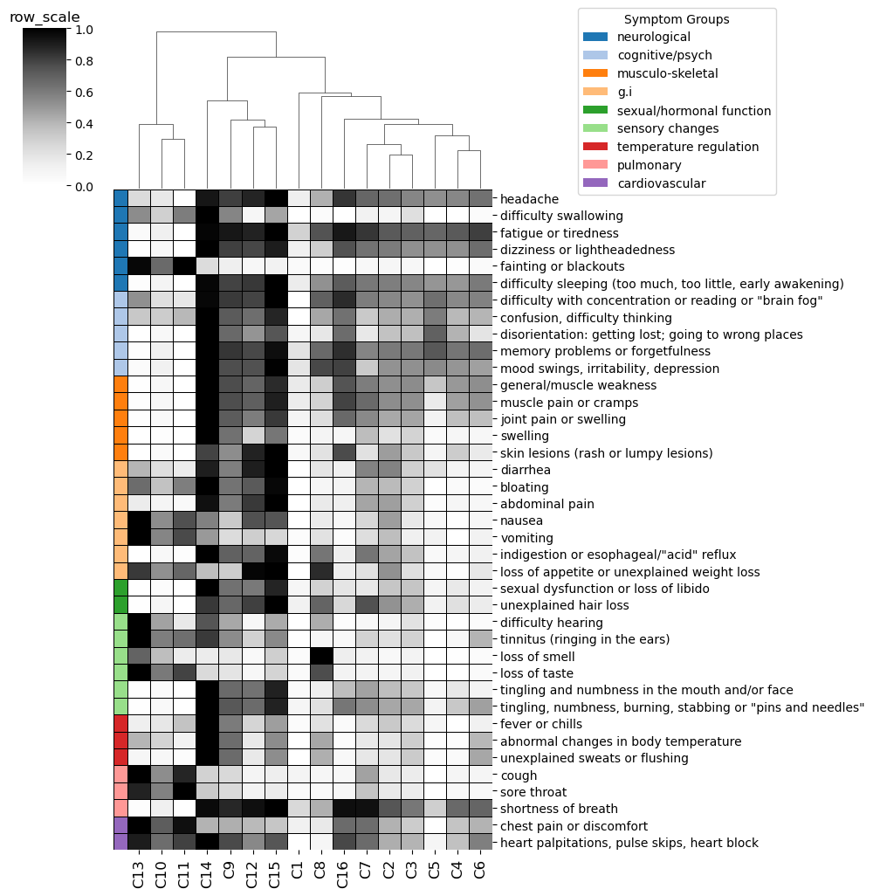
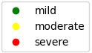
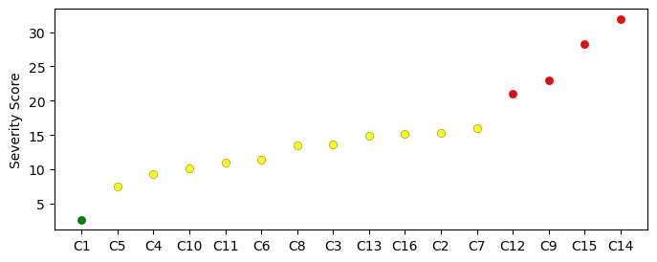
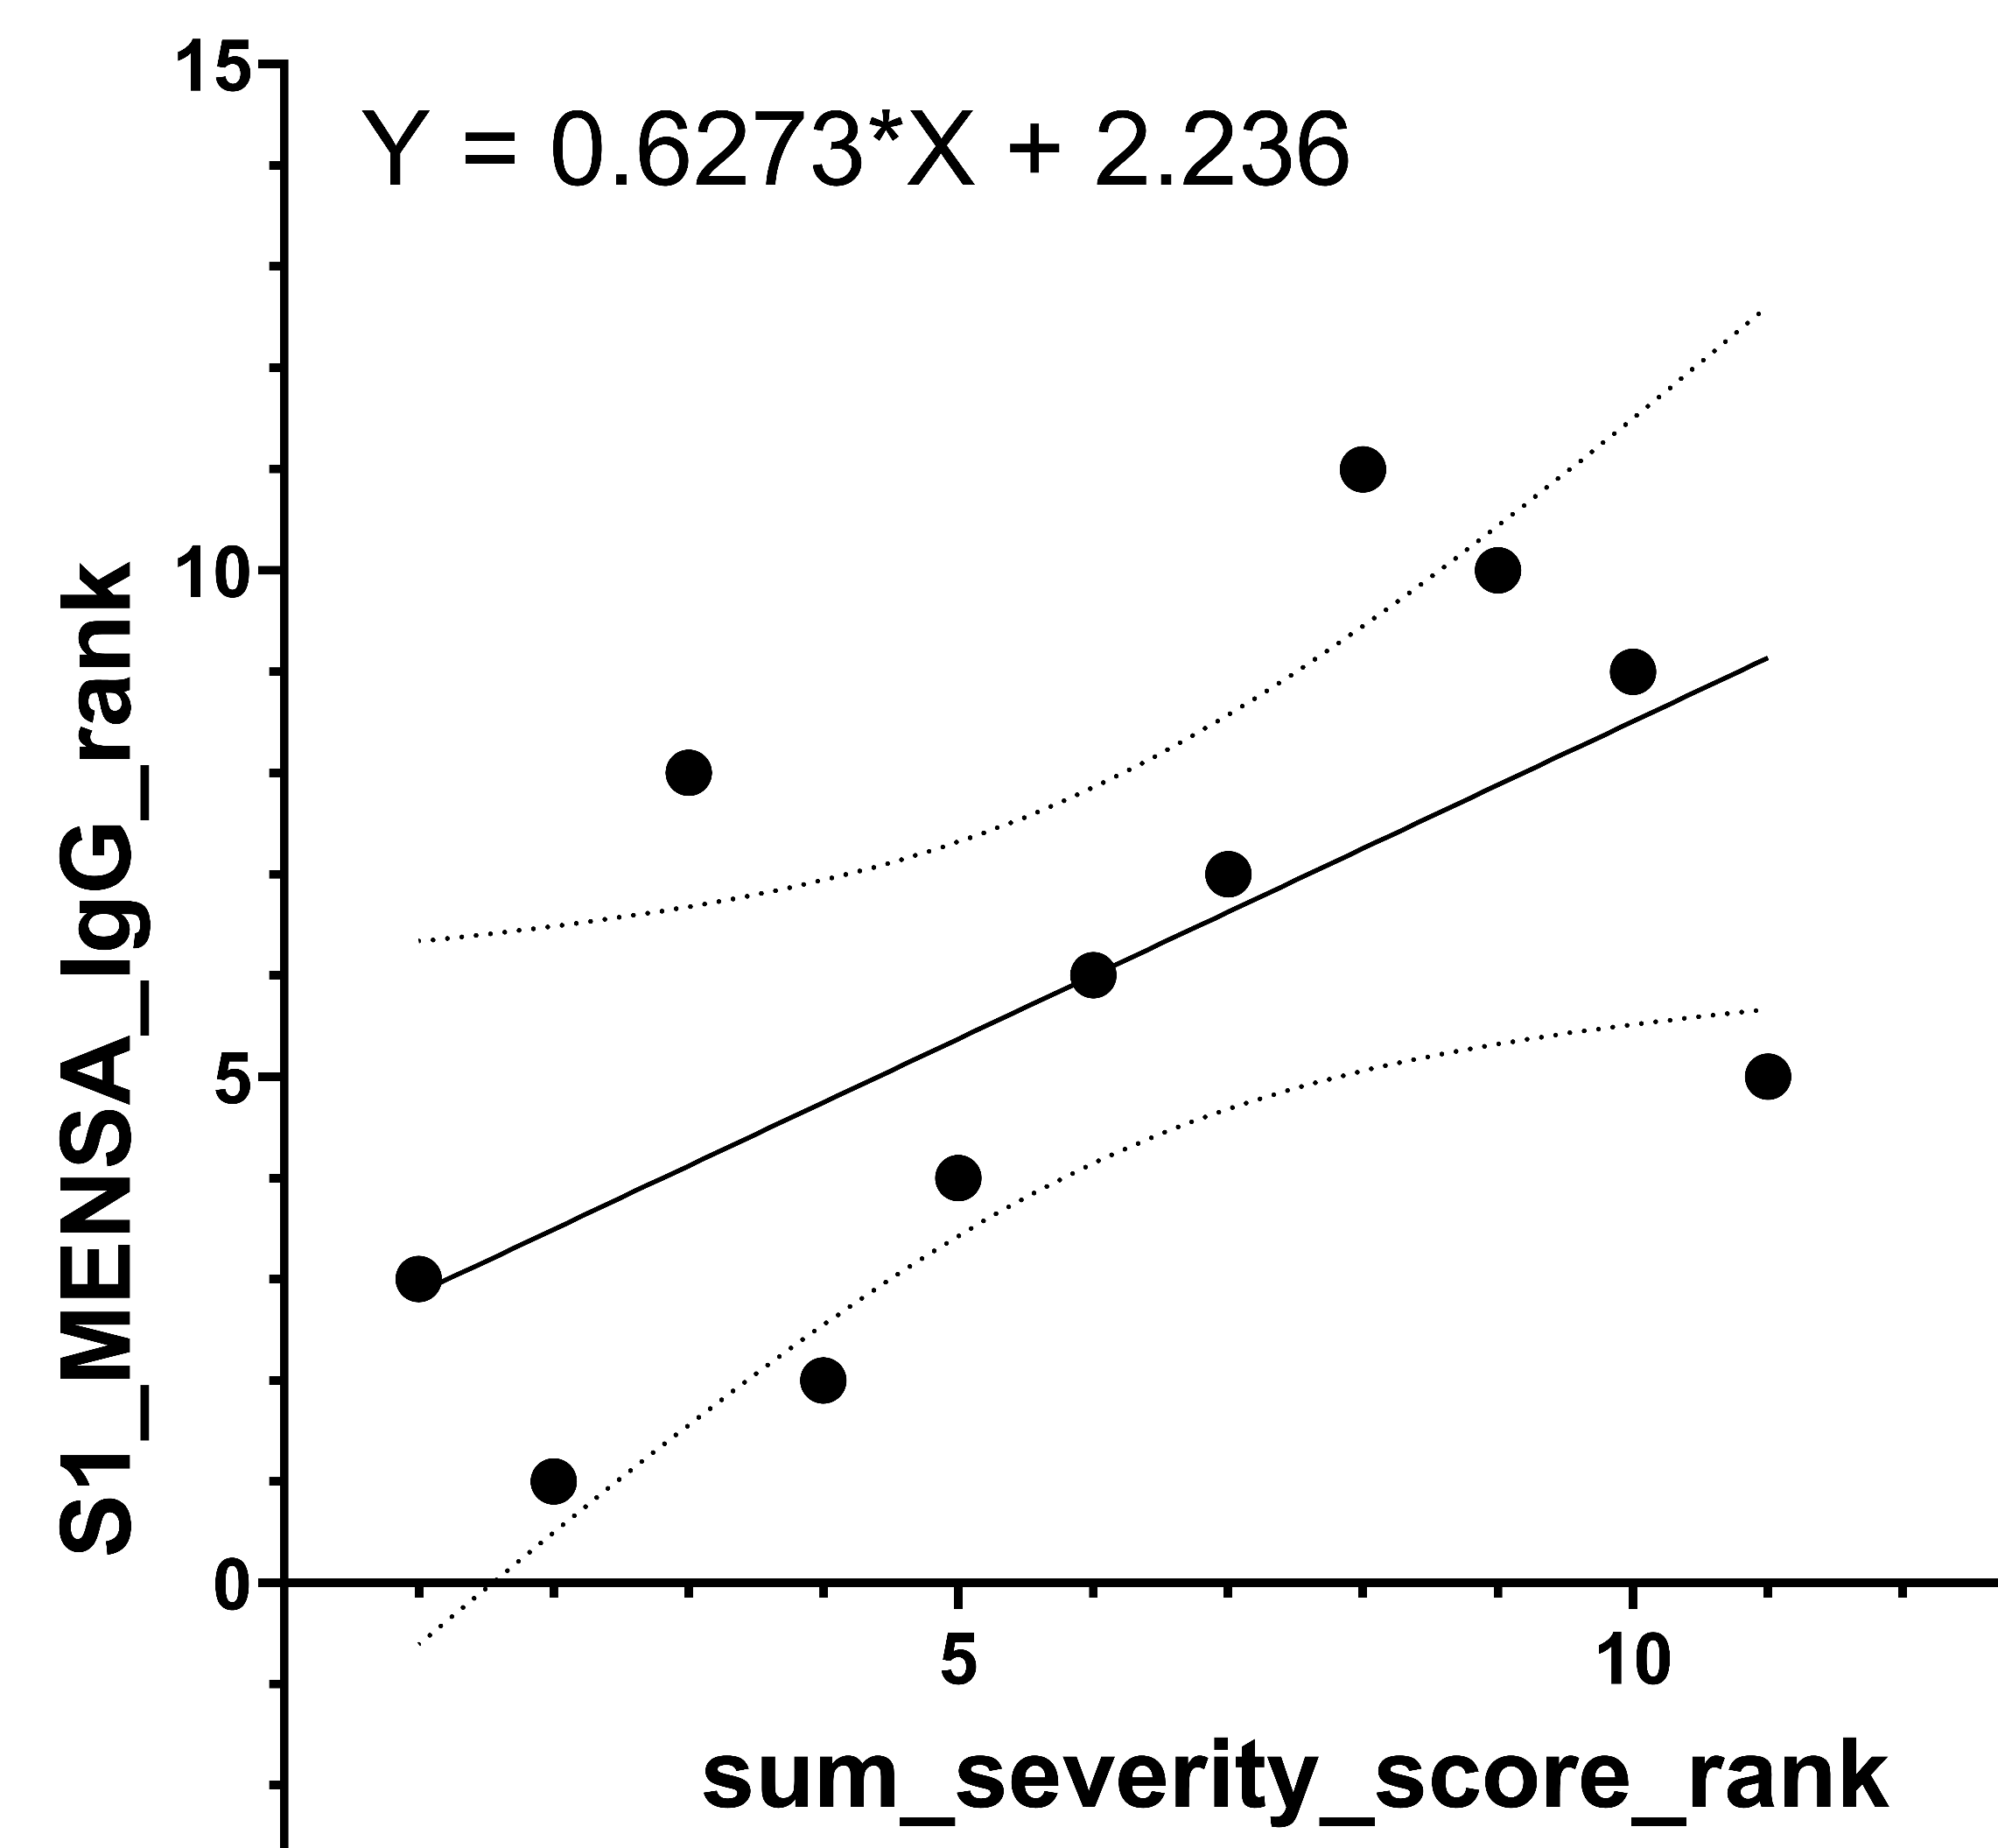
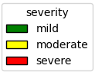
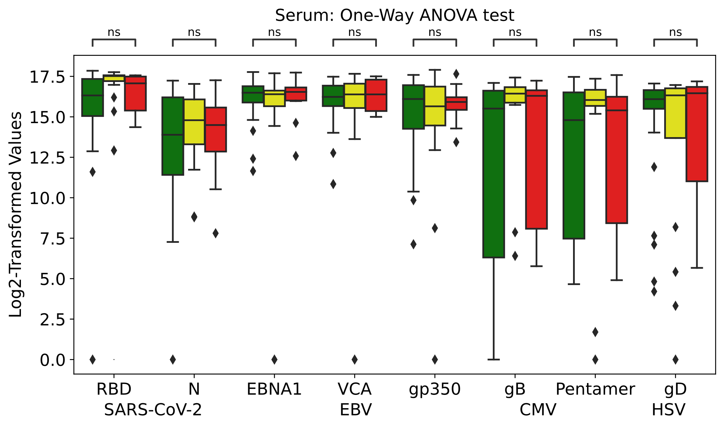
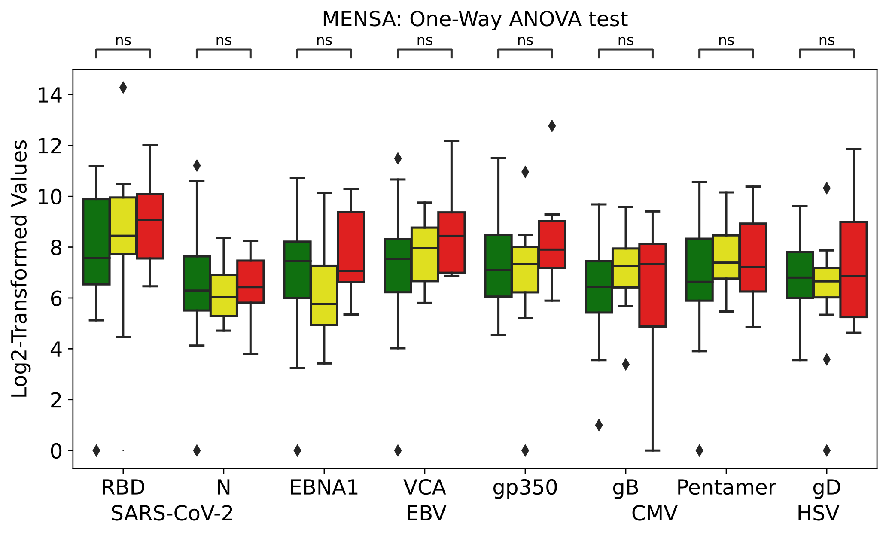
Figure 2
a)
b)
d)
c)
e)
f)
g)
Number of Emory Patients
C1 | 35
C2 | 4
C3 | 4
C4 | 2
C5 | 1
C6 | 1
C7 | 6
C8 | 2
C9 | 1
C10 | 0
C11 | 0
C12 | 1
C13 | 0
C14 | 0
C15 | 0
C16 | 3
Total | 60
Figure 2
Notes:
Figure 3: Association with antibody assay data in Emory. Symptom clusters, endotypes, and severity groups identified from integration of Sinai and Emory surveys, showing correlation with serum and MENSA results.

Slide 4
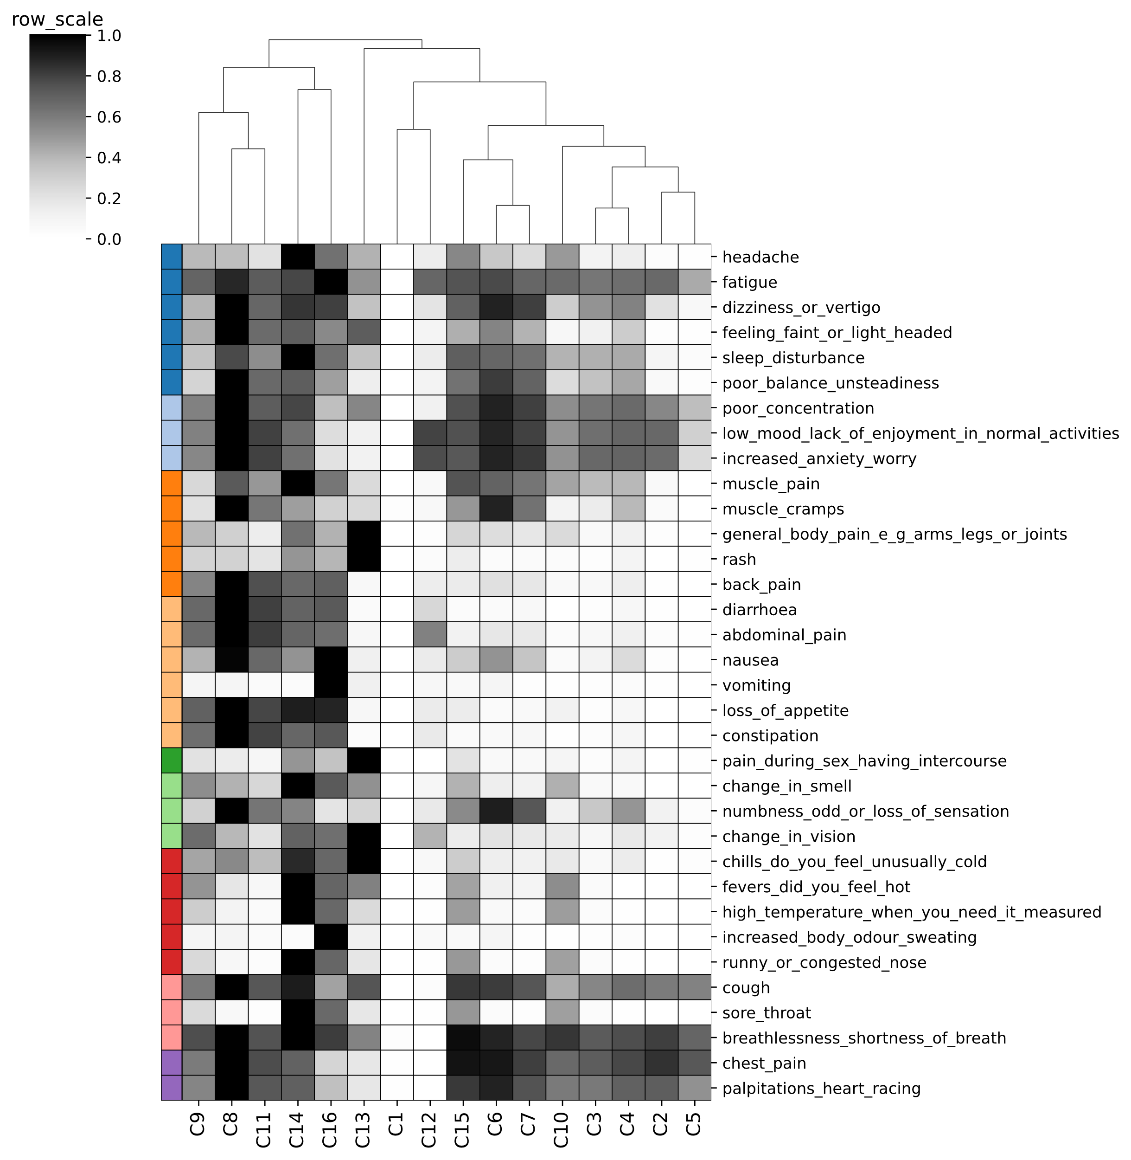
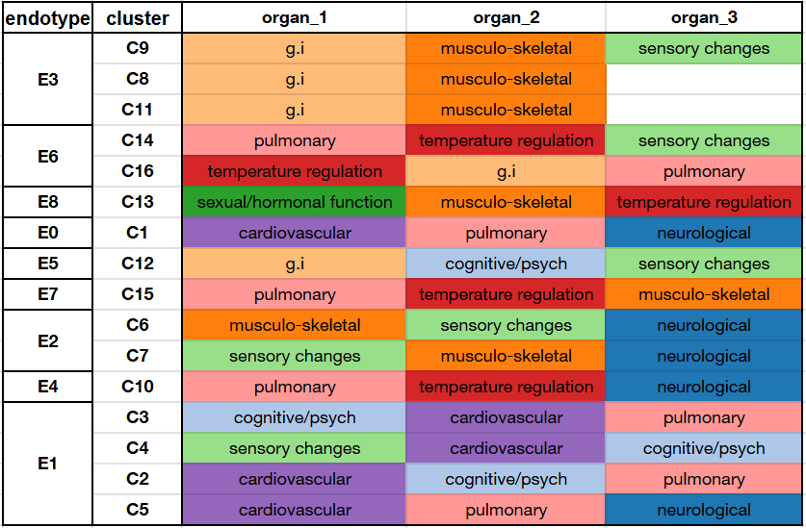
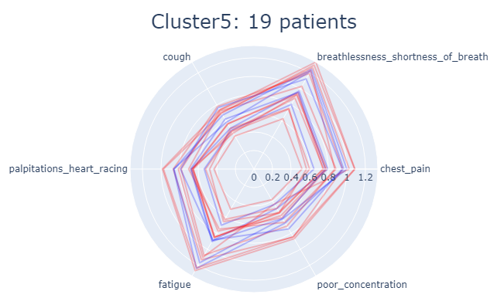
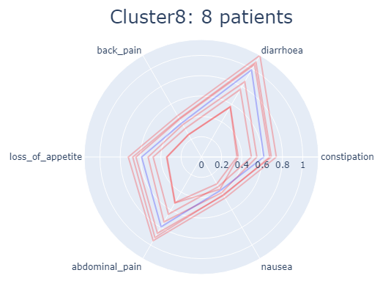
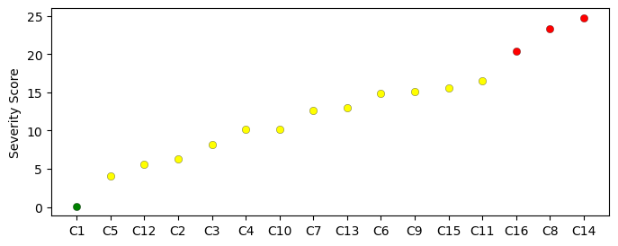
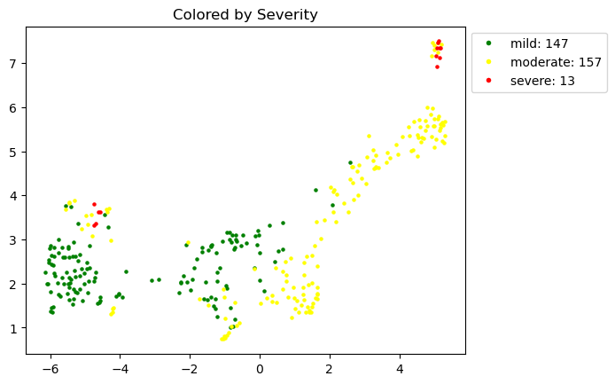
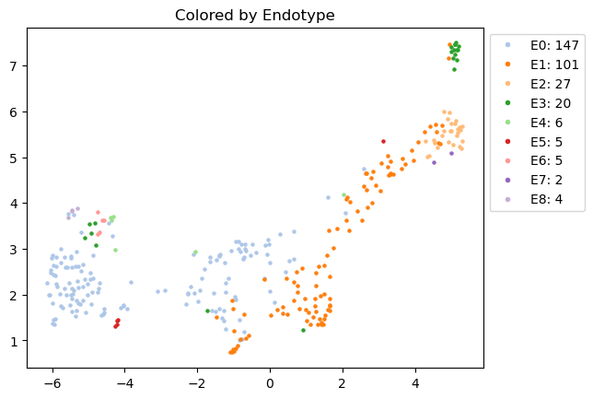
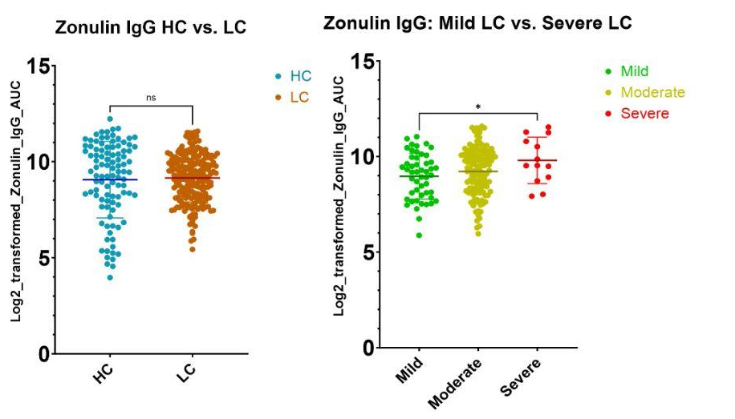
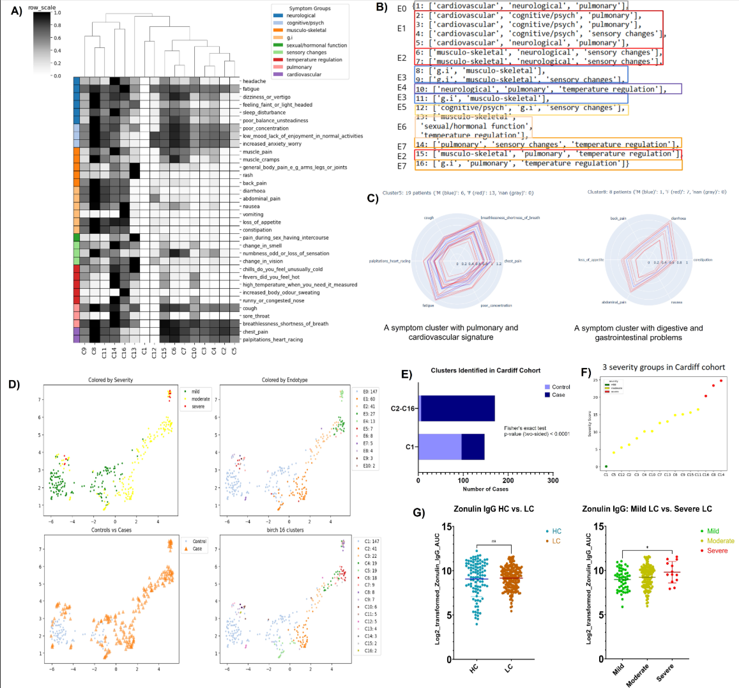


Figure 4
a)
Endotypes 0-8
3 6 8 0 5 7 2 4 1
b)
c)
d)
e)
f)
g)
Figure 4
Notes:
Figure 4: Control vs. Disease analysis in Cardiff data. Symptom clusters, endotypes, and severity groups identified from Cardiff surveys, showing the novel severity-group-specific and cluster-specific biomarkers that otherwise cannot be identified when the whole cohort is used, as well as important gender-specific analysis.

Slide 5













Figure 5
a)
c)
g)
b)
h)
i)
d) Symptoms reported more at infection but less after 1 year
e) Symptoms increasingly reported after infection and then reduced after 1 year
j)
Figure 5
f) Symptoms increasingly reported after infection and after 1 year
k)
Notes:
Figure 5: Longitudinal patterns in UCSF LIINC study, cluster-specific severity change before vs. after 85 days, Correlation with EQ5D scores.

Slide 6







Figure XX
a)
b)
3
6
2
5
1
4
7
c)
d)
e)
f)
Figure XX
Notes:
Figure XX: meta-analysis

Slide 7
OLD

Slide 8

Figure 5
d)
e)
a) Symptoms reported more at infection but less after 1 year
b) Symptoms increasingly reported after infection
and then reduced after 1 year
f)
g)
c) Symptoms increasingly reported after infection and after 1 year
h)
Figure 5
Notes:
Figure 5: Longitudinal patterns in UCSF LIINC study, cluster-specific severity change before vs. after 85 days, Correlation with EQ5D scores.

Slide 9








Figure X
Figure X
Figure X

Slide 10


















Figure 3
Cluster 5: 44
Cluster 15: 13
Cluster 13: 19
Cluster 7: 34
Figure 3
Notes:
Figure 3: Preconditions in Sinai Cohort vs. Symptom Clusters and Signature Symptoms identified

Slide 11










Figure 3
Cluster 6: 35
Cluster 11: 27
Cluster 9: 31
Cluster 4: 48
Comorb | First | Second
Anxiety | C5 | C13
Asthma | C15 | C13
Bowel | C13 | C15
Cancer | C7
Depression | C13 | C5
Diabetes | C6 | C4
Eating disorder | C10 | C15
Hypertension | C5 | C9
Immunodeficiency | C13 | C15/C4
Neurological | C13 | C4
Obesity | C15 | C10/C11
Psychiatric | C15 | C13
Spinal cord | C15
Stroke | C7
Cluster 10: 28
Figure 3
Notes:
Figure 3: Preconditions in Sinai Cohort vs. Symptom Clusters and Signature Symptoms identified

Slide 12






Figure 6
first_survey, second_survey
max(), max()
max(), min()
avg(), avg()
min(), min()
min(), max()
Figure 6
Notes:
Supplementary

Slide 13










Figure 5
OLD
a)
b)
OLD
Figure 5
Notes:
Figure 5: Longitudinal patterns in UCSF LIINC study, cluster-specific severity change before vs. after 90 days, Correlation with EQ5D scores.
OLD

Slide 14



