Slide 1
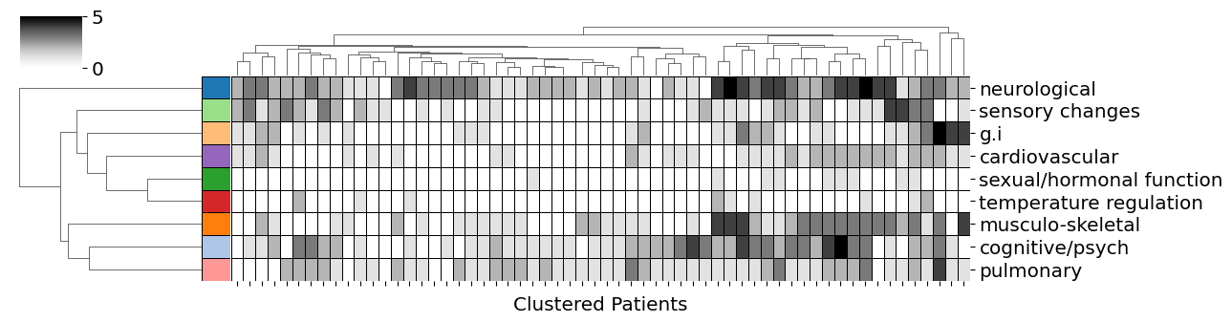
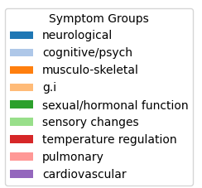

Slide 2
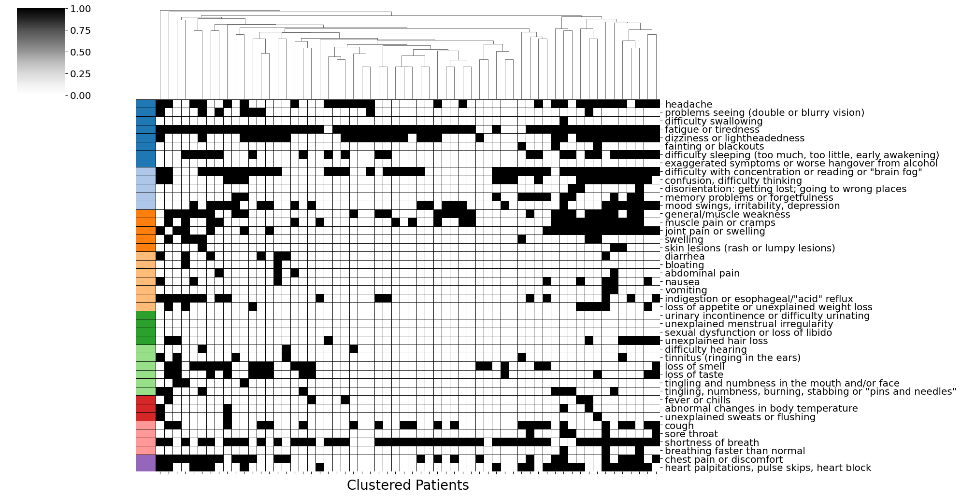

Slide 3
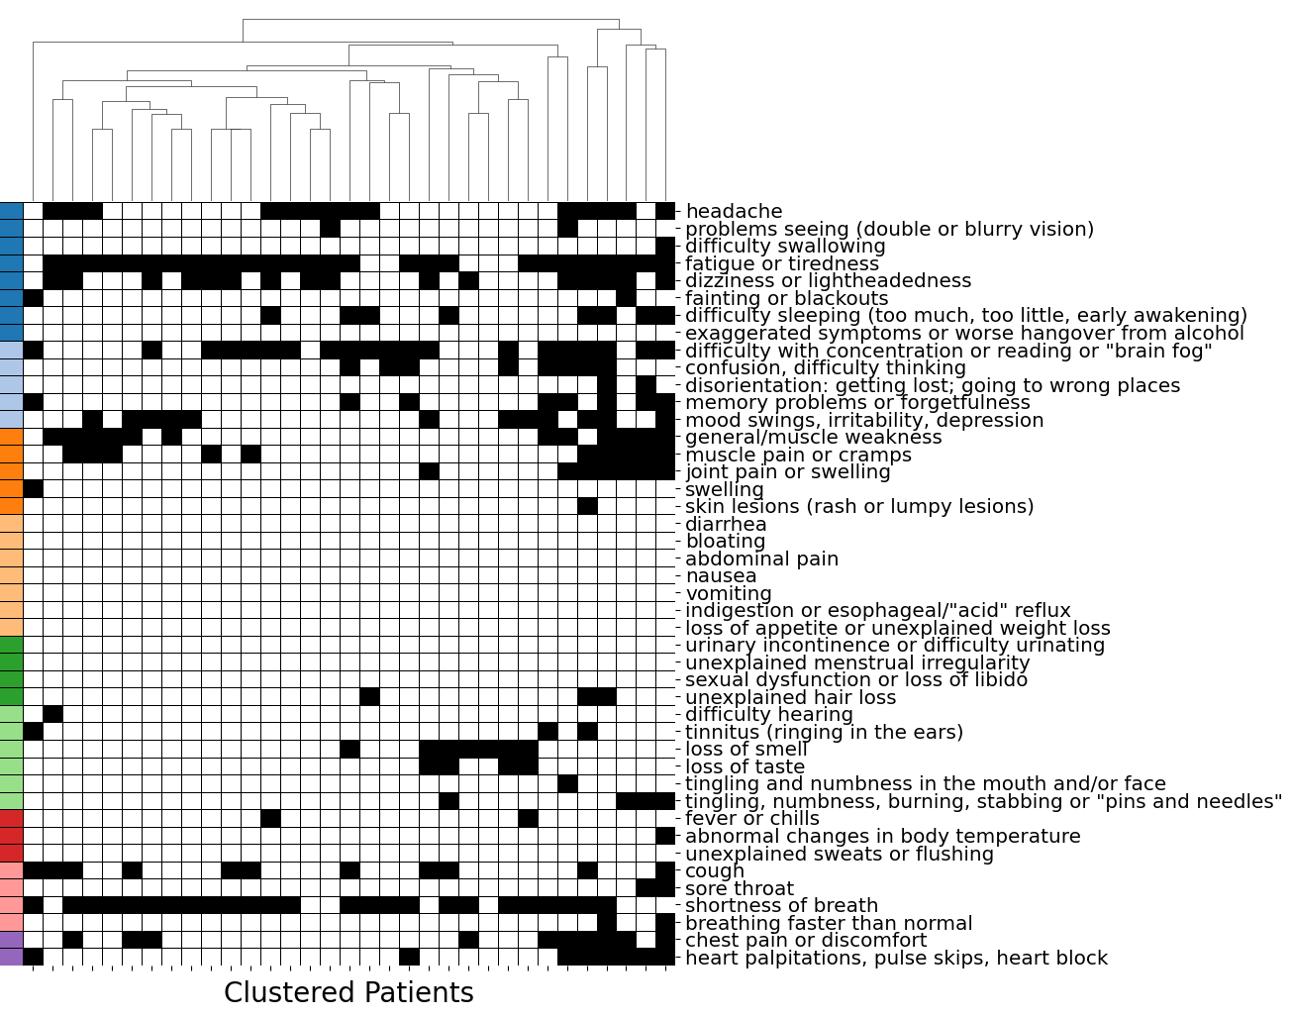
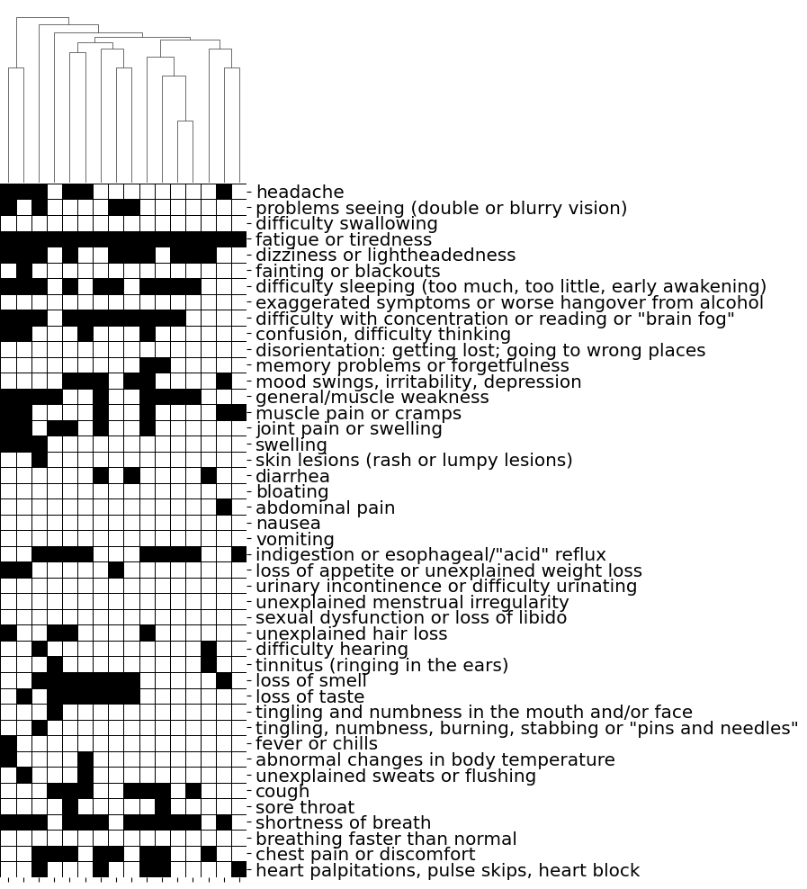
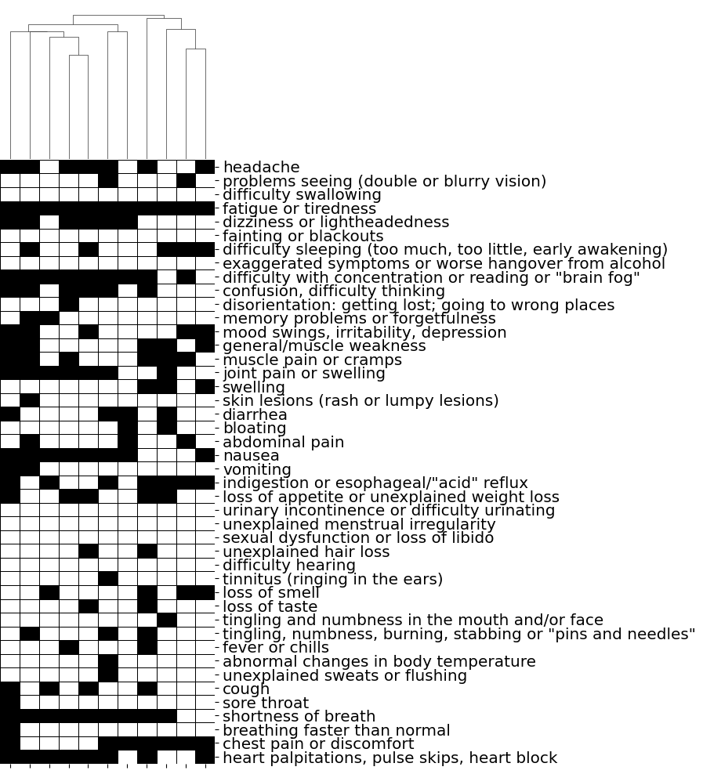

Slide 4
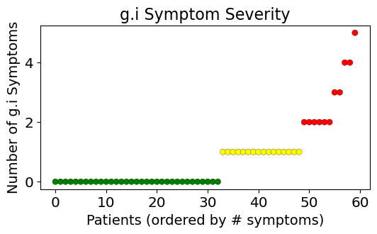
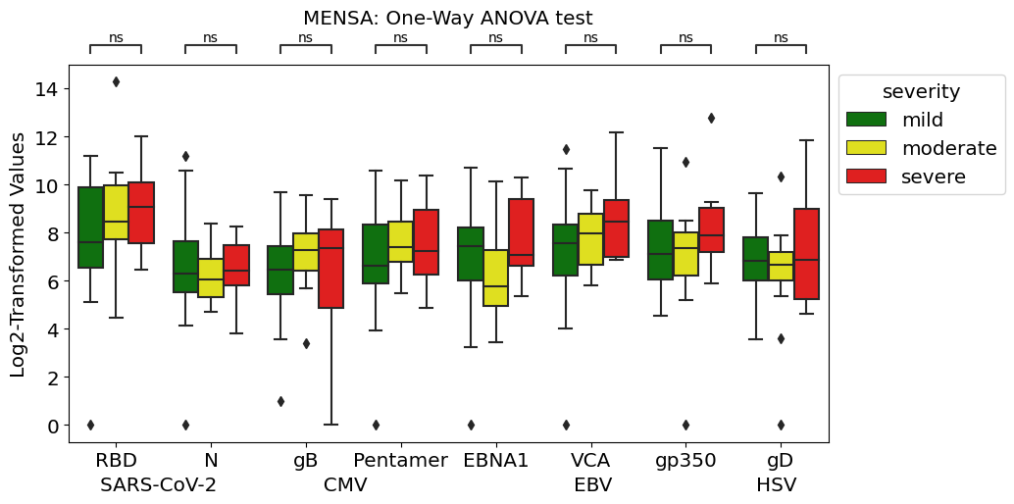
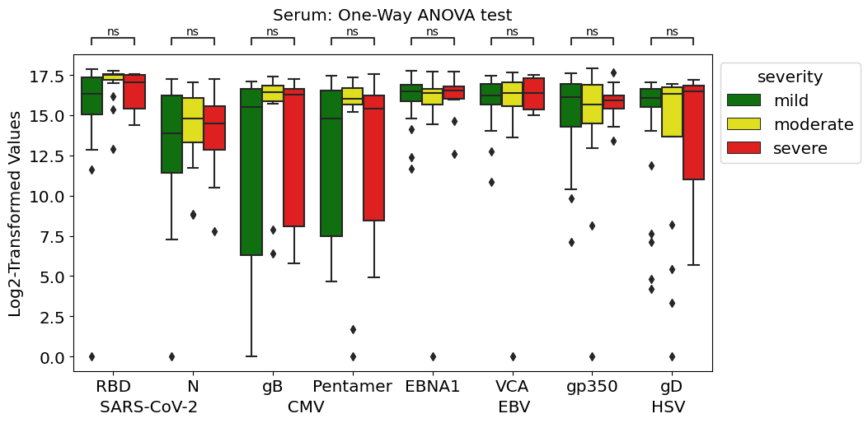
Notes:
SARS-COV-2 RBD, SARS-COV-2 N,
EBV EBNA1, EBV VCA, EBV gp350,
CMV gB, CMV Pentamer, HSV gD

Slide 5
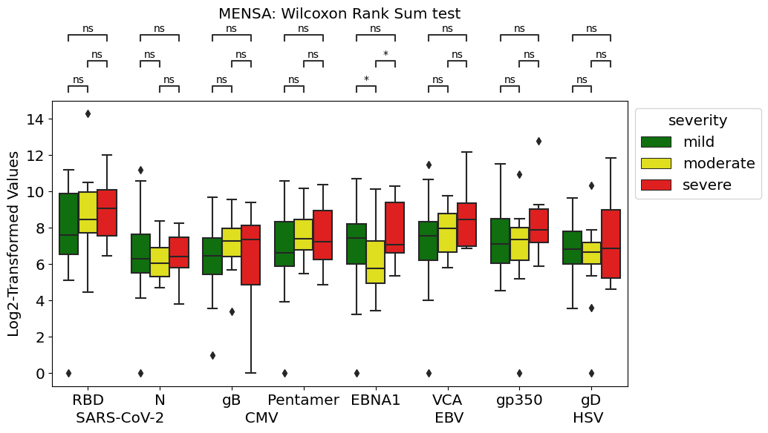
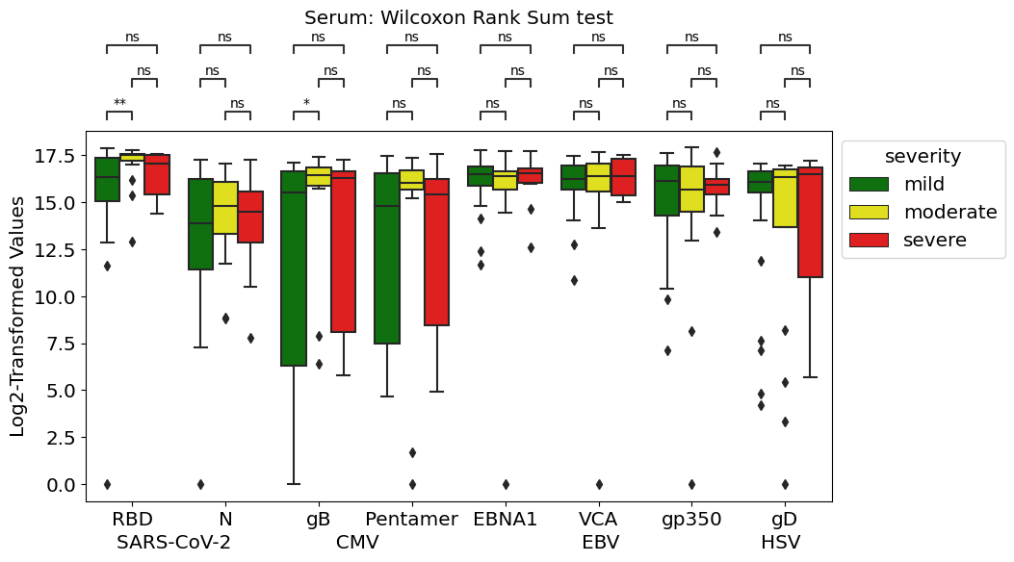

Slide 6
Notes:
params = dict(plt.rcParams)
params = {'legend.fontsize': 'x-large', 'axes.labelsize': 'x-large', 'axes.titlesize':'x-large', 'xtick.labelsize':'x-large',
'figure.figsize': (6, 3), 'ytick.labelsize':'x-large'}
pylab.rcParams.update(params)

