Slide 1

The Self-Righting Automatic Dumpster Cleaner
Revolutionizing Residential Trash Bin Sanitation
Patent Pending: Application No. 63/723,626

Slide 2

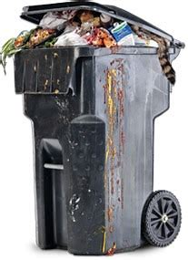

Our Big Idea
• Eco-friendly, self-righting, single-use cleaner for residential bins.
• High-expansion foam eliminates grime, grease, and odors effortlessly.
• Affordable and simple to use for homeowners.

Slide 3
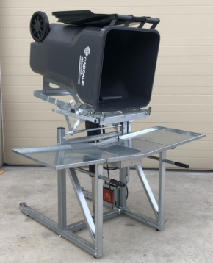
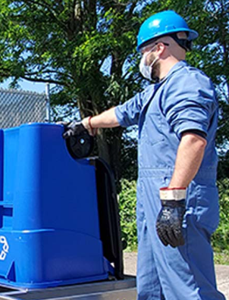
The Residential Cleaning Challenge
• 125 million residential trash bins in the U.S. remain dirty.
• Leads to odors, bacteria buildup, and unsanitary conditions.
• Manual cleaning is inconvenient; professional services are costly.

Slide 4


How it Works
1. Self-Righting Technology: Ensures upright activation for maximum coverage.
2. Pull-Tab Activation: Simple and quick for users.
3. High-Expansion Foam: Dissolves grime and eliminates odors in minutes.
4. Eco-Friendly Design: Biodegradable and single-use.

Slide 5
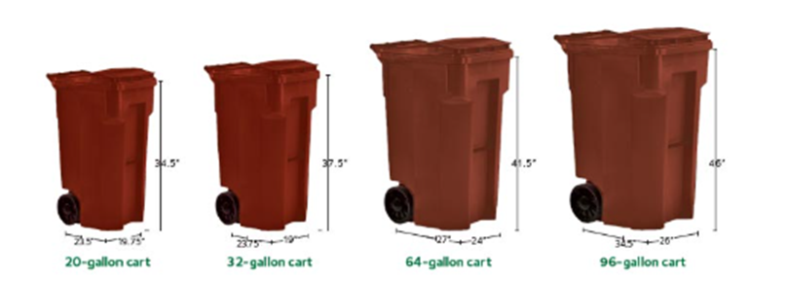
How it Works
• Bin Compatibility: 30-96 gallon rolling trash bins.
• Dimensions: 6-inch diameter x 8-inch height.
• Activation: Pull-tab and impact-trigger.
• Foam Volume: 250 mL.
• Weight: 0.6 lbs.

Slide 6
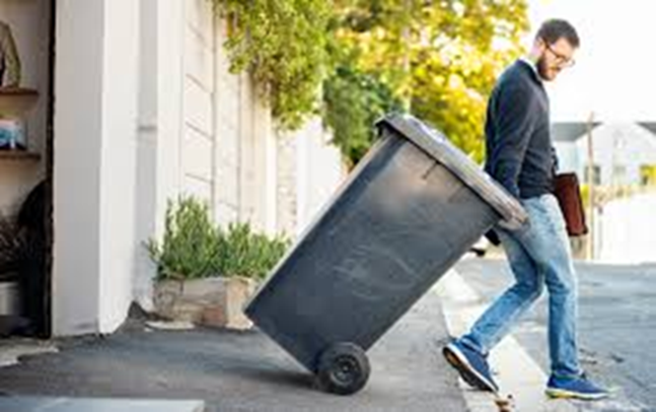
How it Works
• 125 million trash bins in the U.S.
• Growing demand for eco-friendly cleaning solutions.
• Target market: homeowners and eco-conscious consumers.
• Estimated market value: $1.5 billion.

Slide 7
How it Works
• Innovative Design: Patent-pending self-righting and foam activation.
• Convenience: Single-use, no need for manual cleaning.
• Cost-Effective: Affordable pricing for households.
• Sustainability: Eco-friendly and biodegradable materials.

Slide 8
Financial Snapshot
• Funding Secured: $300,000
• Projected Year 1 Revenue: $1.2M
• Profit Margin: 68%
• Scalable production and market growth opportunities.

Slide 9

Key Milestones
• Prototype Development: Months 1-3
• Manufacturing Setup: Months 4-6
• Product Launch: Months 6-12
• Retail Partnerships: Months 9-12

