Slide 1
INTERNET
FRAUD

Slide 2
Table of Contents
Internet Fraud
01
02
03
Introduction
Scam
Types of scams
04
05
05
Cyber Crime
News
Prevention and
Safety
Conclusion

Slide 3
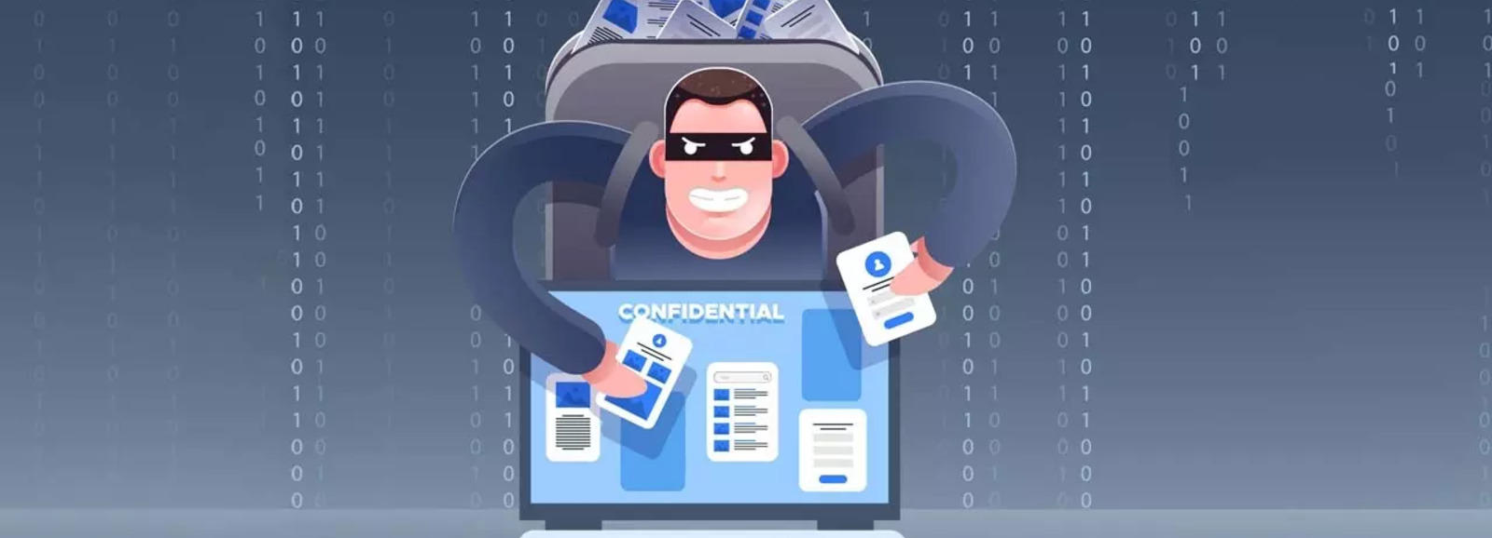
Introduction:
Internet Fraud
The term "internet fraud" generally covers cybercrime activity that takes place over the internet or on email, including crimes like identity theft, phishing, and other hacking activities designed to scam people out of money.

Slide 4
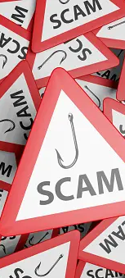
What is scam?
Internet Fraud
A scam is a dishonest and misleading attempt to entice a person to obtaining money by means of deception including fake personalities, fake photos, fake template letters, non-existent addresses and phone numbers, forged documents. Also called Plunder

Slide 5
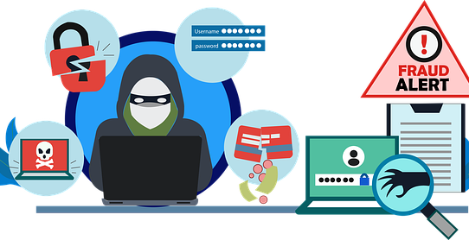
TYPES OF SCAM
Internet Fraud:-

Slide 6
There are lots of scam happening in our today to day life which is new and risk to handle some of the common scams are ,
TYPES OF SCAM
Internet Fraud
Work from Home scam
Advertisement scam
Romance and dating scam
Deep fake
Charity scam
Lottery and Prize scam
Banking and investment Scam
Advance fee fraud
Man in the middle
Phishing

Slide 7
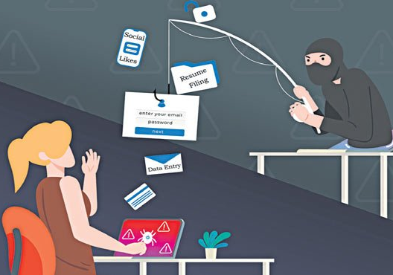
1.Work From Home Scam:-
Work-from-home scams are when deceitful people create fake job profile or postings to benefit themselves. They may use these as a means to steal your personal information or financial assets. As work from home jobs become more popular, scammers are starting to target this market with seemingly lucrative job offers. They may pose as a company or reputable person to get you to trust them.
Delhi man applies for a work-from-home job online, loses Rs 9 lakh in the new cyber fraudNew Delhi. The Man applied for the job through social media and was later tricked into depositing money on pretext of commission.

Slide 8
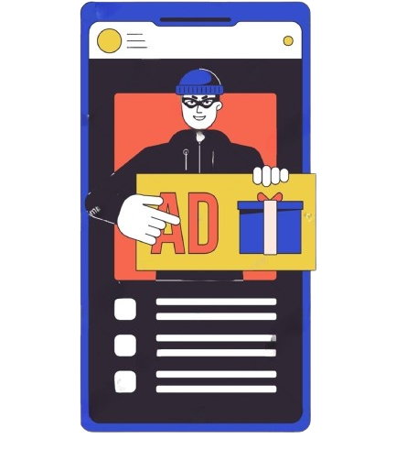
2.Advertisement scam:-
An online ad scam is a deceptive strategy where fraudsters exploit digital advertising platforms to steal money or harm someone's online reputation. These scams often involve urgency, presenting offers as limited-time deals, and may include fake review videos for false endorsements. Fraudsters lure victims with unrealistically discounted high-demand items, demanding upfront payments. Additional fees, like delivery charges or GST, may be requested after the initial payment.To maintain legitimacy, scammers provide fake delivery tracking details, creating a false sense that the purchased item is on its way.
Once the victim transfers the amount, fraudsters block communication, making it challenging for victims to seek recourse. Awareness of these tactics is esential to protect against falling victim to these deceptive

Slide 9
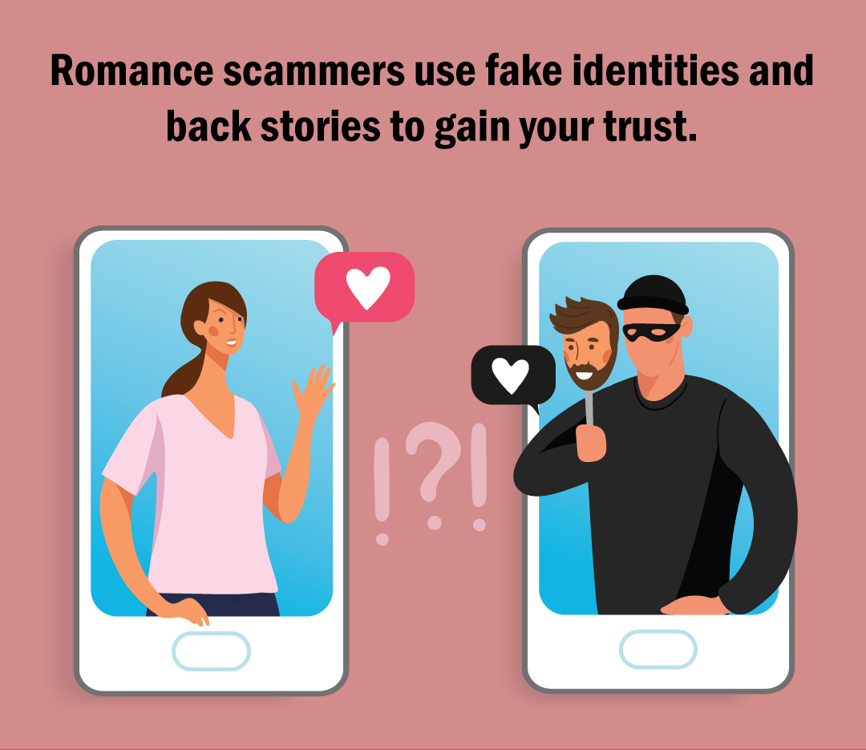
3.Romance scam
A romance scam, also known as an online dating scam, is when a person gets tricked into believing they're in a romantic relationship with someone they met online, when in fact their other half is a Cyber criminal using a fake identity to gain enough of their trust to ask or blackmail - them for money. You meet someone special on a dating website or app. Soon they want to email, call, or message you off the platform.
They say it's true love, but they live far away - maybe for work or because they're in the military. Then they start asking for money.Maybe it's for a plane ticket to visit you. Or emergency surgery.

Slide 10
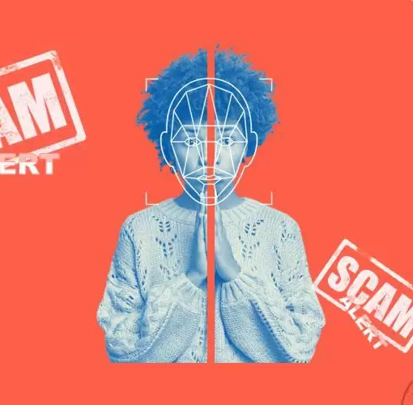
4.DEEP FAKE
Deepfake technology is also being misused to malign high-profile people such as politicians, movie actors, and others just so that the victim loses popularity just before elections or a movie and is deprived of opportunities in the future.
Typically, deepfakes are used to purposefully spread false information or they may have a malicious intent behind their use.The government has issued an advisory to social media & internet platforms to guard against deepfakes by India's IT rules.

Slide 11

5.CHARITY SCAM
Charity scammers use deception to steal money from people who believe they are donating to legitimate causes. Charity scam punishment are 3 months to 10 years in a prison. Indian penal code section 420 for cheating in a law.
Charity scam exploits non profit organization or donors personal information for financial gain
Help line number: 18004357352

Slide 12
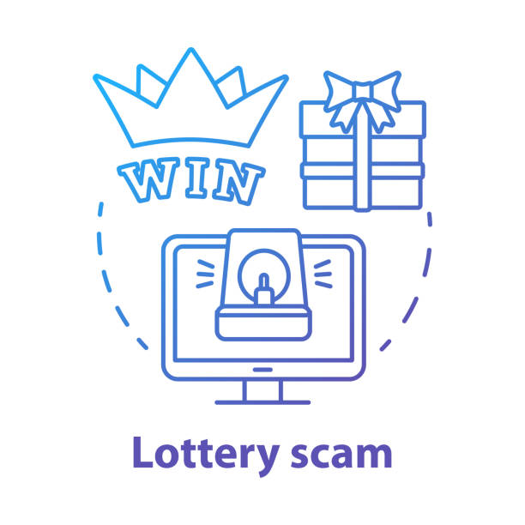
6.LOTTERY SCAM
A Lottery Scam is a type of fraud which begins with an unexpected email notification, phone call or mail explaining you have won a large sum of money in a lottery ticket and asks to contact a particular phone number or email address of an agent which, in actuality, belongs to the fraudster
Ernakulam woman loses Rs 1.12 cr to fraudsters who told her she won online lottery worth Rs 1 cr.

Slide 13
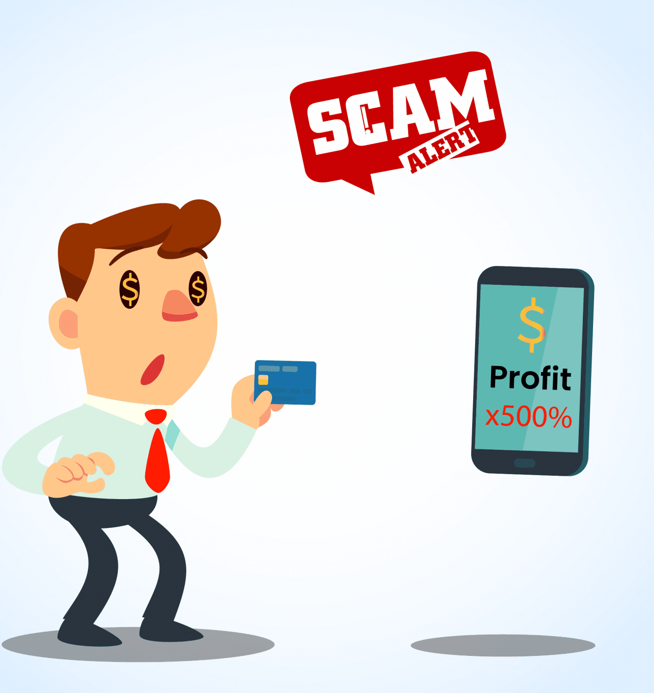
7.BANKING / INVESTMENT SCAM
Banking fraud is the use of potentially illegal means to obtain money, assets, or other property owned or held by a financial institution, or to obtain money from depositors by fraudulently posing as a bank or other financial institution.
Investment fraud happens when people try to trick you into investing money. They might want you to invest money in stocks, bonds, notes, commodities, currency, or even real estate
A scammer may lie to you or give you fake information about a real investment. Or they may make up a fake investment opportunity.

Slide 14
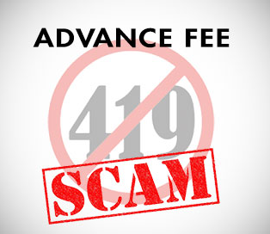
8.ADVANCE FEE SCAM
Why do they call it 419?
The '419' refers to the article of the Nigerian Criminal Code which deals with fraud and makes this type of fraud illegal. Although this scam originated in Nigeria, it is carried out by scammers in many different countries including Ghana, Senegal, Malaysia, Russia and the USA. The scam typically involves promising the victim a significant share of a large sum of money, in return for a small up-front payment,

Slide 15
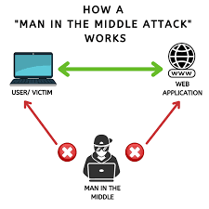
9.MAN-IN-THE-MIDDLE
Man-in-the-browser is the most common type of MiTM attack in which the attackers focus on browser infection and inject malicious proxy malware into the victim's device. The malware is commonly introduced through phishing emails.
Man-in-the-browser (MITB): a form of Internet threat related to man-in-the- middle (MITM), is a proxy Trojan horse that infects a web browser by taking advantage of vulnerabilities in browser security to modify web pages, modify transaction content or insert additional transactions, all in a completely covert fashion…

Slide 16
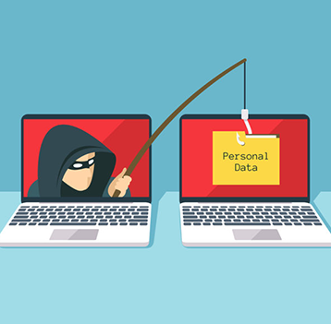
10.PHISHING
Phishing: A technique for attempting to acquire sensitive data, such as bank account numbers, through a fraudulent solicitation in email or on a web site, in which the perpetrator masquerades as a legitimate business or reputable person.
A fake email from a bank asking you to click a link and verify your account details is an example of deceptive phishing.

Slide 17
PREVENTION AND
SAFETY:-
- Ensure Your system is Up-to-date.
- Use Full Service Internet Security Suite.
- Use a Secure Internet Connection.
- Use Strong Password.
- Be Aware of Pop-ups and Fraudulent Emails.
- Protect yourself from identity threats.
- Manage Your Social Media Settings.
- Get the Right Cyber Insurance PolicGet the Right Cyber Insurance Policy.
- Get the Right Cyber Insurance Policy.

Slide 18
CONCLUSION:-
Internet fraud and scams have the ability to devastate their victims, as well as their friends, family, colleagues and society as a whole. The extent of this problem requires a coordinated, partnership approach against a large number of organizations. Fraud is far too simplistic to argue that improvements in technology are directly responsible for the current trends in internet fraud and scams. Despite the low reporting rates of Cyber frauds and scams, victims are still more visible and identifiable than those who offend against them.

Slide 19
THANK YOU

