Slide 1

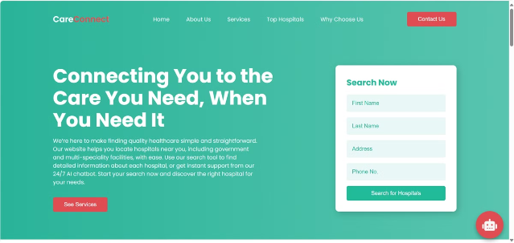
CareConnect: A Comprehensive Healthcare Solution
CareConnect is a user-friendly healthcare website designed to streamline access to medical services. The website is designed to provide a seamless and efficient way for users to connect with nearby healthcare facilities.

Slide 2

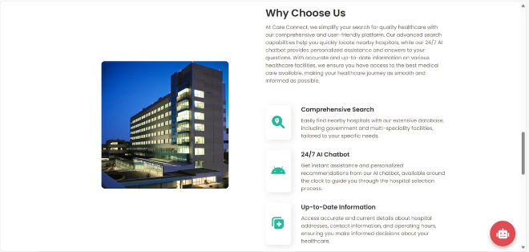
The Problem: Difficulty in Accessing Nearby Healthcare Facilities
1
Limited Information
Finding reliable and up-to-date information about nearby healthcare facilities can be challenging.
2
Time-Consuming Process
The process of searching for healthcare facilities can be time-consuming and frustrating, especially in emergencies.
3
Lack of Accessibility
Not everyone has equal access to healthcare facilities, particularly in rural or underserved areas.
4
Unclear Communication
Finding accurate information about hospital services, wait times, and availability can be confusing.

Slide 3

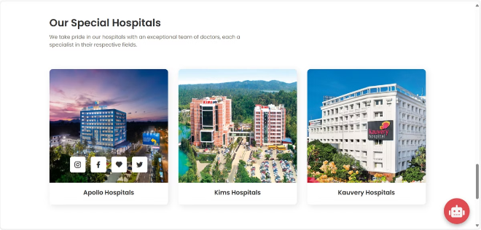
Our Proposed Solution: CareConnect - A User-Friendly Healthcare Website
Simplified Search
CareConnect provides an intuitive and easy-to-use interface for finding healthcare facilities.
Location-Based Search
The website uses GPS technology to identify the user's location and display nearby hospitals, pharmacies, government hospitals, and multispecialty hospitals.
Comprehensive Information
CareConnect provides detailed information about each facility, including services, contact details, and operating hours.

Slide 4
Key Features: Location-Based Hospital Search, State/District Search, and 24/7 AI Chatbot
Location-Based Search
State/District Search
24/7 AI Chatbot
Users can locate nearby hospitals by simply entering their location or allowing the website to access their GPS data.
Users can search for hospitals based on their state and district, even if they are traveling or relocating.
The website features an AI-powered chatbot that provides instant answers to medical queries and offers guidance on accessing healthcare.

Slide 5






Technology Stack:
Web Technologies
Frameworks
HTML
PYTHON
The core structure of the website is built using HTML, which defines the layout and content.
The backend of the website is built using the Python programming language.
CSS
FLASK
CSS provides the styling and visual appearance of the website, ensuring a user-friendly and visually appealing experience.
FLASK is a Python web framework that powers the website's backend functionality, including data processing and communication.
JAVASCRIPT
AI & ML
JAVASCRIPT enhances the website's interactivity, making it dynamic and responsive to user interactions.
AI and machine learning technologies are integrated into the 24/7 chatbot, providing intelligent and accurate responses to user queries.

Slide 6

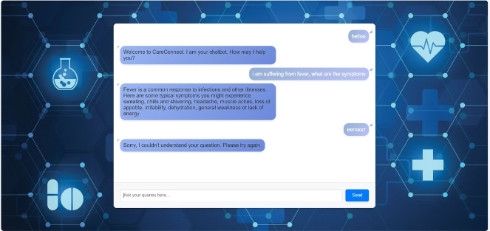
User Experience: Intuitive Interface and Seamless Navigation
1
Simple Design
The website features a clean and uncluttered design, making it easy for users to find the information they need.
2
Easy Navigation
CareConnect has a straightforward navigation menu that allows users to easily access different sections of the website.
3
Mobile-Friendly Design
The website is optimized for mobile devices, ensuring a seamless experience on smartphones and tablets.
4
Visually Appealing
CareConnect incorporates visually appealing design elements, such as high-quality images and intuitive icons, to enhance the user experience.

Slide 7






Impact: Improved Access to Healthcare, Reduced Wait Times, and Enhanced Patient Satisfaction
Reduced Wait Times
By providing accurate information about hospital wait times, CareConnect helps users plan their visits and reduce unnecessary waiting.
Improved Patient Experience
The website's user-friendly design and comprehensive information contribute to a more positive and efficient patient experience.
Increased Accessibility
CareConnect expands access to healthcare by connecting users with nearby facilities, regardless of their location.
Enhanced Communication
The AI-powered chatbot provides instant support and guidance, addressing user concerns and questions.

