Slide 1
Tidyverse
Introduction to Computational CMB
Meg Hemmerlein
12 February 2024

Slide 2
Agenda
Monday
Wednesday
Dataframes
Dplyr & tidyr
Factors
Renaming
Converting
In-class problems
Homework

Slide 3
Monday Objectives
Load external data into dataframe
Install and load packages
Summarize contents of data frame
Reorder and rename factors
Let’s start!

Slide 4
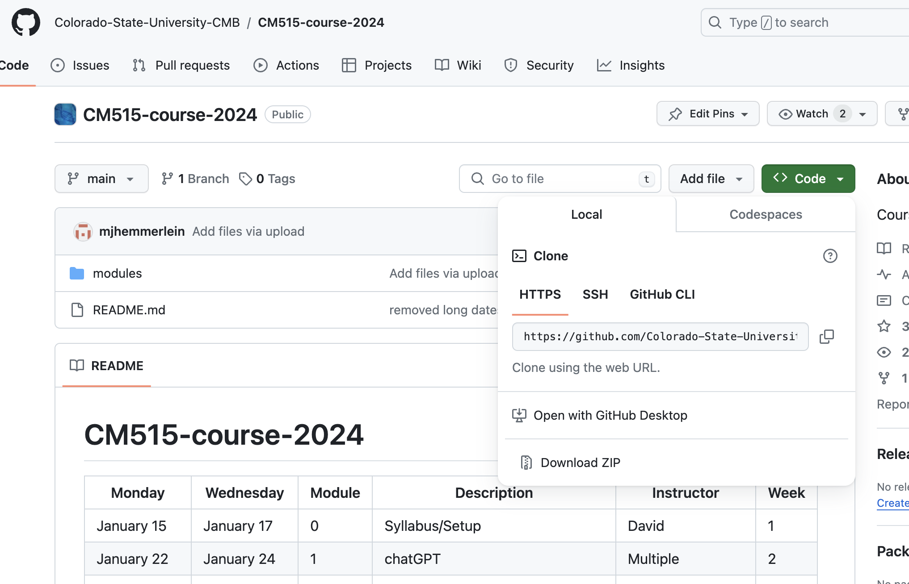
Monday Objectives
Open CMB Github
Copy link

Slide 5
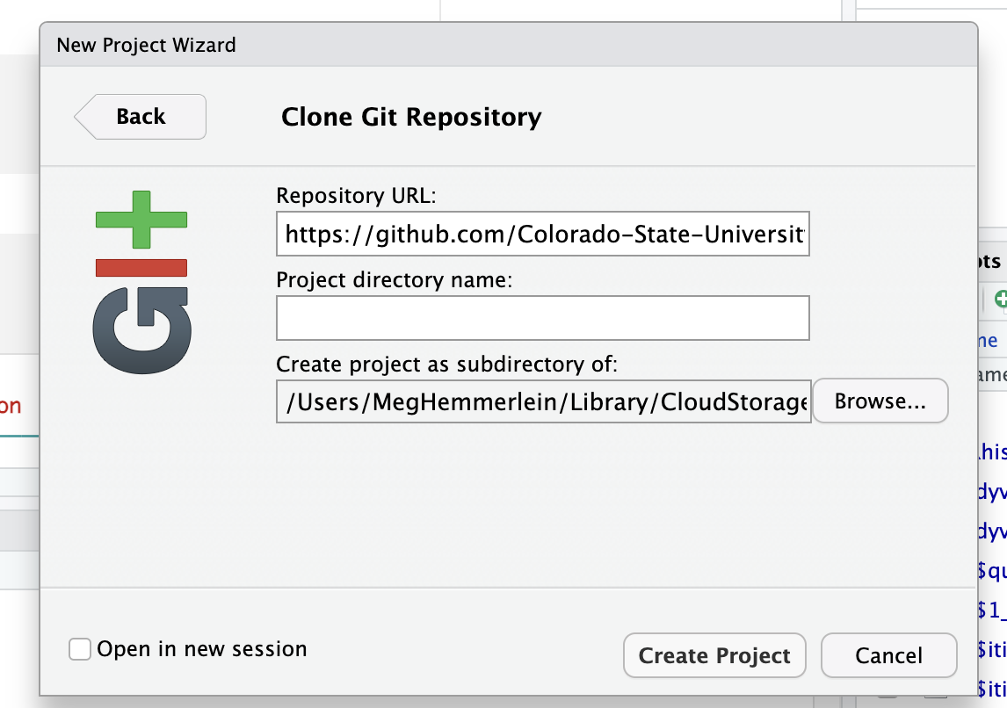
Monday Objectives
Make a new folder on your computer
Open Rstudio
New project
Version control
Git
Paste Repository URL
Specify path

Slide 6
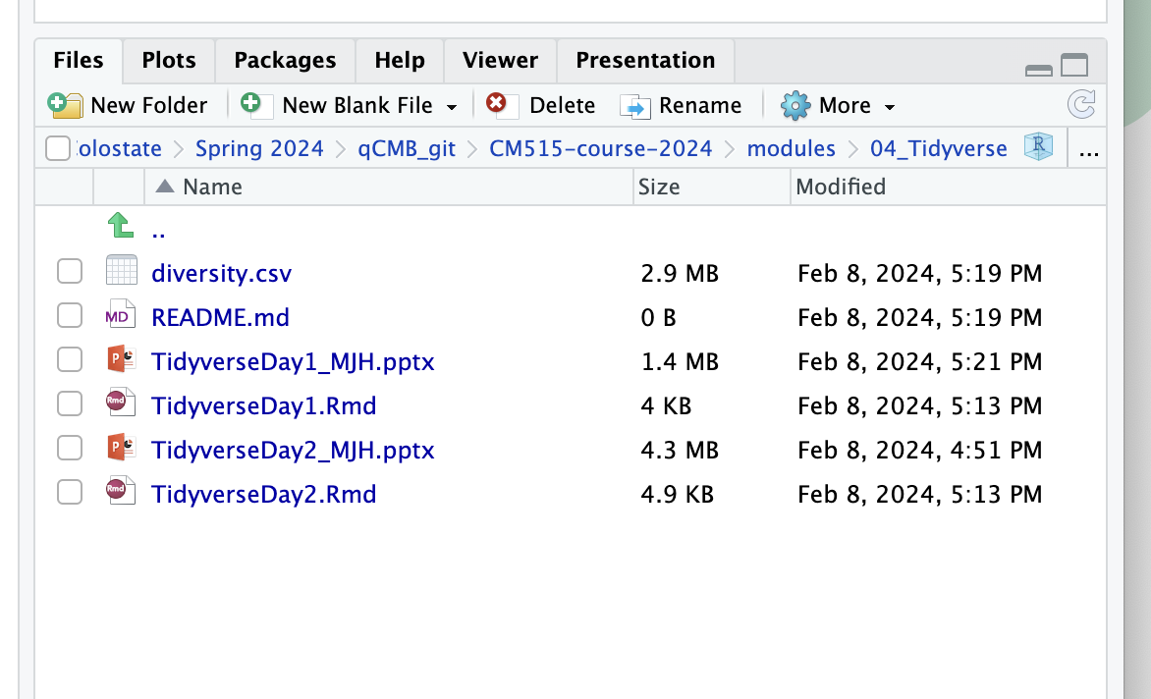
Monday Objectives
Open directory in R
modules >
04_Tidyverse >
TidyverseDay1_MJH.Rmd

Slide 7
Monday Objectives
Make sure everyone is good to go

Slide 8
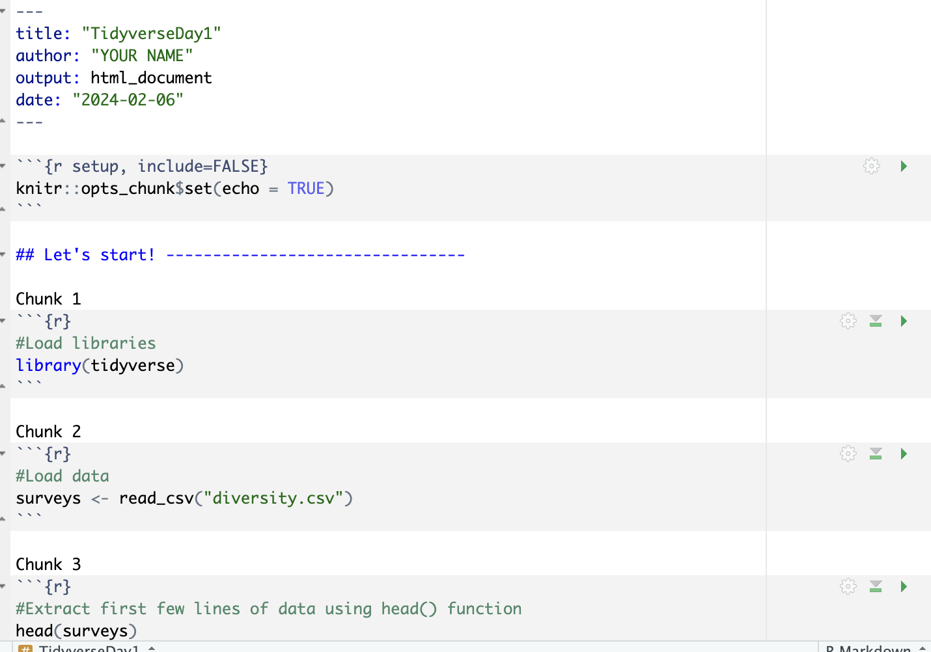
Add your name as the author
Follow along by running the chunks

Slide 9
In the R markdown Run chunk 0-3

Slide 10
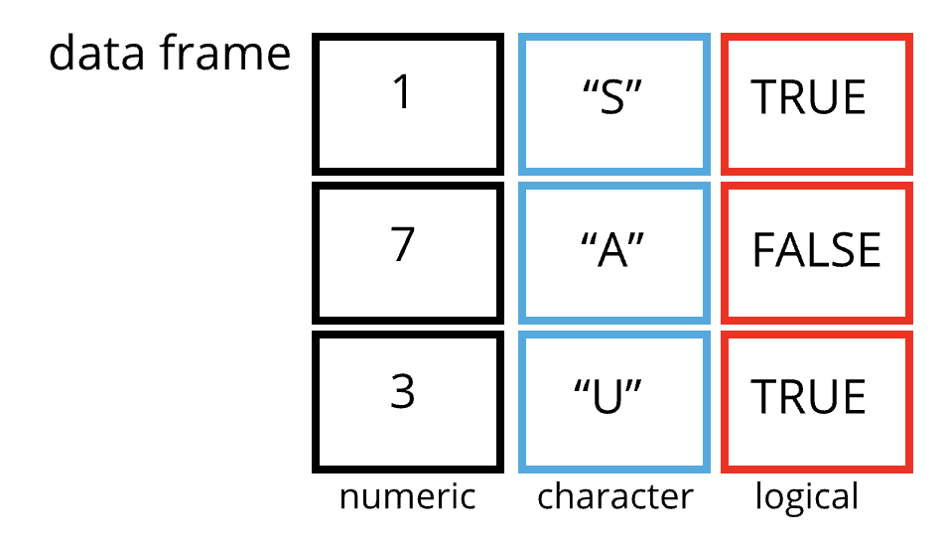
What are dataframes?
A data structure
2-dimensional table of rows and columns (similar to an excel spreadsheet)
Data types:
Character (chr; “S”)
Factor (fctr; +/-)
Numeric (int: 1, dbl; 3.4)
Boolean (bool; True/false)
Date/time
Null/missing values

Slide 11
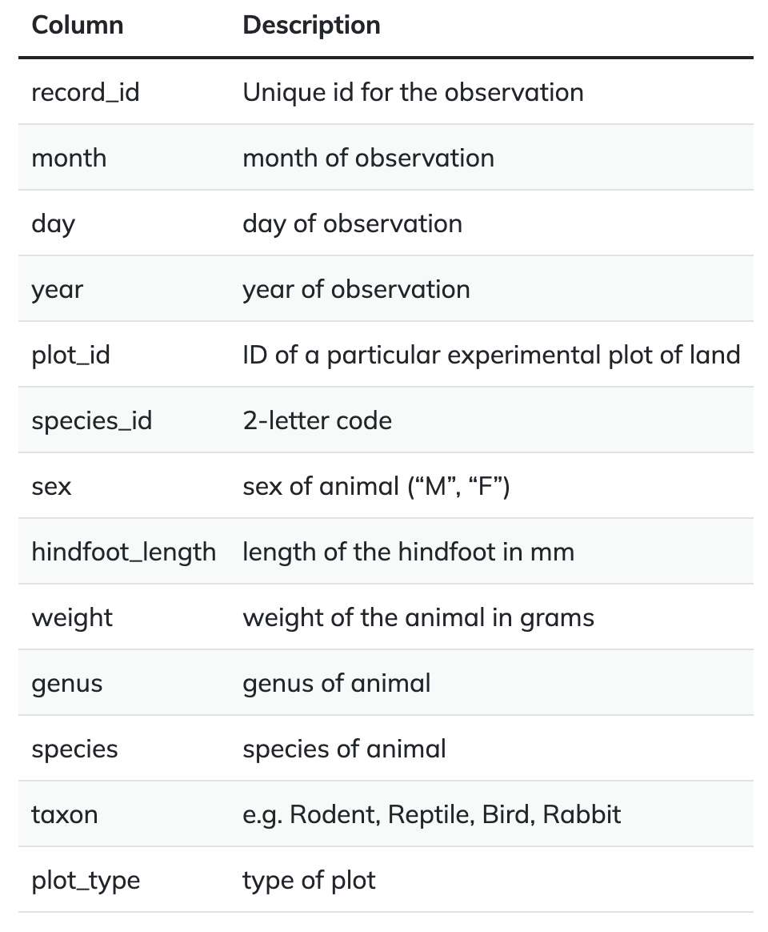
What is in our data frame?
Investigating the animal species diversity and weights found within plots at specific study sites

Slide 12
Inspecting a dataframe
Size:
dim(surveys) - returns a vector with the number of rows in the first element, and the number of columns as the second element (the dimensions of the object)
nrow(surveys) - returns the number of rows
ncol(surveys) - returns the number of columns
Content:
head(surveys) - shows the first 6 rows
tail(surveys) - shows the last 6 rows
Names:
names(surveys) - returns the column names (synonym of colnames() for data.frame objects)
rownames(surveys) - returns the row names
Summary:
str(surveys) - structure of the object and information about the class, length and content of each column
summary(surveys) - summary statistics for each column

Slide 13
Run chunk 4-6

Slide 14
Indexing and subsetting dataframes
Our data frame has rows and columns (2 dimensions)
If we want to look at specific data we can specify “coordinates”
Row numbers are first
Column numbers are second

Slide 15
Indexing and subsetting dataframes
Extracting specific values
Format: data_frame[row_index, column_index]
Example
First row and column from surveys:
surveys[1, 1]
First row and sixth column:
surveys[1, 6]
Extracting multiple rows
Format: data_frame[c(1, 2, 3), c(5, 6)]
data_frame[1:3, 5:6]
Example
surveys[c(1, 2, 3), c(5, 6)
surveys[1:3, 5:6]

Slide 16
Indexing and subsetting dataframes
Subsetting
Format: data_frame[“column name”]
Example
surveys[“species_id”]

Slide 17
Run chunk 7-13

Slide 18
Indexing and subsetting dataframes
Excluding specific values
Format: data_frame[, -column_index]
data_frame[-7:nrow(data_frame)), ]
Equivalent to head(survey)
Example
surveys[, -1]
surveys[-7:nrow(surveys)), ]

Slide 19
Run chunk 14-15

Slide 20
Data types: Factor vs Character
Character
Store text or string values
Variables are not ordered and considered unique
Ex. (“male”, “female”, ”red”, “blue”)
Factor
Represents categorical data with fixed set of levels
Useful when order matters
Unlike characters, factors have predefined levels – default is alphabetical
Ex. Sex variable with values “male” and “female”

Slide 21
Data types: Conversion to a factor
surveys$sex <- factor(surveys$sex)
str(survey)
summary(survey$sex)

Slide 22
Run chunk 16-18

Slide 23
Data types: Finding levels
sex <- factor(c(“male”, “female”, “female”, ”male”))
R will assign 1 to the level “female” and 2 to the level “male” (because f comes before m, even though the first element of this vector is “male”).
levels(sex)
Visualize the levels (order) of the data
nlevels(sex)
Find the number of levels

Slide 24
Run chunk 19-21

Slide 25
Data types: Changing factor order
sex <- factor(sex, levels = c(“male”, “female”))
sex
Re-order to have male first (non-alphabetical)

Slide 26
Run chunk 22-23

Slide 27
Data Types: Renaming factors
When your data is a factor, you can use base R function plot() to quickly look at data
plot(survey$sex)
If we want to add a factor level to an object called ‘sex’ we can use addNA()
sex <- surveys$sex
sex <- addNA(sex)
To rename NA column to undetermined and then re-plot
Levels(sex)[3] <- ”undetermined”
plot(sex)

Slide 28
Run chunk 25-31 Done!

Slide 29
Questions

Slide 30
Q1: What is the class of the object surveys? Dataframe How many rows and how many columns are in the object? Rows: 34786 Columns: 13

Slide 31
Q2: 1. Create a data.frame (sruveys_200) containing only the data in row 200 of the surveys dataset. surveys_200 <- surveys[200, ] 2. Notice how nrow() gave you the number of rows in a data.frame? n_rows <- nrow(surveys) surveys_last <- surveys[n_rows, ]

Slide 32
Q3: Change the columns taxa and genus in the surveys dataframe into a factor surveys$taxa <- factor(surveys$taxa) sruveys$genus <- factor(surveys$genus) summary(surveys) nlevels(surveys$genus) 26 genera in ‘genus’ column. 75 rabbits in the ‘taxa’ column.

Slide 33
Q4: 1. Create a data.frame (sruveys_200) containing only the data in row 200 of the surveys dataset. surveys_200 <- surveys[200, ] 2. Notice how nrow() gave you the number of rows in a data.frame? n_rows <- nrow(surveys) surveys_last <- surveys[n_rows, ]

Slide 34
Q5: 1. Rename “F” and “M” to “female” and “male” respectively. Levels(sex)[1:2] <- c(“female”,”male”) 2. Recreate the barplot such that ”undetermined” is first (before “female”). sex <- factor(sex,levels = c(”undetermined”, “female”, ”male”) plot(sex)

