Slide 1


Advanced Machine Learning project
Real vs Synthetic image classification from Stable Diffusion feature maps
A comparison of tabular, spatial and ensemble learning approaches
Burroni Leonardo

Slide 2
Project Goal
This project investigates binary classification of precomputed spatial feature maps extracted from real and AI-generated images.
The task is to distinguish real examples from synthetic examples while keeping data handling, model selection, and evaluation reproducible.

Slide 3
Dataset (1)
Source File¹ | Label | Semantic class | Samples | Tensor shape | Origin
features_0.npy | 0 | Real | 1,654 | (1654, 1280, 16, 16) | Pascal VOC and COCO
Features_1.npy | 1 | Fake | 2,383 | (2383, 1280, 16, 16) | DALL-E 3, Stable Diffusion 1.4 and Midjourney
Total |  |  | 4037 | Per sample: (1280, 16, 16)
¹Dataset from Bonechi, Andreini, and Toniella Corradini, “Comparing Real and Synthetic Image Representations in Stable Diffusion Models.”

Slide 4
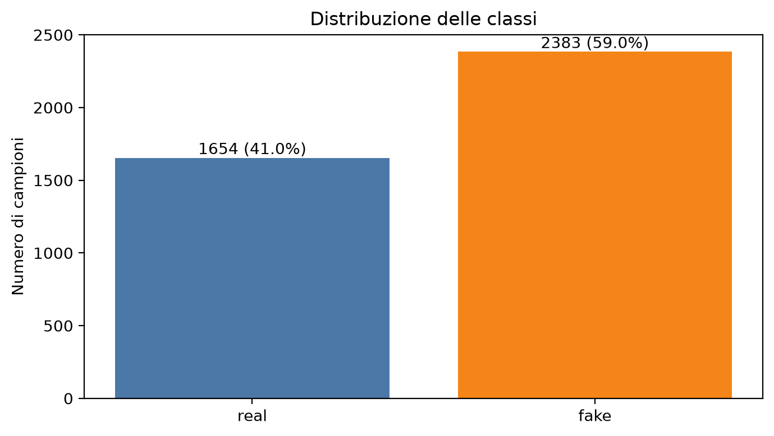
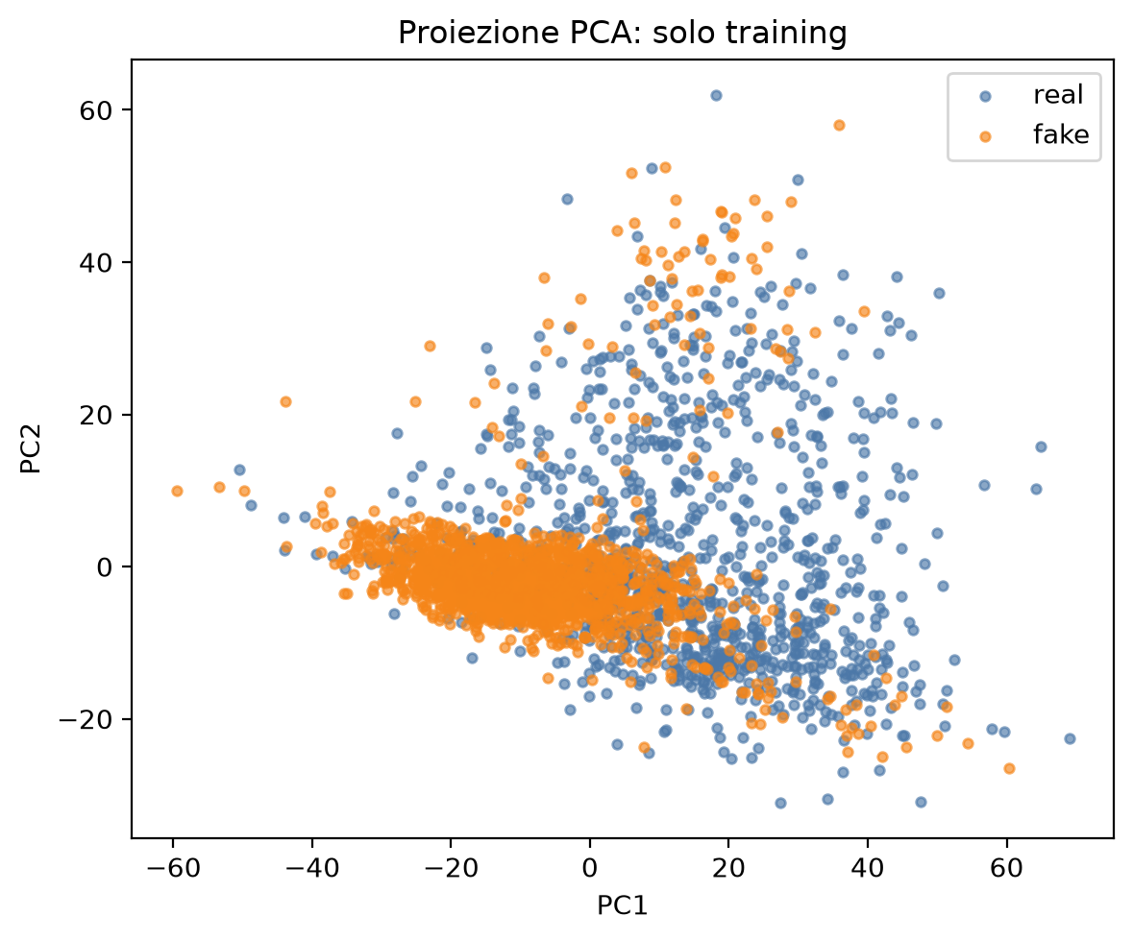
Dataset (2)
Train split | Validation split | Test split
2,825 samples (70 %) | 606 samples (15 %) | 606 samples (15 %)
Stratified split: the splits were made by keeping the imbalance ratio of the dataset.
Balanced Accuracy is used as the main evaluation metric.
An almost clear separation is visible by plotting a PCA representation of the train split.
A diagnostic logistic regression using only global mean, standard deviation, minimum, and maximum reaches:
- Validation balanced accuracy: 0.7332.
- Validation ROC-AUC: 0.8019.

Slide 5
Experimental protocol
A single stratified split is shared across notebooks: 70% training, 15% validation, and 15% test, with seed 42.
Training data alone is used to fit learned preprocessing components, including scalers and spatial normalization statistics.
Validation balanced accuracy² is the primary criterion for hyperparameter selection, early stopping, ensemble-weight selection, and decision-threshold selection.
The test partition remains isolated until all model choices are frozen.
²Balanced Accuracy is choosed as the main evaluation metric to overcome the slight imbalance of the dataset.

Slide 6
Considered Models
SVM with RBF kernel
XGBoost
MLP
CNN spatial head
ConvNeXt
Ensemble (SVM + XGBoost + CNN)

Slide 7
3 Input Representations
feature map: 1280 x 16 x 16
GAP (Global Average Pooling)
1,280 values
SVM (RBF kernel)
Mean + std
2,560 values
XGBoost, MLP
Normalized spatial map
1280 x 16 x 16
CNN, ConvNeXt
GAP: For each channel, the mean of its values is computed.
The idea is: “On average, how prevalent is the pattern detected by this channel?”, without asking where it appears in the image. It is therefore a very concise overall summary.
Best suitable for tabular models like SVMs.
Mean+std: Each channel is summarized by mean and std values. Still does not preserve the positions of the patterns but preserves spatial variability. Still tabular data but more informative than GAP. Used is XGBoost and MLP.
Normalized spatial map: Keep the original tensor shape but each channel is normalized using mean and std of the train samples. Preserves the position of the patterns. Used to avoid high-value channels to dominate the classification.

Slide 8
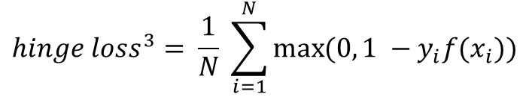
SVM
Preprocessing
GridSearch
Splitted Dataset
Stratified KFold
GAP
Best SVM configuration
Test evaluation
Train
Validation
Mean+std
$${hinge loss}^{3}= \frac{1}{N} \sum_{i=1}^{N}{\max{(0, 1 −y_{i}f(x_{i}))}}$$
Best Parameters: C = 10, gamma = scale
Best Preprocessing: GAP
Split | N samples | Loss | Accuracy | Balanced accuracy | Precision | Recall | F1 | ROC-AUC | PR-AUC
Train | 2825 | 3.39*e-05 | 1.0 | 1.0 | 1.0 | 1.0 | 1.0 | 1.0 | 1.0
Validation | 606 | 0.17 | 0.98 | 0.97 | 0.97 | 0.99 | 0.98 | 0.99 | 0.99
Test | 606 | 0.18 | 0.96 | 0.97 | 0.99 | 0.95 | 0.97 | 0.99 | 0.99
³Hinge Loss does not estimate a probability, it’s goal is to separate the classes with a safe margin y $∈${+1, -1}. If an example is correctly classified but too close to the margin, still receives a penalty. The output is a score, not a probability.

Slide 9
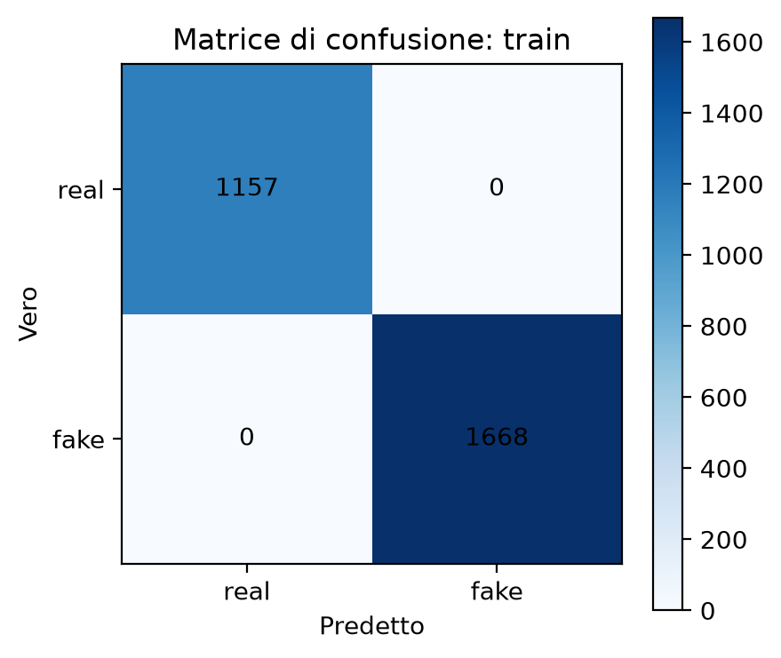
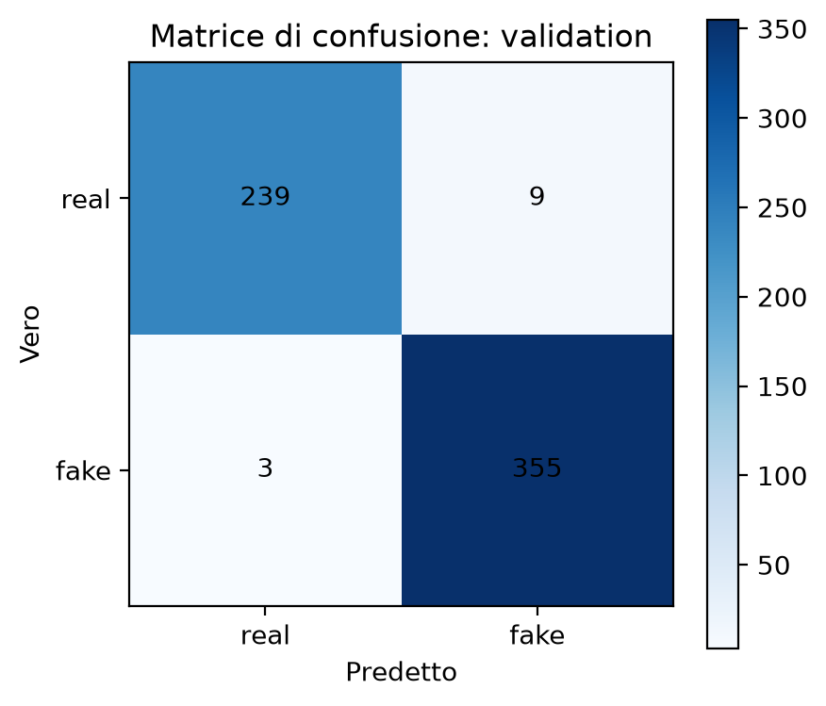
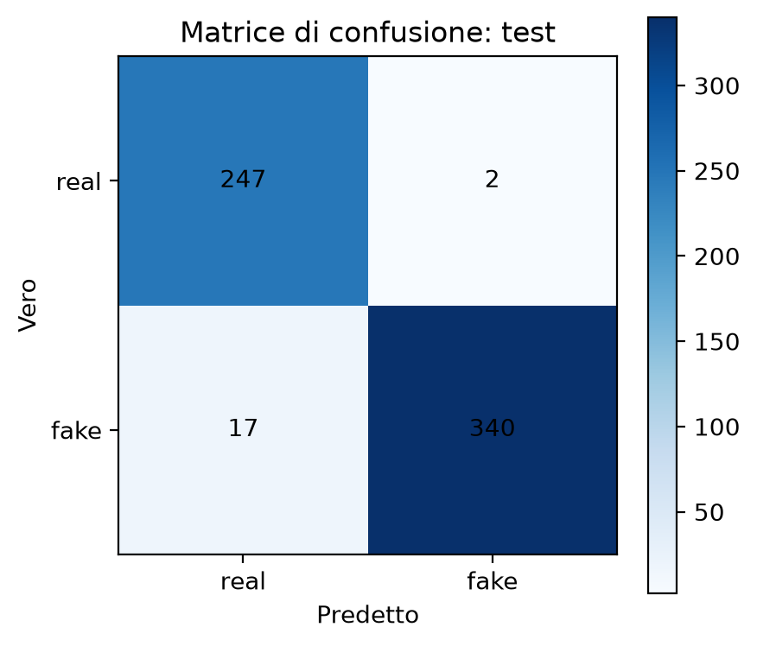
SVM – Confusion Matrices

Slide 10
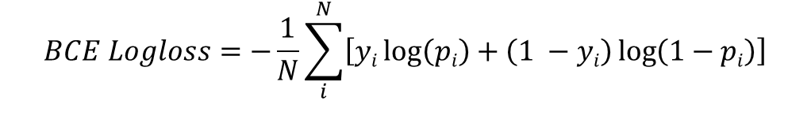
XGBoost
Preprocessing
GridSearch
Splitted Dataset
Stratified KFold
GAP
Best XGBoost configuration
Test evaluation
Train
Validation
Mean+std
$$BCE Logloss=−\frac{1}{N}\sum_{i}^{N}{\left[yi\log\left(pi\right)+\left(1 −yi\right)\log\left(1−pi\right)\right]}$$
Best Parameters: max_depth = 4, lr = 0.1
Best Preprocessing: GAP
Split | N samples | Loss | Accuracy | Balanced accuracy | Precision | Recall | F1 | ROC-AUC | PR-AUC
Train | 2825 | 0.005 | 1.0 | 1.0 | 1.0 | 1.0 | 1.0 | 1.0 | 1.0
Validation | 606 | 0.08 | 0.97 | 0.96 | 0.96 | 0.98 | 0.97 | 0.99 | 0.99
Test | 606 | 0.10 | 0.96 | 0.95 | 0.96 | 0.96 | 0.96 | 0.99 | 0.99

Slide 11
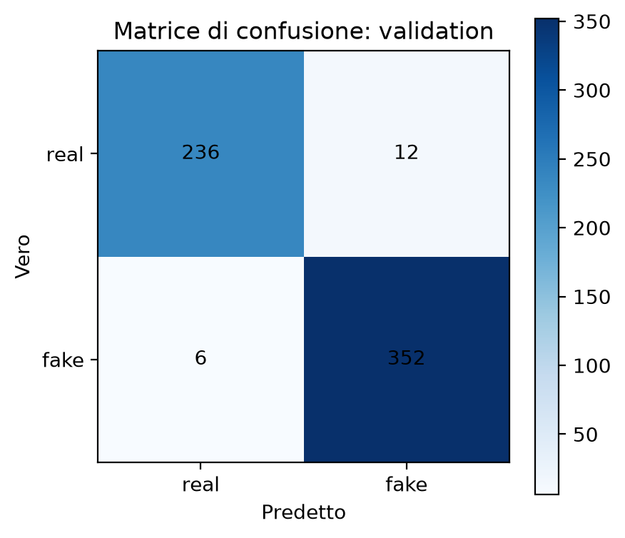

XGBoost – Confusion Matrices

Slide 12
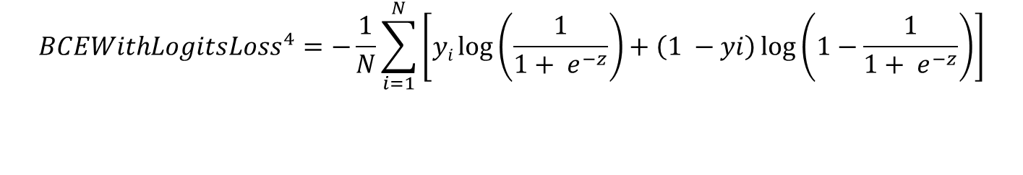
MLP
input
Linear(2560, 512)
LayerNorm
GELU
Dropout(0.30)
Linear(512, 128)
LayerNorm
GELU
Dropout(0.30)
Linear(128, 1)
logit
Preprocessing
Splitted Dataset
Stratified KFold
GAP
Test evaluation
Train
Validation
Mean+std
$${BCEWithLogitsLoss}^{4}=−\frac{1}{N}\sum_{i=1}^{N}{\left[yi\log\left(\frac{1}{1+ e^{−z}}\right)+\left(1 −yi\right)\log\left(1−\frac{1}{1+ e^{−z}}\right)\right]}$$
output
Split | N samples | Loss | Accuracy | Balanced accuracy | Precision | Recall | F1 | ROC-AUC | PR-AUC
Train | 2825 | 0.004 | 0.99 | 0.99 | 1.0 | 0.99 | 0.99 | 0.99 | 0.99
Validation | 606 | 0.14 | 0.97 | 0.97 | 0.97 | 0.97 | 0.97 | 0.99 | 0.99
Test | 606 | 0.14 | 0.96 | 0.969 | 0.98 | 0.95 | 0.97 | 0.99 | 0.99
⁴ BCEWithLogitLoss is the standard Binary Cross Entropy Loss applied directly to logits, the raw output scores of the model before the sigmoid. It has the sigmoid inside and not as an additional block in the model.

Slide 13

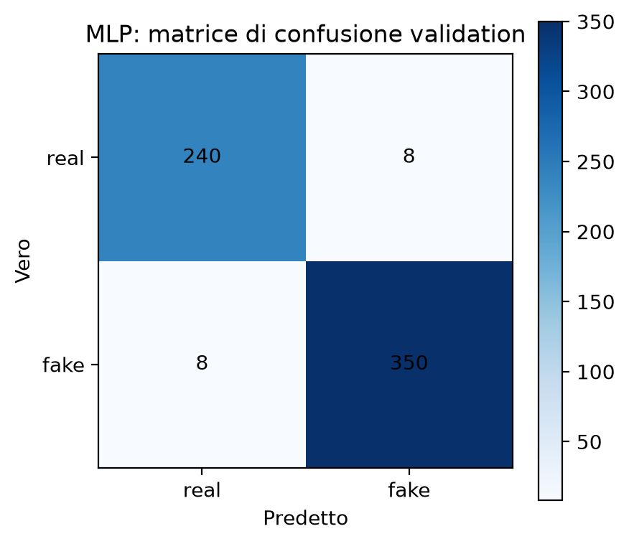
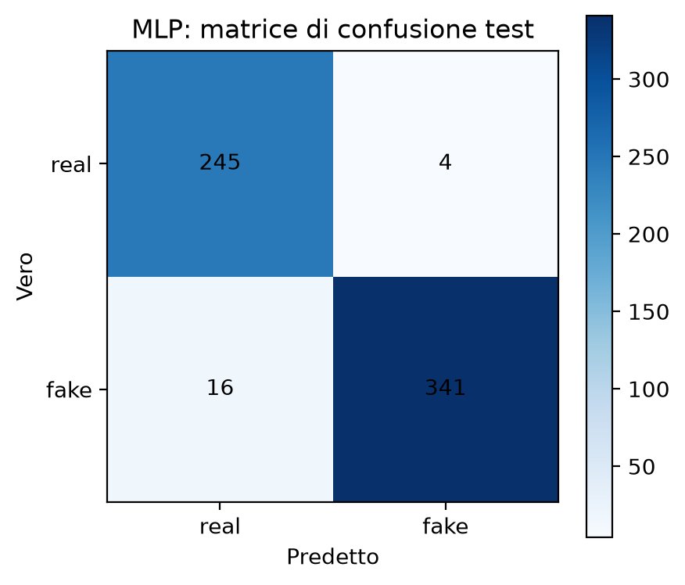
MLP – Confusion Matrices

Slide 14
CNN Spatial Head - Architecture
1
3 X Residual Block
Channel Attention
Input
Initial Block
Residual
Adaptive AvgPool2D
(128, 1, 1)
Feature Map Normalizzata
(1280, 16, 16)
Conv1x1
1280 → 128
Conv3x3
128 → 128
Conv1x1
128 → 128
(128, 16, 16)
Conv1x1
128 → 16
+
GELU
GroupNorm⁵
GroupNorm
GroupNorm
GELU
GELU
GELU
GELU
Conv1x1
16 → 128
Sigmoid
FFNN Classifier
Adaptive
AvgPool2D
Sigmoid
Dropout 0.30
Linear
256 → 60
Concatenate
(256 values)
Modulation
(Element-wise multiply)
Inference only
Adaptive
MaxPool2D
(128, 16, 16)
Logit Loss
Linear
64 → 1
GELU
⁵Used GroupNorm for memory saving purposes. It normalizes each example one at the time instead of BatchNorm that normalizes a batch of examples. GroupNorm, after Conv1x1 divides a single example (128, 16, 16) into 8 groups of (16, 16, 16) and normalizes each of them.

Slide 15
CNN Spatial Head
2
3 X Residual Block
Channel Attention
Input
Initial Block
Residual
Adaptive AvgPool2D
(128, 1, 1)
Feature Map Normalizzata
(1280, 16, 16)
Conv1x1
1280 → 128
Conv3x3
128 → 128
Conv1x1
128 → 128
(128, 16, 16)
Conv1x1
128 → 16
+
GELU
GroupNorm
GroupNorm
GroupNorm
GELU
GELU
GELU
GELU
Conv1x1
16 → 128
Sigmoid
FFNN Classifier
Adaptive
AvgPool2D
Sigmoid
Dropout 0.30
Linear
256 → 60
Concatenate
(256 values)
Modulation
(Element-wise multiply)
Inference only
Adaptive
MaxPool2D
(128, 16, 16)
Logit Loss
Linear
64 → 1
GELU
Initial Block: Projection in a more compact feature space.
Channel compression (1280 → 128) Conv1x1
GroupNorm stabilizes the distributions
GELU allows non-linear transformations
GroupNorm normalizes each example independelty. Used because the batch is small due to limited computational capabilites.

Slide 16
CNN Spatial Head
3
3 X Residual Block
Channel Attention
Input
Initial Block
Residual
Adaptive AvgPool2D
(128, 1, 1)
Feature Map Normalizzata
(1280, 16, 16)
Conv1x1
1280 → 128
Conv3x3
128 → 128
Conv1x1
128 → 128
(128, 16, 16)
Conv1x1
128 → 16
+
GELU
GroupNorm
GroupNorm
GroupNorm
GELU
GELU
GELU
GELU
Conv1x1
16 → 128
Sigmoid
FFNN Classifier
Adaptive
AvgPool2D
Sigmoid
Dropout 0.30
Linear
256 → 60
Concatenate
(256 values)
Modulation
(Element-wise multiply)
Inference only
Adaptive
MaxPool2D
(128, 16, 16)
Logit Loss
Linear
64 → 1
GELU
3 X Residual Blocks (cascade):
DepthwiseConv3x3 extracts patterns indepentently for every channel (less computations).
PointwiseConv1x1 Combines the previously obtained patterns .
Residual:
H(x) = F(x) + x
Skip connection brings x directly. No need of projection.

Slide 17
CNN Spatial Head
4
3 X Residual Block
Channel Attention
Input
Initial Block
Residual
Adaptive AvgPool2D
(128, 1, 1)
Feature Map Normalizzata
(1280, 16, 16)
Conv1x1
1280 → 128
Conv3x3
128 → 128
Conv1x1
128 → 128
(128, 16, 16)
Conv1x1
128 → 16
+
GELU
GroupNorm
GroupNorm
GroupNorm
GELU
GELU
GELU
GELU
Conv1x1
16 → 128
Sigmoid
FFNN Classifier
Adaptive
AvgPool2D
Sigmoid
Dropout 0.30
Linear
256 → 60
Concatenate
(256 values)
Modulation
(Element-wise multiply)
Inference only
Adaptive
MaxPool2D
(128, 16, 16)
Logit Loss
Linear
64 → 1
GELU
Channel Attention:
Adaptive AvgPool2D computes mean of the 16 channels.
The two Conv1x1 work as bottlenecks, dimensionality reduction.
Sigmoid produces a weight for each channel
Multiplication applies the weights at each channel
Attenuates useless channels.
Keeps more informative channels.
Uses global context of the feature map to weight the channels.

Slide 18
CNN Spatial Head
5
3 X Residual Block
Channel Attention
Input
Initial Block
Residual
Adaptive AvgPool2D
(128, 1, 1)
Feature Map Normalizzata
(1280, 16, 16)
Conv1x1
1280 → 128
Conv3x3
128 → 128
Conv1x1
128 → 128
(128, 16, 16)
Conv1x1
128 → 16
+
GELU
GroupNorm
GroupNorm
GroupNorm
GELU
GELU
GELU
GELU
Conv1x1
16 → 128
Sigmoid
FFNN Classifier
Adaptive
AvgPool2D
Sigmoid
Dropout 0.30
Linear
256 → 60
Concatenate
(256 values)
Modulation
(Element-wise multiply)
Inference only
Adaptive
MaxPool2D
(128, 16, 16)
Logit Loss
Linear
64 → 1
GELU
Adaptive AvgPool2D computes the mean of each channel
Adaptive MaxPool2D takes the highest activation of each channel
A feature can be useful if it is widespread over the feature map or because it is high in a specific point.

Slide 19
CNN Spatial Head
6
3 X Residual Block
Channel Attention
Input
Initial Block
Residual
Adaptive AvgPool2D
(128, 1, 1)
Feature Map Normalizzata
(1280, 16, 16)
Conv1x1
1280 → 128
Conv3x3
128 → 128
Conv1x1
128 → 128
(128, 16, 16)
Conv1x1
128 → 16
+
GELU
GroupNorm
GroupNorm
GroupNorm
GELU
GELU
GELU
GELU
Conv1x1
16 → 128
Sigmoid
FFNN Classifier
Adaptive
AvgPool2D
Sigmoid
Dropout 0.30
Linear
256 → 60
Concatenate
(256 values)
Modulation
(Element-wise multiply)
Inference only
Adaptive
MaxPool2D
(128, 16, 16)
Logit Loss
Linear
64 → 1
GELU
Classification Head
First Linear layer combines the global extracted features from the channels.
The last Linear layer produces a single logit and since it is not yet a probability, we apply Sigmoid

Slide 20
CNN Spatial Head - Training 7
Logit
Prepocessing
Splitted Dataset
Stratified KFold
Per-Channel Normalization
(only Train split)
CNN Forward pass
BCEWithLogit Loss
CNN Backward pass
+
Gradient clipping
+
AdamW
epoch++
Final Evaluation on test set
Choosing threshold based on Validation split
Early Stopping
+
Best checkpoint
Valutation on Validation split
$${BCEWithLogitsLoss}^{6}=−\frac{1}{N}\sum_{i=1}^{N}{\left[yi\log\left(\frac{1}{1+ e^{−z}}\right)+\left(1 −yi\right)\log\left(1−\frac{1}{1+ e^{−z}}\right)\right]}$$
⁶ BCEWithLogitLoss is the standard Binary Cross Entropy Loss applied directly to logits, the raw output scores of the model before the sigmoid. It has the sigmoid inside and not as an additional block in the model.

Slide 21
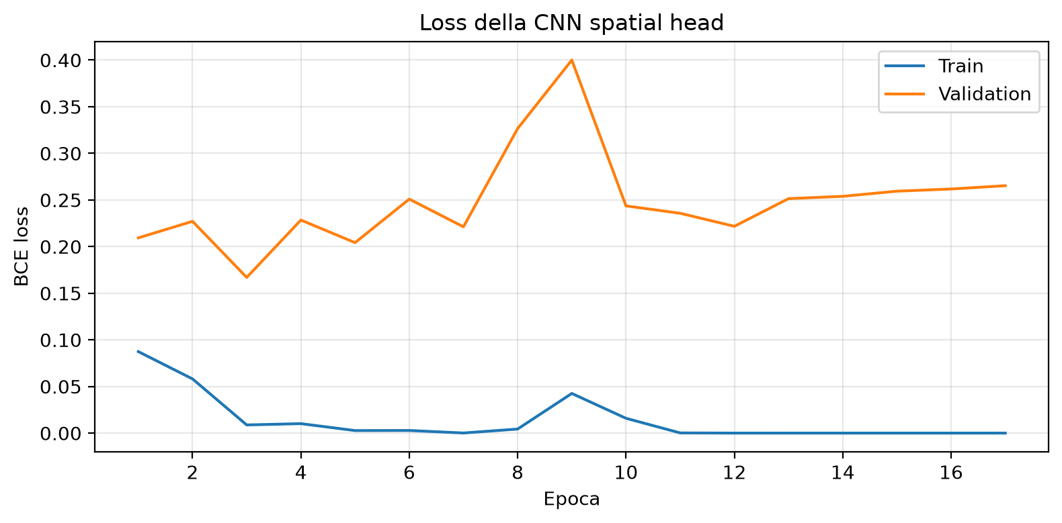
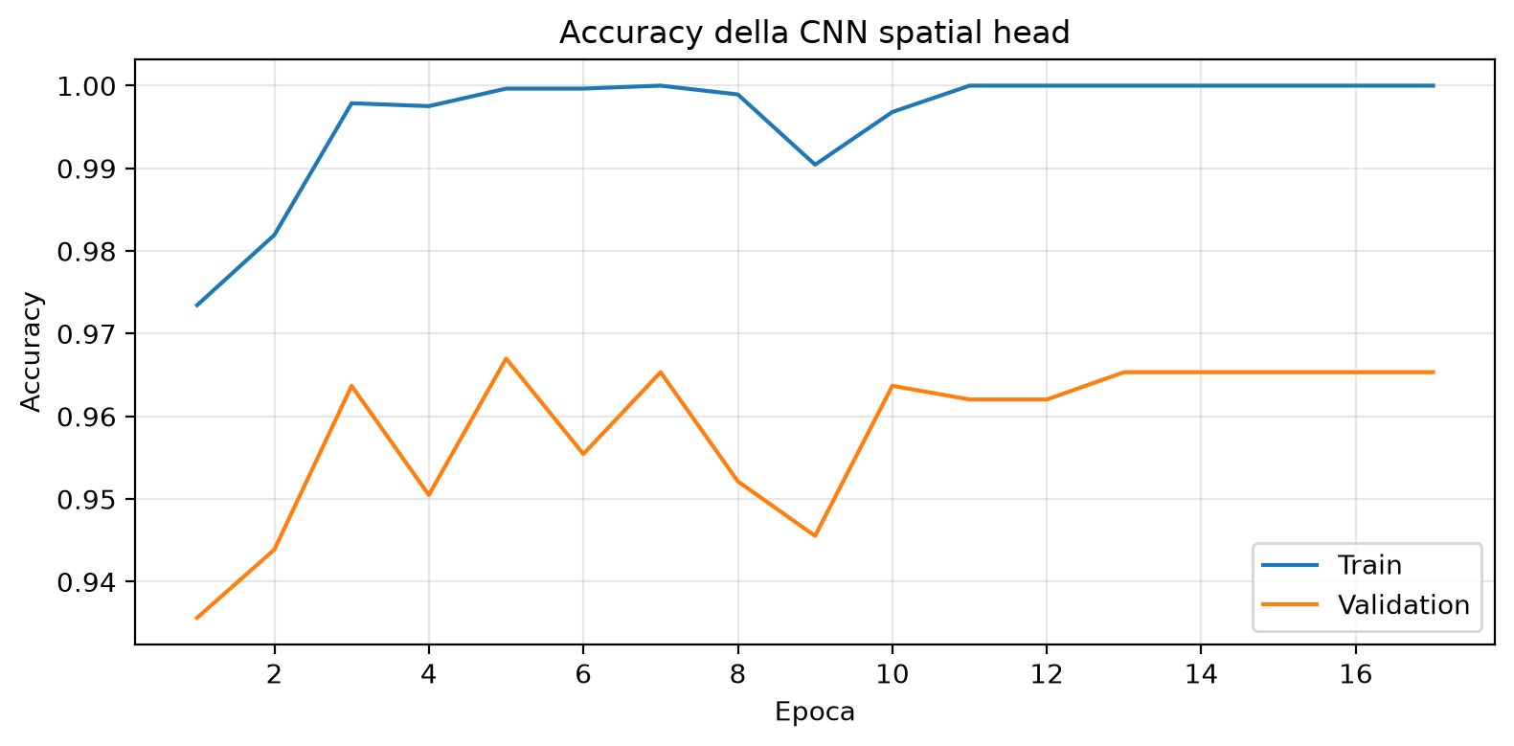
CNN Spatial Head - Results 8
Split | N samples | Loss | Accuracy | Balanced accuracy | Precision | Recall | F1 | ROC-AUC | PR-AUC
Train | 2825 | 0.0027 | 0.99 | 0.99 | 0.99 | 1.00 | 0.99 | 1.00 | 1.00
Validation | 606 | 0.20 | 0.97 | 0.97 | 0.96 | 0.98 | 0.97 | 0.99 | 0.99
Test | 606 | 0.13 | 0.96 | 0.96 | 0.98 | 0.96 | 0.97 | 0.99 | 0.99

Slide 22
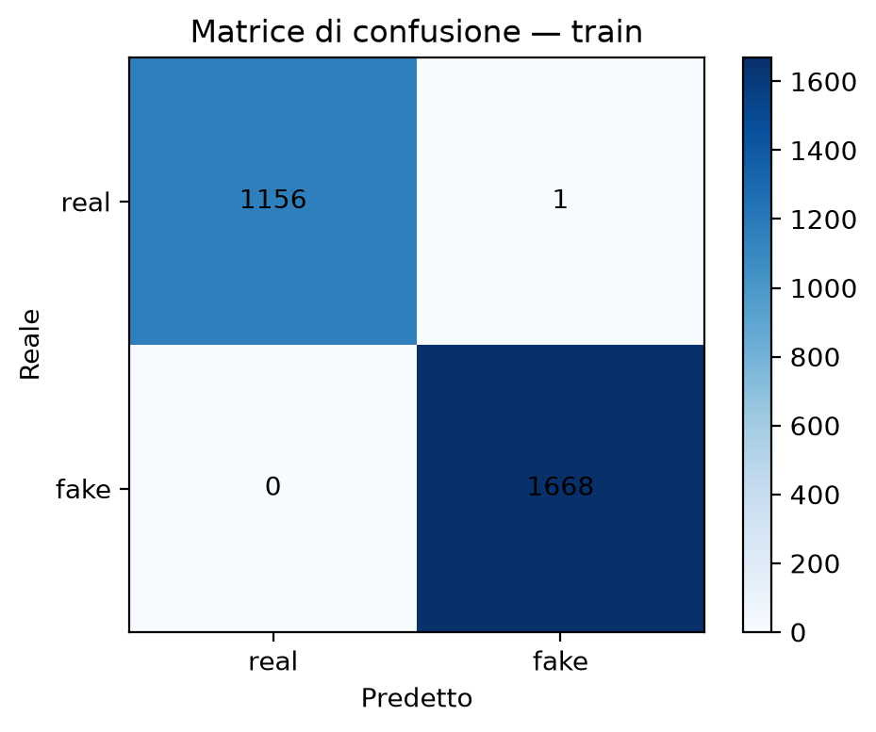
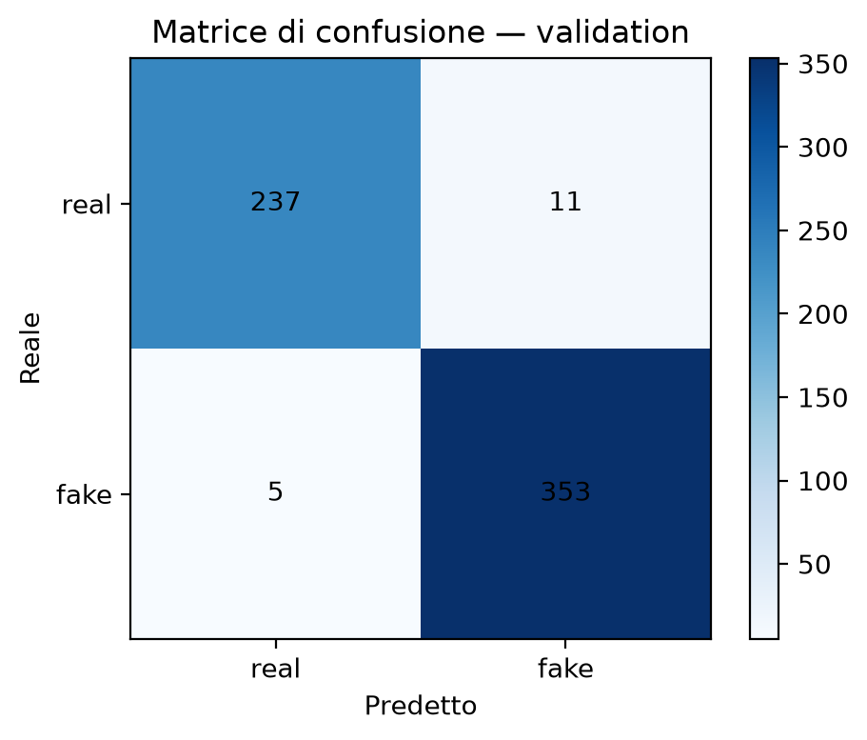
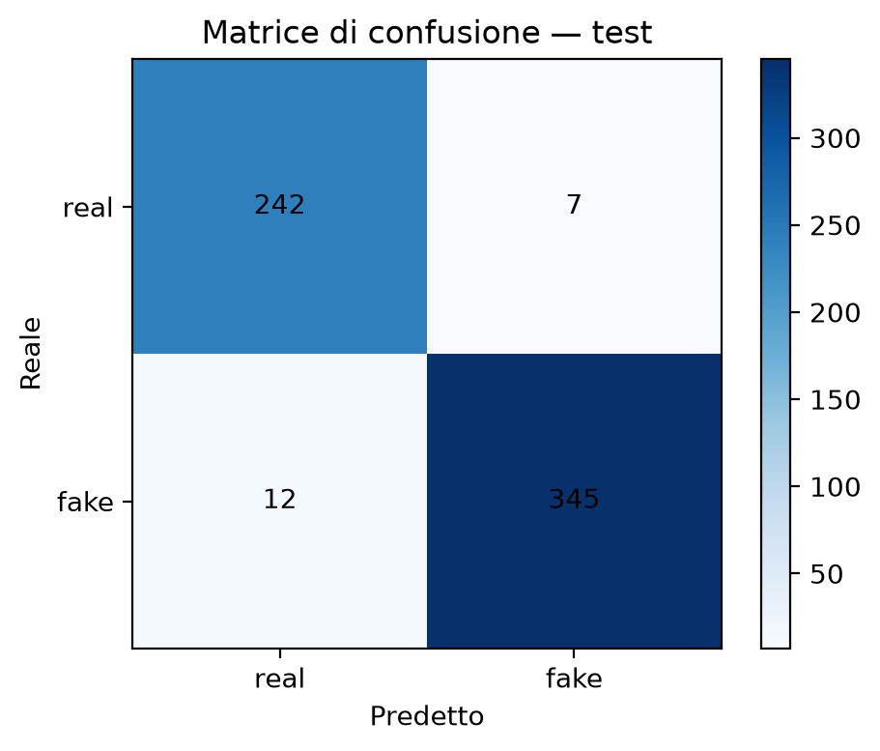
CNN Spatial Head – Confusion Matrices 9

Slide 23
ConvNeXt - Architecture
Prepocessing
Stage 1
Downsample
Normalized Input
1280 x 16 x 16
Conv1x1
1280 → 256
LayerNorm2d
3 X ConvNeXt blocks
256 channels, 16x16
LayerNorm2d + Conv2x2, stride2
256 → 384, 8x8
Stage 3
Downsample
Stage 2
2 X ConvNeXt blocks
512 channels, 4x4
LayerNorm2d + Conv2x2, stride2
384 → 512, 4x4
3 X ConvNeXt blocks
384 channels, 8x8
Classification Head
LayerNorm2d → GlobalAveragePooling
Dropout 0.30 → Linear 512 → 1 logit
ConvNeXt Block
DepthWise
Conv7x7
LayerNorm
3 X MLP
+
GELU
Layer Scaling
Stochastic Depth
About 8.66 M learnable parameters in total

Slide 24
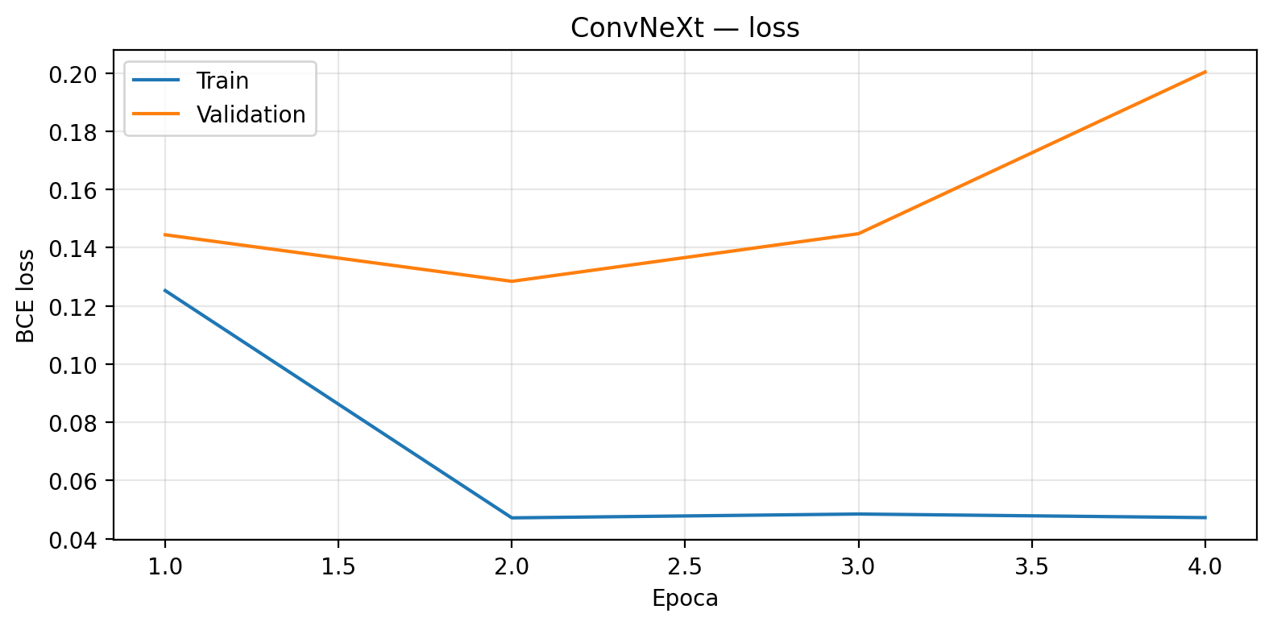
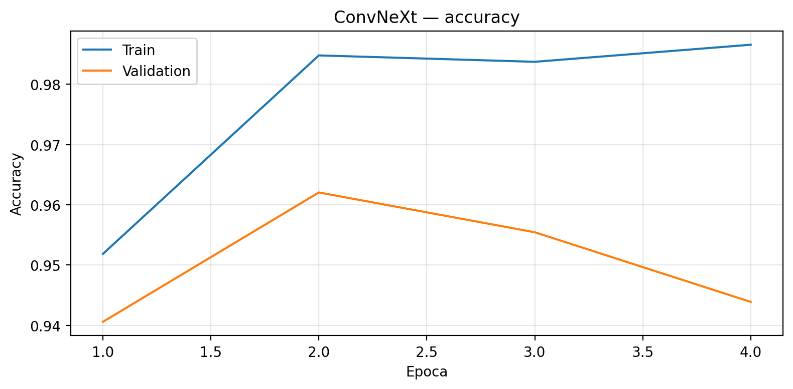
ConvNeXt – Training
Training
Preprocessing
Splitted Dataset
Stratified KFold
Normalization
(mean and std for every channel)
BCEWithLogitLoss
Warm up: 5 epochs
Cosine decay
Gradient Accumulation
Gradient clipping
Batch size =32
AdamW * LR 3e-4
Best epoch = 2
Validation
Balanced Accuracy
Best Checkpoint
Early Stopping
Test Evaluation

Slide 25
ConvNeXt – Training Results
Training
Preprocessing
Splitted Dataset
Stratified KFold
Normalization
(mean and std for every channel)
BCEWithLogitLoss
Warm up: 5 epochs
Cosine decay
Gradient Accumulation
Gradient clipping
Batch size =32
AdamW * LR 3e-4
Best epoch = 2
Validation
Balanced Accuracy
Best Checkpoint
Early Stopping
Test Evaluation
Split | N samples | Loss | Accuracy | Balanced accuracy | Precision | Recall | F1 | ROC-AUC | PR-AUC
Train | 2825 | 0.0472 | 0.98 | 0.98 | 0.99 | 0.98 | 0.98 | 0.99 | 0.99
Validation | 606 | 0.1284 | 0.96 | 0.96 | 0.96 | 0.96 | 0.96 | 0.98 | 0.99
Test | 606 | 0.1056 | 0.95 | 0.95 | 0.97 | 0.94 | 0.96 | 0.99 | 0.99

Slide 26



ConvNeXt – Confusion Matrices

Slide 27
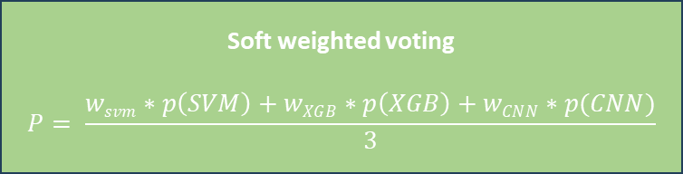
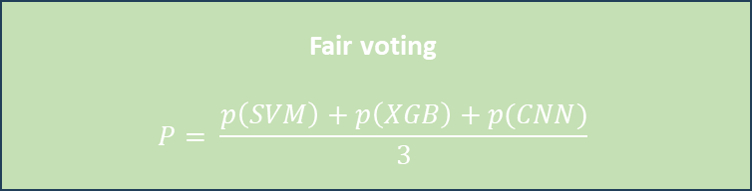
Ensemble - Architecture
2 Voting Systems compared
Ensemble*
Fair voting
$$P= \frac{p\left(SVM\right)+p\left(XGB\right)+p(CNN)}{3}$$
SVM RBF
Splitted Dataset
Stratified KFold
XGBoost
Soft weighted voting
$$P= \frac{wsvm∗p\left(SVM\right)+wXGB∗p\left(XGB\right)+wCNN∗p(CNN)}{3}$$
CNN Spatial Head
Comparing the 2 voting systems on the validation set
(Balanced Accuracy)
Comparison on Test Split
Best Ensemble performer
Soft weighted voting won!
ConvNext
*The Ensemble is composed by the 3 already trained and best performing models seen previoulsy.

Slide 28
Ensemble – Comparison Results
Ensemble, soft weighted voting
Split | N samples | Loss | Accuracy | Balanced accuracy | Precision | Recall | F1 | ROC-AUC | PR-AUC
Test | 606 | X | 0.96 | 0.97 | 0.99 | 0.95 | 0.97 | 0.99 | 0.99
ConvNeXt
Split | N samples | Loss | Accuracy | Balanced accuracy | Precision | Recall | F1 | ROC-AUC | PR-AUC
Test | 606 | 0.1056 | 0.95 | 0.95 | 0.97 | 0.94 | 0.96 | 0.99 | 0.99

Slide 29
Conclusions
Performances between ensemble and ConvNeXt are comparable because all the models are evaluated on the same test split.
Ensemble
ConvNeXt
SVM, XGBoost, CNN are trained on personal machine, less computational requirements.
Must handle 3 different models.
ConNeXt is trained on external machine with a more powerful GPU. More computational power required.
Only one model to handle.

Slide 30
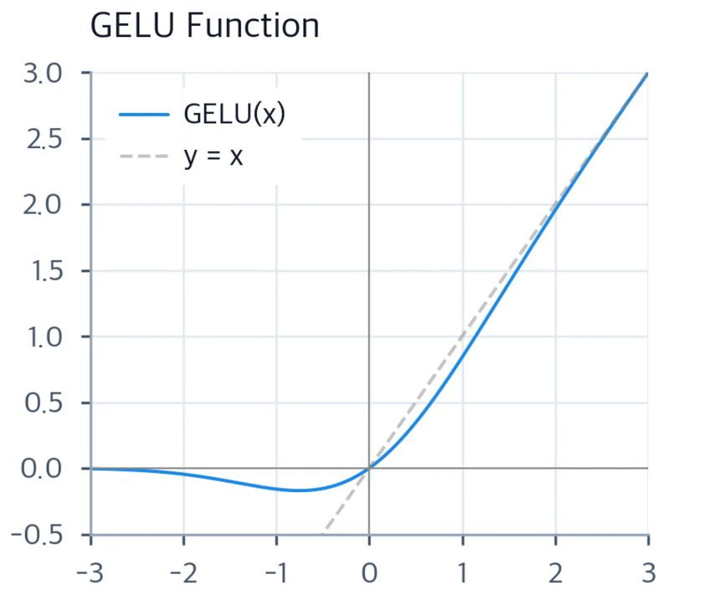
GELU activation function
(Gaussian Error Linear Unit)
While ReLU sets all negative values to zero, GELU allows small negative values to pass through gradually, so small inputs can still contribute to the output.
GELU smoothly weights each input by its probability of being positive under a Gaussian distribution.

Slide 31

AdamW optimizer
Is an adaptive optimizer. For every parameters it tracks
  Mean of past gradients (the average update direction).
  Squared mean of past gradients (when the gradient changes).
Every parameters receives a custom learning rate.
Weight decay is applied at every step slightly reducing the weights.
$$θ←\left(1−ηλ\right)θ−\text{AdamUpdate}$$
$$η learning rate \\ λ decay coefficient$$

