Slide 1



SMART INDIA HACKATHON 2024
Problem Statement ID – 1741
Problem Statement Title- Centralized application-context aware firewall
Theme- Blockchain & Cybersecurity
PS Category- Software
Team ID: K24030
Team Name : Night’s Watch

Slide 2
Proposed Solution
What?
To create a lightweight agent s/w and an endpoint firewall server with a centralized dashboard featuring context-aware dynamic firewall policies/rule generation using Retrieval Augmented Generation with a Large Language Model. The Lightweight agent software running as a service on every endpoint of the organization enforces firewall policies received from the firewall and blocks anomalous network events with specialized machine learning model continuously improved with historical network data and Cyber Threat Intelligence.
How?
Extensive endpoint monitoring using custom built Go-based metrics, event logs and traffic collector which forwards them to the centralized firewall.
Responsive go-based EDR agent with advanced application level firewall policy enforcing capabilities utilizing the Windows API.
Intelligent automation of SOC operations powered by LLM agents
Features:
Application level granular firewall policies utilizing Windows API for:
  Denying internet access/ specific established connections.
  Port, Protocol blocking
Application level network monitoring features on each endpoint such as:
  Hosts (Domains/IPs) that are communicating with the application
  Traffic type composition with bandwidth metrics for each application on every endpoint
  Country-wise traffic flow details
Alerts pushed to the administrator if any anomaly is detected in the network with a smart report consisting of:
  Timestamp, severity score and the application that behaves anomalous and endpoint details like external IP, country of origin etc.,
  Smart Response details based on MITRE ATT&CK
Firewall supports effortless migration process as it utilizes containerization.
Novelties
Retrieval Augmented Generation and Enforcement of dynamic firewall policies based on network-context from historical data utilizing a fine-tuned LLM model.
Integration of open-source CTI feeds from sources like CVE , AlienVault, MISP, NIST, etc., into the firewall’s database dynamically for instant detection and response for brand-new threats.
Ensemble Model continuously trained on historical network data for real-time anomaly detection and responding to them with higher accuracy.

Slide 3
Technical Approach
Dataset | Description | Number of features
CSECIC-IDS2018 | The dataset includes network logs from different attack scenarios Brute-force, Heartbleed, Botnet, DoS, DDoS, Web attacks, and infiltration of the network from inside. | 80
ISCX-Botnet-2014 | Botnet traffic generated by the Malware Capture Facility Project, a research project with the purpose of generating and capturing botnet traces in long term. | 19
CIC-UNSW-NB15 | Usage of IXIA perfectstorm tool to capture 100GBs of network traffic in two days, and to extract features from the captured network traffic, they used Argus and Bro-IDS tools. | 47
PerimeterX TestBed Dataset | Custom made network dataset generated from testbed sandboxes with recent network-based malware families. | 50

Slide 4
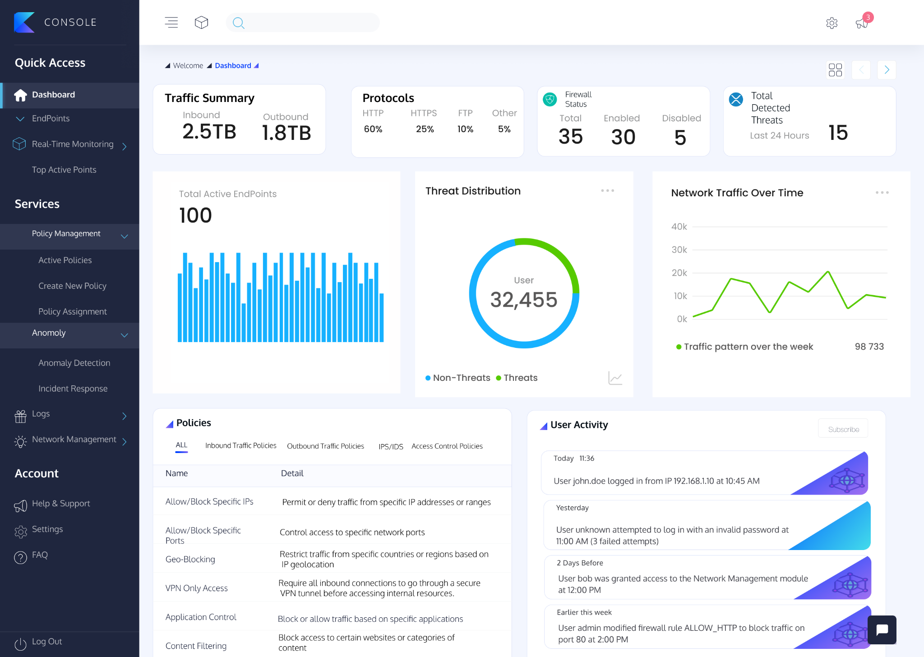
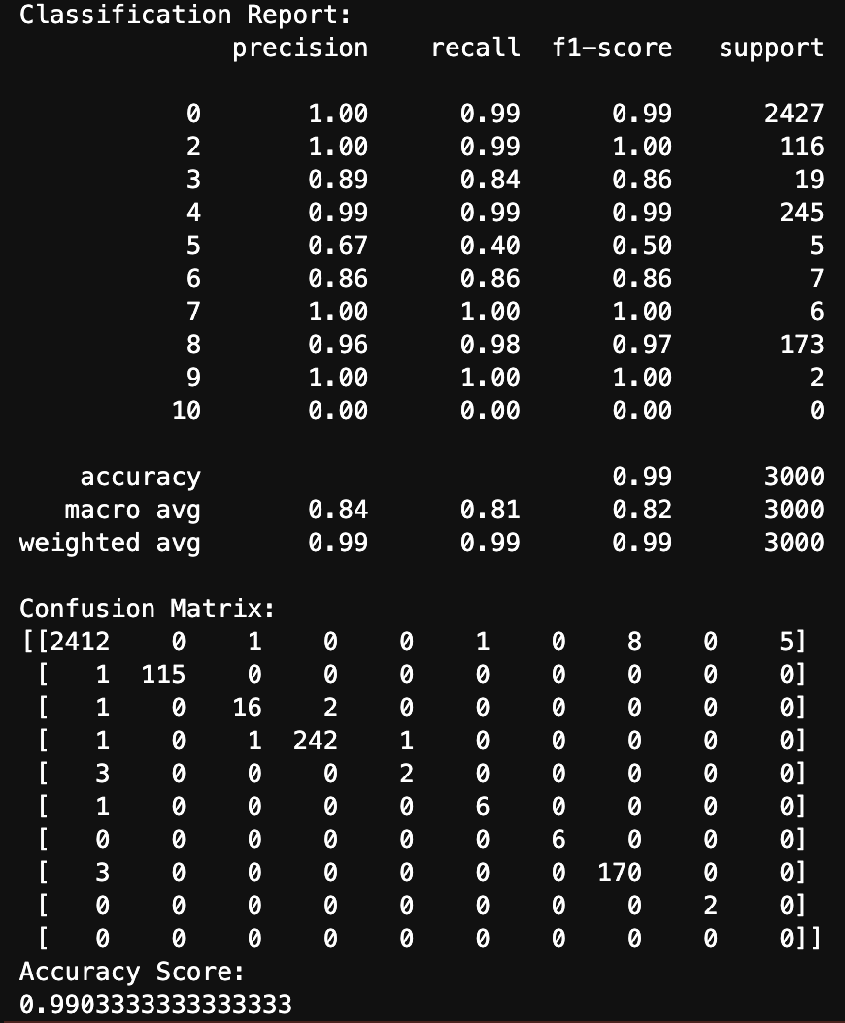
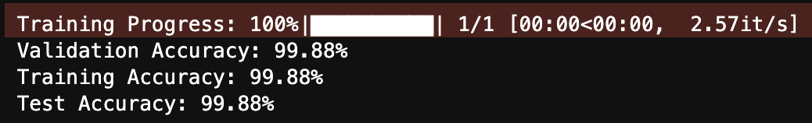
Feasibility And Viability
Training of Ensemble Model
Technology Stack
Endpoint Agent:Go
Windows API
Centralized Dashboard:
Front-End: React.js
Back-End: Django Rest Framework
Monitoring: Grafana, Prometheus
Database:
Network logs database: InfluxDB
Firewall database: Postgresql
Vector database for RAG: Milvus
Prototype Developed
Web Console
Feasibility
Integration of open-source libraries.
Compatible with MITRE ATT&CK framework
Follows CERT-In Guidelines
Interoperability with Existing SIEMs in the organization.
Modular code development with Agile Methodology
Low Resource Footprint
Customizability and automation friendly to the core.
Training of Naive Bayes Model
Video Link
Youtube: https://youtu.be/b7d6aRaLzPo

Slide 5
Impact And Benefits
Impacts
Utilizing network context to adaptively generate firewall rules would enable organization to respond to evolving sophisticated threats.
Incorporating open-source CTI feeds into this framework allows for real-time security updates.
Utilizing an ensemble model for continuous training on historical network data significantly boosts anomaly detection accuracy, facilitating quicker and more precise responses to network anomalies.
Benefits
The endpoint firewall provides data sovereignty as it is entirely on-premises and not cloud-native.
More cost effective than other products in the market.
  K7 On-premises EPS: ₹600/endpoint
  CrowdStrike Falcon: ₹800/endpoint
  SentinelOne Singularity Complete: ₹3,500/endpoint (Purple AI)
Features that are not in K7 On-premises EPS but in PerimeterX:
  Application-wise traffic monitoring
  Constant CTI integration
  LLM agent based policy/rule generation
Offers more granular controls over the system than Windows Local Firewall
Firewall supports effortless migration process as it utilizes container-based deployment.
K7 On-premises EPS | PerimeterX Endpoint firewall
Lack of dynamic CTI Integration | Dynamic 24/7 CTI Integration
Lack of Application-wise traffic monitoring on each endpoint | Extensive Traffic monitoring on each endpoint with features like: Application-wise traffic monitoring Country-wise traffic flow details Hosts (Domains/IPs) that are communicating with the endpoint
Lack of extensive gen-AI features | Use of LLMs in Dynamic rule generation based on context provided by the user/network Retrieval of logs based on user’s context
The endpoint firewall solution can benefit:
  National organizations, Financial Institutions, Banks, Hospitals who have huge concern over data privacy.
    No involvement of cloud thus maintaining data sovereignty.
    Localized integration of threat intel from various feeds like AlienVault OTX.
    Transparent architecture.
  SMBs and Startups
    Reduced installation and operational costs.
    Solution adapts itself to the network environment with minimal manual intervention.
  Schools, Colleges and Universities
    Advanced surveillance capabilities such as browsing history analysis.
    Enforcing censorship such as maintaining blocklist of websites.
  Manufacturing companies with SCADA/ICS/OT products (Unix)
    Monitoring and regulation of industrial traffic with the help of CTI.
    Protocol specific CTI Integration (Eg. ModBus CVE-2024-7567) for SCADA/ICS/OT products
  SOC Teams:
    Network traffic heatmap for the organization in 2D.
    Windows event log deep tracing abilities.
    Automated logging and report generation features help maintain deep records of all network activity.
Infected systems can be attended by:
  Immediate alerts with severity score to the web console on malicious behaviour of the endpoints.
  Quarantine/Self-heal features to immediately isolate node from other parts of the network from self replicable malware.
Reduced manual policy updates as the firewall leverages self-learning policies, automatically adjusting rules based on real-time traffic analysis and evolving threat data.
The firewall leverages the MITRE ATT&CK framework to map detected threats against known adversary TTPs.

Slide 6
Research And References
Papers referenced:
  Employing LLMs for Incident Response Planning and Review, Sam Hays, Jules White
  Large Language Models for Networking: Workflow, Advances and Challenges Chang Liu, Xiaohui Xie, Xinggong Zhang Senior Member, IEEE, Yong Cui, Member, IEEE
Blogs:
  https://lilianweng.github.io/posts/2023-06-23-agent/

