Slide 1
Content :
Data to be analyzed
Datasheet
Pivot table
Dashboard
Conclusion

Slide 2
Data to be analyzed: automobile theft in (2001-2010) India:
I got this data from https://data.gov.in.
In this data we got the name of every state and union territory of India , where their are 4 types of the vehicle which is stolen over past 10 years.
We are going to see where the most theft of vehicle occurred in the different time lapse .
Here we will even try to see how much have been tracked and recovered .
After seeking the result we would be even able to see how much police was active at different location at different lapse of the period .
Which vehicle is stolen the most in the different state at different time .

Slide 3
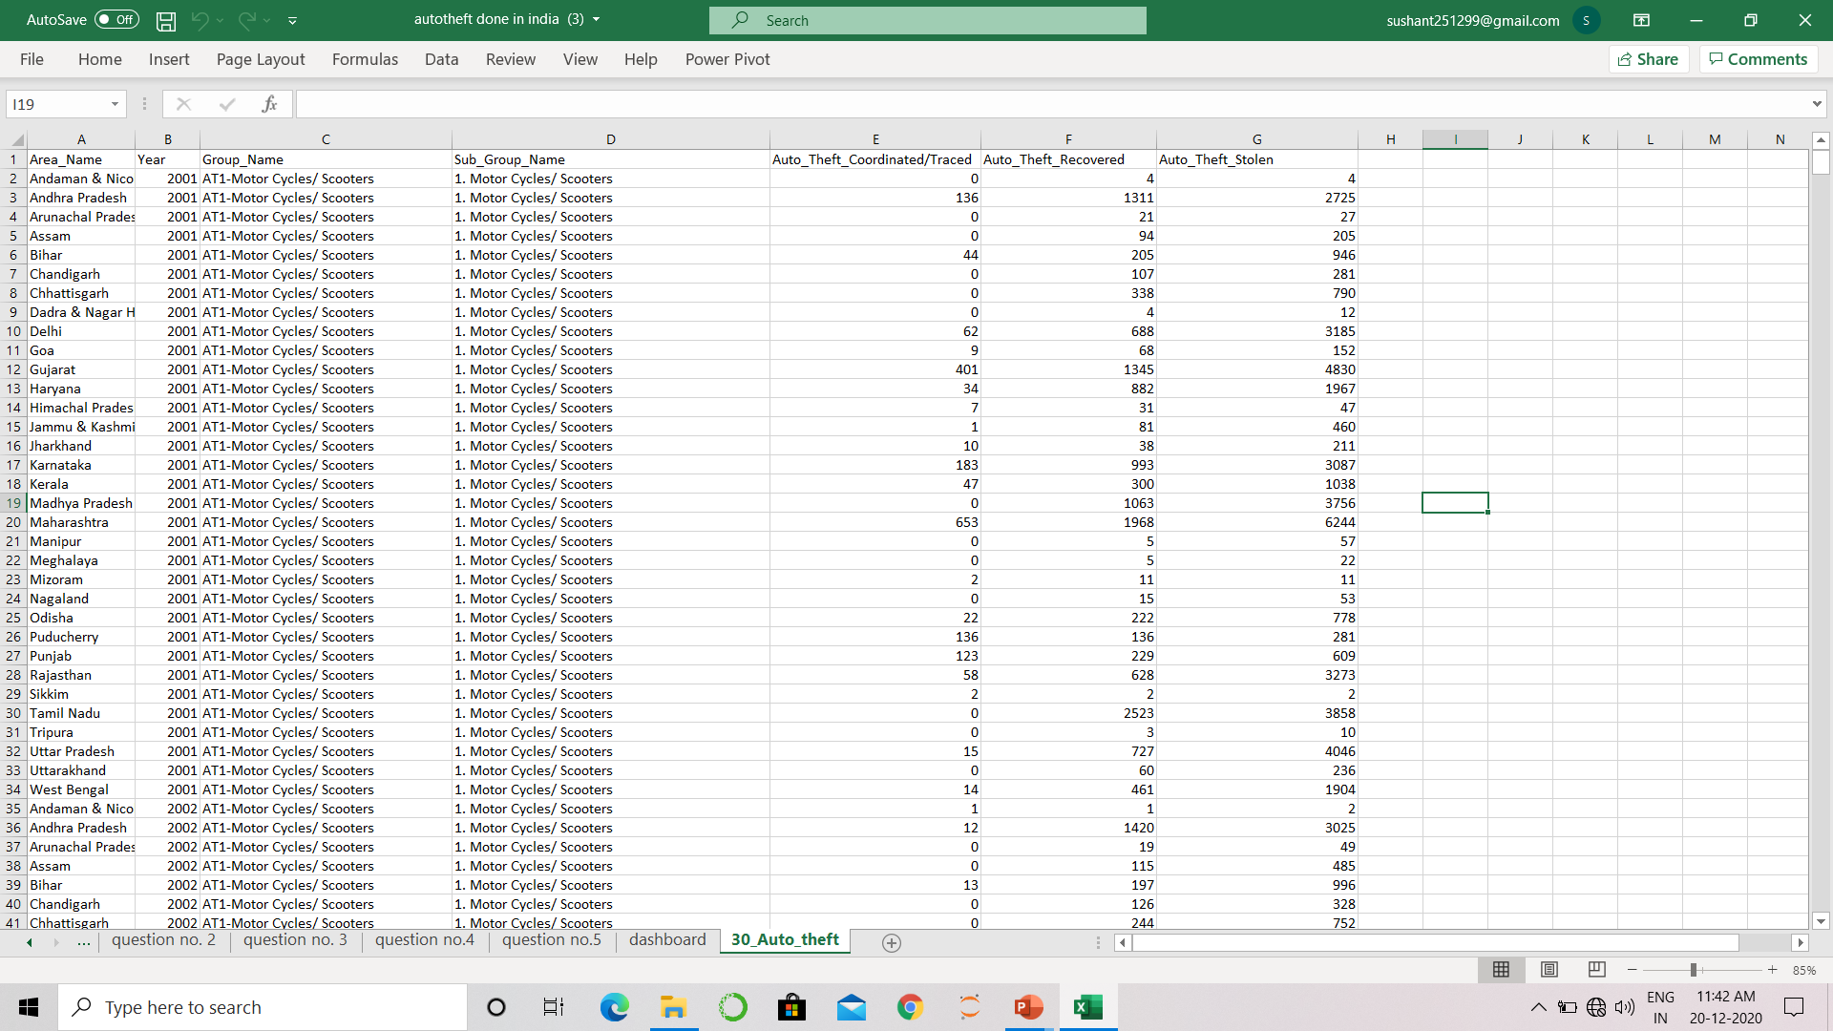
Datasheet:

Slide 4
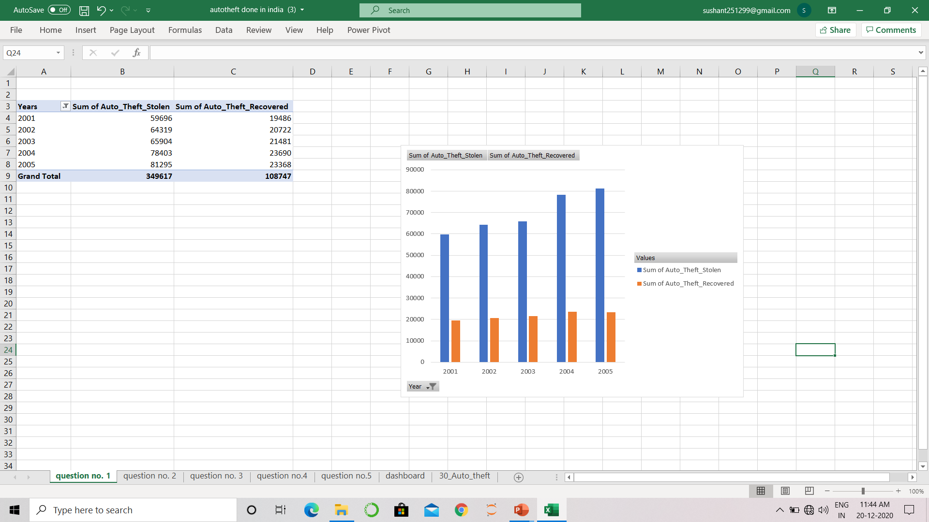
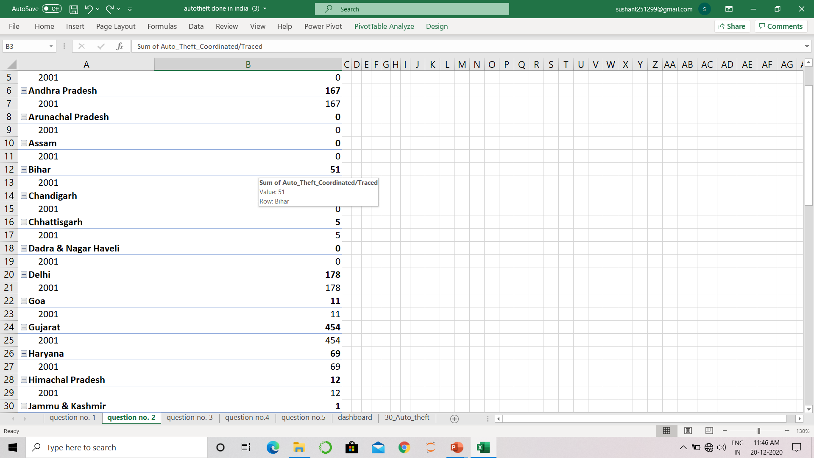
Pivot table on the data:

Slide 5
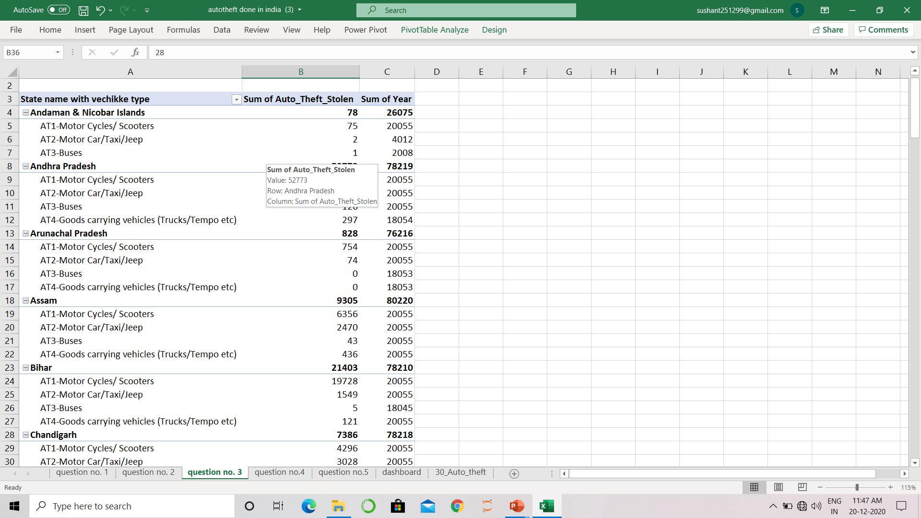
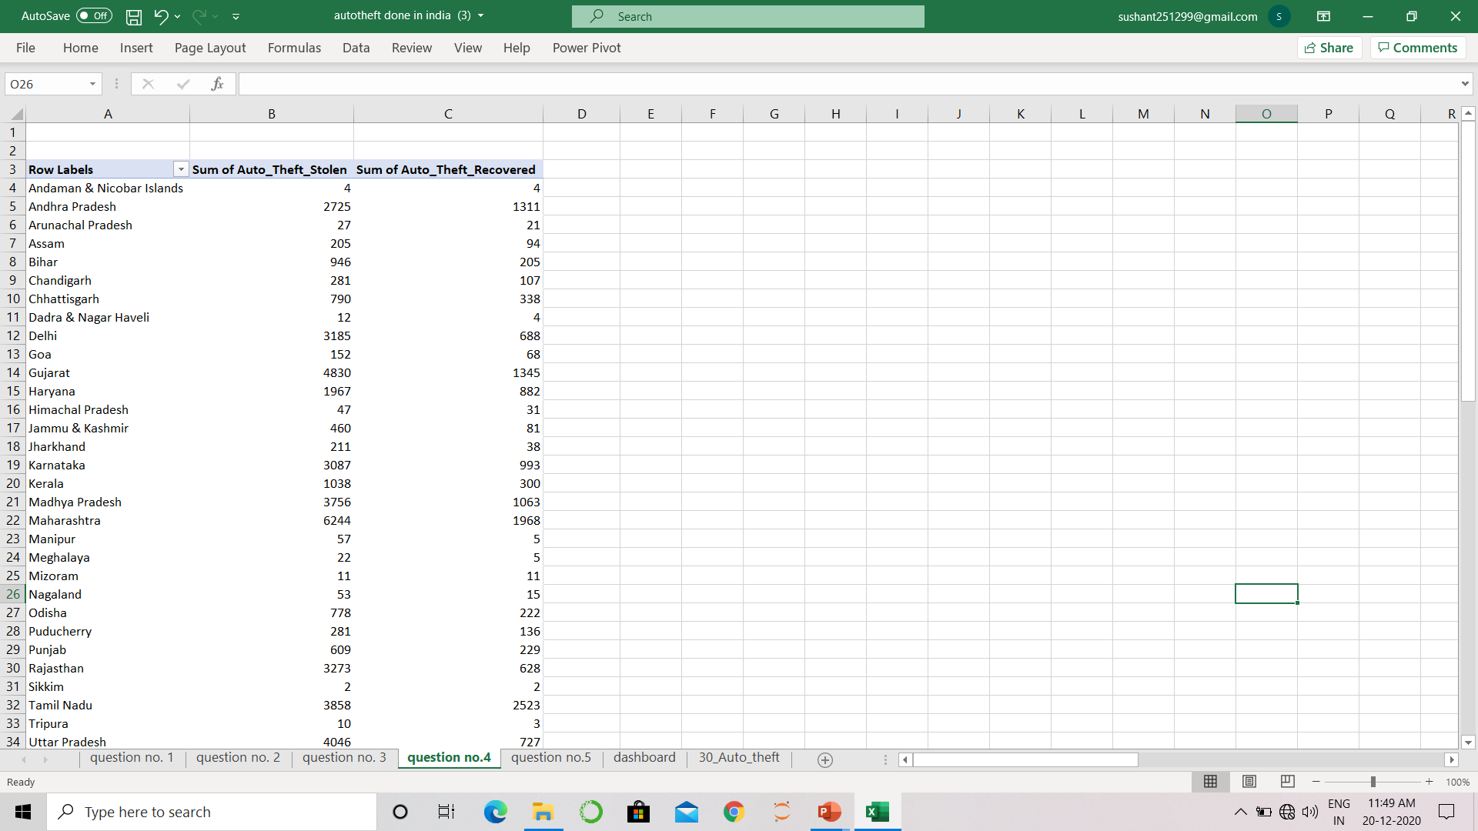
More pivot table

Slide 6
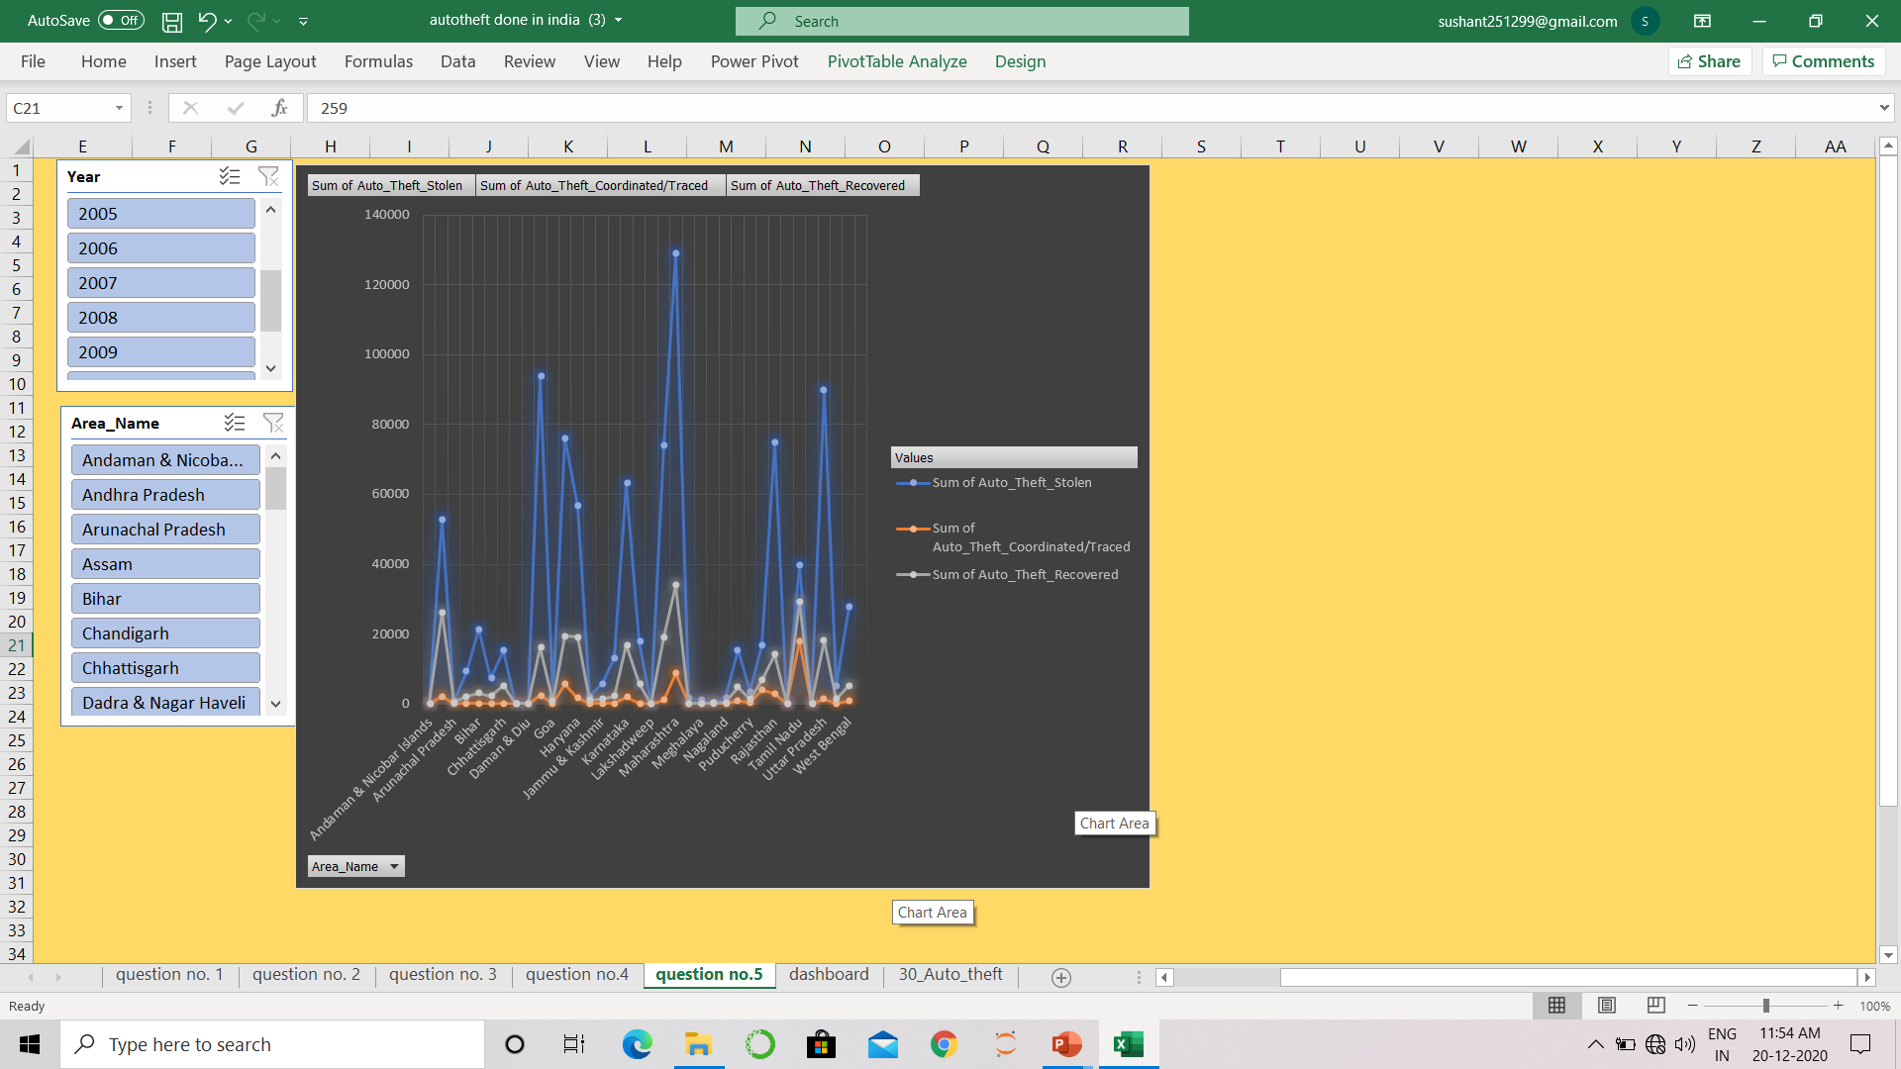
Dashboard:

Slide 7
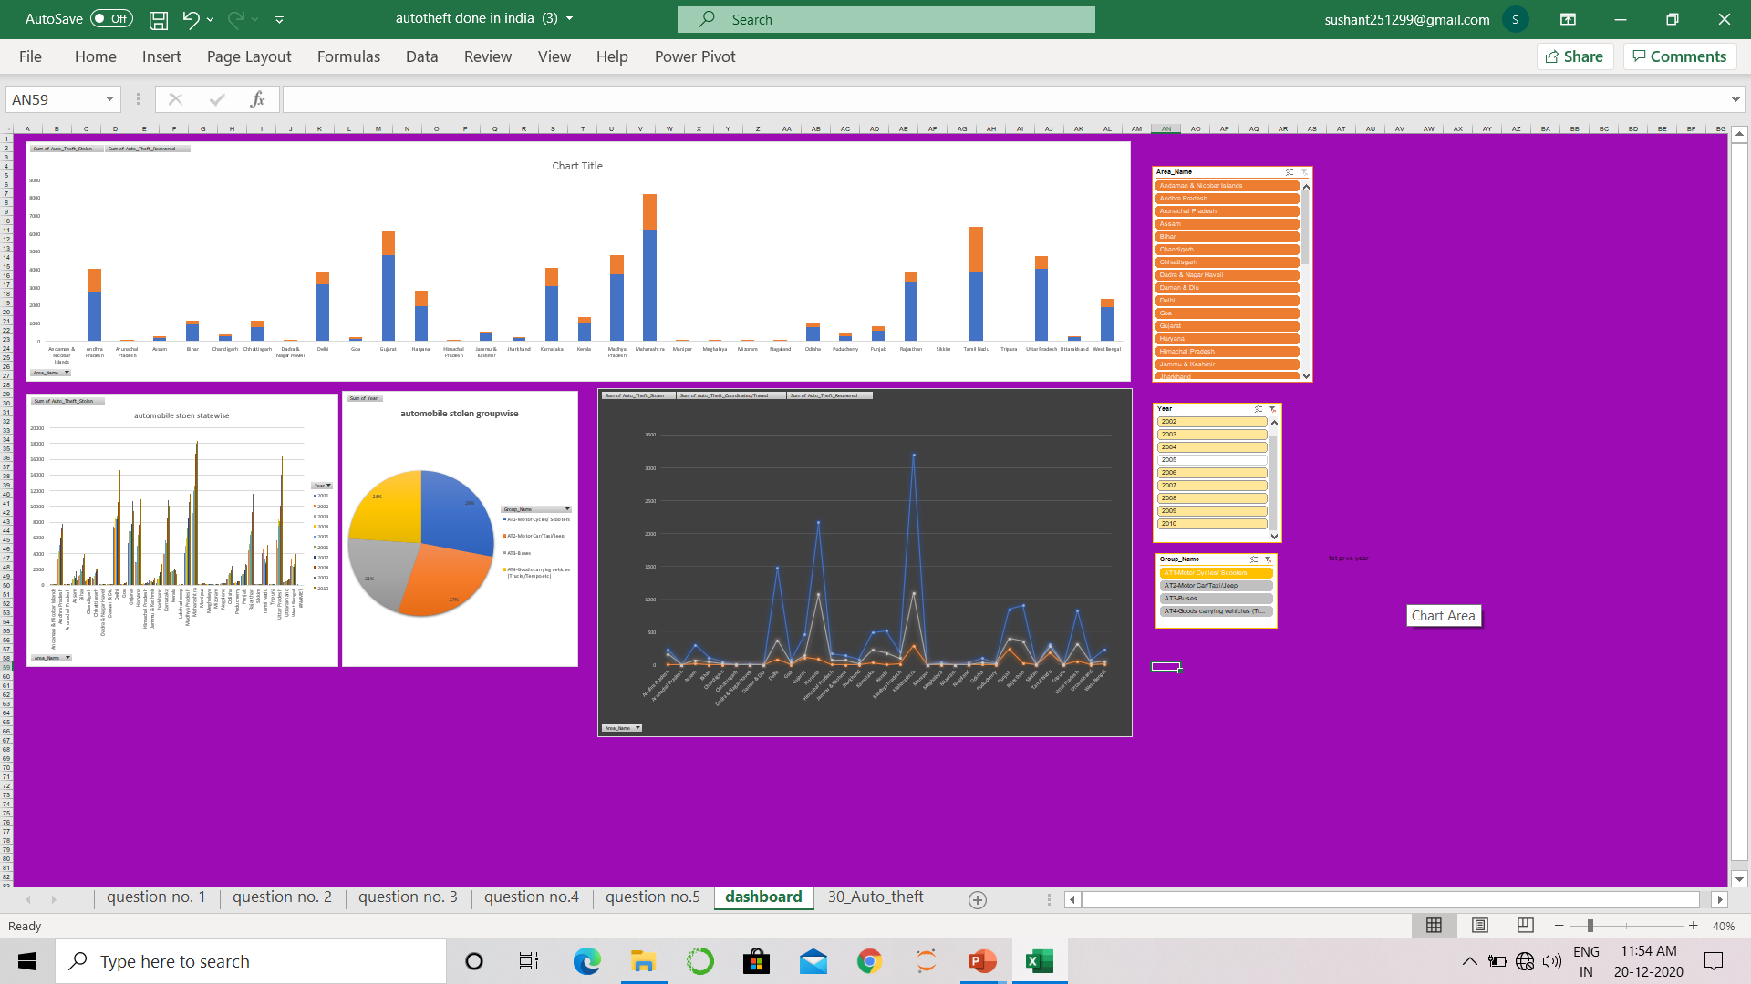
Dashboard

Slide 8
Conclusion :
After going through the data we found that the most no. of the vehicle stolen is from Maharashtra
Even the most no .of the vehicle recovered is from the Maharashtra
If we seen which state and union territory police is most active while (recovering: stolen) is Lakshadweep
when is comes to state is Tamil nadu
In Maharashtra 2010 maximum no. of the car stolen was recorded.

