Slide 1
Group 20
Diabetes Dataset
Felipe Flores - 1640618

Slide 2
Introduction
Why did I choose this data set?
Due to having a strong connection with this topic
What was my goal?
To see if certain features truly played an important role in someone being diabetic

Slide 3
What is the dataset?
Contains roughly more than 250,000 patients
Discussing whether or not they are diabetic.
As well as various health statistics regarding the patients.
In total there are 22 features in the dataset.
Examples of features:
Their physical health, diet regarding fruits and vegetables, heart diseases, and they are a smoker.

Slide 4
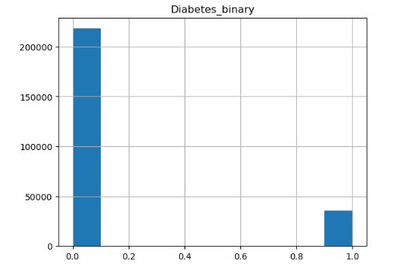
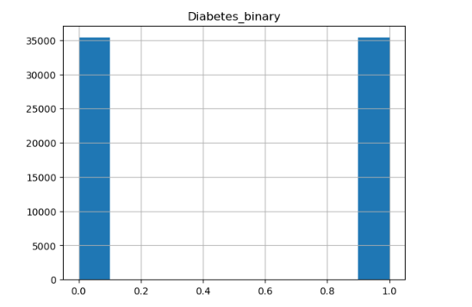
Preprocessing
The Data Set was severely unbalanced.
Undersampling was used to even out the data set.
The final set had 70,692 instances.

Slide 5
Different Feature Selection Methods Used
Correlation:
Selecting the features with the highest correlation to the target variable.
The Selected Features:
HighBP
HighChol
Smoker
Fruits
AnyHealthCare
MentHlth
DiffWalk
Sex
Income
LassoCV:
Features selected through a function called LassoCV.
The Selected Features:
HighBP
BMI
Smoker
HeartDiseaseorAttack
HvyAlcoholConsump
GenHlth
MentHlth
PhysHlth
DiffWalk
Wrapper Method:
This is the feature set that yielded the best results.
The Selected features:
BMI
Stroke
HeartDieaseorAttack
PhysActivity
Veggies
GenHlth
MentHlth
PhysHlth
Income

Slide 6
The Features That Were Selected For Step 2
The Method that was used was LassoCV
Diabetes Binary
Whether the patient has diabetes
BMI
Body Mass Index
Quantitative
Stroke
Whether a patient has had a stroke before
Qualitative
HeartDiseaseorAttack
Presence of certain heart diseases or attack
Qualitative
PhysActivity
Physical activity in the past 30 days
Qualitative
Veggies
Consumed veggies 1 or more times a day
qualitative
GenHlth
Scale determining the general health of an individual
qualitative
MentHlth
Number of days of poor mental health the last 30 days
Quantitative
PhysHlth
Physical illness or injury the last 30 days
Quantitative
Income
Scale determining the income of the patient
Qualitative

Slide 7
Wrapper Method
There were 4 different sequential selection models that were created.
As two estimators were used: KNN and Random Forest Classifier.
As well as two directions: forward and backward
The best selection model was Random Forest Classifier going forward.

Slide 8
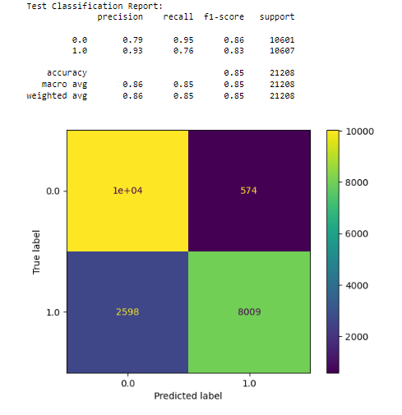
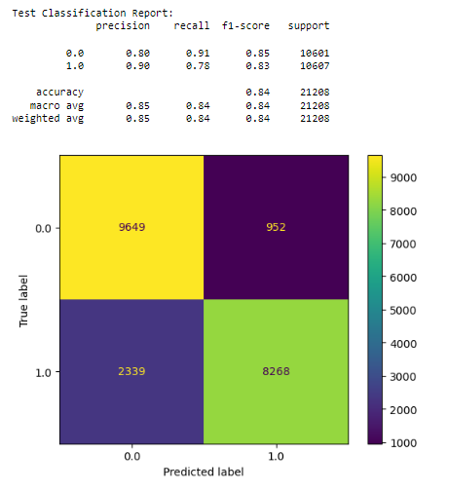
Noteworthy Models From Step 1
SVM
Parameters that were used:
C: 5, Degree: 3, Gamma: ‘auto’, kernel: ‘rbf’
Logistic Regression
Parameters that were used:
C: 8, l1_ratio = 0, penalty = ‘l1’,
Random_state = 42,
solver = ‘saga’

Slide 9
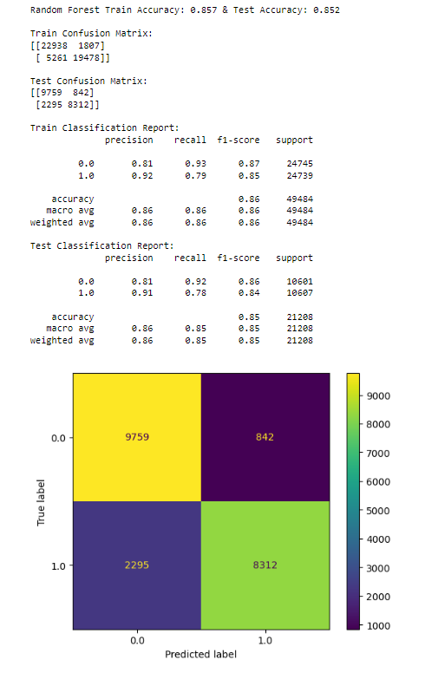
Best Model From Step 1
Model: Random Forest Classifier
Params
Criterion: Entropy
Max_features: ‘sqrt’
Max_depth: 15
Min_samples_split: 2
Min_samples_leaf: 17
Random_state: 42

Slide 10
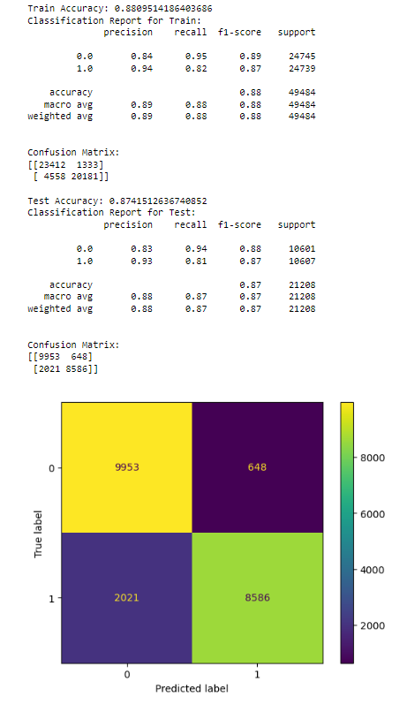
XGBoost Model
Is an implementation of gradient boosting decision trees
Creates a series of models and combines them to make one
Model that is more accurate
Was optimized through GridSearchCV
Parameters:
Colsample_bytree = 0.5, learning_rate = 0.3,
Max_depth = 6, min_child_weight = 1,
Objective = ‘binary:hinge’, seed = 1, subsamples = 0.5

Slide 11
Extreme Machine Learning Model
This model was one that I referenced off of a highly acclaimed article on kaggle
The model unlike other feed forward neural networks does not use back propagation, weights for hidden layers are randomly generated, and output is linear rather than sigmoidal.
Overall, this model was the most accurate model that was created having a 100% accuracy.

Slide 12
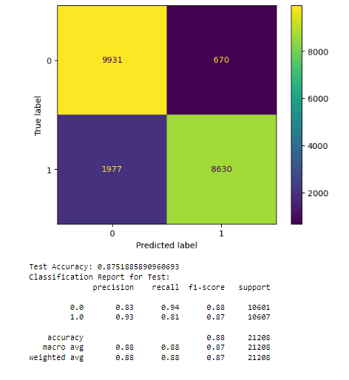
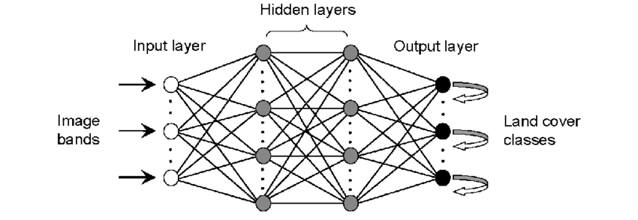
Neural Network
There were 4 layers in total for this neural network

Slide 13
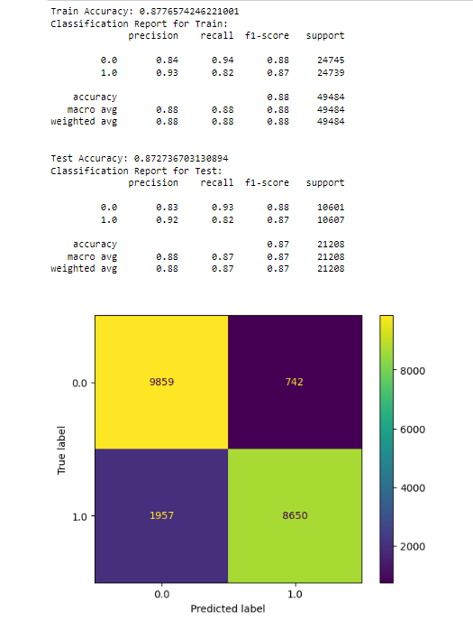
Ensemble Model
The three models that were used were: a logistic regression, SVM, Random Forest Classifier.
The type of ensemble model was a voting model done through VotingClassifier by sklearn.
The voting types was hard voting

Slide 14
Final Notes
Overall, the best model was the deep machine learning model with its 100% however, I'm unsure how trustworthy this model is.
In truth I place more trust in the simple neural network that was created. While the computational speed is not on par, I do have more trust in it.
Lastly, it was interesting to see that my previous assumptions of which features were crucial in someone being diabetic was partially true.
For instance, did not expect income, and alcohol consumption to be considered important.

