Slide 1
Lab3
Lee Chung Lai (Bertram Lee)

Slide 2
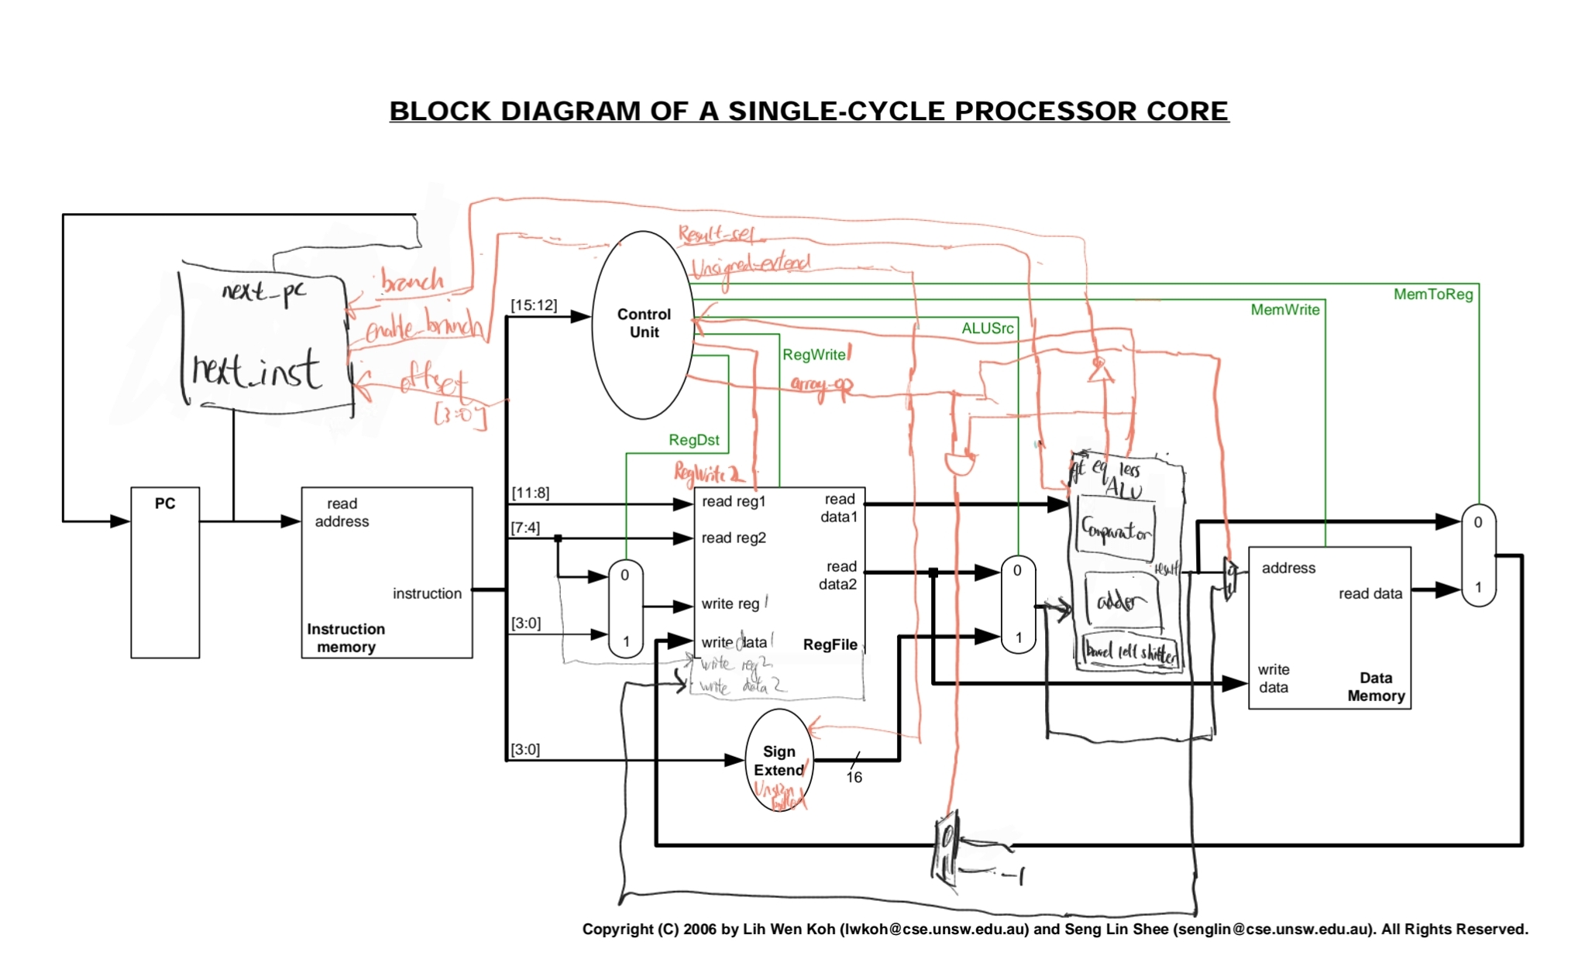
Single Cycle

Slide 3
Design choices
Two write back ports
Two registers that go along the pipeline
Comparison of BNE during ID stage (early detection, less penalty for wrong prediction)
Add a not equal comparison block in ID stage
Some control signals for LA instruction is not available until EX stage
Modify control signals in the control bus in EX stage

Slide 4
Signal and Datapath naming
Controls
normal controls: c_[stage]_[signal name]
hazard controls: hc_[stage]_[signal name]
Datapath
[stage]_[data path name]
c_mem_write
ex_result

Slide 5
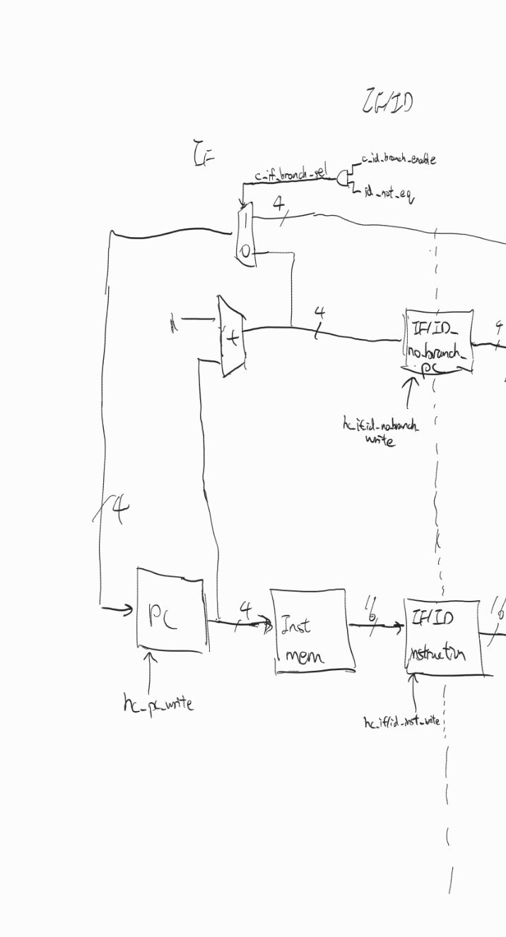
IF stage

Slide 6
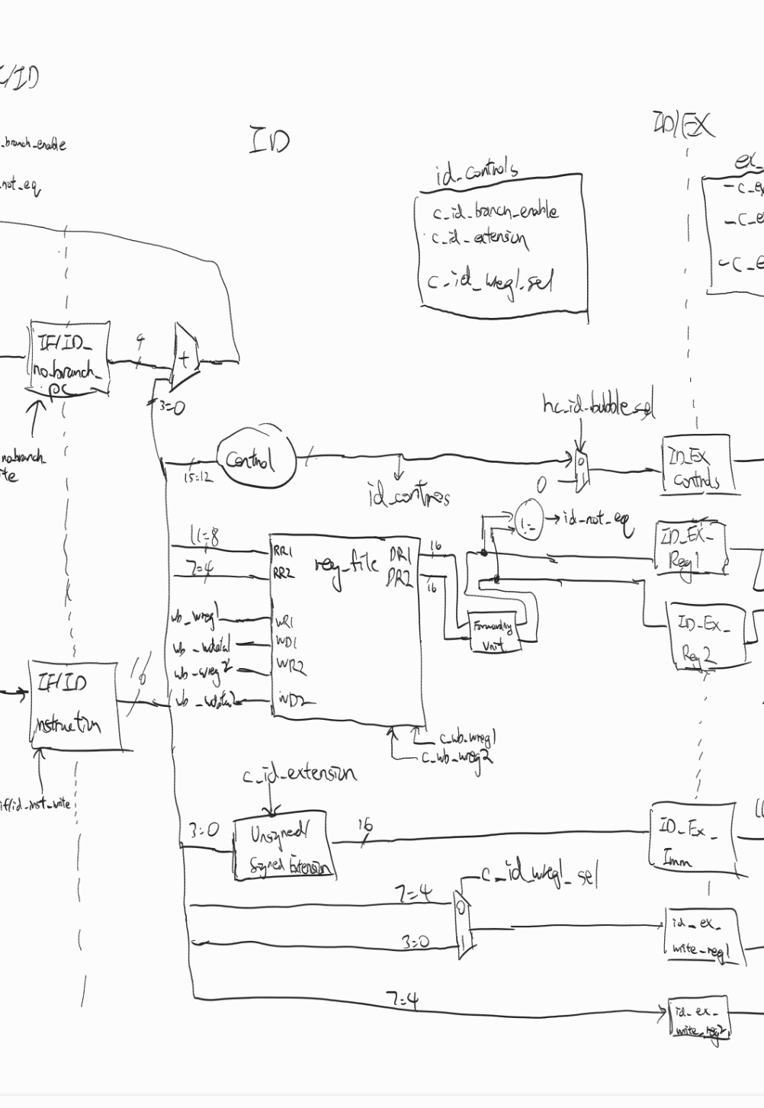
ID stage

Slide 7
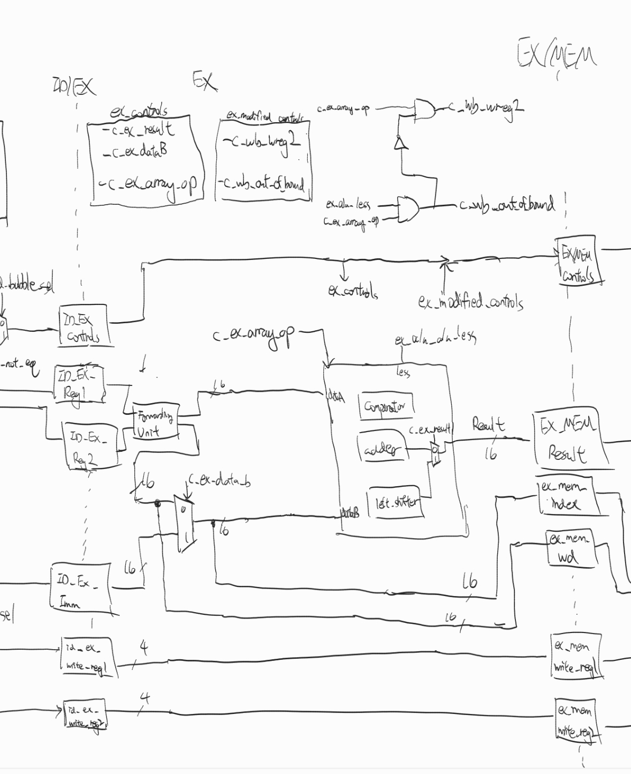
EX stage

Slide 8
Forwarding, Hazards and Static Prediction
Forwarding
No changes if writing into $0
Forwarding unit to EX stage (Forward from MEM and WB stage)
Forwarding unit to ID stage for BNE (same module as the one in EX stage)
Hazard (Load Use Hazard)
Hazard Detection Unit controls stalling
Gets input from controls of both EX stage and MEM stage
Branch Prediction
Static Prediction (default no branch)
Flush when incorrect prediction

Slide 9
Forwarding and Load Use Hazard
Is the data available?
Instructions that writes to write port 1
Instructions that writes to write port 2
 | EX | MEM | WB
LW | NA | NA | A
ADD | NA | A | A
SLRi | NA | A | A
LA | NA | NA | A
 | EX | MEM | WB
LA | NA | A | A

Slide 10
Considerations for BNE
Forwarding is same as others
Additional requirements to prevent Load Use Hazard (stalling)
BNE does compare in ID stage, it needs data immediately in ID stage
Unlike other instructions, when BNE is in ID stage, it needs to check data dependency in both EX stage and MEM stage
IF | ID | EX | MEM | WB
 | ADD |  | LW
IF | ID | EX | MEM | WB
 |  | ADD |  | LW
IF | ID | EX | MEM | WB
 | BNE |  | LW
IF | ID | EX | MEM | WB
 | BNE |  |  | LW

Slide 11
Why Two Forwarding Unit?
Only one forwarding unit in EX stage
BNE can only be determined at EX stage and need to flush two stages
Only one forwarding unit in ID stage
Stall even for Non BNE instruction RAW dependency
Having two forwarding unit allows early branch detection and minimize stalling
IF | ID | EX | MEM | WB
 | ADD | ADD
IF | ID | EX | MEM | WB
 | ADD |  | ADD

Slide 12
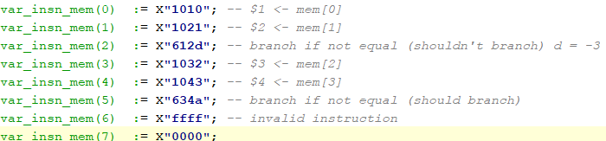
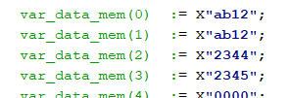
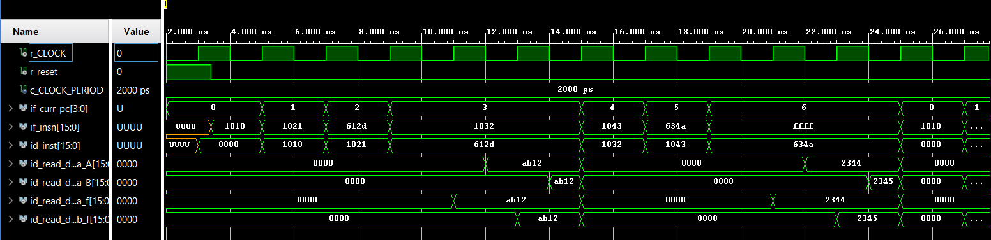
Testing
IF | ID | EX | MEM | WB
LW | BNE $2,$1 | $2<-mem[1] | $1<-mem[0]

Slide 13
IF | ID | EX | MEM | WB
$3<-mem[2] | BNE $2,$1 | nop | $2<-mem[1] | $1<-mem[0]

Slide 14
IF | ID | EX | MEM | WB
$3<-mem[2] | BNE $2,$1 | nop | nop | $2<-mem[1]

Slide 15
IF | ID | EX | MEM | WB
FFFF | BNE $3,$4 | $4<-mem[3] | $3<-mem[2] | BNE $2, $1

Slide 16
IF | ID | EX | MEM | WB
FFFF | BNE $3,$4 | nop | $4<-mem[3] | $3<-mem[2]

Slide 17
IF | ID | EX | MEM | WB
FFFF | BNE $3,$4 | nop | nop | $4<-mem[3]

Slide 18
IF | ID | EX | MEM | WB
$1<-mem[0] | nop | BNE $3,$4 | nop | nop

Slide 19
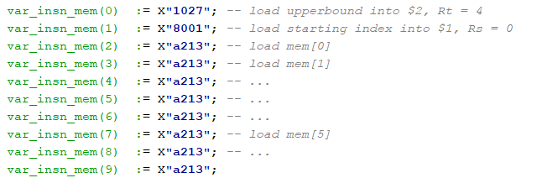
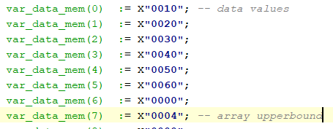
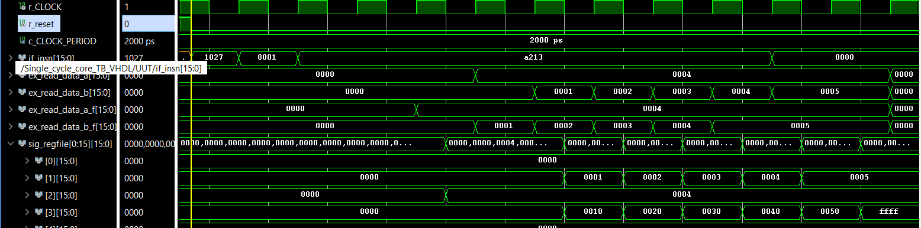
Test 2

Slide 20
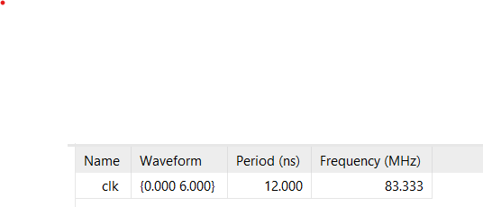
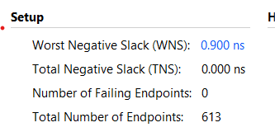
Max Freqency
12-0.9 = 11.1 ns
Max frequency = 1/(11.1ns) = 90.1MHz

