Slide 1
Overview
Main Loop
velocity command
get base state & joint state
calculate kinematics
MPC
decide stance / swing
calculate contact forces with MPC
calculate joint torques

Slide 2

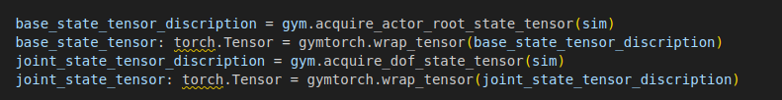
Velocity Command & Get States
acquire_actor_root_state
position, rotation, linear velocity, angular velocity
acquire_dof_state
position, velocity

Slide 3


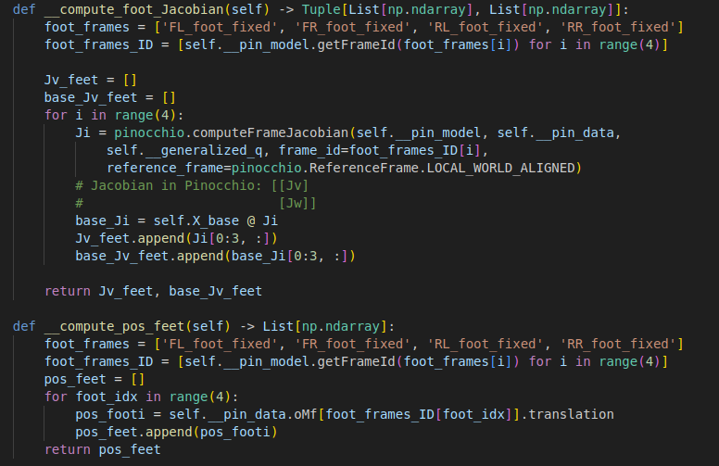
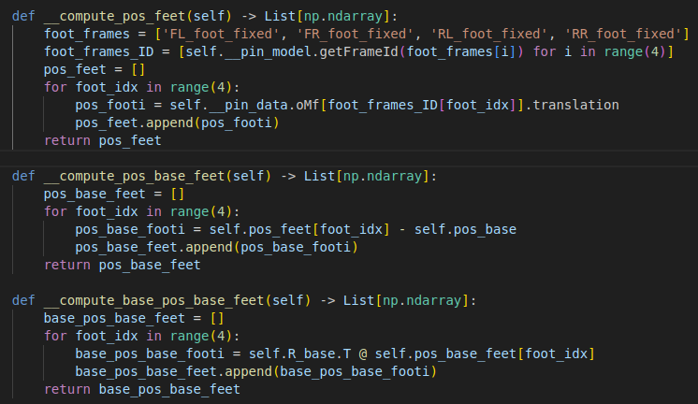
Compute Kinematics
Forward Kinematics
input : joint position, base position
output : feet position, jacobian

Slide 4
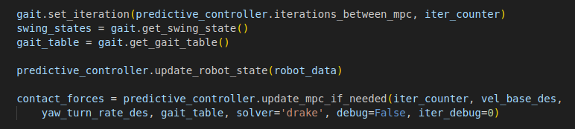
Compute Dynamics
Update gait schedular
Decide which leg is the stance (ground contact for power)
Decide which leg is the swing (in the air, moving to the next landing point)
Prepare for MPC
Enter the current robot states into the MPC internal state (x).
base_pos, base_quat
lin_vel, ang_vel
q, q_dot
Run QP solver
Calculate foot forces by solving a Quadratic Program (QP) at regular intervals
Whether the leg can exert force or not is configured as a constraint through the gait table.

Slide 5
Compute Dynamics : gait schedular
swing_states = gait.get_swing_state()
Decide each leg is in swing or stance return.
If in swing, calculate torque using the force output by the PD controller, if in stance, use the MPC.
gait_table = gait.get_gait_table()
When the MPC predicts for a certain horizon ahead, it returns whether the leg is in stance or swing at each point in time.

Slide 6
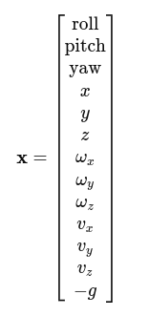


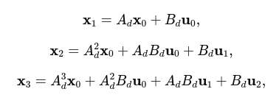
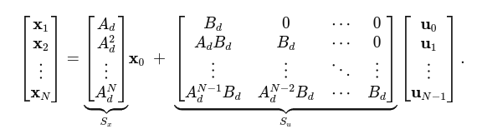
Compute Dynamics : MPC
predictive_controller.update_mpc()
generate reference trajectory
generate dynamics model
discretize dynamics model
generate QP constraints
generate dynamics model
A: linear dynamics between robot base states (roll/pitch/yaw, pos, vel).
B: Reflects how the foot force (u) accelerates/rotates the robot base.

Slide 7

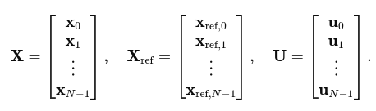

Compute Dynamics : MPC
QP constraints
friction cone constraints
gait constraints
When in the swing position, the strength of the foot should be zero.
When in the stance position, the foot force should be placed within the friction cone.
x_k : robot state
x_k_ref : desired state
Q : error weight
R : foot force weight
H, q : summary of the error, and u size as the second/first term.
=> 로봇이 레퍼런스와 멀어질수록 비용이 커짐, 발힘이 과도해도 비용이 커짐.

Slide 8
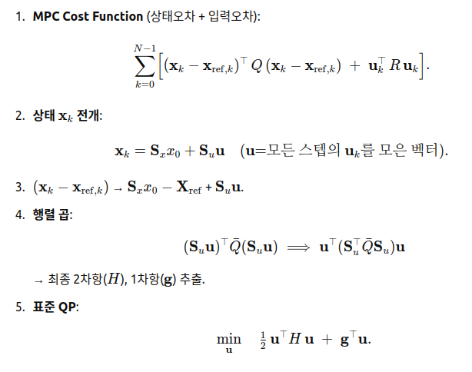
Compute Dynamics : MPC

Slide 9
Calculate joint torques
set_foot_placement
Calculate the final position of the foot at the end of the swing.
compute_traj_swingfoot
Create foot trajectory with cubic hermite interpolation (x, x_dot).
pos_targets_swingfeet
Generate joint torque with PD controller when swing state.
Generate joint torque with MPC when stance state

Slide 10
Overview
Main Loop
velocity command
get base state & joint state
calculate kinematics
MPC
decide stance / swing
calculate contact forces with MPC
calculate joint torques

