Slide 1

Energy, cost and carbon efficiency in clouds: From resource allocation to cloud architecture
By
Ehsan AHVAR
Post-Doc researcher
INRIA\IRISA, MYRIADS Team

Slide 2
Outline
Part one: personal presentation
Education
Working experience
Study activities during my Phd
Sensor network
IoT and smart home
NFV
Cloud computing
Part two: DISCOVERY project contribution
Analyzing Energy Consumption of Cloud Computing from Centralized to Distributed clouds
Let’s discuss (discuss about future work)

Slide 3
Part 1: Personal Presentation

Slide 4
Education and working experience
Post-doc researcher
INRIA
Myriads team
Anne-Cécile Orgerie and Adrien Lebre
Phd in computer science and telecommunication
IMT, Telecom Sudparis, École doctorale EDITE de Paris
Noel Crespi.
Working Experience:
Payame Noor University (Faculty member of IT department)

Slide 5
Research Activities During My Phd

Slide 6
ITEA ICARE Project
Innovative Cloud Architecture for Real Entertainment (ICARE)
2012-2015
22 partners from 5 European countries
Thales, Technicolor, Thomson, VTT Finland, UPM Madrid, RTL BCE Luxembourg, etc
Using cloud computing for user entertainment in smart homes
Our contribution
Proposed a use case (finally 3 use cases selected to be implemented)
Leading a Deliverable (selecting Enablers for one of the use cases)
Proposed an Enabler for one of the selected use case
As an academic partner: standardizations and publications

Slide 7
Sensor Networks
Study field (1)

Slide 8
Sensor Network
Energy Consumption
Routing protocols
Data aggregation techniques
GloMosim Simulator of UCLA
Publication
Ehsan Ahvar et al. “RER: a Real time Energy efficient Routing protocol for query-based applications in wireless sensor networks,” Telecommunication Systems journal, Springer, Volume 61, Issue 1, 2016 (SCI-E IF 0.822).
Ehsan Ahvar et al. “ERP: an Energy-aware Routing Protocol for query-based applications in Wireless Sensor Networks,” The Scientific World Journal, Volume 2014.
Ehsan Ahvar et al. “Improving Decision-Making for Fuzzy Logic-based Routing in Wireless Sensor Networks,” Workshop of the 10th IEEE International Conference on Ubiquitous Intelligence and Computing (UIC Symposium-UIAS), Italy, 2013.

Slide 9
Smart Homes and IoT
Study field (2)

Slide 10
Smart Homes and IoT
Context-aware systems
User Localization in smart homes
IoT for user location discovery in smart homes
Why IoT-based localization in future smart homes?
Users’ privacy and comfort
The IoT will introduce more and more sensors into future smart homes (various sensor options)
Cost
Advent of low-cost and low-power sensors
Saving cost and space by designing a ULD platform that utilizes already available sensors in future homes
Concept of sensor virtualization gives opportunity of using already exist sensor for other applications
Using several heterogeneous sensors can increase detection accuracy and fault tolerance
Publication
Ehsan Ahvar et al. “On Analyzing User Location Discovery Methods in Smart Homes: A Taxonomy and Survey,” Journal of Network and Computer Applications (JNCA), Elsevier, 2016.
Ehsan Ahvar et al. “Sensor Network-Based and User-Friendly User Location Discovery for Future Smart Homes”, Sensors, Vol. 16, No. 7, 2016.

Slide 11
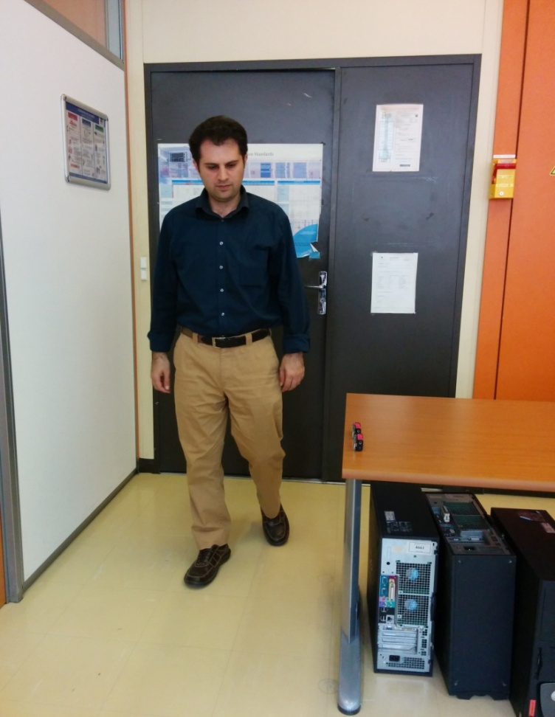
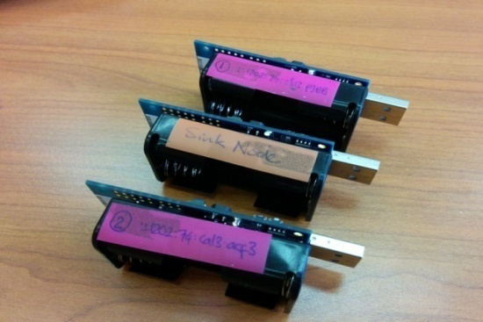
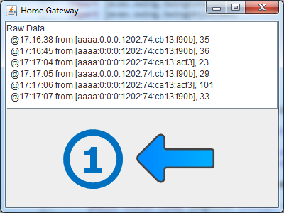
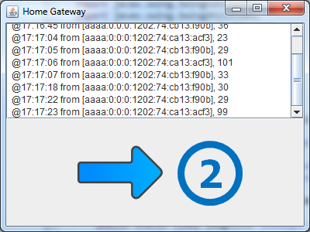
ULD Application: User Direction\Motion Detection
ITEA ICARE Project
Equipment
Laptop: Home Gateway
Mote 1: Sink (connect to Gateway)
Mote 2: Light sensor 1
Mote 3: Light sensor 2
Scenario
When a light sensor detects a light change (above threshold), it sends a signal to the Sink
Maxfor CM5000/TelosB
Microcontroller: 16 bit, TI MSP430F1611
Memory: Flash - 48KB, RAM - 10KB
Radio Chip: TI CC2420 (IEEE 802.15.4)
Sensors: temperature, humidity, light
16 pins GPIO: UART, SPI, I2C
User & Reset Buttons
3xLeds
USB Interface
2xAA Batteries

Slide 12
Possibility of reusing already installed sensors for a new application?

Slide 13
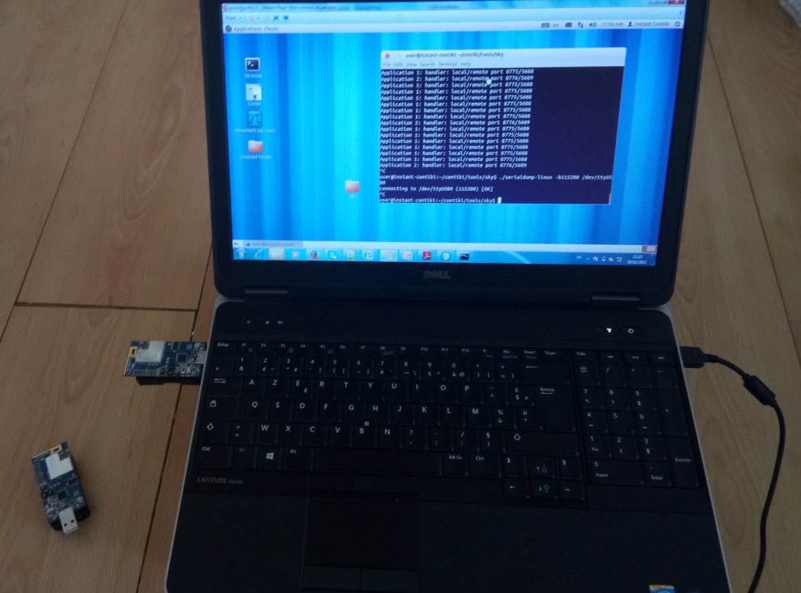
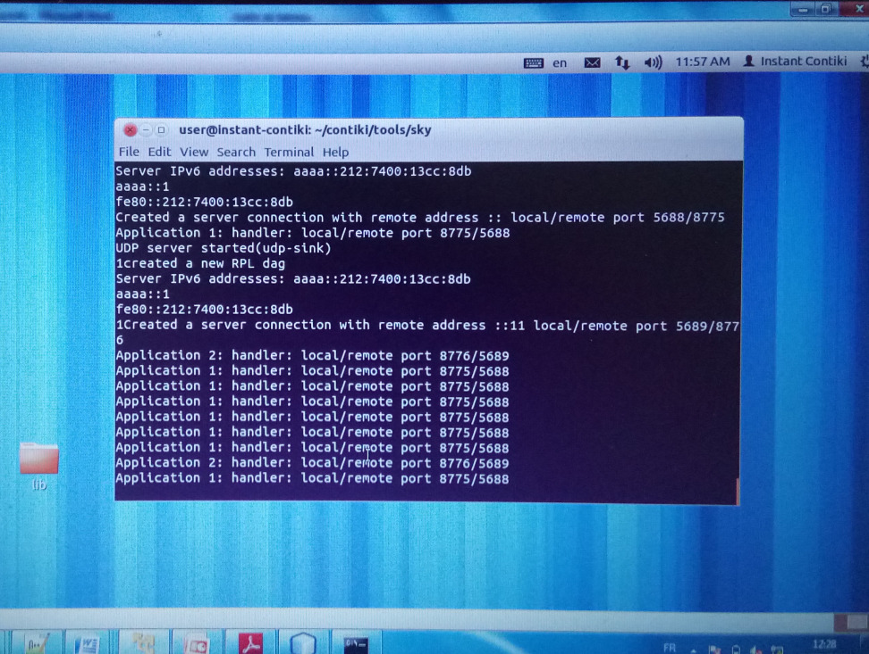
Sensor Virtualization: one sensor for two or more applications
Using a light sensor for two applications (with two different sensing rates)
Equipment
Two CM5000 TelosB motes and a Laptop. Mote 1 as a light sensor . Mote 2 as our Sink connected to USB port of the laptop.

Slide 14
Network Functions Virtualization (NFV)
Study field (3)

Slide 15
Network Functions Virtualization (NFV)
NFV is a promissing solution to offer cost-efficient, scalable and more rapid deployement of network services.
Our work
Designing algorithms for placing VNFs or chains in the network
Cost (Optimal number of VNFs, VNFs location, etc)
Publications
S. Ahvar, H. Pann Phyu, E. Ahvar, N. Crespi, R. Glitho, “CCVP: Cost-efficient Centrality-based VNF Placement and Chaining algorithm for network service provisioning", IEEE NetSoft, Italy, 2017.
S. Ahvar, J. Sahoo, E. Ahvar, M. Salahuddin, R. Glitho, H. Elbiaze, N. Crespi, “Proactive VNF placement for Value Added Services in Content Delivery Networks", Submitted to IEEE Transactions on Network and Service Management.

Slide 16
Already Presented in Placement WG of DISCOVERY
Study field (4)
Cloud Computing

Slide 17
Phd Thesis
Cost Efficient Resource Allocation for Green Distributed Clouds
Objective
Improving energy cost and carbon emission in distributed clouds
Contribution
Designing cost and carbon emission-efficient VM placement algorithms for distributed clouds
Reward
Finalist of Nokia Bell Labs France thesis pitch competition, 2016

Slide 18
Research Activities in Cloud Domain
NARA
Inter-DC communication cost
EU Patent
NACER
Inter-DC communication cost
IEEE NCA
Step-by-Step Improvement
NACEV
Inter/intra-DC communication cost + computing cost
CACEV
Inter/intra-DC communication cost + computing cost + carbon efficiency
IEEE SCC
D-CACEV
Inter/intra-DC communication cost + computing cost + carbon efficiency + VM migration
Submitted to TSC

Slide 19
Part 2: DISCOVERY project contribution

Slide 20
Analyzing Energy Consumption of Cloud Computing
from Centralized to Distributed clouds
Three main steps
To simplify the analysis, cloud architectures can be categorized
Proposed a taxonomy
Proposed an energy model
can be used for all cloud categories
Designing an interactive environment
To compute energy consumption of each cloud architecture based on proposed model

Slide 21
Step 1: Cloud Taxonomy (1/3)
Large
Low
CC
CNs
SNs
Architecture ( 1 )
Cat. 1
Mega DC
. . .
Network
End-user 1
End-user 2
. . .
End-user k
. . .
CC₁
. . .
CC_{|B|}
A Partly
Distributed
Architecture
SNs
SNs
CC Size
Cat. 2
CNs
CNs
CC Number
Network
. . .
Micro DC
End-user 1
End-user 2
End-user k
. . .
. . .
CC_{k+1}
. . .
CC_{|B|}
Architecture ( i-1 )
SNs
SNs
Cat. 3
Network
User Side
CC₁
CN
CC₂
CN
. . .
CC_{k}
CN
Small
High
Nano DC
End-user 1
End-user 2
End-user k
Architecture ( i )
Network
Cat. 4
User Side
CC₁
CC₂
CC_{|B|}
CN,SN
CN,SN
. . .
CN,SN
CC: Cloud Center
End-user 1
End-user 2
End-user k (k=|B|)
CN: Compute Node
SN: Service Node

Slide 22
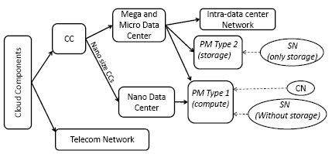
Step 1: Cloud Taxonomy (2/3)
CC structure
Based on cloud architecture characteristics, CCs can be physically considered as a mega (tens thousands PMs), micro (between 1000 to 4000 PMs) or even a nano (usually only one PM) data center.
PMs generally can be divided into two main types.
Type 1 PMs are specialized for computing purposes (e.g., hosting VMs (CN), cloud management).
Type 2 PMs have a large-size storage in order to save data (i.e., storage node
A router or switch chassis generally include control plane, data plane and environment units.
routing engine cards are control plane elements,
Line cards and switch fabric cards are key elements of data plane,
the environment units includes the elements that do not play any role in data traffic handling (e.g., chassis power supply and fans)

Slide 23
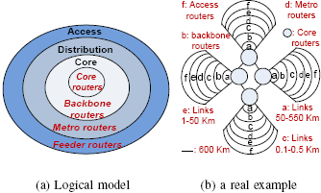
Step 1: Cloud Taxonomy (3/3)
Intra-data center(CC) network topology
In order to find the number and type of network elements (and links) to connect PMs inside a data center, we need to consider a network topology.
Since 2008, more than thirty network topologies have been proposed for data centers .
We consider a fat tree architecture (i.e., k-ary fat tree topology) for inside of the data centers.
Many data centers have been designed based on the fat tree topology (e.g., the Massively Scalable Data Center (MSDC) of Cisco).
all switching elements are identical. This identically, in practical point of view, enables us to utilize cheap commodity parts for all of the switches in the communication architecture and, in modeling point of view, makes modeling and analyzing the system much simpler than the architectures with non identical switches.
Telecommunication network structure (inter-CCs network)
consider a three-layer hierarchical network model
a real telecommunication network (i.e., a simplified version of a ISP)

Slide 24
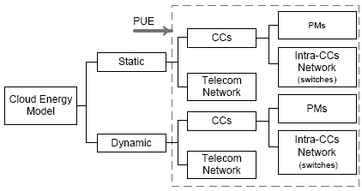
Step 2: Proposed Energy Model
In energy point of view:
overall energy consumption of a mega or micro data center can be estimated based on energy consumption of its IT equipments and its PUE value.
in order to simplify our work, we only analyze IT equipments of data centers.
Cloud infrastructure divided into two main parts:
(1) IT equipment of CCs (for a nano CC IT equipment is only a PM),
(2) telecommunication network.

Slide 25


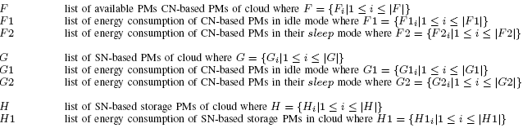

Energy Model for Static Energy Consumption
Static energy consumption simply means sleep mode or idle mode
CN-Based PM
SN-Based PM
Storage PM type 2 is considered as an x-bay NAS (here, x means the number of hard disks).
as usually all PMs type 2 are kept active in the real world, we consider a constant (static) amount of energy for PMs type 2.
In a PM type 2, CPU and storage are two main parts of consuming energy. In order to make energy consumption of a PM type 2 constant, instead of considering three sleep, active and idle modes for storage (i.e., hard disks) of PM type 2, we consider a constant energy consumption for it (i.e., average energy consumption of active and idle modes).
We also consider a constant amount of CPU energy consumption for each NAS (e.g., 15% CPU usage).
Storage PM

Slide 26


Energy Model for Static Energy Consumption
Static energy consumption simply means sleep mode or idle mode
Intra-CCs Network Elements
Inter-CCs Network Elements

Slide 27

Energy Model for Dynamic Energy Consumption
Compute dynamic energy consumption of PMs based on their CPU utilization
Challenge: defining a general formula
different multi-core CPU architectures (e.g., CPUs with heterogeneous cores or homogeneous cores) with various power management techniques (e.g., DVFS, asymmetric core and threat motion).
Our method
a formula based on extracted information (i.e., sampling technique) from a real environment.
a simple core management policy (because of technical limitation)
for a n-core cpu. At each time, first Alpha number of cores are fully utilized (100%), (Alpha+ 1)th core (Beta = Alpha+ 1) works between 0 and 100% and remaining cores (i.e., n- cores) are not active (0%).
the total n-core CPU resource was divided into n intervals and the number of cores was mapped on CPU utilization (i.e. 0 core = 0%, 1 core =(1/n)% and so on till n cores = 100% CPU utilization).
A sequence of number corresponding to the cores was created.
The current CPU utilization (i.e., un) is fallen into an interval of two consecutive numbers Alpha and Beta.
The PM energy consumption is the difference between situation Alpha energy consumption and situation Beta energy consumption.

Slide 28
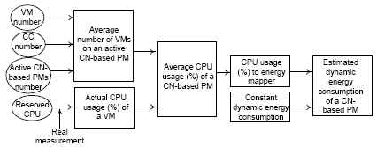
Dynamic Energy Consumption of CN-based PMs
depends on energy consumption of VMs running on it.
Challenge
may lead to overestimation.
as almost all cloud providers are currently using over-commitment (overbooking) techniques, estimating energy consumption of a CN-based PM based on reserved resources of its VMs can lead to overestimation (i.e., estimating even more than maximum power consumption of the PM).
Proposed idea

Slide 29


Network Dynamic Energy Consumption (intra-CC)
load-dependent power consumption: packet processing and storing\forwarding the payload.
Estimating average traffic load of a switch (R_{pkt})
the fat tree topology utilizes the similar switches
by estimating total internal traffic of a data center and dividing it to the number of switches, we can simply find Rpkt and then Rbyt of a switch.
assume a packet from a PM goes to another PM that is located in the same data center with probability of P’ and it goes to outside of the data center with probability of 1-P’
two types of inside-data center traffic:
traffic exchanged between PMs of the data center (Tin),
traffic between PMs of the data center and outside (Tet).
Rpkt= (P’. T_{in} +(1-P’). Tet)/S
T_{in} =X.Y.B where X:PMs in a data center, B: average distance between two PMs inside a data center and each PM on average generates Y amount of traffic. total internal traffic of the data center can be estimated as X.
T_{et} =X.Y.3. a packet should pass through three switches (i.e., the shortest path which includes 1 access, 1 aggregation and 1 core switches) from a PM to go to outside of the data center.

Slide 30


Telecom Network Dynamic Energy (inter-CC)
load-dependent power consumption: packet processing and storing\forwarding the payload.
Estimating average traffic load of a router (R_{pkt})
We consider an average traffic load for each type of routers (feeder, metro, backbone, core)
A three-step method to estimate traffic load
estimate the total traffic of telecommunication network (Ttot) by adding the total exchanged (in/out) traffic of cloud data centers together including (1) the traffic exchanged between data centers and end users (Teu), (2) inter-data centers traffic (Tdc).
we find the possible paths between end users and data centers and for each path we consider a variable that shows probability of using that path. We do the same method for possible data center-to-data center paths.
having the possible paths between end users and data centers and their probabilities, we can compute how much traffic passes through each type of router. Considering the number utilized routers for each type of router and Teu, we can estimate average traffic (rate) passing through each router type for end user to data center communication. We do the same method for data center to data center communication

Slide 31
Path1: feeder, metro, backbone, core1
CC
(data center)
Path2: feeder, metro, backbone, core2, core1
Probability P1 traffic passes through Path1
Probability 1-P1 traffic passes through Path2
Core1
Path2
Core 2
Backbone
Path1
Backbone
core=P1(total traffic/number of cores)
+ (1-P1)(2*total traffic/number of cores)
metro
metro
backbone=total traffic/number of backbones
feeder
metro=total traffic/number of metros
feeder
feeder=total traffic/number of feeders
User(s)
User(s)

Slide 32
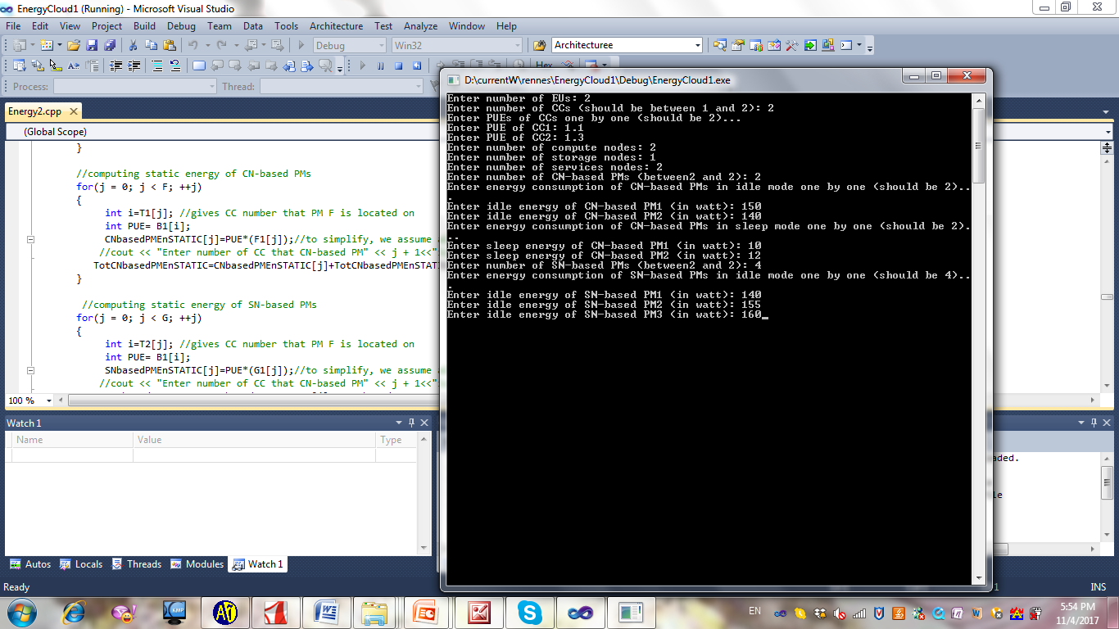
Step 3:
an interactive environment to compute cloud energy

Slide 33
Let’s discuss about relation between: Energy (saving) Energy Cost (saving) Carbon Emission (generation) Resource Allocation (method) Cloud Architecture (type)

Slide 34
Let’s discuss: energy saving alone or …?
Energy consumption of distributed\edge cloud infrastructure\architecture
Is it possible to compare energy consumption of different cloud architectures accurately without considering effect of resource allocation (VM placement) or routing methods?
What is more important for cloud or network providers: energy saving or energy cost saving?
What about carbon emission?
How much can be effect of VM placement method on energy saving?
Relation between energy saving and carbon emission generation?
complexity v.s. accuracy
Energy, cost and carbon efficiency in clouds: From resource allocation to cloud architecture

Slide 35


Discuss more…
Two hot research topics
Revenue (Energy Cost)
Green Cloud (Carbon Emission)
Data centers (DCs) currently consume large amount of energy and generate noticeable carbon emission
According to prediction
DCs will account for about 8% of worldwide electricity consumption by 2020, and will generate about 2.6% of global carbon emission [1].
[1] P. Xiang Gao, A. R. Curtis, B. Wong, S. Keshav, “Its Not Easy Being Green”, ACM SIGCOMM, Finland, 2012.
As a result
Cloud and network providers must reduce their energy cost and carbon emission.
For example, France Telecom-Orange has the ambition of decreasing its energy consumption and carbon emission from 2006 to 2020 by 15 and 20% respectively [2].
[2] S. Gosselin, F. Saliou, F. Bourgart, E. Le Rouzic, S. Le Masson, A. Gati, “Energy Consumption of ICT Infrastructures: an Operator’s Viewpoint”, 38th ECOC Conference, Amsterdam, 2012.

Slide 36
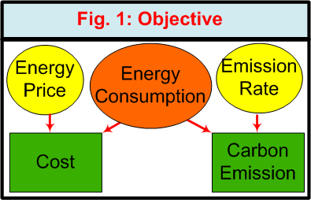
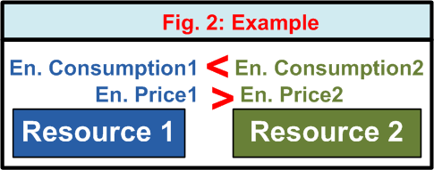
Energy, Energy Cost , Carbon Emission, Resource Allocation and Cloud Architecture Relation
Problem Definition
A three dimensional problem:
how to minimize energy consumption (in form of resource utilization optimization)
how to find resources with best energy price
how to choose the resources which are connected to energy sources with lowest carbon emission rate

Slide 37
What do you think?
Energy Saving alone?
Energy Cost Saving?
What about considering carbon emission as well?
Another idea…?
Thanks for Listening

