Slide 1

Stressing AMQP DISCOVERY Project Rennes Face2Face Meeting
Abdelhadi Chari, Jean-François Peltier
March 30th, 2017

Slide 2
How to stress AMQP
OpenStack Internal Communication Bus issue?
AMQP protocol and RabbitMQ
AMQP test cases
AMQP stressor time diagram
AMQP stressor configuration
Preliminary results
Next steps

Slide 3
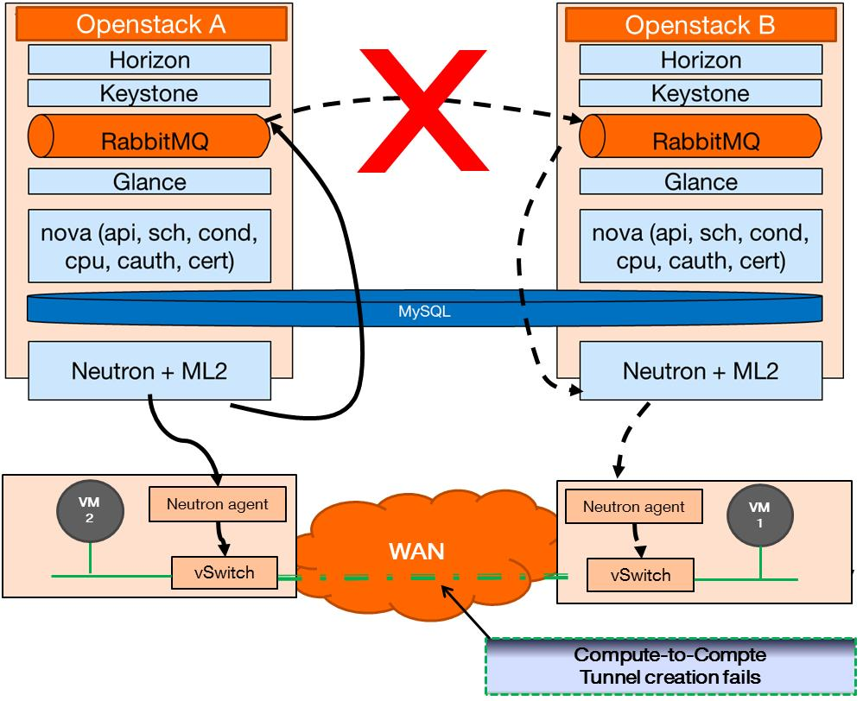
OpenStack Internal Communication Bus issue
Today, it is still unclear whether OpenStack internal communication bus (CB) is an issue when using a single OpenStack instance to power a massively distributed cloud
In particular, regarding the impact of WAN (delay, packet loss, failure)
It seems commonly agreed that AMQP does not behave well in a WAN environment, other solutions like Shovel should then be used (WAN-friendly).
Our goal is to settle this matter

Slide 4
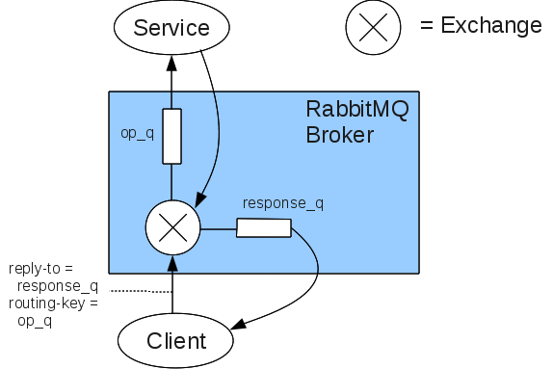
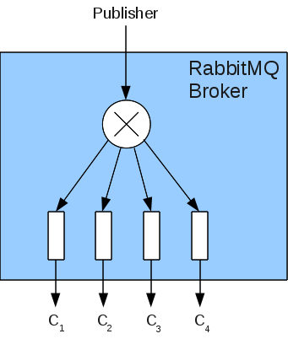
AMQP protocol and RabbitMQ
AMQP stands for Advanced Messaging Queuing Protocol
AMQP is the messaging technology chosen by OpenStack for internal communication within services
RabbitMQ is an AMQP message broker
Exchanges and Queues:
Exchanges are set up by services (publisher)
Queues are set up by clients (subscribers)
They are linked through routing keys
Different types of Exchanges:
Direct (point to point communication)
Topic (to one ore many based on key)
Fanout (toward multiple agents)
Channels
AMQP connections are long-lived TCP connections
In one TCP connection we can multiplex multiple channels

Slide 5
Our test setup
Setup to emulate whole AMQP traffic generated by 100 compute nodes (heart beats + system messages)
True fake AMQP messages are generated toward Openstack agents
Control Node
RabbitTracer
RabbitMQ Server
Nova
(scheduler, conductor, etc.)
RabbitMQ Generator
Neutron:
(dhcp agent, L3 agent, etc.)
Messages generated are relayed to the agents as normal AMQP messages.
This puts stress on Communication bus
These messages are ignored by the agents
TC WAN emulation, delay, packet loss
Wireshark
Compute Node 1
Compute Node 2
L2 Agent
L2 Agent
Nova CPU
Nova CPU
VM
VM
VM
VM
VM
VM
VM
VM
VM
VM
Our goal is to test:
- Impact of WAN on AMQP messages performance
- Functional impact

Slide 6
AMQP test cases
List of tests cases to be performed :
VM creation without delay nor packet loss nor AMQP stress
VM creation with delay up to 200ms
VM creation with delay up to 200ms and 5% packet loss
VM creation with delay up to 200ms and 5% packet loss and AMQP stress
VM creation with delay up to 200ms and 5% packet loss and AMQP stress with a link disconnection and reconnection after 5s

Slide 7
AMQP generator time diagram (1/2)
AMQP controller
AMQP Generator
Protocole-Header
Connection.Start (pika)
Connection.Tune
Connection.Open
Channel.Open
Channel 1
Exchange.Declare
Direct, reply_7d570042...

Slide 8
AMQP generator time diagram (2/2)
AMQP controller
AMQP Generator
Basic.Publish Routing Key reply_7d570042...
Content-Header (OSNoise_message)
Content-Body (payload) channel 1
Basic.Ack
. . .
Nova-compute
Other TCP session
AMQP (unknown type 111,
Channel 25194,
payload)

Slide 9
AMQP generator configuration
AMQP generator uses python-pika library
The file config allows to set up the type of AMQP exchange and the payload as well as the throuput (messages/second):
exchange_name = reply_7d570042265647439ccad7e7778ddf61 or discovery for all reply exchanges
exchange_type = direct
routing_key = reply_7d570042265647439ccad7e7778ddf61
message_payload = {"oslo.message":"{\"_msg_id\":\"DUMMY_RESPONSE_MESSAGE\", \"method\": \"test_generateur\", \"_dummy_payload\":\« 0123456789…01234567890\"}", "oslo.version": "2.0"}
publish_rate = 100
duration = 30

Slide 10
Preliminary results
The duration for instantiating a VM is measured in an environment where :
the TCP sessions are stressed (AMQP messages between controller and the agents)
the RabbitMQ controller is stressed (representing up to 100 computes)
Creation time increases with AMQP load (1000 msg/s): by factor 3.5
Creation time increases with delay :
100 ms by factor 3.5
200 ms by factor 7.1
Creation time increases with both load and delay (1000msg/s, 100 ms) by factor 7.6

Slide 11
Next steps
What we achieved so far:
RabbitMQ traffic matrix identification
Development of a first version of RMQ traffic generator (mirroring OpenStack messages)
Perform more measurements to evaluate precisely the impact on system performances of RabbitMQ controller performance versus WAN performance issues
Do we really need to load RabbitMQ with external tool or can we rely on massive creation of VMs through Rally or ENOS?

Slide 12
-Thank you-

