Slide 1
MACHINE LEARNING
GROUP PROJECT PRESENTATION
Intelligent Object Detection & Adaptive Navigation for Autonomous Vehicles using Machine Learning
Group - 31
Divya Raj Singh - 2021528
Nitesh Garg - 2021075
Pratham Singhal - 2021347
Shivam Yadav - 2020126

Slide 2
INTRODUCTION
Self-driving vehicles have great potential to improve safety and efficiency. However, like many parts of India, they face significant challenges, especially in areas with poor roads. These conditions may include inflexible mismanagement; Changes in the problem require advanced models that can be adapted to a variety of situations, such as measurement, good vision, and changes in the background.
An important aspect of this work is to improve object detection and intelligent decision making in complex and dynamic tasks. This includes identifying objects, animals and passengers and making informed decisions about safe travel. This project was specifically designed to solve India's transportation and infrastructure problems, which are different from many countries.Current benchmarks in self-driving technology may not be calibrated for these vast Indian scenarios, making them susceptible to errors and misjudgments.

Slide 3
MOTIVATION
In the rapidly changing world of technology, the concept of driverless cars has turned from a distant dream into reality. This is the beginning of changing our transportation system, improving safety, and reducing human error. Our goal is to achieve accuracy and adapt quickly to road conditions.
By exploring the evolution of artificial intelligence-supported search and navigation systems, we will ultimately pave the way for transportation transformation. This presentation will get to the heart of this revolution by exploring how machine learning algorithms can enable cars to understand and identify objects in their environment and quickly decide and navigate a difficult place.

Slide 4
LITERATURE REVIEW - 1
Pedestrian Crossing Intention Forecasting at Unsignalized Intersections Using Naturalistic Trajectories
Paper titled “Pedestrian Crossing Intention Forecasting at Unsignalized Intersections Using Naturalistic Trajectories” by Esteban Moreno, Patrick Denny, Enda Ward, Jonathan Horgan, Ciaran Eising, Edward Jones, Martin Glavin, Ashkan Parsi, Darragh Mullins, and Brian Deegan
The article emphasizes the reliance of current autonomous vehicle designs on onboard sensors, which may have a limited field of view, leading to potentially dangerous situations.
Uses dataset of “Dataset of Naturalistic Road User Trajectories at German Intersections.”
Pre-processing steps- 1) labeling pedestrian intention 2) imbalance handling 3) feature selection 4) training and testing split 5) handling the unclear scenario
Models used - random forest, feed-forward neural network
The Random Forest model is the primary focus and outperforms the neural network in terms of accuracy and training times in the context of the described study.

Slide 5
LITERATURE REVIEW - 2
2) Pedestrians’ Detection Methods in Video Images
“Pedestrians’ Detection Methods in Video Images: A Literature Review”
This paper reviews current algorithms for pedestrian detection using image processing, where used images have been obtained from video surveillance or conventional cameras
Traditional Methods Traditional methods for pedestrian detection often involve handcrafted features and classifiers. Features such as Histogram of Oriented Gradients (HOG), Scale-Invariant Feature Transform (SIFT), and Speeded Up Robust Features (SURF) have been widely used.
Models used - Linear SVM, HOG, SIFT
Pre-processing Steps- 1) Image smoothing 2) Region of interest selection 3) Color Transformation 4) Inverse Perspective mapping 5) Segmentation
These steps are common in many pedestrian detection methods and help to prepare the image data for further processing and analysis.

Slide 6
DATASET - 1
ImageNet Large Scale Visual Recognition Challenge (ILSVRC) [1]
This dataset spans 1000 object classes and contains 1,281,167 training images, 50,000 validation images and 100,000 test images
Used this dataset to train the model to classify any object given in an image
ImageNet (image-net.org)

Slide 7
DATASET - 2
2) DATS_2022 [2]
Dataset that covers images from indian roads to capture the unstructured indian traffic scenario.
It contains more than 10,000 images.
Annotations for a small set of images in .xml, .txt, .json formats are also included.
Used this dataset to train the our model.
DATS_2022 - Mendeley Data

Slide 8
DATASET - 3
3) MoDES Dataset of Cattle [3]
Dataset that covers images from indian roads with cattles and potholes for training the model.
It contains more than 4,00,000 images.
Annotations for a small set of images in .xml, .txt, .json formats are also included.
Used this dataset to train the our model.
This dataset helped in further optimization of model to make most appropriate decision in case of overlap of various road obstructions.
https://www.kaggle.com/datasets/bsridevi/modes-dataset-of-stray-animals

Slide 9
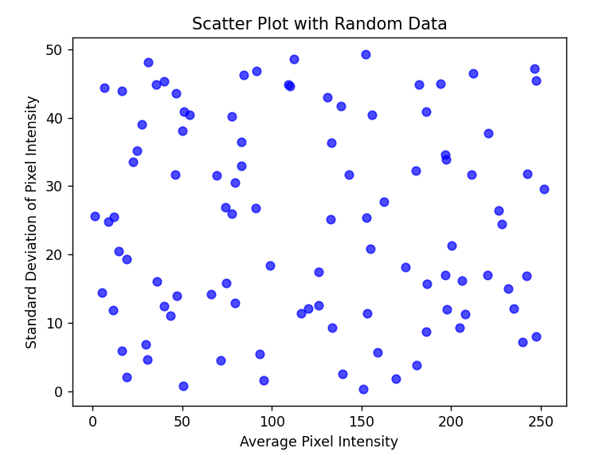
DATA VISUALISATION
Pixel Intensity as attribute

Slide 10
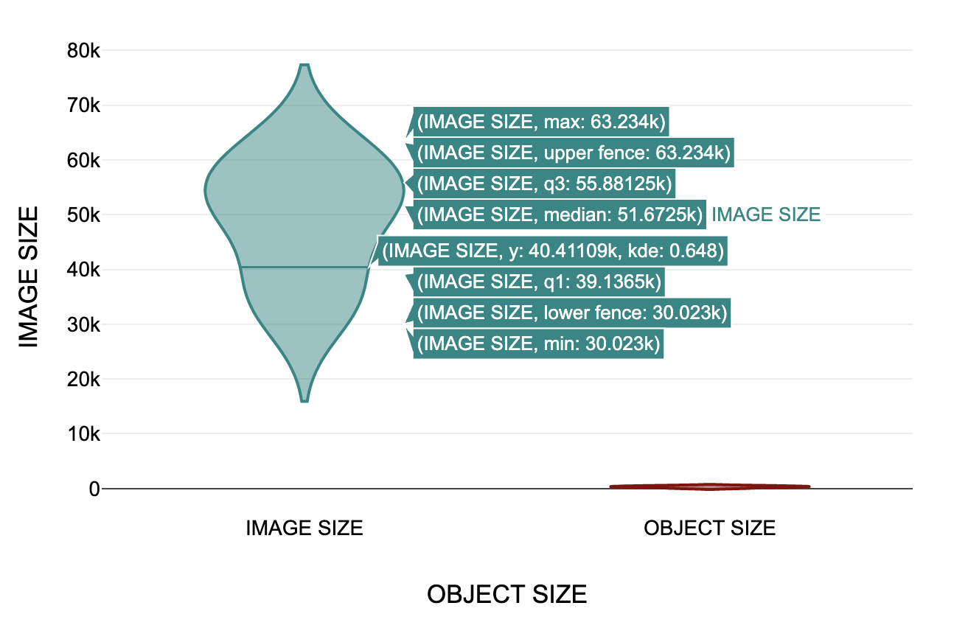
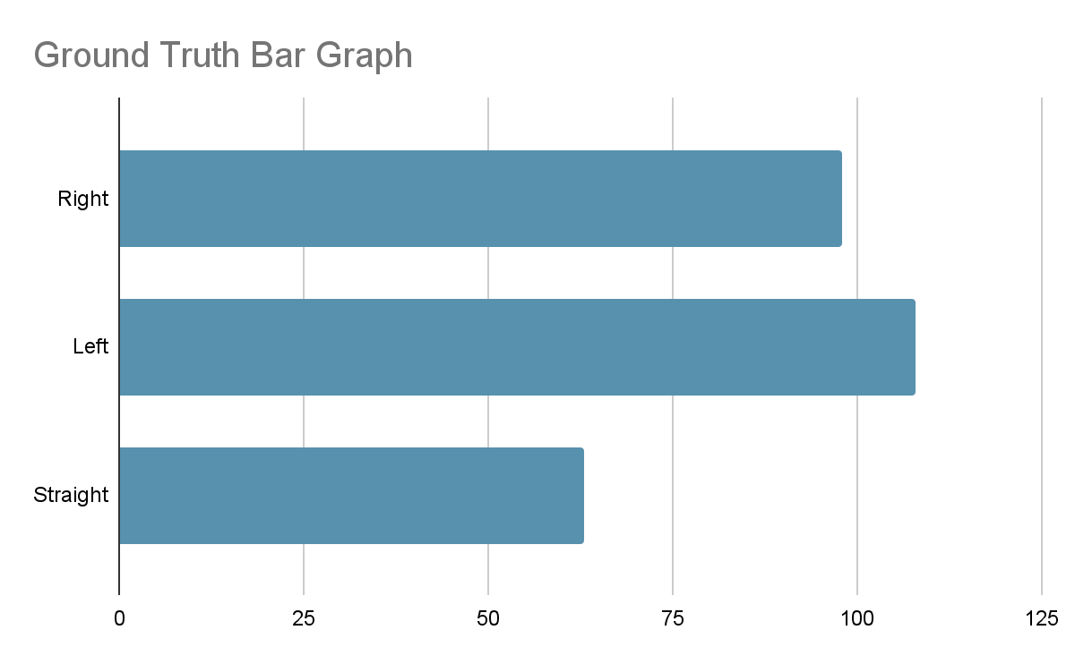

Slide 11
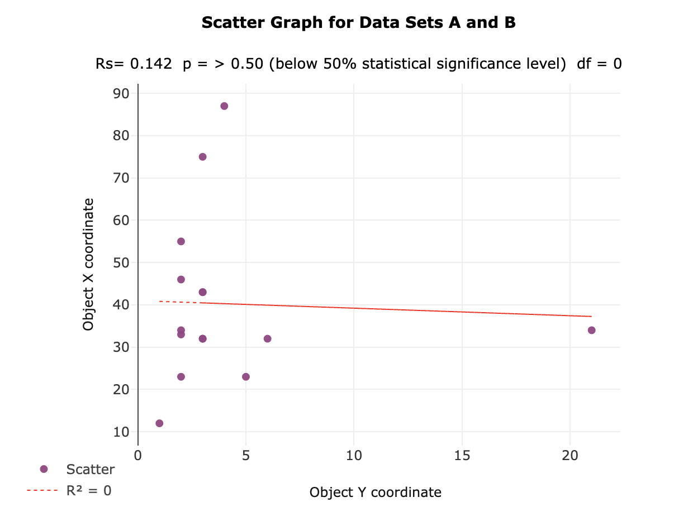

Slide 12
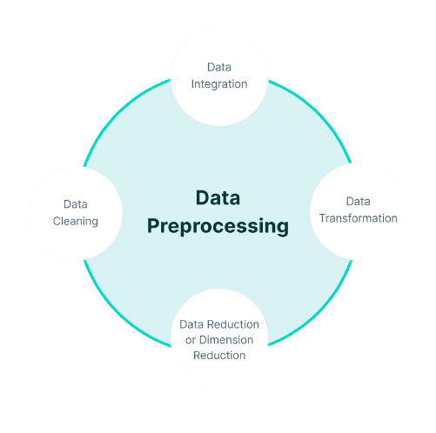
PREPROCESSING - 1
DATA CLEANING: removed null values and outliers
DATA INTEGRATION: integrated various datasets of cows, potholes, pedestrians and objects
DATA TRANSFORMATION: used CV2 from openCV library to read image data and convert it for feature extraction
DATA REDUCTION: reduced a dataset of 12,00,000 images to approximately 10,200

Slide 13
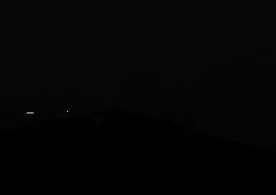

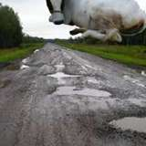
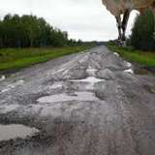
PREPROCESSING - 2
DATA CLEANING
Removed Null values to reduce computational size:
Removed outliers, like cow standing in air which would not be a case in real world scenario:

Slide 14
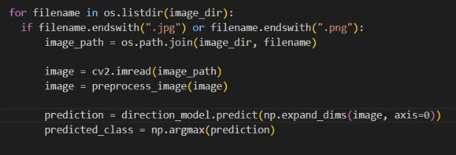
PREPROCESSING - 3
DATA TRANSFORMATION
Use of OpenCV library feature CV2 to read the image data and extraction of features from the image dataset:

Slide 15
METHODOLOGY - 1
We used many models for prediction :
Faster R-CNN
HOG + SVM
YOLO
Random Forest
First, we modified a pre-trained CNN “VGG16” which classifies any object to also classify potholes by looking at road portion having more grayer colour or water using Gaussian Blur.
For Predicting an Image, we divided the image into 3 segments horizontally, then identified different objects in the 3 segments.
We gave different loss values to different categories. Eg- humans have highest loss value, then animals, then potholes.
The segment having the lowest loss value is predicted using the model. The 1st segment is “Left”, 2nd is “Straight” and 3rd is “Right”.

Slide 16
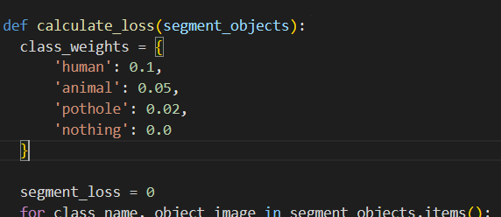
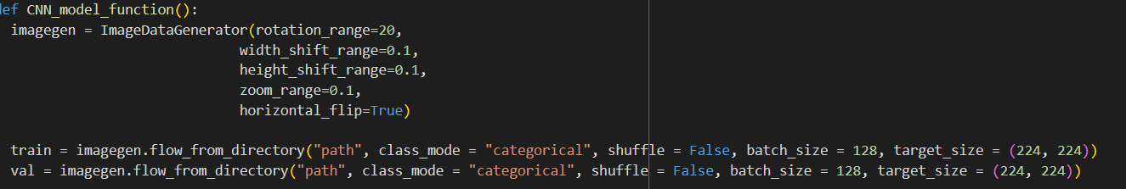
METHODOLOGY - 2
Hyper-Parameter Tuning :-
optimized the code for different types of learning rates - 0.001, 0.01, 0.1
Tune the dropout rate to prevent overfitting and improve generalization on the validation set.
Tune the number of epochs to find the point where the model converges without overfitting.

Slide 17
RESULTS
Model | Accuracy | Precision | Recall | F1 Score
HOG+SVM | 62.38% | 0.56 | 0.51 | 0.44
Logistic Regression | 57.61% | 0.50 | 0.45 | 0.42
Gaussian Naive Bayes | 60.02% | 0.55 | 0.52 | 0.53
Random Forest | 83.61% | 0.80 | 0.80 | 0.80

Slide 18
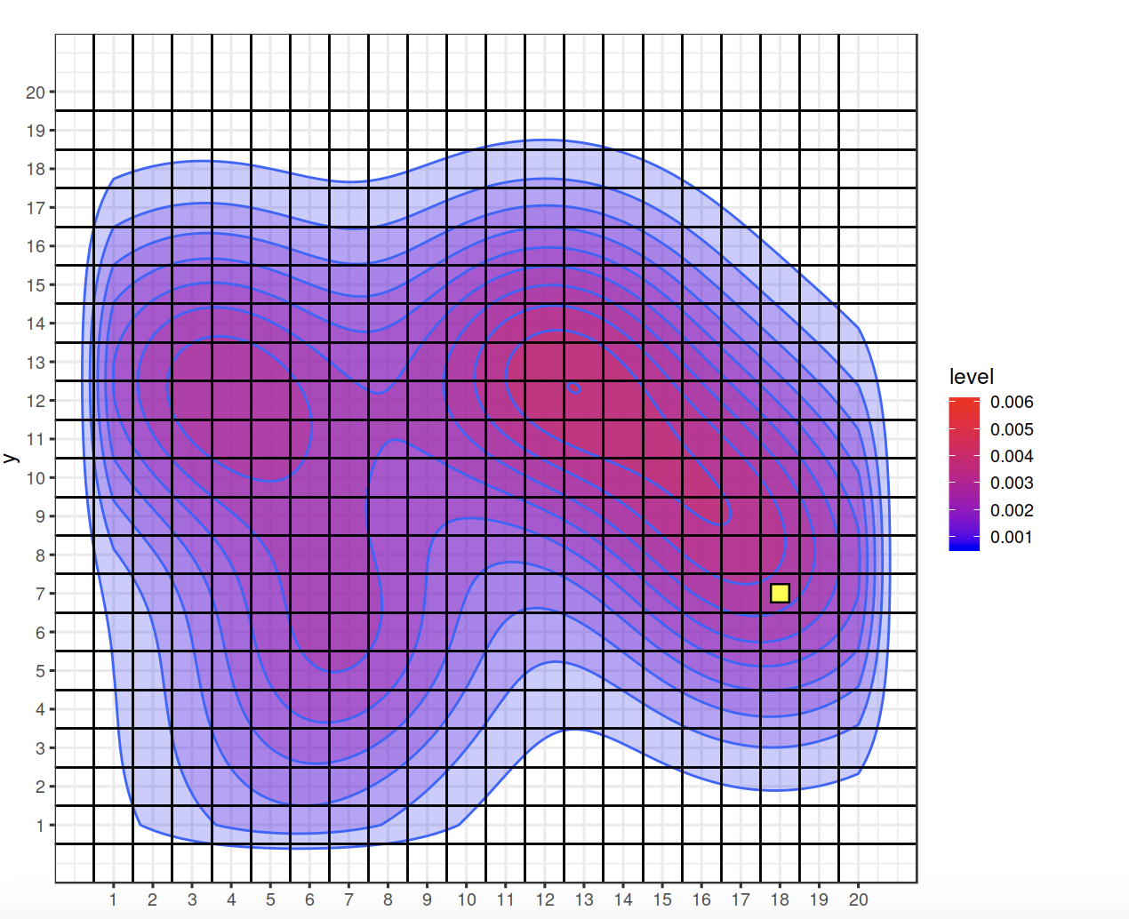
OBJECT LOCATION HEATMAP
The heatmap shows the location of various objects as sensed by the model. The hotspots show that the occurrence of objects is more in the right of the road in the given dataset.
Furthermore, We observe that the sky is relatively clear, which is validated by the lack of aerial objects in our given datasets.

Slide 19
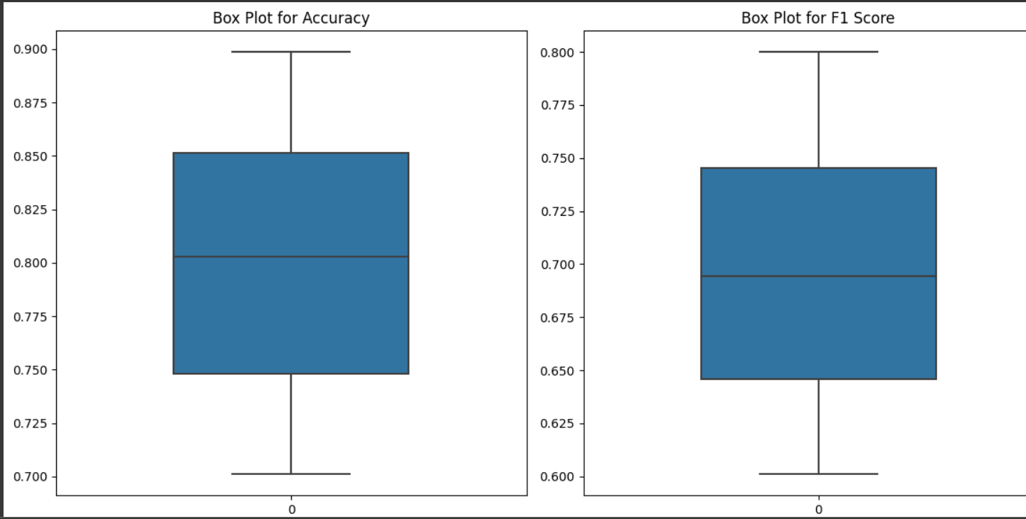

Slide 20
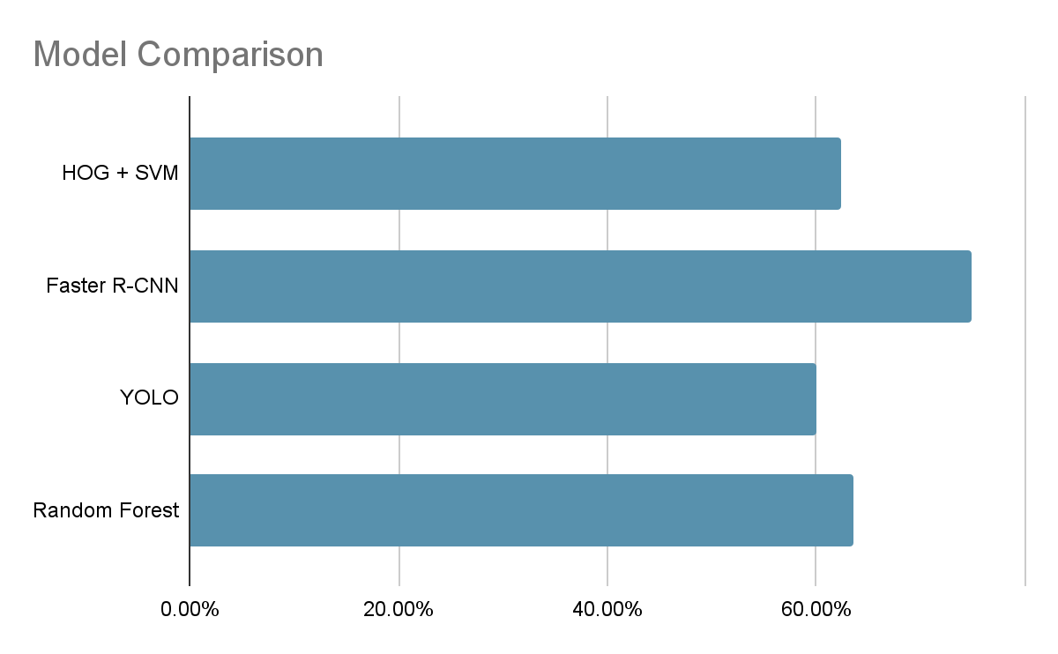
ANALYSIS
1. HOG + SVM is a simple and fast method but less robust to variations.
2. Naive Bayes is a quick method for text but is not suitable for image data.
3. Random forest can perform multiclass classification and provide probability over prediction, but it could be more efficient for high-dimensional data.

Slide 21
CONCLUSION
Learnings
The project helped us learn and use diverse machine-learning models with various hyperparameters.
It helped us learn how to evaluate various models based on their precision, recall, F1 Score, and accuracy metrics.
It allowed us to explore various models for the project and assisted with the next step of narrowing down our technique.
Model can do much better with brake as another possible output for the vehicle as the current model is finding it hard to make sound decisions in case of traffic or overlapping obstructions.
Model is currently missing features that simplifies the image based on colour, which could save computational time and give faster decisions for maneuvering the car.
Future Tasks
The future scope of the project can incorporate finding and experimenting with some unexplored models.
Better training of the data further optimizes the hyperparameters and combines all the better models to get even better performance.
Using methods like cross-validation and leave-one-out cross-validation for training the data to find a perfect balance between variance and bias.
Keeping in mind the speed of the road obstructions could also be kept in mind.
Object direction could also be explored to make better turning decisions.

Slide 22
TIMELINE
Week 1 : Initial Analysing and selection of Dataset and discussing about the future use and making amendments to data to match real world scenarios
Week 2 : Preprocessing the data and visualising the available data using various kinds of graphing techniques
Week 3-4 : Extracting and selecting useful and relevant features and finding correlation present in the available data
Week 5-7 : Applying various possible appropriate ML models and techniques to the data through code like Logistic Regression, SVM, Random Forest, Naive.
Week 8-9 : Analysing the performance of each model for accuracy through various parameters
Week 10 : Further Optimization of the model with best results according to various parameters and finally deploying the model for the project.
Week 11 : Documentation of the work along with creating PPTs and making final amendments
We have done the proposed work till week 8-9 as mentioned in the project proposal.
In addition to the proposed work, we were able to make few optimizations to make the code better by further refining the dataset and doing comprehensive result analysis and comparing it with given models on the world wide web.

Slide 23
INDIVIDUAL CONTRIBUTION
Pratham Singhal: Dataset Collection, Data Pre-Processing, Dataset trimming, feature extraction, data analysis
Shivam Yadav: Research, Literature Survey, Data Visualisation, result analysis
Nitesh Garg: Code Implementation, Model Comparison
Divya Raj Singh: Hyperparameter tuning, Evaluation metrics like performance, accuracy, precision, model training.

Slide 24
THANK YOU

