Slide 1
Team 1- Hospital
Heart disease prediction
Notes:
Template version: 7/29/2013, for PowerPoint 2010

Slide 2
Objective
Analyze data set and come up with insights
Predict Heart disease

Slide 3
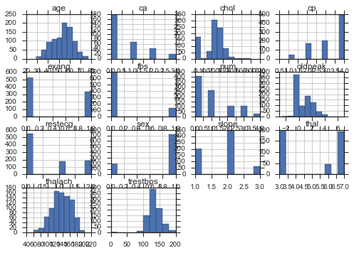
Data Exploration: df.hist()

Slide 4
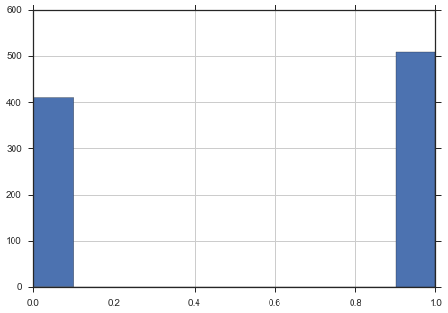
Dependent Variable – Num : 54% Baseline model

Slide 5
Correlation of Variables: df.corr()
 | age | sex | cp | trestbps | chol | fbs | restecg | thalach | exang | oldpeak | slope | ca | thal | num
age | 1.000000 | 0.059074 | 0.160545 | 0.240113 | -0.094709 | 0.232162 | 0.216070 | -0.364599 | 0.198582 | 0.254381 | 0.147920 | 0.373453 | 0.136450 | 0.284783
sex | 0.059074 | 1.000000 | 0.174879 | 0.001700 | -0.196941 | 0.088660 | -0.017503 | -0.180504 | 0.182619 | 0.102933 | 0.124853 | 0.095866 | 0.373528 | 0.308392
cp | 0.160545 | 0.174879 | 1.000000 | 0.021165 | -0.139485 | 0.046324 | 0.036247 | -0.349037 | 0.416770 | 0.247330 | 0.209343 | 0.211612 | 0.318350 | 0.473443
trestbps | 0.240113 | 0.001700 | 0.021165 | 1.000000 | 0.088483 | 0.159022 | 0.096467 | -0.106053 | 0.151138 | 0.160459 | 0.057503 | 0.095646 | 0.106890 | 0.109116
chol | -0.094709 | -0.196941 | -0.139485 | 0.088483 | 1.000000 | 0.024244 | 0.115945 | 0.238281 | -0.037562 | 0.045323 | -0.064665 | 0.051329 | -0.180299 | -0.230772
fbs | 0.232162 | 0.088660 | 0.046324 | 0.159022 | 0.024244 | 1.000000 | 0.129863 | -0.054688 | 0.032062 | 0.052240 | 0.084511 | 0.156896 | 0.103808 | 0.146087
restecg | 0.216070 | -0.017503 | 0.036247 | 0.096467 | 0.115945 | 0.129863 | 1.000000 | 0.049036 | 0.034349 | 0.116900 | -0.021675 | 0.141925 | -0.041551 | 0.068724
thalach | -0.364599 | -0.180504 | -0.349037 | -0.106053 | 0.238281 | -0.054688 | 0.049036 | 1.000000 | -0.354936 | -0.148951 | -0.364551 | -0.264195 | -0.327854 | -0.392091
exang | 0.198582 | 0.182619 | 0.416770 | 0.151138 | -0.037562 | 0.032062 | 0.034349 | -0.354936 | 1.000000 | 0.392169 | 0.322238 | 0.125932 | 0.341977 | 0.463133
oldpeak | 0.254381 | 0.102933 | 0.247330 | 0.160459 | 0.045323 | 0.052240 | 0.116900 | -0.148951 | 0.392169 | 1.000000 | 0.419311 | 0.285170 | 0.253504 | 0.386574
slope | 0.147920 | 0.124853 | 0.209343 | 0.057503 | -0.064665 | 0.084511 | -0.021675 | -0.364551 | 0.322238 | 0.419311 | 1.000000 | 0.113485 | 0.289363 | 0.344932
ca | 0.373453 | 0.095866 | 0.211612 | 0.095646 | 0.051329 | 0.156896 | 0.141925 | -0.264195 | 0.125932 | 0.285170 | 0.113485 | 1.000000 | 0.251095 | 0.454433
thal | 0.136450 | 0.373528 | 0.318350 | 0.106890 | -0.180299 | 0.103808 | -0.041551 | -0.327854 | 0.341977 | 0.253504 | 0.289363 | 0.251095 | 1.000000 | 0.500680
num | 0.284783 | 0.308392 | 0.473443 | 0.109116 | -0.230772 | 0.146087 | 0.068724 | -0.392091 | 0.463133 | 0.386574 | 0.344932 | 0.454433 | 0.500680 | 1.000000

