Slide 1


Empowering Educators: Unveiling the Shiksha App

Slide 2

Content
Understanding the Shiksha Platform
Navigating the Shiksha App
Leveraging Shiksha for Educational Excellence

Slide 3
Understanding the Shiksha Platform

Slide 4
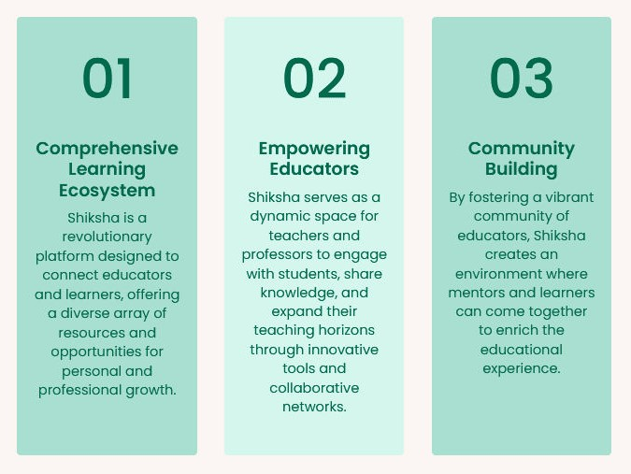
Introduction to Shiksha

Slide 5
Professional Growth:
Avenues for educators to enhance their skills, access career development resources, and stay updated with the latest trends in the education sector, thereby empowering them to excel in their roles.
CAREER DEVELOPMENT OPPORTUNITIES

Slide 6

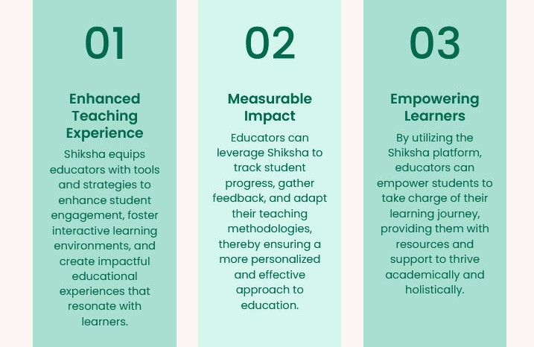
Student Engagement and Impact

Slide 7


Shiksha's Role in Educational Transformation
.

Slide 8
Navigating the Shiksha App

Slide 9
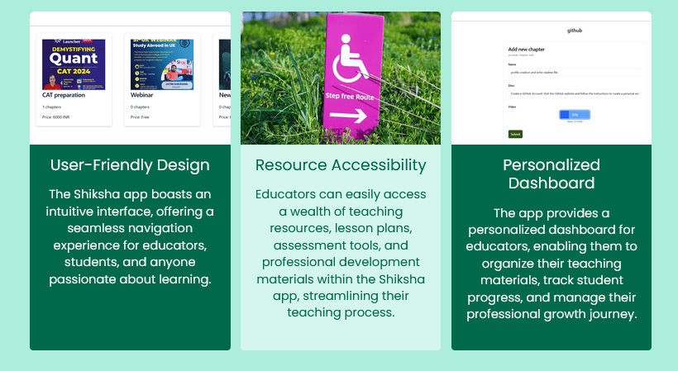
Exploring the Shiksha Interface

Slide 10

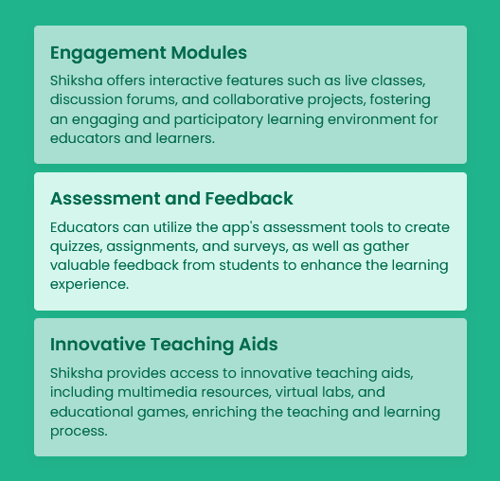
Future Features Include

Slide 11

Shiksha offers
robust technical support and assistance to educators, ensuring a smooth user experience and providing timely resolutions to any app-related queries or concerns.
Scope and Objective
Technical Assistance:Shiksha offers robust technical support and assistance to educators, ensuring a smooth user experience and providing timely resolutions to any app-related queries or concerns.
Accessibility Features: The app is designed to be inclusive, with accessibility features that cater to diverse learning needs, ensuring that educators and learners from all backgrounds can engage with the platform seamlessly.

Slide 12
Leveraging Shiksha for Educational Excellence

Slide 13


Personalized Learning Journeys

Slide 14
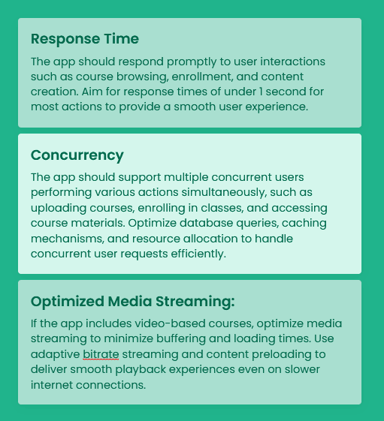
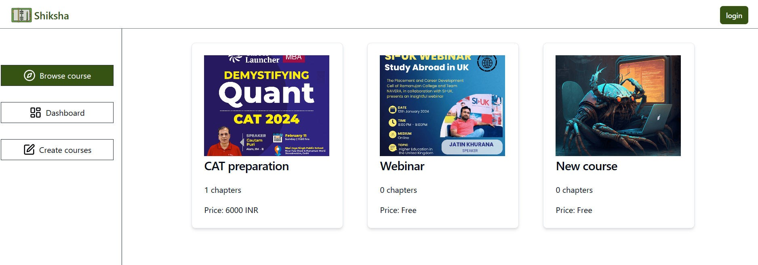
PERFORMANCE

Slide 15
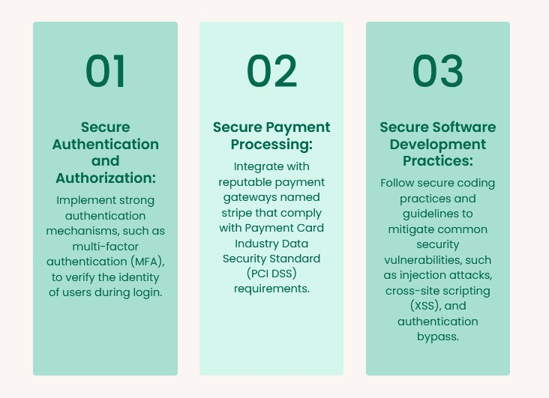
Security

Slide 16

Future-Ready Education with Shiksha

Slide 17


Thank You
visit:
https://shiksha-lms.vercel.app/

