Slide 1
Probabilistic output in left/right hand motor imaginary experiment
Bezsudnova Yulia
24/04/18

Slide 2
Natural arm control paradigm for pick and place task
Motor Imagery signals for right and left hand movement as user output.
Shared control paradigm – the natural-like blend of user control and robot control.
To decode users intention by computer vision means – to correct trajectory
To perform correction of misclassification of users commands
To be able to work with multiple objects –to choose
First task : TO BE ABLE TO GO TO ANY POINT ON THE PLANE

Slide 3
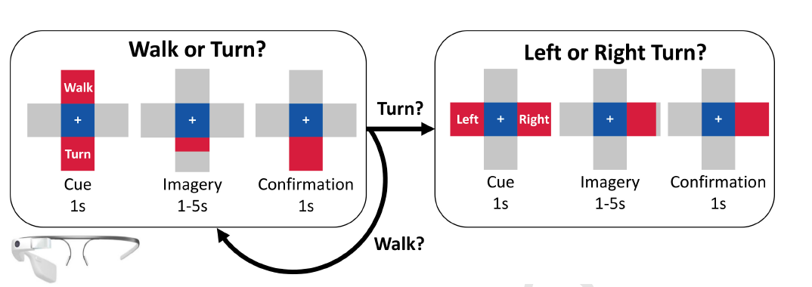
2D plane movement from binary signals
In literature
More the two mental states(two hands and foot motor imagery)
Two or more types of brain signals (MI+P300)
Cascaded classifier
Posterior probability output of binary classifier – “User controls two degree of freedom – Left or right + The assurance of the classifier”

Slide 4
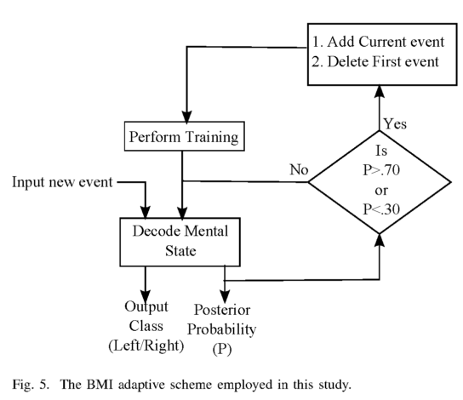
The advantages of posterior probability (PP)
“PP are required when classifier is making a small part of overall decision and the classification output must be combined for overall decision”
To make decoder co-adaptable to changing brain state of subject
To perform mistake correction
To be able to blended seamlessly with robot control
To perform 2D plane movement from binary signals
Platt, J. (1999). Probabilistic outputs for support vector machines and comparisons to regularized likelihood methods. Advances in Large Margin Classifiers, 10(3), 61–74. https://doi.org/10.1.1.41.1639
Bhattacharyya, S., Shimoda, S., & Hayashibe, M. (2016). A Synergetic Brain-Machine Interfacing Paradigm for Multi-DOF Robot Control. IEEE Transactions on Systems, Man, and Cybernetics: Systems, 46(7), 957–968. https://doi.org/10.1109/TSMC.2016.2560532

Slide 5
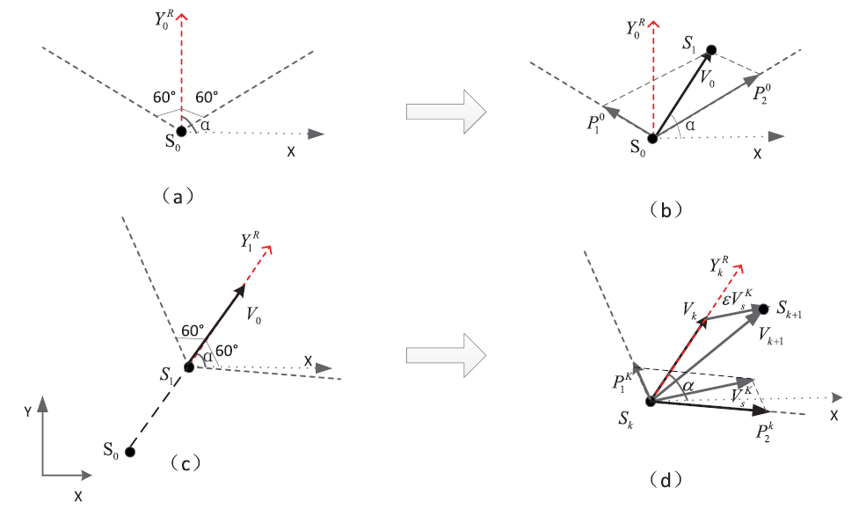
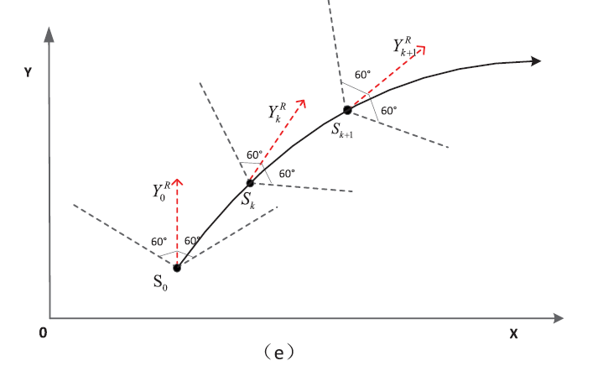
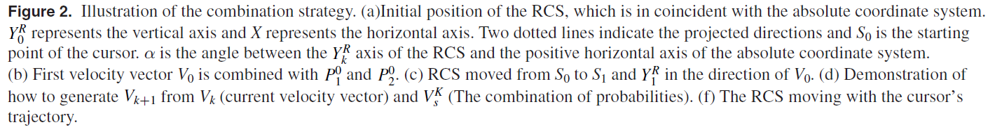
A binary motor imagery tasks based brain computer interface for two dimensional movement control Bin Xia, Lei Cao, Oladazimi Maysam, Jie Li, Hong Xie, Caixia Su and Niels Birbaumer
2017 J. Neural Eng. 14 066009
Left and Right MI signal – CSP+ SVM plus sigmonoid combination

Slide 6
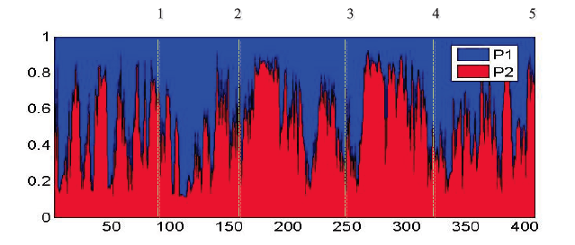
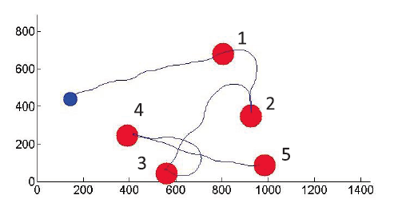
A binary motor imagery tasks based brain computer interface for two dimensional movement control Bin Xia, Lei Cao, Oladazimi Maysam, Jie Li, Hong Xie, Caixia Su and Niels Birbaumer
2017 J. Neural Eng. 14 066009
A novel combination strategy is introduced, which allows the participant to control 2D movement by controlling the combination of two-class MI tasks in a rotating coordinate system (RCS)
Posterior probabilities(p1, p2) were applied to construct a 2D movement control system instead of discrete labels.

Slide 7




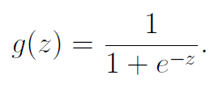
Ways to get posterior probability
SVM+sigmoid combination
The method leaves the SVM error function unchanged, but it adda a trainable post-processing step which is trained with regularized binomial maximum likelihood (log-odd)
Logistic regression
kernel machine trained explicitly maximize a log multinomial likelihood
Random forest classifier
BLDA – need to calculate prior probability

Slide 8
Ways to get posterior probability
SVM+sigmoid combination
The method leaves the SVM error function unchanged, but it adda a trainable post-processing step which is trained with regularized binomial maximum likelihood (log-odd)
Logistic regression
kernel machine trained explicitly maximize a log multinomial likelihood
Random forest classifier
BLDA – need to calculate prior probability
Have comparable quality

Slide 9
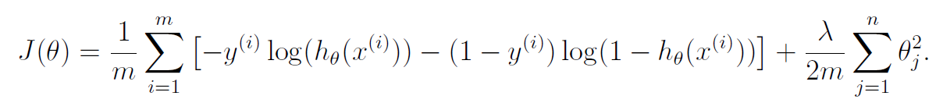
Logistic regression with regularization
Hypothesis
Estimated probability that y=1 on input x, where theta is parameter
Cost function to choose parameter theta
maximum likelihood estimate method of estimating the parameters of a statistical model, given observations. MLE attempts to find the parameter values that maximize the likelihood function, given the observations
To find minimum – gradient descend

Slide 10
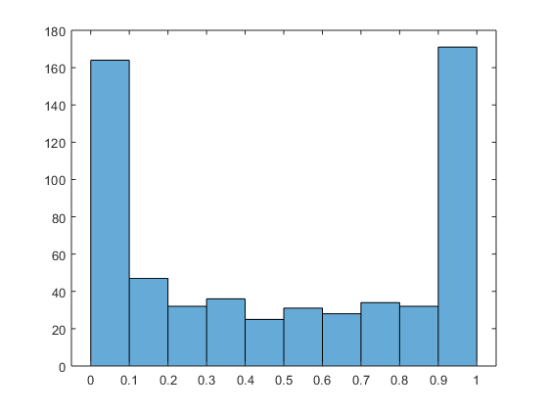
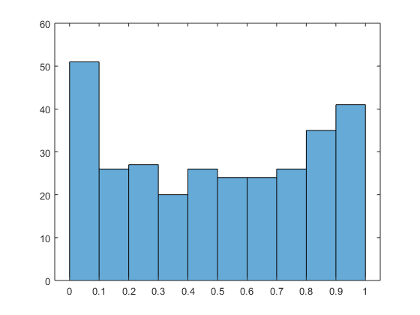
Results – probability distribution Left vs Right hand – cross-validation results.
Good performants
Bad performants
Mean accuracy 86% (82%)
Mean accuracy 50% (48%)
does not change with regularization parameter
Optimal regularization parameter is chosen from validation curve of calculated accuracy

Slide 11
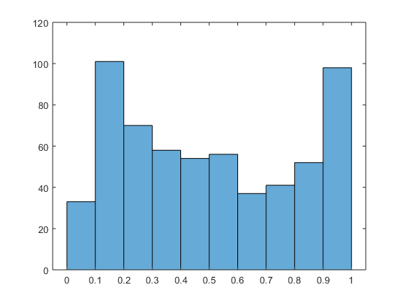
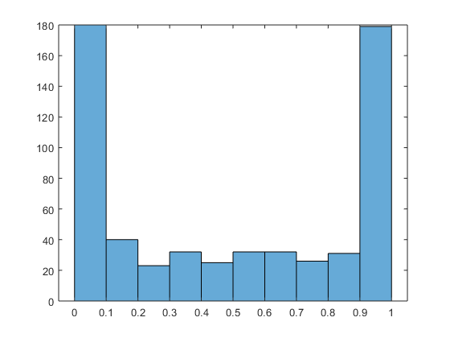
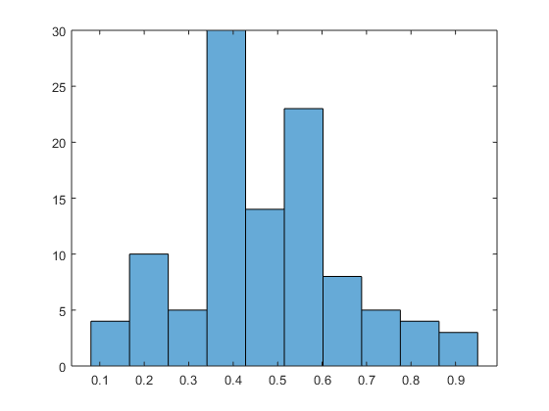
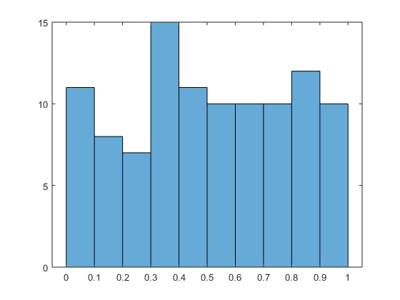
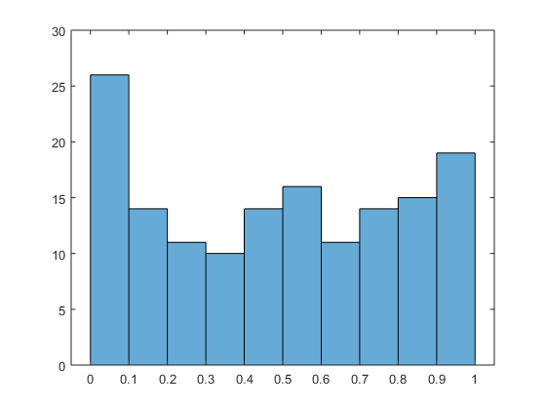
Results – misclassification distribution
Overall PP distribution λ=2
Overall PP distribution λ=0.03
Overall PP distribution λ=0.04
Misclassified PP distribution λ=2
Misclassified PP distribution λ=0.03
Misclassified PP distribution λ=0.04
75% misclassified results є[0.3;0.7]
44% misclassified results є[0.3;0.7]
31% misclassified results є[0.3;0.7]

Slide 12
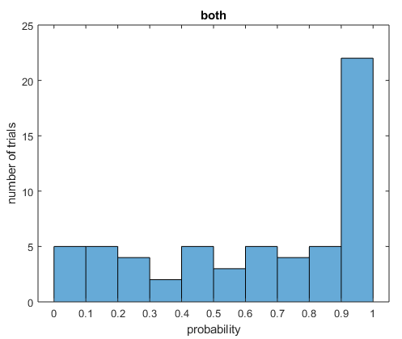
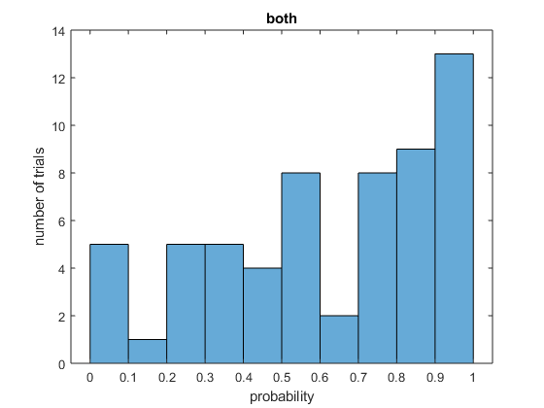
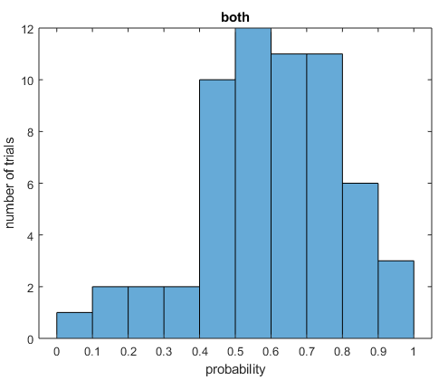
Hypothesis – probability of both hands movement ̴50%
λ=2
Optimal λ=0.03
Optimal λ=0.04
60% є[0.3;0.7]
8% є[0.3;0.7]
31% є[0.3;0.7]

Slide 13
Hypothesis – probability of both hands movement ̴50%
λ=2
Optimal λ=0.03
Optimal λ=0.04
training
60% є[0.3;0.7]
8% є[0.3;0.7]
31% є[0.3;0.7]
Choose regularization parameter

Slide 14
Future plan
Problem: to understand is user can control probability, which should yield in both hand imaginary having 50% pick in distribution
To choose right regularization parameter – the algorithm
To try to implement SVM+sigmanoid combination (as in a paper)
To train user in online experiment:
When user can see the probability outcome and try to adjust “thinking” (mental state)
THEN – 2D plane movement paradigm – algorithm to canculate coordinates of courser – validate the paradigm in online experiment with visual courser

Slide 15
Thank you!

Slide 16
