Slide 1

Website user testing and customer journey mapping

Slide 2

Who I am
Website content editor
Digital strategist
Social media lead
Digital content creator

Slide 3
Website background
Website built on Oracle
  hardcoding
  custom navigation based on LGNL
  focus groups using Citizens Panel
  not meeting accessibility standards

Slide 4
Website background
Website #1 built on Jadu
  non-technical
  SNL built in
  first proper user testing

Slide 5
Website background
Website #2
  responsive design
  rolling programme of user testing
    users filmed
    template for report and recommendations
    done for web journeys and new processes

Slide 6
Website background
Website #3
  new, custom navigation
  designed around tasks and customer journeys
  radical change in design

Slide 7
Why user test?

Slide 8
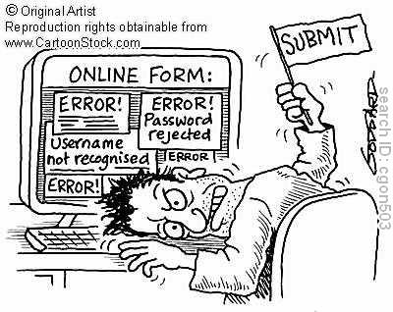

Slide 9
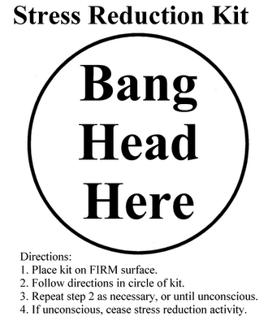

Slide 10
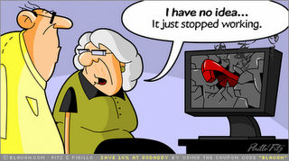

Slide 11
Why journeys go wrong
Council processes don’t translate
Officers can be inward looking
Management don’t see the web team as experts
Silo working eg school meals, blue badge
Dead ends
3rd party sites

Slide 12
Types of user testing
Online eg usertesting.com
Remote user testing software
Hallway testing
Live testing

Slide 13
Hallway testing
It’s cheap
It’s quick
It’s low-tech
Good for testing processes and wireframes before go-live
First Fridays

Slide 14
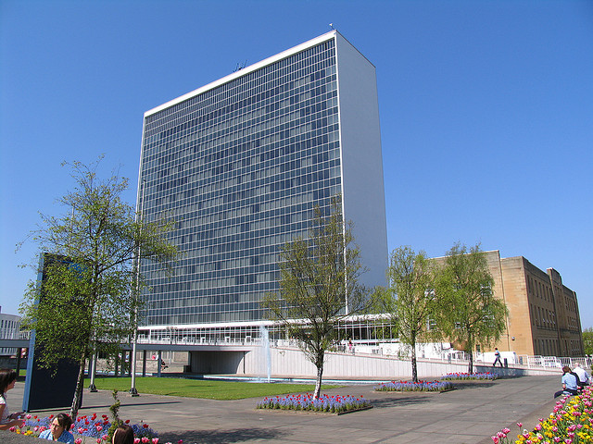

Slide 15
Hallway testing
15 landings
1 staff restaurant
1500 employees
Another council building across the road with 250 employees and 3 landings
73% of staff are South Lanarkshire residents
1277 people who’ll do anything for chocolate

Slide 16
Live testing
Employees who don’t work on the website or for the service being tested
Friends and family of the web team
Web feedback people
Citizens Panel
Employee groups
Employment groups

Slide 17
Live testing
Keep the scenarios simple
  in real life people do one thing at a time
Tell testers you’re not testing them
Give them a get out clause
Don’t help them unless they don’t understand the scenario
Nominal payment

Slide 18
How people start
Start them on Google, not the homepage
  Google results may be your homepage
Where they start their journey becomes a reference point
  may even become a sticking point

Slide 19
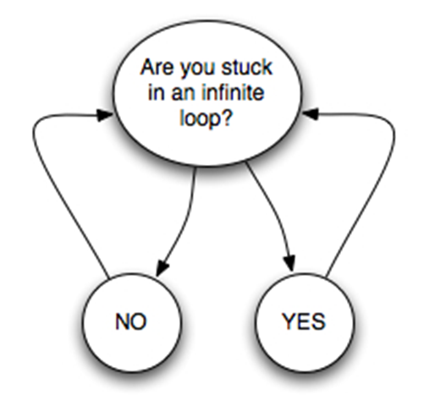

Slide 20
Filming
Film over the shoulder
Be unobtrusive
Don’t hover or bother
DVD

Slide 21
Playback
Note navigation
Note times
Note what terms people search on/use in forms
Note each step taken
Keep calm

Slide 22
Some interesting results
Some use navigation
Some use site search
Some use A-Z
Some use the breadcrumb
Some use a mixture
If you want to drop any of these what you have left has to be bullet proof

Slide 23
Some interesting results
People often over-estimate their web skills
People think they have completed a task when they haven’t
A lot of people hate maps
People don’t read more than 2 lines of instructions

Slide 24
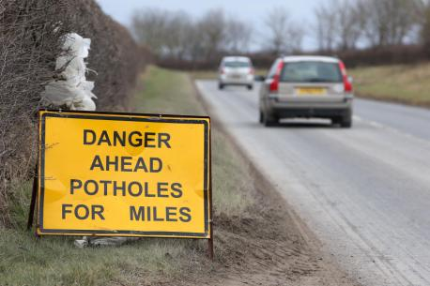

Slide 25
Road and lighting faults
First channel shift project
Quick win to integrate web mapping with roads back office
Work done without input from web team
Once live web team recognised issues
  Only able to report using map
  Lengthy instructions
  Not plain English
  Not usable on a mobile

Slide 26
Road and lighting faults user testing
People took about an hour to report three faults
Most people hated the maps
Out in the real world
  Avoidable contact went up
  Internal double-handling went up
  Old form had to be reintroduced for mobile users

Slide 27
What we did
Worked with ESRI to make the mapping more intuitive
Set the scale so the pin shouldn’t be dropped in gardens
Reduced the length of the form
Translated everything into plain English, including lighting columns
Set up another round of user testing

Slide 28
The results
People took 15 minutes to report 3 faults
People’s experience more positive
Back office report more accurate reporting

Slide 29
Experience mapping
Low-tech
Quick
Shows breaking points clearly
Shows highlights clearly
Captures thoughts and feelings
Used by DVLA, HM Prison Service, Borders and Immigration Agency, DWP and NHS

Slide 30
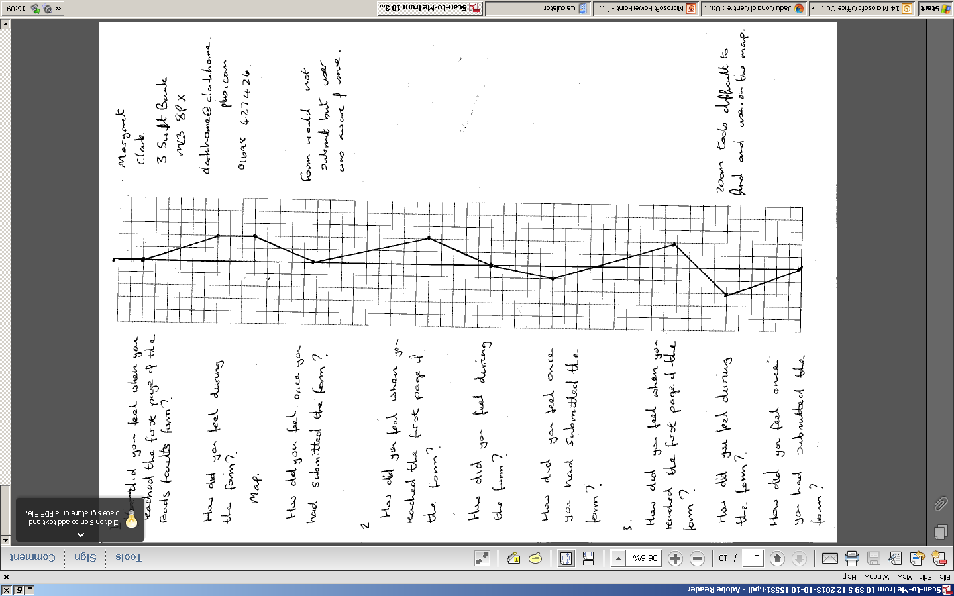

Slide 31
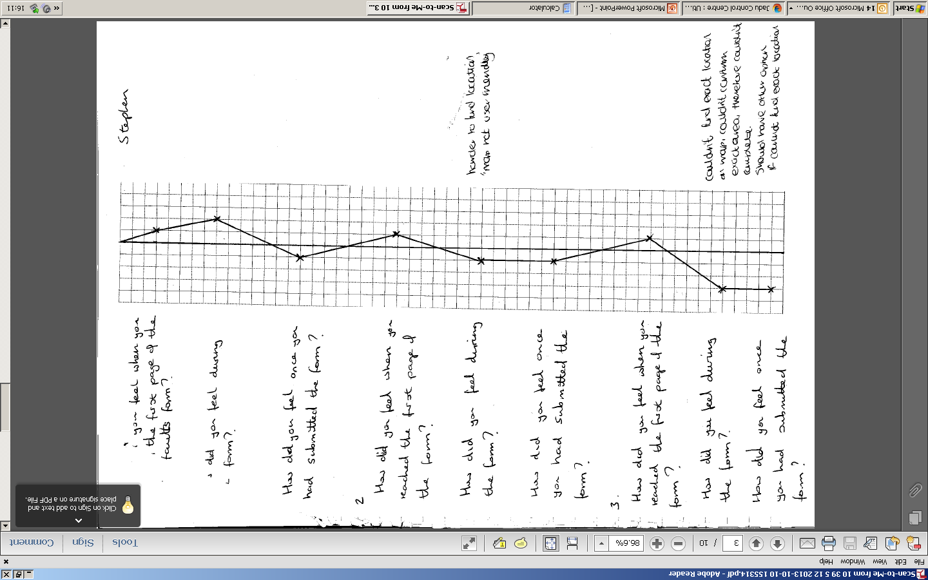

Slide 32
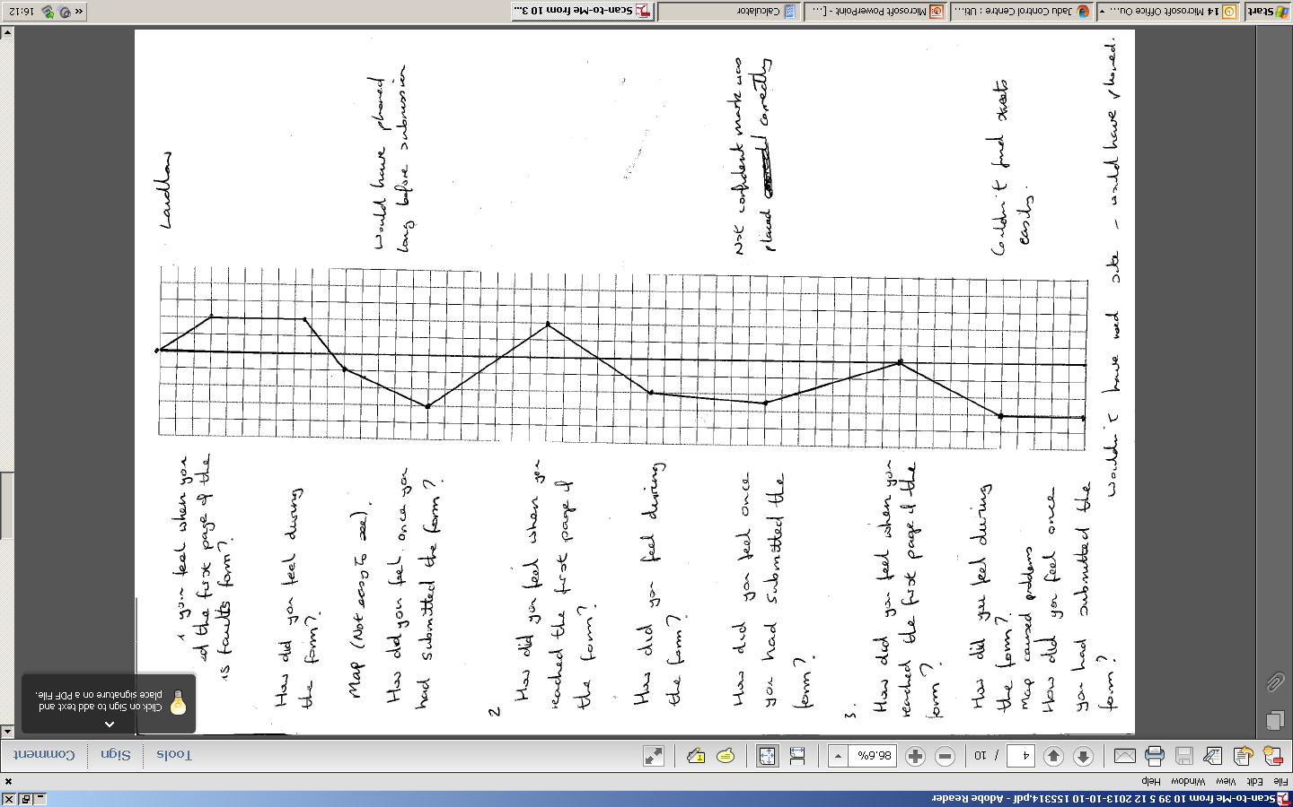

Slide 33
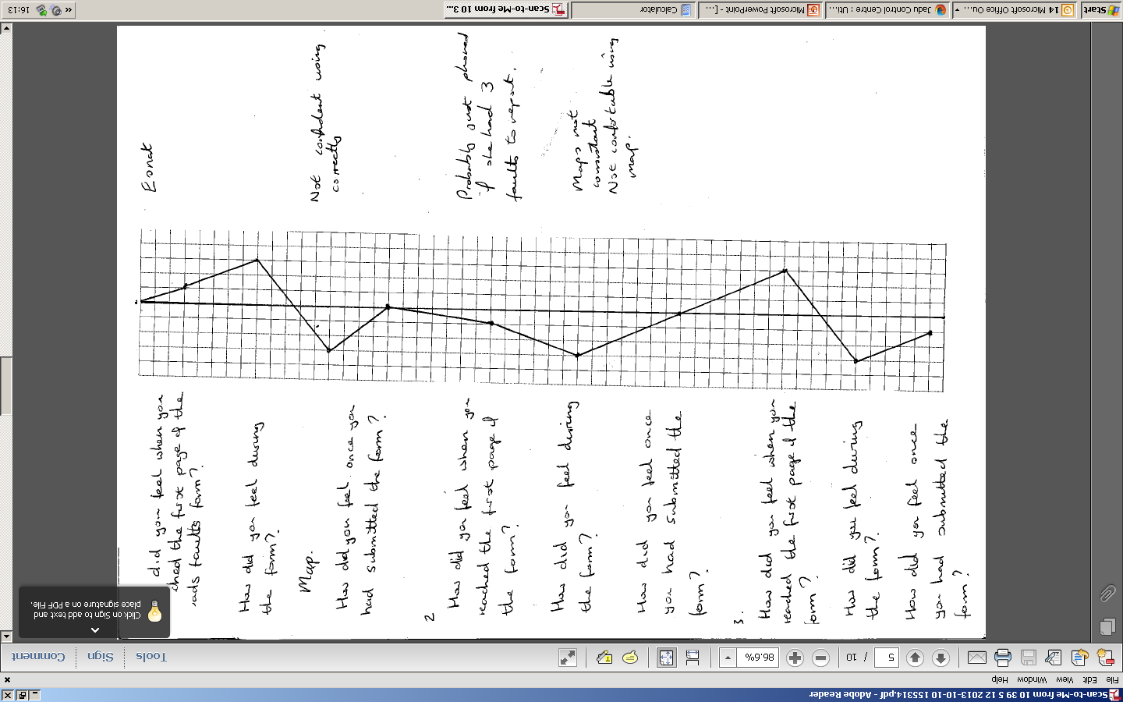

Slide 34
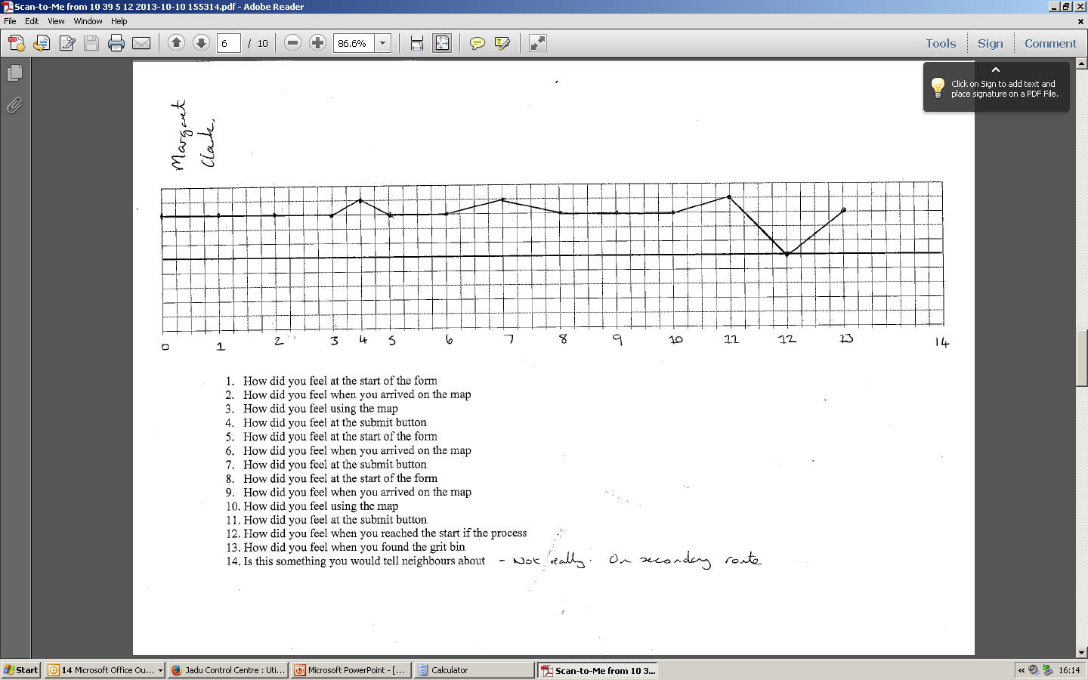

Slide 35
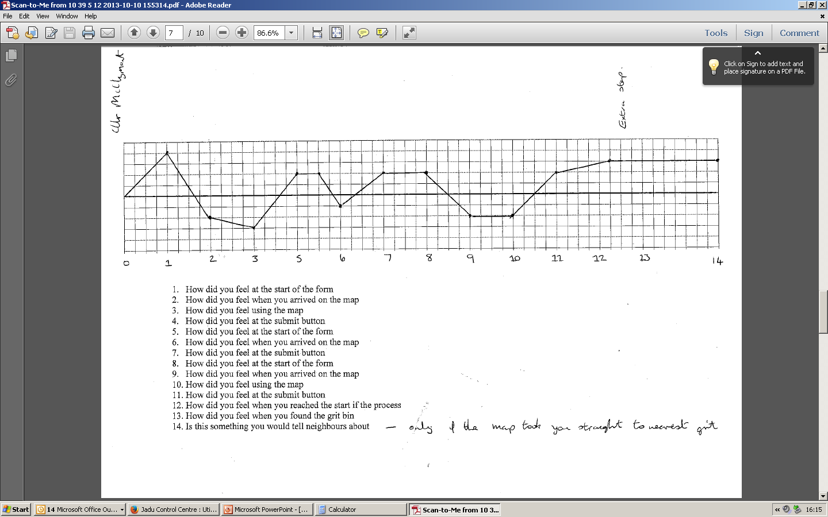

Slide 36
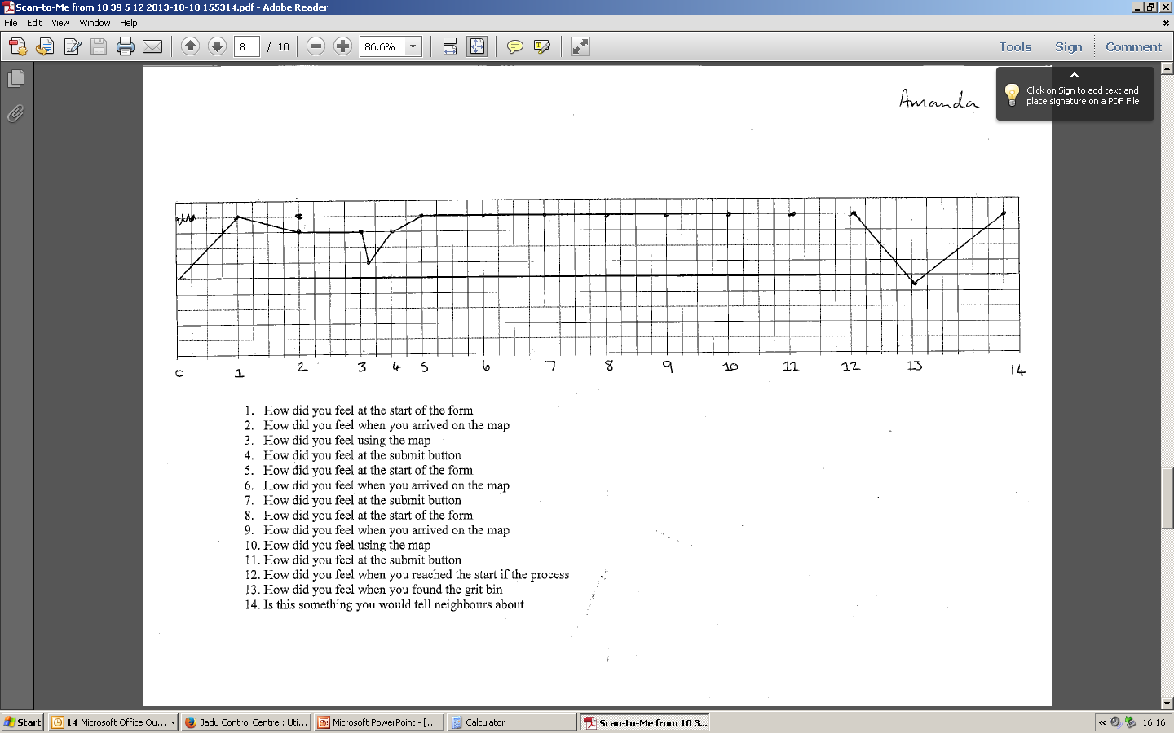

Slide 37
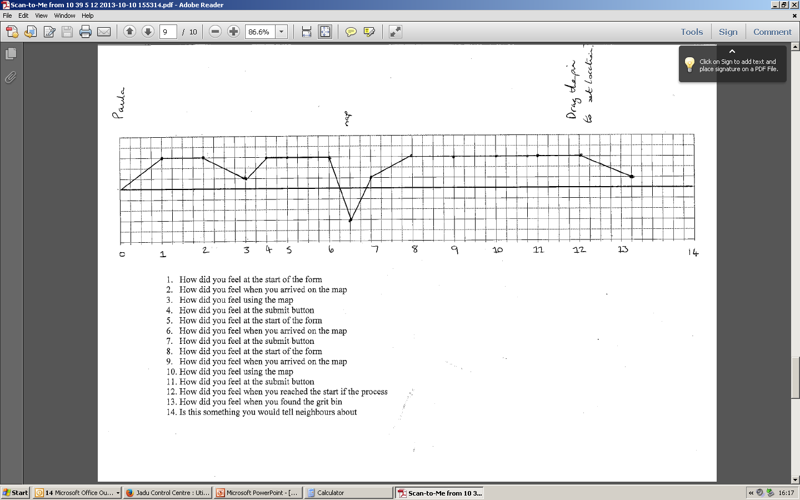

Slide 38


Slide 39
The future
Regular user testing
Testing on different devices
A blend of different kinds of testing
Testing as part of service transformation/improvement
Testing before during and after web/service development
Possible development of templates and methodology for benchmarking

Slide 40
What about Better Connected?
BC reviewers are not your customers
If your customers contradict BC, go with your customers as long as you have evidence
Don’t shoehorn BC scenarios in for the sake of it – they’ll get in the way of what the important people are trying to do.

Slide 41


Slide 42
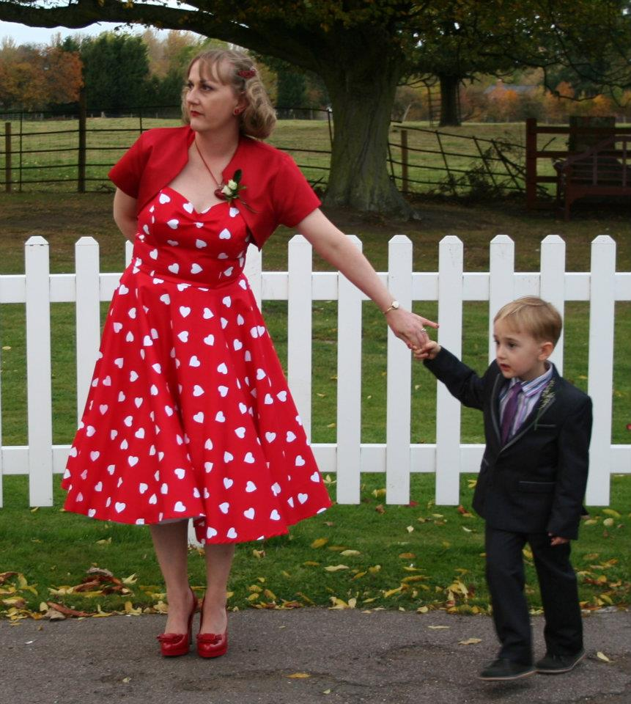
carolyne.mitchell@_x000b_southlanarkshire.gov.uk
@Cal444

