Slide 1
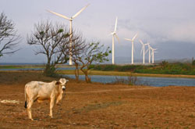
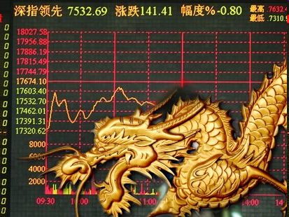
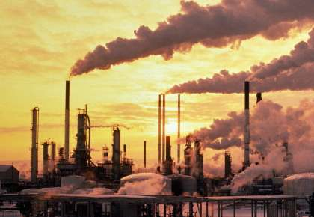
Reforming Carbon Governance.
The Clean Development Mechanism (CDM) from an emerging economy perspective

Slide 2
The Sonderforschungsbereich (SFB) 700
20 individual research projects covering theory, political order, security, economy and environment (www.sfb-governance.de)
Five universities and research centers in Berlin and Potsdam, some 20 scholars and more than 45 Ph.D. students involved
Focus on non-OECD countries
Project by University of Potsdam focuses on carbon governance in developing and emerging economies

Slide 3
"The Clean Development Mechanism [the offset part of the Kyoto Protocol], which provides about 95% of the offsets used in the European market, is clearly broken and should be quickly phased out."
Fred Krupp, President EDF, Wall Street Journal Environmental Capital blog, 20 March, 2009

Slide 4
Policy question
Shall a post-Kyoto agreement include an offset mechanism like the Clean Development Mechanism (CDM)?

Slide 5
Research question
What effects did the CDM have in its major host countries (Brazil, China, and India)?

Slide 6
Overview
What is the CDM?
Why is it so heavily criticized?
The CDM in Brazil, China and India
Reform proposals
So what?

Slide 7
Overview
What is the CDM?
Why is it so heavily criticized?
The CDM in Brazil, China and India
Reform proposals
So what?

Slide 8
How does a CDM work?
Host country (developing country, Annex II country)
Industrial country
(Annex I country, or private firm from annex 1 country)
Anticipated emissions without CDM
Reduc-tion
Additional
CO₂ emissions
De facto emissions
with CDM
Kyoto-Protocol
defined amount
of CO₂ emissions
Trading Carbon Emission Reductions
Transfer of technology and resources

Slide 9
Objectives of the CDM
Cost-effective mechanism for Annex I countries to offset
GHG
Induce practices of sustainable development in host
countries
→ Strongest link regarding carbon governance between developing and developed world

Slide 10
The CDM a „new mode of governance“
  Use of market instruments to provide mitigation options efficiently and effectively
  Private actors interact directly with international organizations
  Development of several multiactor, multilevel public-private partnerships (PPPs) and new networks
  New actors in respective countries

Slide 11
Business operation under the shadow of hierarchy
Low project risk
Closure of PPP once dispensable OR transformation into business relationship
rule implementation
High project risk
rule setting
Initiation of PPP
2001
2004
2008
Carbon market evolvement

Slide 12
Overview
What is the CDM?
Why is it so heavily criticized?
The CDM in Brazil, China and India
Reform proposals
So what?

Slide 13
Fundamental critique
Don‘t commodify nature!
No impact at all!
Distortion from real problems

Slide 14
Technical critique regarding the fulfillment of the objectives
Hardly any contribution to sustainable development
Questionable additionality

Slide 15
Critique regarding the governance of the CDM
Important sectors left out
Regional disparities (LDC 0.9% of all projects)
Red tape and unprofessional bureaucracy

Slide 16
Overview
What is the CDM?
Why is it so heavily criticized?
The CDM in Brazil, China and India
Reform proposals
So what?

Slide 17
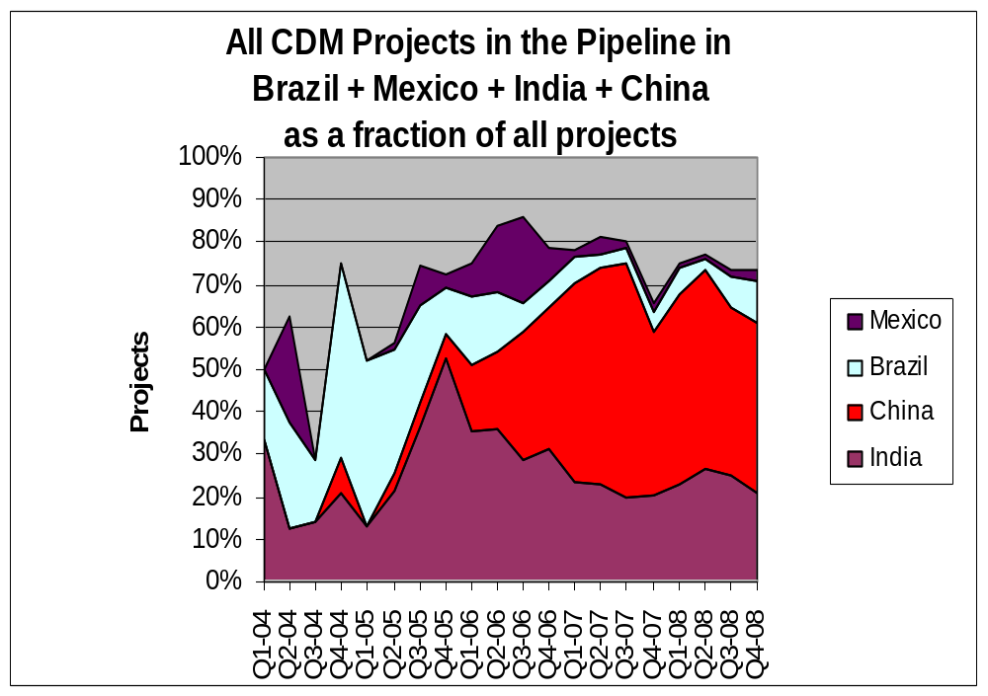
(Source: UNEP 2009)

Slide 18
 | No. of projects in pipeline (registered) | % share of worldwide total projects in pipeline | Volume of kCERs up to 2012 in pipeline | 3 most common project types | 3 most common project types worldwide
Brazil | 352 (150) | 7,8% | 188.294 | Biomass energy; hydro power; agriculture | 1.Hydro power 2. Biomass energy 3. Wind power
China | 1682 (433) | 37% | 1.567.120 | Hydro power; wind power; energy efficiency
India | 1208 (395) | 26.6% | 461.617 | Biomass energy; wind power; energy efficiency
(Source: UNEP 2009)

Slide 19
The CDM in Brazil
Strong local capacities and increased awareness
Introduction of cleaner technologies (landfill, small hydro)
Push for renewable energy (> Profina)
CERs 20th largest export commodity

Slide 20
The CDM in China
Strong local capacities, increased awareness, and rise of local project developers and DOEs
Push for renewable energy
Slowly emerging discourse on climate change within public
HFCs taken care of

Slide 21
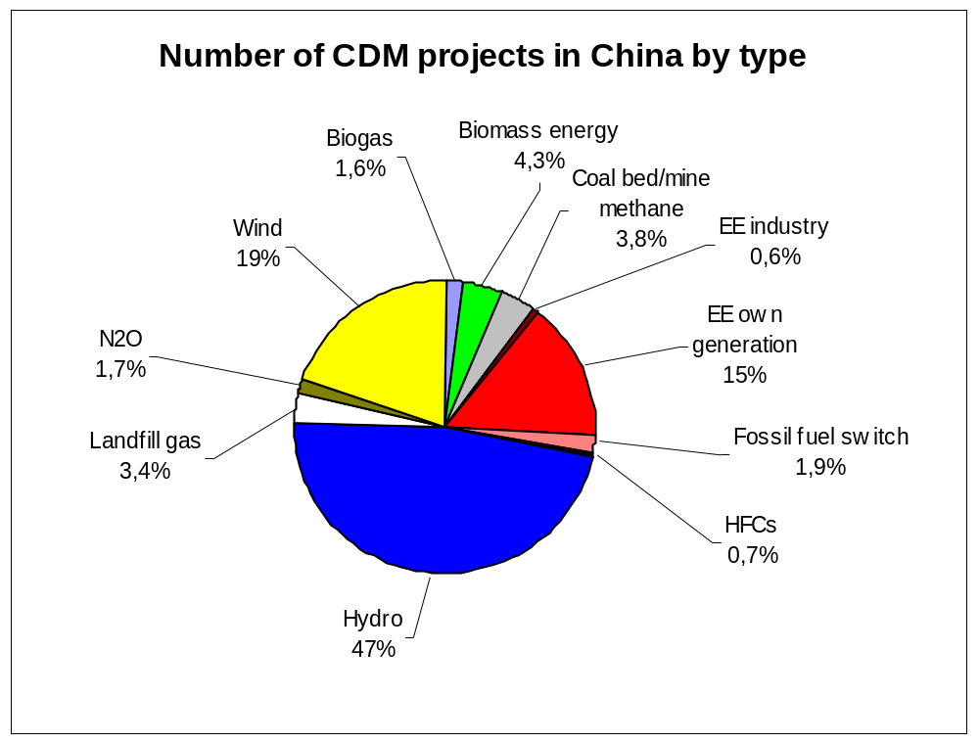
(Source: UNEP 2009)

Slide 22
The CDM in India
Strong local capacities, increased awareness, and rise of local project developers and carbon financiers
Push for renewable energy, in particular wind energy and biomass
Small push towards decentralized energy system
→ In India most projects where additionality is questionable but also most projects where sustainable practices have been induced

Slide 23
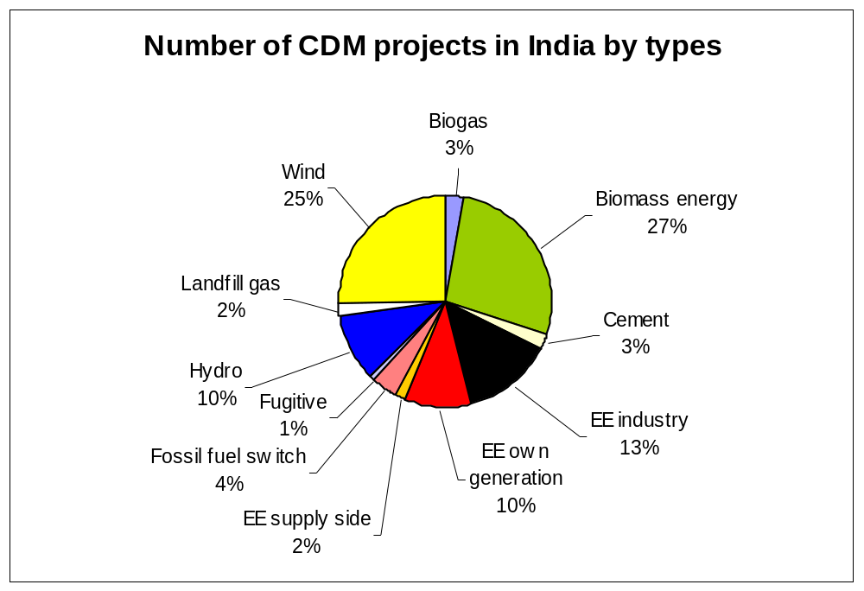
(Source: UNEP 2009)

Slide 24
The CDM in emerging economies
CDM a successful instrument to link emerging markets into Kyoto
Market mechanism accepted and perceived as successful in the most important host countries
Strong ownership of governments
Multilevel regulation problematique but no race to the bottom
Strong output legitimacy, weak input by civil society

Slide 25
 | Brazil | China | India
Government | Holds up ‘environmental integrity’ in project development | Keeps control of market and foreign actors, but also provides capacity development | Has facilitating role for CDM market development
Project developers/ Consultancies | Heavy competition, but informal cooperation among biggest consultancies | International and domestic project developers | Many unilateral projects developed by Indian companies
Buyers/traders | Financial community has large interest in developing carbon market and trading, but so far with limited success | Banks have no interest in trading, hardly an interest in project financing | Slowly emerging awareness among national banks
Civil society | Awareness, but limited engagement in CDM | Awareness, positive position, no capacity | Engagement in project activities, but no watchdog
Epistemic communities | Strong involvement from key scientists in methodology development and cooperation with DNA | Involvement of scientists in CDM capacity development and project development | Mostly among development assistance community + business community

Slide 26
Overview
What is the CDM?
Why is it so heavily criticized?
The CDM in Brazil, China and India
Reform proposals
So what?

Slide 27
The radicals
Stop CDM!
Tax carbon or build a global cap and trade system!
<->
Path dependency
Vested interests

Slide 28
Scale it up!
PoA
Sectoral/ policy CDM
Large potential of rather cheap CERs with probably good sustainable development impact
<->
Who is setting the baseline?
MRV?

Slide 29
Increase the scope!
Include LULUCF
Include CCS
Include nuclear
<->
Technical problems, partially MRV
Strong political opposition

Slide 30
Reform the governance structure!
Professionalize EB
Set-up an appeals body

Slide 31
Increase sustainability!
Include discount factors for CERs
Set international SD standards
<->
Vested interests

Slide 32
Overview
What is the CDM?
Why is it so heavily criticized?
The CDM in Brazil, China and India
Reform proposals
So what?

Slide 33
CDM in post-2012 architecture
Will play a role as a „temporary tool to help transition countries toward broader commitments“ (GAO 2008, 38) in a reformed way
Still strongest link between Annex I and II countries
CDM only one instrument towards a low carbon future

Slide 34
Thank you for your attention!
Contact details:
Markus Lederer
lederer@uni-potsdam.de
+49 331 977 3531
University of Potsdam, Germany

