Slide 1
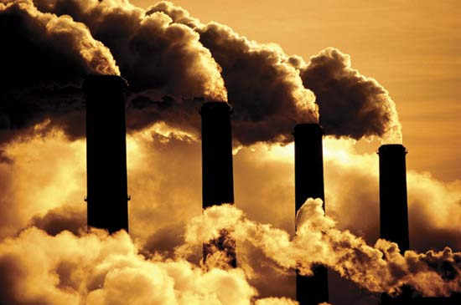

Governance Effects of Emerging Carbon Markets:
Insights From UK-Listed Companies
SMITH SCHOOL OF ENTERPRISE
and the ENVIRONMENT (SSEE)
Chukwumerije Okereke
5th May 2009

Slide 2
Outline
Context
Sample and Significance
Results
Anatomy of Governance
4 Key Governance Impacts of Emerging Carbon Markets
Summary and Conclusion
SMITH SCHOOL OF ENTERPRISE
and the ENVIRONMENT- SSEE

Slide 3
Sample
Oil | BP | Shell | Schulmbeger
Mining and Steel | BHP Billiton | Corus
Power | Scottish Power | Centrica | Solar Century
Business Organisations | UK-BCSD | UK-Steel | Assoc. of Electricity Generators
Govt. Depts. | Environment Agency | DEFRA | BERR
NGOs | Christian Aid | Green Peace | Climate Group
Agencies | Carbon Trust | SDC | Carbon Neutral

Slide 4
Material Impact
Greehouse Gas Emissions
  20% of UK Emissions
  5 Companies accounted for over 67% of FTSE 100
  Shell, BP, BHP Billiton, Scottish Power, Corus
  Annual direct =304 million tonnes =Poland/Spain
  Annual indirect =2 billion =Canada+UK=India
SMITH SCHOOL OF ENTERPRISE
and the ENVIRONMENT - SSEE

Slide 5
Material Impact
 | FTSE 350 | S&P 500 | Global 500
% Response | 67 | 64 | 77
Scope 1 | 365 MtCO2-e | 1.7 BtCO2-e | 2,690 MtCO2-e
Scope 2 | 122 MtCO2-e | 253.7 MtCO2-e | 494 MtCO2-e
Scope 3 | 2,573 MtCO2-e | 237.1 MtCO2-e | 4,175 MtCO2-e
Source CDP 2008
SMITH SCHOOL OF ENTERPRISE
and the ENVIRONMENT - SSEE

Slide 6
Results
Activities
  Strategy; risk, infancy; incremental
Drivers and Barriers
  Cost saving, profit, CA, regulation
Policy
  National level; level playing field; sector
Governance
SMITH SCHOOL OF ENTERPRISE
and the ENVIRONMENT- SSEE

Slide 7
Anatomy of Governance
POWER
ACTORS
INSTITUTIONS
PROCESSES
OUTCOME
IDEAS
OBJECTIVES
RULES

Slide 8

Effect 1: Increased Private Role
Industry
Entreprenuers
Individuals
Partnerships
Collaborative
SMITH SCHOOL OF ENTERPRISE
and the ENVIRONMENT -SSEE
Notes:
Implies rapid commercialization of CCS, many nuclear plants are replaced and new improved ones built – additional 30% capacity should be installed

Slide 9

Effect 2: Promote Voluntarism
Market
Technology
Innovation
SMITH SCHOOL OF ENTERPRISE
and the ENVIRONMENT -SSEE
Notes:
Implies rapid commercialization of CCS, many nuclear plants are replaced and new improved ones built – additional 30% capacity should be installed

Slide 10

Effect 3: Increased Efficiency
Low Cost
Steady Growth
Global Reach
SMITH SCHOOL OF ENTERPRISE
and the ENVIRONMENT -SSEE
Notes:
Implies rapid commercialization of CCS, many nuclear plants are replaced and new improved ones built – additional 30% capacity should be installed

Slide 11
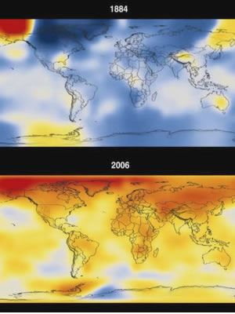
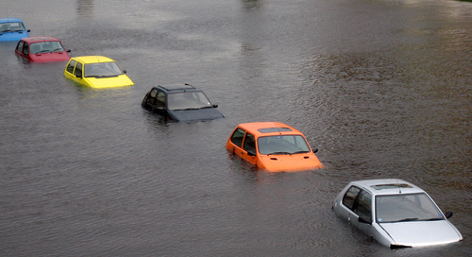
Effect 4: Reduced Effectiveness?
A question of scale

Slide 12
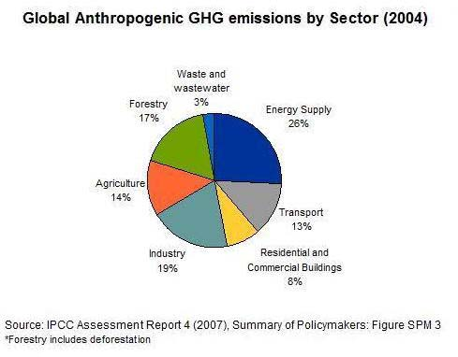
.

Slide 13
A 550ppm 2050 World
Coal use grows by 50% comapre to 2002
  But half of gen. capapcity uses CCS
Natural Gas is largest fossil contributor to electricty gen.
  Implies 3ple 2002
Highly effeicnt coal and gas facilities
  Wide deployment of CHP units
Nuclear gen grows 3ple 2002 level
Rapid Grwoth in Renewables
  Wind increase 160-fold 911% p.a; Solar grows at ca. 205 p.a
SMITH SCHOOL OF ENTERPRISE
and the ENVIRONMENT -SSEE

Slide 14
A 550ppm 2050 World Contd.
Ca. 1 billion vehicles on worlds roads
20% ghg Emissions
ca. 2 billion 2050
Aviation emissions will 3ble by 2050
  High effeiciny hydrogen vehicles
  Biomass fuel
  Hybrid cars
  Wider use of diesel
  Rail transport (up by 7%)
SMITH SCHOOL OF ENTERPRISE
and the ENVIRONMENT -SSEE

Slide 15
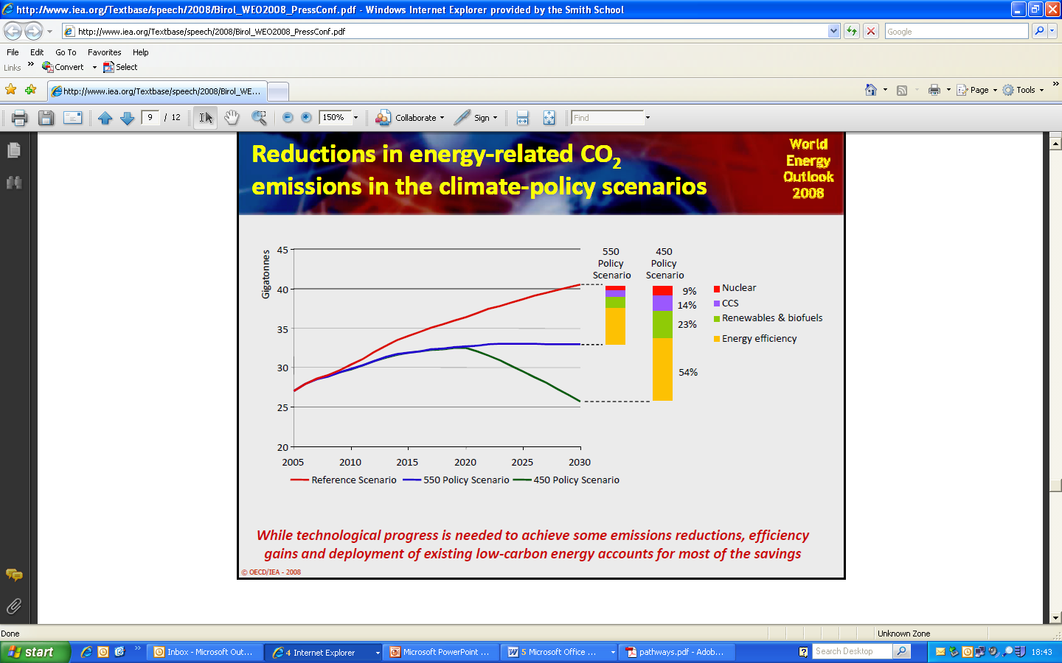
Reduction Pathways

Slide 16
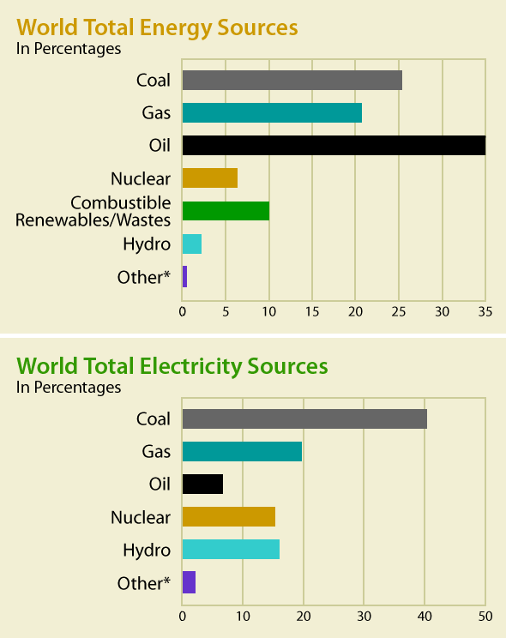
More Renewable Urgently Needed

Slide 17
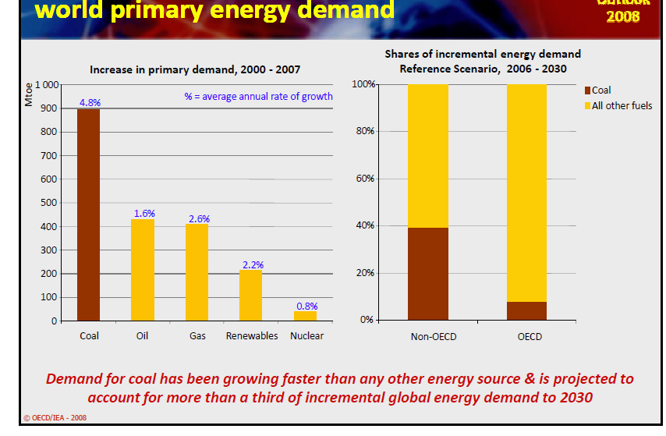
The Dominance of Coal
Notes:
Power and Heat contributed 40% of global C02 from fuel combustion. 70% of this from coal fire power sta. China builds 1 per week

Slide 18
Conclusion
The private sector matters
Market a useful component
Caution however required
State’s role very crucial
Strategic approach needed
The international dimension essential
SMITH SCHOOL OF ENTERPRISE
and the ENVIRONMENT -SSEE

