Slide 1
An agenda for change in U.S. climate policy? Presidential ambitions and Congressional powers
Tora Skodvin and Steinar Andresen (co-author)
(tora.skodvin@cicero.uio.no)
LSE Workshop: Carbon Markets
London, May 5 2009.

Slide 2
Presidential ambitions: Key points in Obama’s climate policy program
Make the United States a leader on climate change by rejoining the UN-based negotiation process with an aim to develop an international climate treaty.
GHG emissions objectives:
  Stabilise GHG emissions at their 1990-levels by 2020
  80% reduction in GHG emissions from 1990-levels by 2050
  Economy-wide cap-and-trade, no free allocation of emission credits.

Slide 3
Congressional powers
The president can negotiate international treaties, but only ”with the Advice and Consent of the Senate” (U.S. Constitution, Article II, Section 2);
International treaties require ratification by a 2/3 qualified majority of the Senate (67 votes) (Article II, Section 2);
When ratified, international treaties acquire the same status as federal law and are subjected to the same implementation regime (Article VI).
Implications:
  The United States rarely joins international treaties that are not founded on existing federal law.
  Ability to take on international leadership role depends on the adoption of federal climate legislation.
  Congress has a significant role to play in the realisation of Obama’s climate policy ambitions.

Slide 4
2008 Elections: Reinforced Democratic majority in both chambers of Congress
House of Representatives:
257 Democrats, 178 Republicans (218 required for majority)
Republicans lost 19 seats in the House
Senate:
56 Democrats, 2 independent (that normally vote with the Democrats), 1 undecided (Minnesota)
1 switch from Republican to Democrat (Arlen Specter)
Democrats control a ”filibuster-proof” majority of 60 votes.
Notes:
The Senate’s filibuster procedure allows individual senators to talk for as long as they like. This has become a much-used technique to halt the legislative process on issues where the senator in question opposes the proposed legislation but lacks the support to win a vote (in a simple majority of 51 votes). The Senate majority can end filibuster by adopting a cloture motion, which requires the support of a qualified majority of 3/5 of the senators (i.e., 60 of 100 senators). Thus, a minority of 41 senators can block a motion to invoke cloture and thus policy change

Slide 5
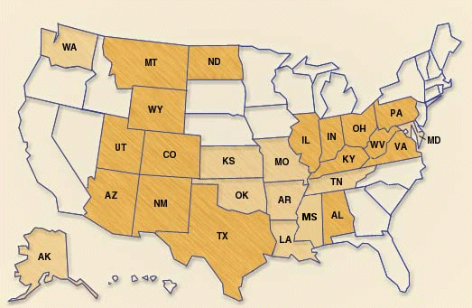
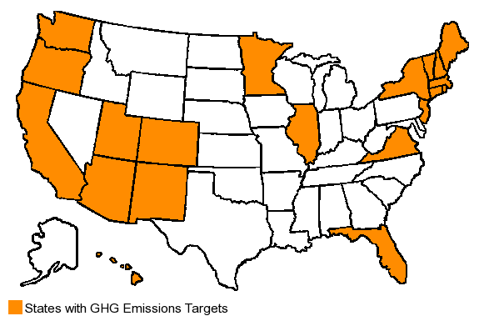
Ideological dimension important, but regional dimension also significant
Coal-producing states
States with GHG emissions targets
Source: Energy Information Administration,
http://www.eia.doe.gov/
Source: Pew Center on Global Climate Change,
http://www.pewclimate.org/

Slide 6
The regional conflict dimension in the Congressional climate policy debate
110th Congress: Group of 10+ Democratic senators signaled their opposition to the Warner-Lieberman proposal;
  Coal-producing states strongly represented;
  Support, in principle, mandatory GHG emissions regulations;
  But do not support ambitious and costly measures (particularly short term).
111th Congress: Observers have identified 43 undecided senators;
  12: ”Probably yes”, 10: ”Probably no”, 21: ”Fence sitters”
  56% of the ”Fence sitters” are Democrats, 71% represent coal-producing states. (Source: Environment & Energy Publishing, www.eenews.net)
These senators will not vote for climate policy legislation that conflicts with the interests of their constituencies.

Slide 7
What could U.S. climate legislation look like?
Level of ambition:
  Most proposals less ambitious than, for instance, EU position
  Short-term targets (2020) likely to be more controversial than long-term targets
Policy instruments:
  All proposals include cap-and-trade provisions, but acceptability linked to system design.
  Notably, cost containment mechanism is likely: ”Safety valve” or ”Carbon market Efficiency Board”. A ”hybrid” system (trade → tax) would imply incompatibility with the EU ETS.
Concern about risk of ”carbon leakage”:
  All proposals include ”border tax adjustment” or similar measure to protect competitiveness of U.S. industry.
Notes:
Border tax adjustment: Goods imported from countries without similar constraints on carbon emissions are taxed in accordance with market value of carbon emissions of production in the U.S..

Slide 8
New opportunities offered by the financial crisis: A ”Green New Deal”?
Economic stimulus package of USD 700+ billion adopted in February
Key feature: linkage of economic, energy security and climate change issues.
Energy-related provisions will have low impact on GHG emissions unless they are combined with comprehensive climate legislation that puts a price on carbon.
  Educational effect: GHG measures can be economically profitable and serve other purposes linked to energy security.
  But: Republicans sceptical of this argument. Congressional vote on stimulus reveals deep partisan (ideological) split.

Slide 9
Prospects for change in U.S. climate policy
”This was the moment when the rise of the oceans began to slow and our planet began to heal”
President Obama has embarked on a shift in U.S. climate policy both at the domestic and international levels.
Mobilising sufficient Congessional support for federal climate legislation will be challenging even with a reinforced democratic majority in Congress.
Federal climate legislation may be adopted in 2010 at the earliest.
Obama’s delegation will likely go to Copenhagen without a clear Congressional mandate. Important not to repeat the mistakes of the Clinton administration in Kyoto: U.S. commitments must be negotiated on the basis of status in the domestic decision-making process.
Even with federal legislation in place, the stretch from 60 to 67 votes in the Senate may be a long one.
Notes:
Citation: Obama when he won the Democratic Party’s nomination for the presidential election, cited in The Economist 14 march.

