Slide 1
CON29 -
Mark Edwards
Jamie Winch

Slide 2
The Proposal
To develop and implement a prototype solution allowing customers and other stakeholders to access CON29 data held by selected Local Authorities, and other relevant organisations, in the most efficient and cost effective manner whilst conforming to common standards.
Land Registry are seeking to take over the provision of maintaining a Local Land Charges register and the enquiries of a Local Authority (CON29) forms part of the service.

Slide 3
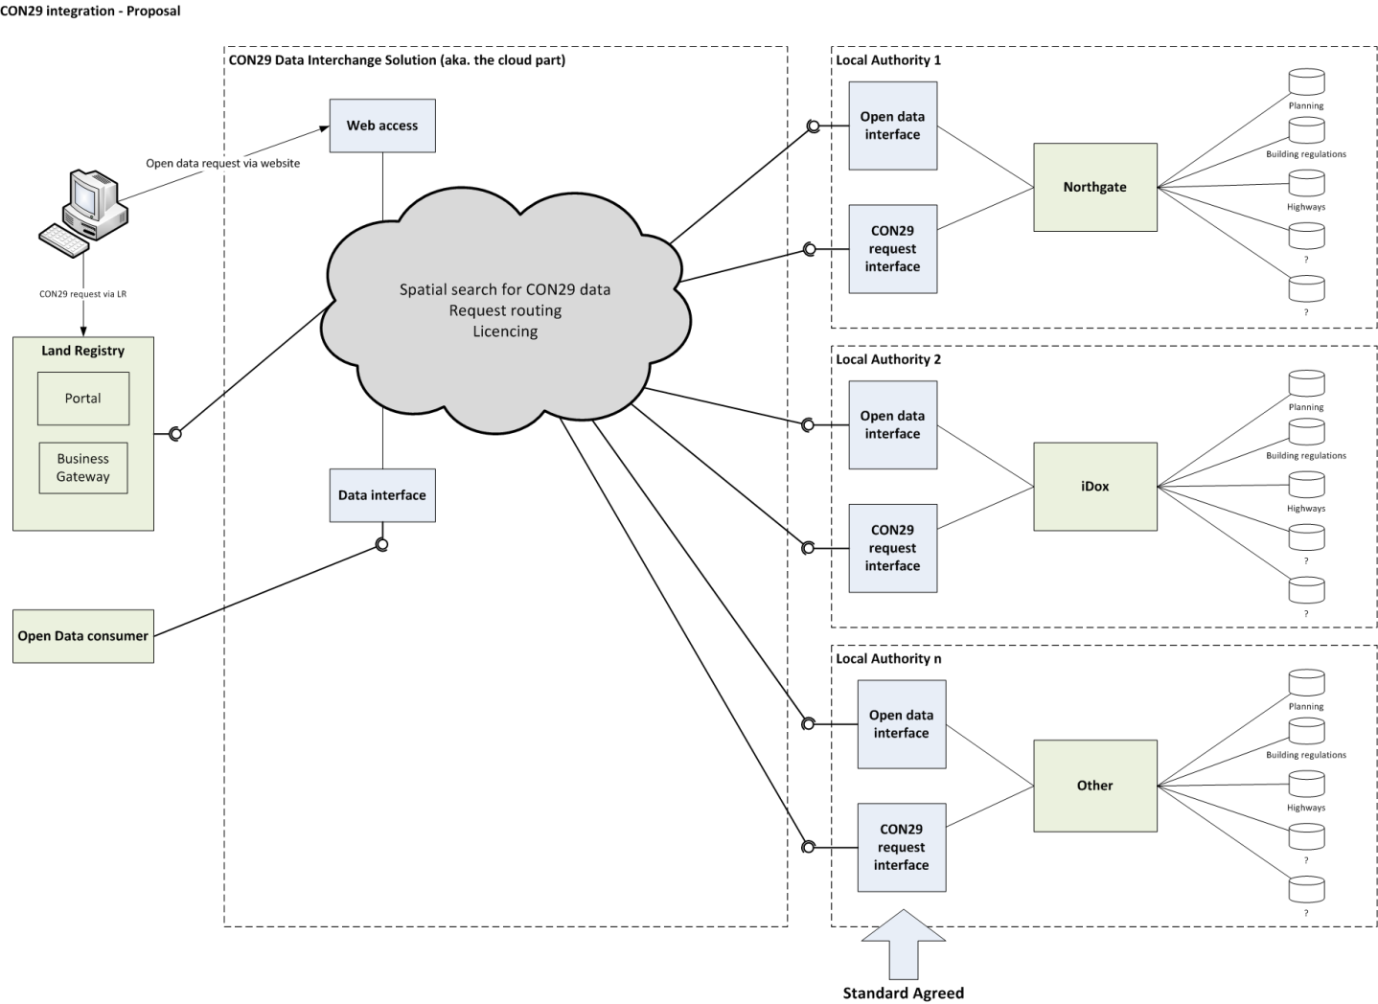
The Proposal (Cont’d)
Notes:
The diagram shows –
The data stays with in the LA.
Existing systems (planning, BC etc.) remain
Contacts with software suppliers remain
Open data interface with current systems/datasets and LR ‘cloud’
Open standard request interface with LR ‘cloud’
Data cached in LR ‘cloud’ for the duration of the search request – no longer! EIR!!
Search for data spatially
Decision making engine routes the request to appropriate LA/data provider and deals with licencing, charging, audit etc.
Data available via LR Portal/BG, open data interface (Data.gov.uk?) and web access (citizen via Gov.uk?)

Slide 4
Drivers
Digital by Default
World Bank Report
Improve the conveyancing process
Encourage and support Local Authority digitisation
Release Open Data
Notes:
Digital by Default – Release the information via electronic channels; available to citizens etc.
World Bank Report – The UK dropped from 7th to 10th at the end of 2013 on the Ease of Doing Business Index. One factor is ‘Registering Property’ which the UK is currently 68th in the WBR; No. 10 & Cabinet Office see this proposal, along with LLC, as an improvement which could help increase this position.
Improve conveyancing process – Conveyancers (particularly volume conv.) have reported they would really see the benefits if LR were to offer this as a solution. LR are looking into streamlining the CON29 report to make sure it is relevant to todays needs. Standardised Search Results
LA Digitisation – There remains a need to digitise LA data. Going forward
Open Data – The OD agenda is high on the list for all governments, not just UK, it was on the top 10 agenda when the G8 met last year.

Slide 5
World Bank Report

Slide 6
Registering a Property - indicators
Step | Description | Time | Cost
1 | Standard enquiries (Sellers pack) Seller's to buyer's Solicitor | 1-4 weeks | £3,500 - £10,000
2 | Conduct Conveyancing searches | 1-3 weeks | £300 - £1,000
3 | Draft & exchange of contracts | 1 day | Included in step 1
4 | Pre-completion LR search | 1 day | £4
5 | SDLT submission | 1 day | % of the value of property
6 | Registration of transfer & charge at LR | 7 days | £40 - £920
Year | Enhancements to Registering a Property indicator
2010 | No reform as measured by Doing Business
2011 | The lodging of a SDLT processed automatically and electronically by the HMRC
2012 | No reform as measured by Doing Business
2013 | Electronic lodgment (e-DRS) for property transfer applications at LR.

Slide 7
Research
Market Warming Day – 20th June 2013
Local Authority Engagement
Focus Groups
Customers
Local Authorities
Personal Search Companies
Local Government
Independent Market Research
Infoland (Norwegian Searches)
Notes:
Market Warming Day – over 20 private sector suppliers attended to discuss our proposals and how they could potentially assist. There were 18? Expressions of interest resulting in 12 meetings. Will come on to this more later.
LA Engagement – On top of the 254 LA engagement meetings for LLC prototype and proposals, the team have also visited >30 LA’s to discuss CON29 specifically.
Focus Groups – representatives from the major stakeholder groups (Customers, Local Authorities, PSC’s, Local Government) were invited to join focus groups to discuss the CON29 proposal.
Market Research – x 2; IPSOS MoRI research has revealed that appetite remains.
Infoland – Norway launched a similar approach to this proposal… need some figures etc.

Slide 8
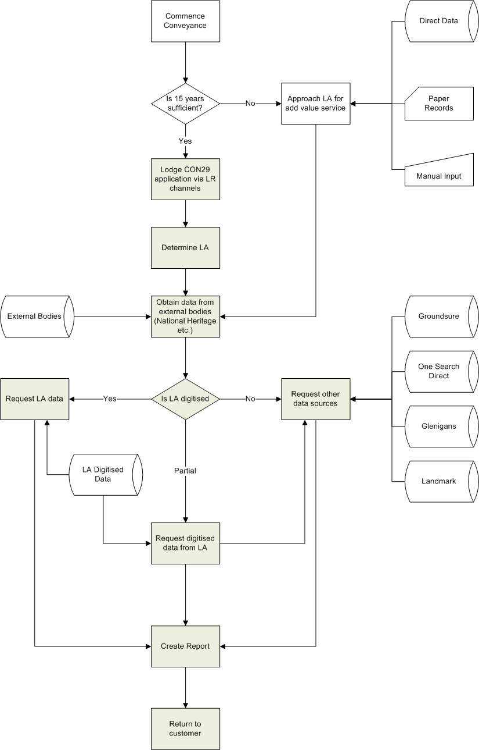
Hybrid Solution

Slide 9
Benefits
Area | Benefit
Customer (includes; licensed conveyancers, solicitors, lenders & private individuals) | Clarity and ease of contact Closer understanding / relationship Greater range of products / services to meet needs Standardized cost/format Standardized processing times Enhanced “e” product set Increased use of “e” services State guarantee Enhanced customer experience Faster and earlier decision making
Local Authorities | Revenue share Funding model for digitisation Reduced operating costs Reduced EIR requests Improved service
Central government | Improve World Bank Report rating Digital by default agenda Public/Private sector working Access to data

Slide 10

Any Questions?

