Slide 1

Mark Pinheiro
Head of Procurement
Government Digital Service
GDS
GDS
GDS

Slide 2

The Government Digital Service is part of the Efficiency and Reform Group within the Cabinet Office
Mark Pinheiro
GDS

Slide 3


We were created by Francis Maude in response to Martha Lane Fox’s report...
Mark Pinheiro
GDS

Slide 4
Revolution not evolution
Martha Lane-Fox, 2010
Mark Pinheiro
GDS

Slide 5
Create GDS
Fix publishing
Fix transactions
Go wholesale
Mark Pinheiro
GDS

Slide 6
We are here to provide simpler, clearer and faster services and information for citizens and businesses
@MTBracken
Mark Pinheiro
GDS

Slide 7
In doing this we will save money for the tax payer
@MTBracken
Mark Pinheiro
GDS

Slide 8
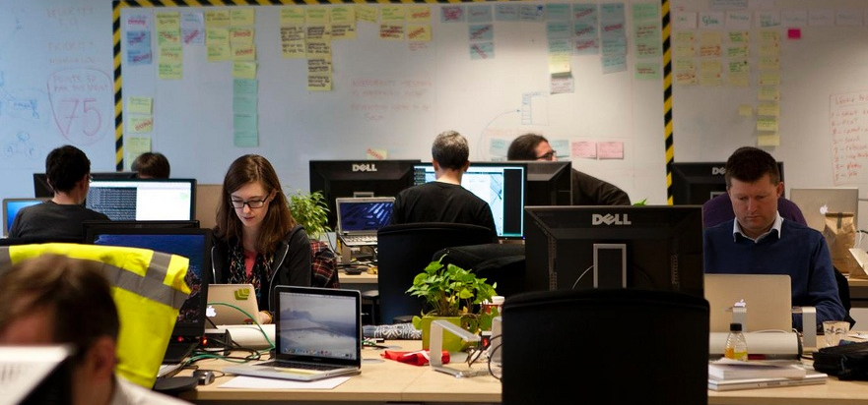
We’re a multi-disciplinary team, working with colleagues across government
Mark Pinheiro
GDS

Slide 9
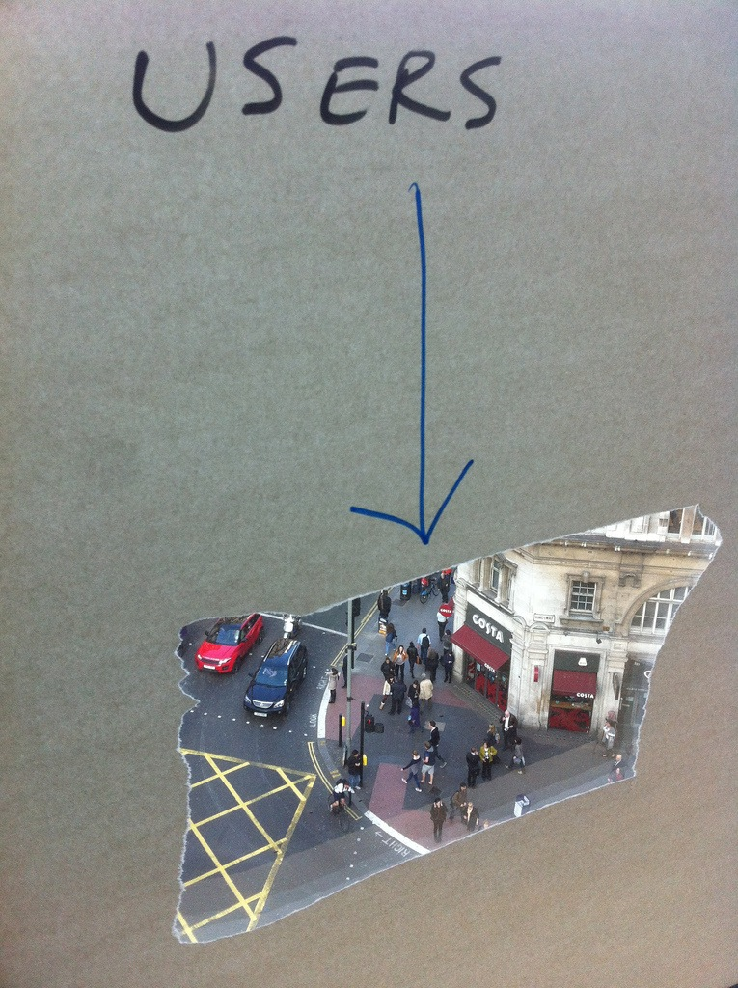
Focused on user needs
Mark Pinheiro
GDS

Slide 10
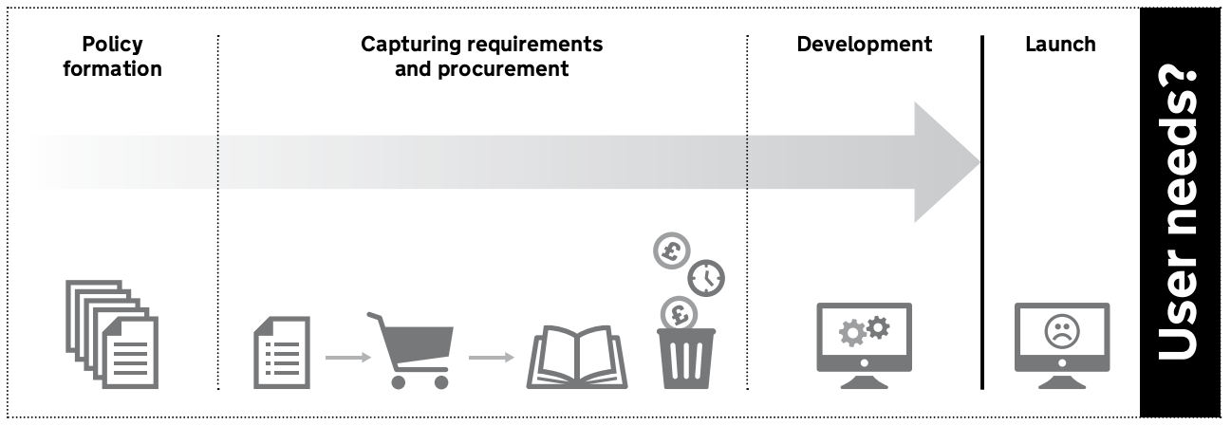
We used to focus on what government wanted
Mark Pinheiro
GDS

Slide 11
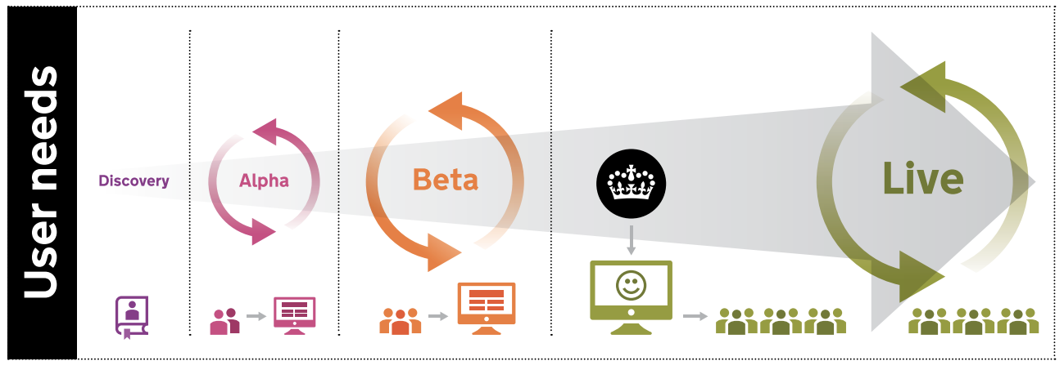
Now we focus on the needs of our users, in an agile way
Mark Pinheiro
GDS

Slide 12
Procurement must be agile too
Mark Pinheiro
GDS

Slide 13
IT is a commodity
Mark Pinheiro
Notes:
Use electricity analalogy

Slide 14
Business outcomes matter
Detailed requirement doesn’t
Mark Pinheiro
GDS

Slide 15
What is G-Cloud?
Mark Pinheiro
GDS

Slide 16
It’s a series of frameworks to buy cloud-based services
GDS
Mark Pinheiro
GDS
Notes:
It’s a framework that allows Government and the wider public sector to buy commodity Cloud services

Slide 17
Creating a competitive marketplace
Dave
GDS
Mark Pinheiro
GDS
Notes:
from lots of different providers from the UK, the EU and across the world.

Slide 18
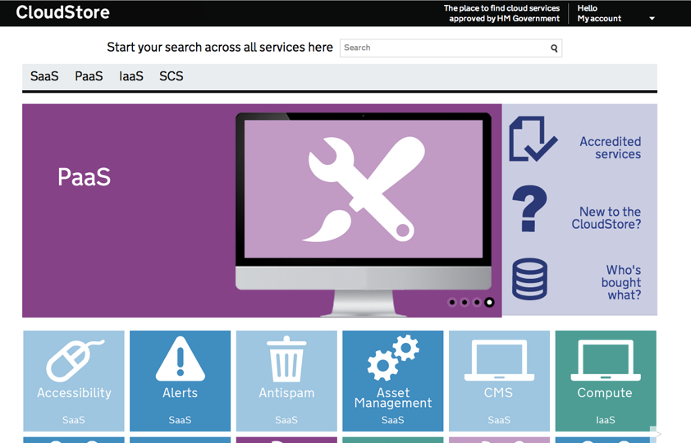
... accessed through CloudStore
Dave
GDS
Mark Pinheiro
GDS
Notes:
It’s about creating a vibrant, dynamic marketplace for suppliers, in particular SMEs, to offer a wide range of services in a transparent, commoditised way. It’s about making a break with the bad old days of Government outsourcing its IT strategy to big corporations that over charged, under-delivered and locked buyers into long term contracts

Slide 19
It’s about transforming the way the Public Sector buys digital services
Mark Pinheiro
GDS
Notes:
But there is a much bigger ambition than just being yet another method of procurement - it’s about flexibility, lower cost, improving speed of delivery

Slide 20
G-Cloud is about creating a simpler, clearer, faster procurement channel for digital contracts
Mark Pinheiro
GDS
18
Notes:
What’s our vision for G-Cloud?

Slide 21
Infrastructure as a Service (IaaS)
Platforms as a Service (PaaS)
Software as a Service (SaaS)
Specialist Cloud Services
Mark Pinheiro
GDS
Notes:
The G-Cloud framework allows you to choose and purchase services

Slide 22
Benefits
Avoid long contracts
Pay-as-you-go
Save money on maintenance and physical storage
Flexible and Transparent
Mark Pinheiro
GDS
Notes:
The G-Cloud framework allows you to choose and purchase services

Slide 23
1,186 suppliers
(84% SMEs)
Mark Pinheiro
GDS
18
Notes:
Today

Slide 24
13,000+ services
Mark Pinheiro
GDS
18

Slide 25
29,000+ buyers
Mark Pinheiro
GDS
18

Slide 26
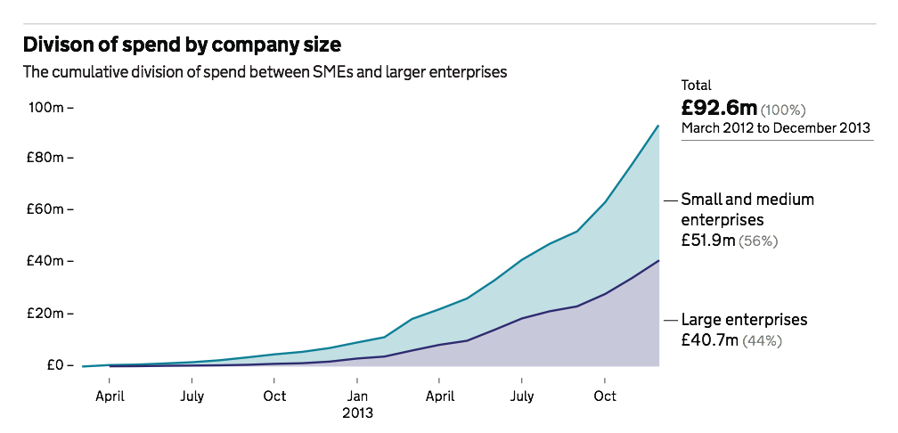
Reported spend
Mark Pinheiro
GDS
18
Notes:
18 months approx.

Slide 27
G-Cloud 5 has just opened for applications and will go live in May
Mark Pinheiro
GDS

Slide 28
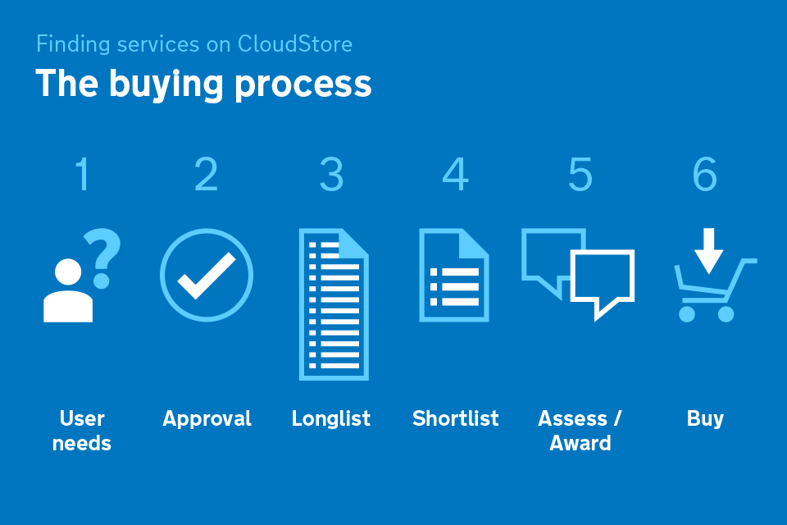
https://www.gov.uk/government/publications/cloudstore-buyers-guide
Mark Pinheiro
GDS
18
Notes:
Progress on ensuring 25% of central departmental new ICT spending will be transitioned to public cloud computing services by December 2015

Slide 29
Security
Accredit per buyer per system
Accredit once - PGA
Mark Pinheiro
GDS
18
Notes:
We want to continue to improve from what’s been built and make it even better. Over the next few months, G-Cloud is going to go through a transformation process to bring it up to date with the other transactional services that we’re working on.

Slide 30
Digital Service Framework
Easy access to suppliers with the right capabilities who work in an agile way
Providing a large pool of quality suppliers Providing a flexible and speedy route to meet customers’ needs
Regularly refreshed (every 6-9 months)
Mark Pinheiro
GDS
18

Slide 31
What’s next …
Mark Pinheiro
GDS
18
Notes:
We want to continue to improve from what’s been built and make it even better. Over the next few months, G-Cloud is going to go through a transformation process to bring it up to date with the other transactional services that we’re working on.

Slide 32
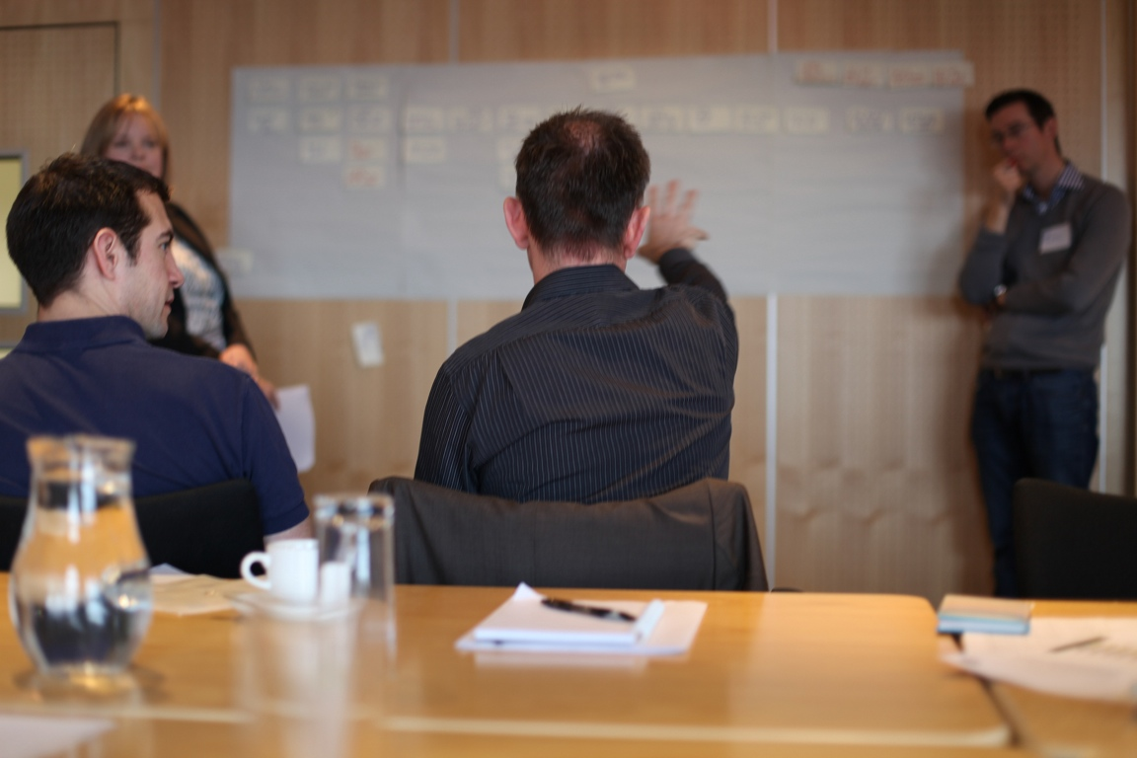
We’re reviewing how to continue to improve on what we’ve learnt
Mark Pinheiro
GDS

Slide 33
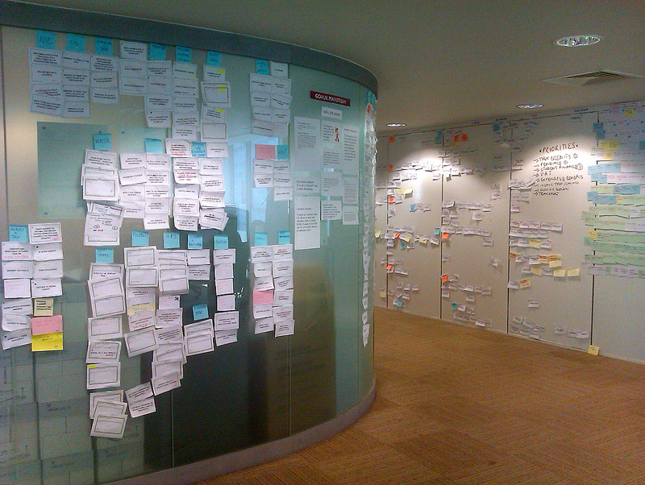
To better understand our user needs and where we can make the process easier
Mark Pinheiro
GDS

Slide 34
Get involved
enquiries@gcloud.cabinet-office.gov.uk
Mark Pinheiro
GDS
18
Notes:
We want to continue to improve from what’s been built and make it even better. Over the next few months, G-Cloud is going to go through a transformation process to bring it up to date with the other transactional services that we’re working on.

Slide 35
Mark Pinheiro
Head of Procurement
Government Digital Service
GDS

