Slide 1
Online customer services: The procurement story
Jayne Hilditch
Corporate Services Director

Slide 2
Thames Valley housing The project The procurement the outcome

Slide 3
Online customer services
Customer services
Corporate brochure-ware

Slide 4
Online customer services
Customer services
Corporate brochure-ware

Slide 5


Slide 6
Core business & Expertise in this

Slide 8
A successful project…
Off the shelf solution
Big IT suppliers
Commodity relationship
Bespoke solution
SME supplier
Real partnership

Slide 9
An agile project
User stories, not a full tech spec
MVP: Minimum Viable Product
Get real user feedback
Iterative development cycle

Slide 10
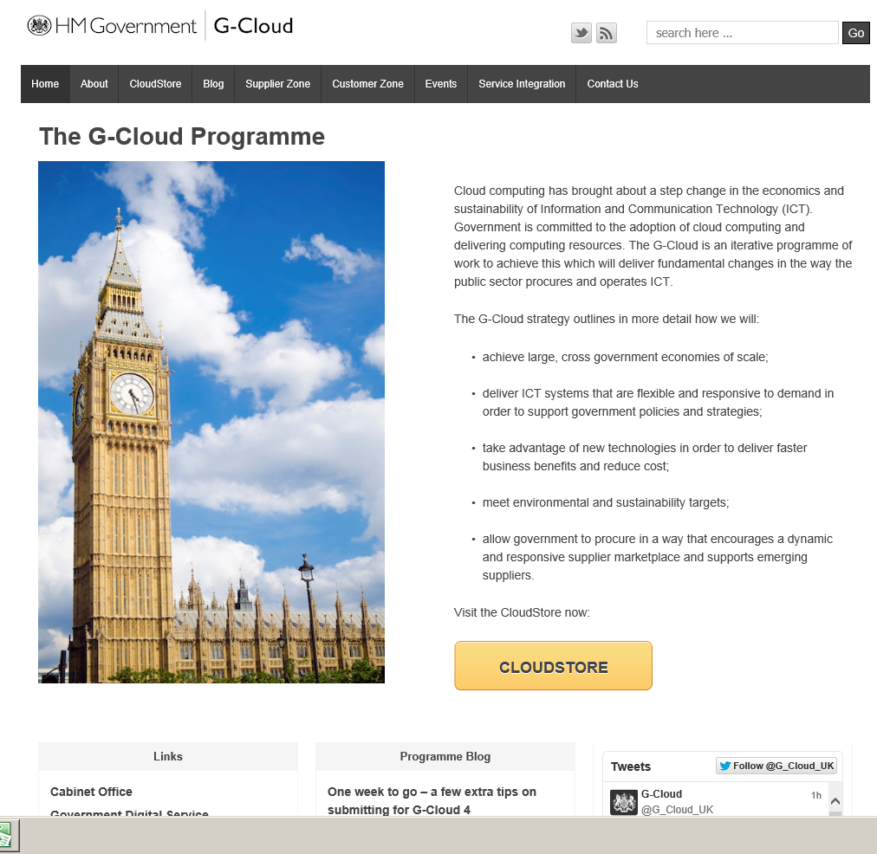

Slide 11
G-cloud 2 : the plan
Desktop research: suppliers on framework
PQQ : project vision and criteria for first sift
26 responses, shortlisted to 6.
RFP : User stories for phase 1, phase 2+ ‘epics’
Pricing: Fixed price for phase 1, phase 2 T&M
Weighting: 40% price / 60% quality
Visit, score, appoint.
Start work.

Slide 12
G-cloud 2 : IN PRACTICE (1/2)
Some good firms were luke warm
We asked why
Too many unknowns:
Risk priced in
Too risky for SME
Paused the process for more discovery
Restarted the process

Slide 13
G-cloud 2 : IN PRACTICE (2/2)
Provision to contract on fixed price and/or time & material
Evaluate on the basis of notional MVP
Contract on T&M
You’ll never know exactly what’s involved in the MVP until you do it for real.

Slide 14
Lessons learned:
Successful procurement means different things to different people
Ask questions if things aren’t feeling right
Unknowns = risk = priced in
Penny wise v pound poor

