Slide 1

Our Journey to a 4 Star SOCITM Ranking

Slide 2

or as I prefer to call it…
DISCLAIMER:
This is a reflection on me, not you - please don’t throw stuff!

Slide 3
Some background info…
Been in local government for nearly 17 years – 3 years as Web Manager
Our web team consists 3 posts (2 full time and 1 part time)
We use a devolved content model
Currently 40 Content Authors across the Council
Using Immediacy Content Management System from Alterian
SOCITM 2 star ranking in 2010, 2011 & just missed 3 stars in 2012
11% increase in user sessions in 2012/13

Slide 4
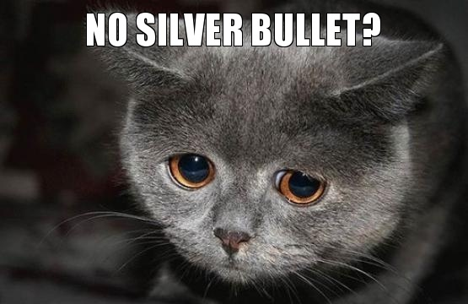
Manage expectations…
There’s nothing in this presentation that’s mind blowing
You’ve probably heard it all before
There’s no silver bullet…

Slide 5
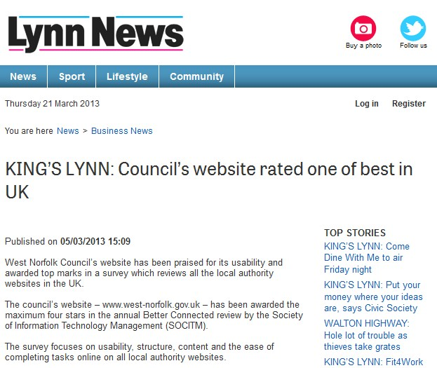
But on the plus side…
Hopefully this presentation will show you that:
  You don’t need massive budgets
  You don’t need big web teams
  It doesn’t need to be complicated
  Anyone can do it…

Slide 6

What we did (and didn’t) do?...
No big site re-design
No new CMS
No consultancy
No new whizz bang fancy stuff (technical term)
No big brown envelope filled with cash (tempting)
BUT
We did change the way we think
We improved on what we had
We didn’t ask permission…

Slide 7

We had a think…
The customer had to come first
Sections of website often reflected our internal structure. No use to anyone outside the council
We had to become more task orientated
The good elements often hidden amongst the bad
No value/no page
You can’t make everything perfect – prioritise!
Researched our customers:
  Web Analytics
  GovMetric (website feedback)
  Customer Services
Notes:
06/27/08

Slide 8
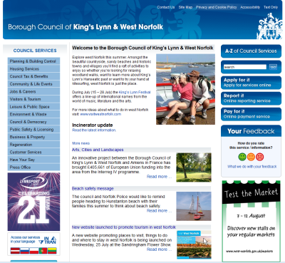
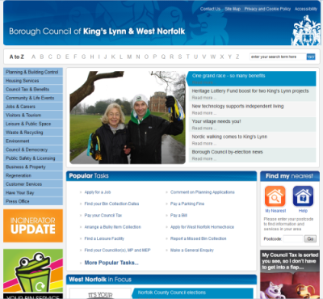
We improved on what we had…
New front page
Uncluttered, better use of space and all about TASKS

Slide 9
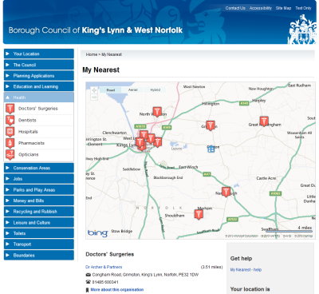
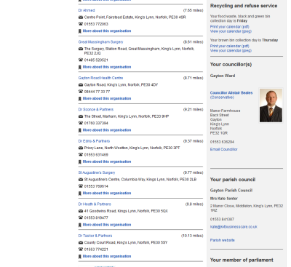
We improved on what we had…
Find my Nearest
Easy to use, intuitive, and with all the information in one place
Information from multiple partners (NHS Choices, Norfolk CC)

Slide 10
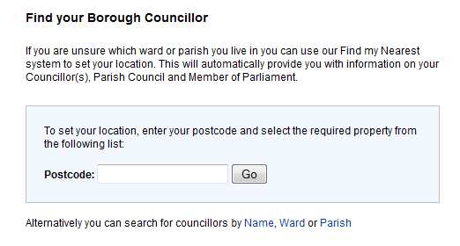
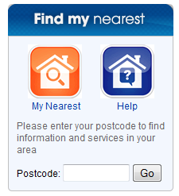
We improved on what we had…
Many Find my Nearest solutions interface are often too complicated. GIS systems often aren’t the most user friendly
Speak to other councils who’ve successfully implemented
Users are familiar with Google and Bing mapping
Point your customers towards it and offer them some help

Slide 11
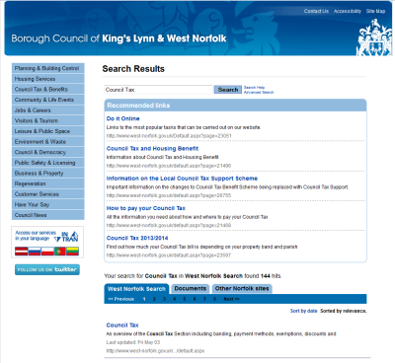
We improved on what we had…
Search and A to Z
Use of recommended links to signpost information
Remove documents from search results

Slide 12

We didn’t ask permission…
We’ve all been here at some point
Working groups and governance is great but it’s no good if you don’t/can’t make effective decisions
Problems if decisions are based on opinion rather than on fact
Sometimes you just need to do it!

Slide 13
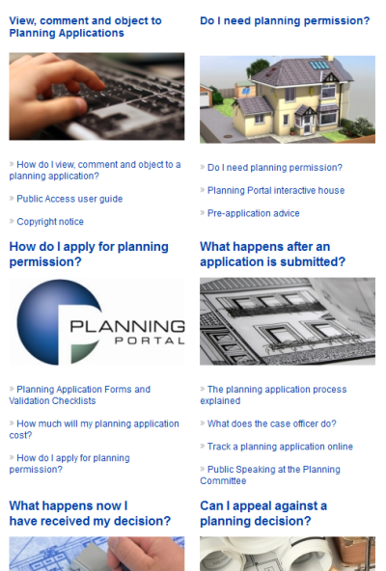
We didn’t ask permission…
Keep the group of decision makers small
Keep Communications and Customer Services happy
Find an ally in a service area who believes in your ideas
If that fails, use evidence (web site feedback)

Slide 14
The future…
Mobile web development – responsive design depending on device
Mobile app - report and access Council services
Re-design landing pages (all about tasks)
Content review and audit (looking to streamline)
Corporately led “Digital by Default” review
Add and improve the range of services available online

Slide 15
Thank you
Any questions?
andrew.howell@west-norfolk.gov.uk
Twitter: @Speedball74

